Slide 1
Final Report- Group 34
Justin Chuderewicz - jlc2bgd
Mitchell Flattum - mef8ueq
Andrew Hunter - abh8sxf
William Peritz - wgp3aq

Slide 2
Question of Interest
Which factors influence hotel reservation cancellations?
Notes:
Our analysis aims to identify key factors / determinants that lead to the cancellation of hotel bookings. Various aspects, such as demographic data, booking channels, time-related factors (ex. season and booking lead time), and broad economic indicators, can be crucial in understanding what leads to hotel cancellations. For example, certain demographics might have a higher/lower tendency to cancel, or bookings made through specific channels might be more subject to cancellation. Moreover, economic conditions and seasonal factors could also significantly impact cancellation rates.

Slide 3
Motivation
Our group shares an interest in economics and finance, so our first thought when we found our hotel data was that we wanted to understand consumer habits related to hotel bookings.
The answer to our question of interest can prove to be valuable for hotels as it aims to identify the customer segments and economic conditions most associated with reservation cancellations.
Notes:
Understanding these patterns can enable hotels to strategically adjust their pricing and marketing efforts. Specifically, hotels can modify prices for customer groups perceived as more likely to cancel, or alternatively, target advertising towards those less prone to cancellation. Additionally, insights into how economic fluctuations in the U.S. influence cancellation rates could guide hotels in adapting their pricing and promotional strategies according to prevailing economic conditions. This research could thus lead to more effective management of reservations and revenue.

Slide 4
Data Description
In this data set takes an existing Hotel Booking Demand dataset from sciencedirect where each row is a hotel booking.
The dataset is meant to document numerous factors that may play into hotel demand, combined with different economic indicators that may point to larger patterns outside of the hotel industry
Each observation represents a distinct hotel reservation
Each observation contains:
Data about the person booking
Data about the hotel being booked
Data about economic conditions at the time of booking
Over 119,000 observations

Slide 5
Variables of Interest
is_canceled
Response Variable
Binary
1 if the reservation was cancelled, 0 if it was not
Other important variables:
ADR | Hotel’s average daily rate at the time of booking | Numeric
lead_time | Number of days between booking and the reservation date | Numeric
deposit_type | Indication on if the customer made a deposit to guarantee the booking. Either No Deposit, Non Refund, or Refundable | Categorical
arrival_date_week_number | Week number of the arrival date | Numeric
previous_cancellations | Number of previous bookings that were canceled by the customer prior to the current booking | Numeric

Slide 6
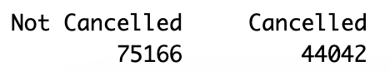
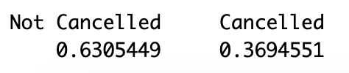
Exploratory Data Analysis
Counts of observations for each class in the binary response variable
Proportions of observations for each class in the binary response variable

Slide 7
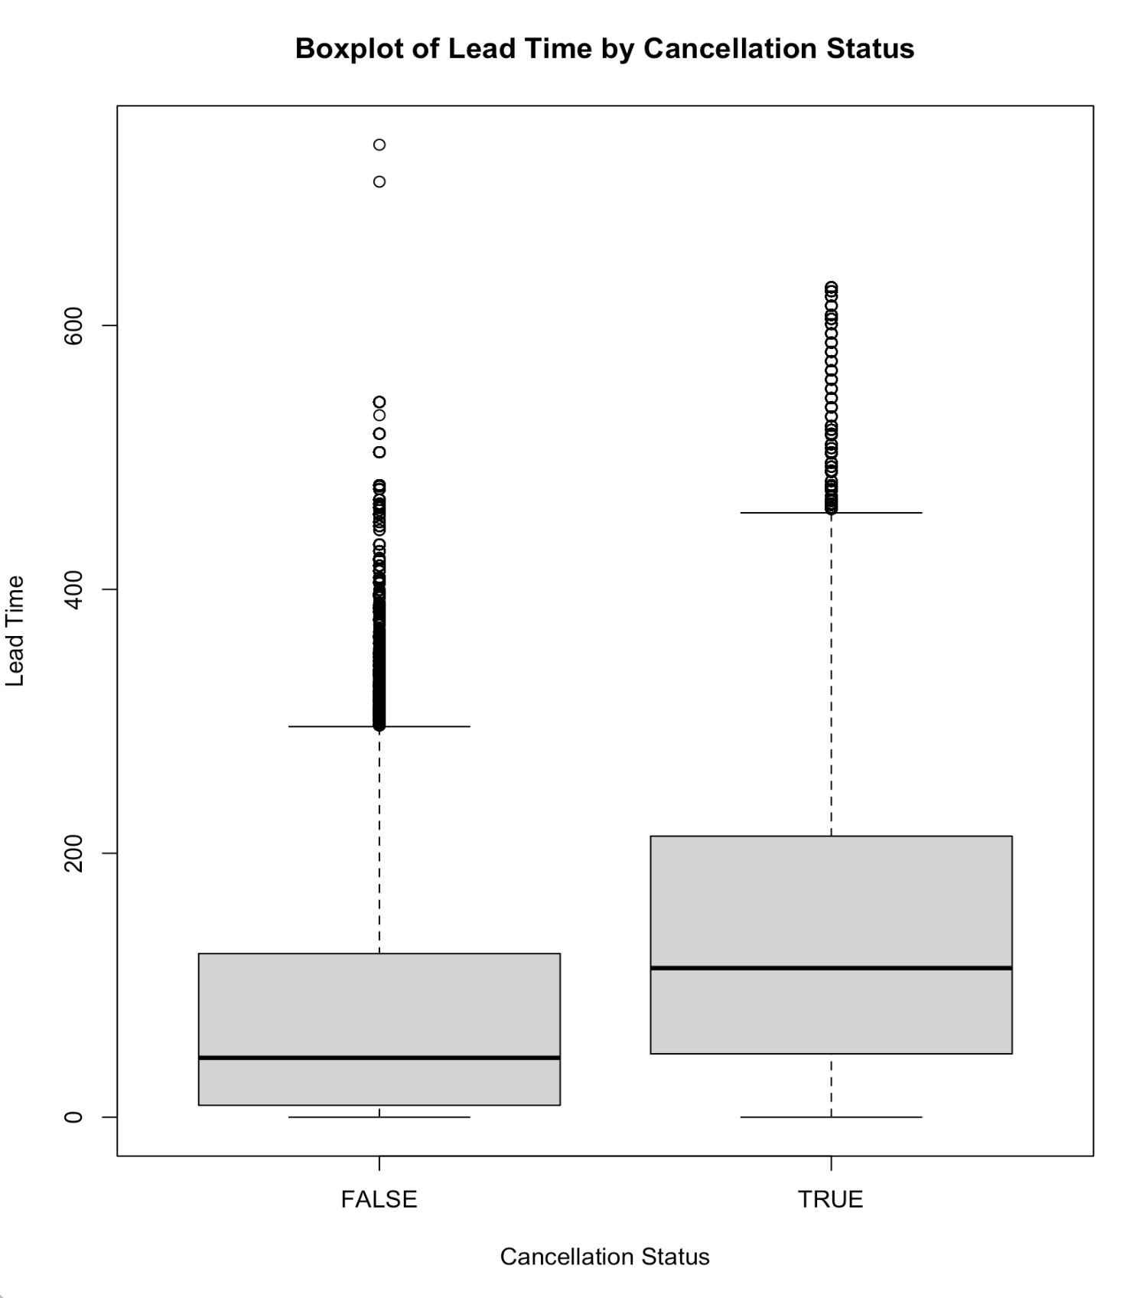
Exploratory Data Analysis

Slide 8
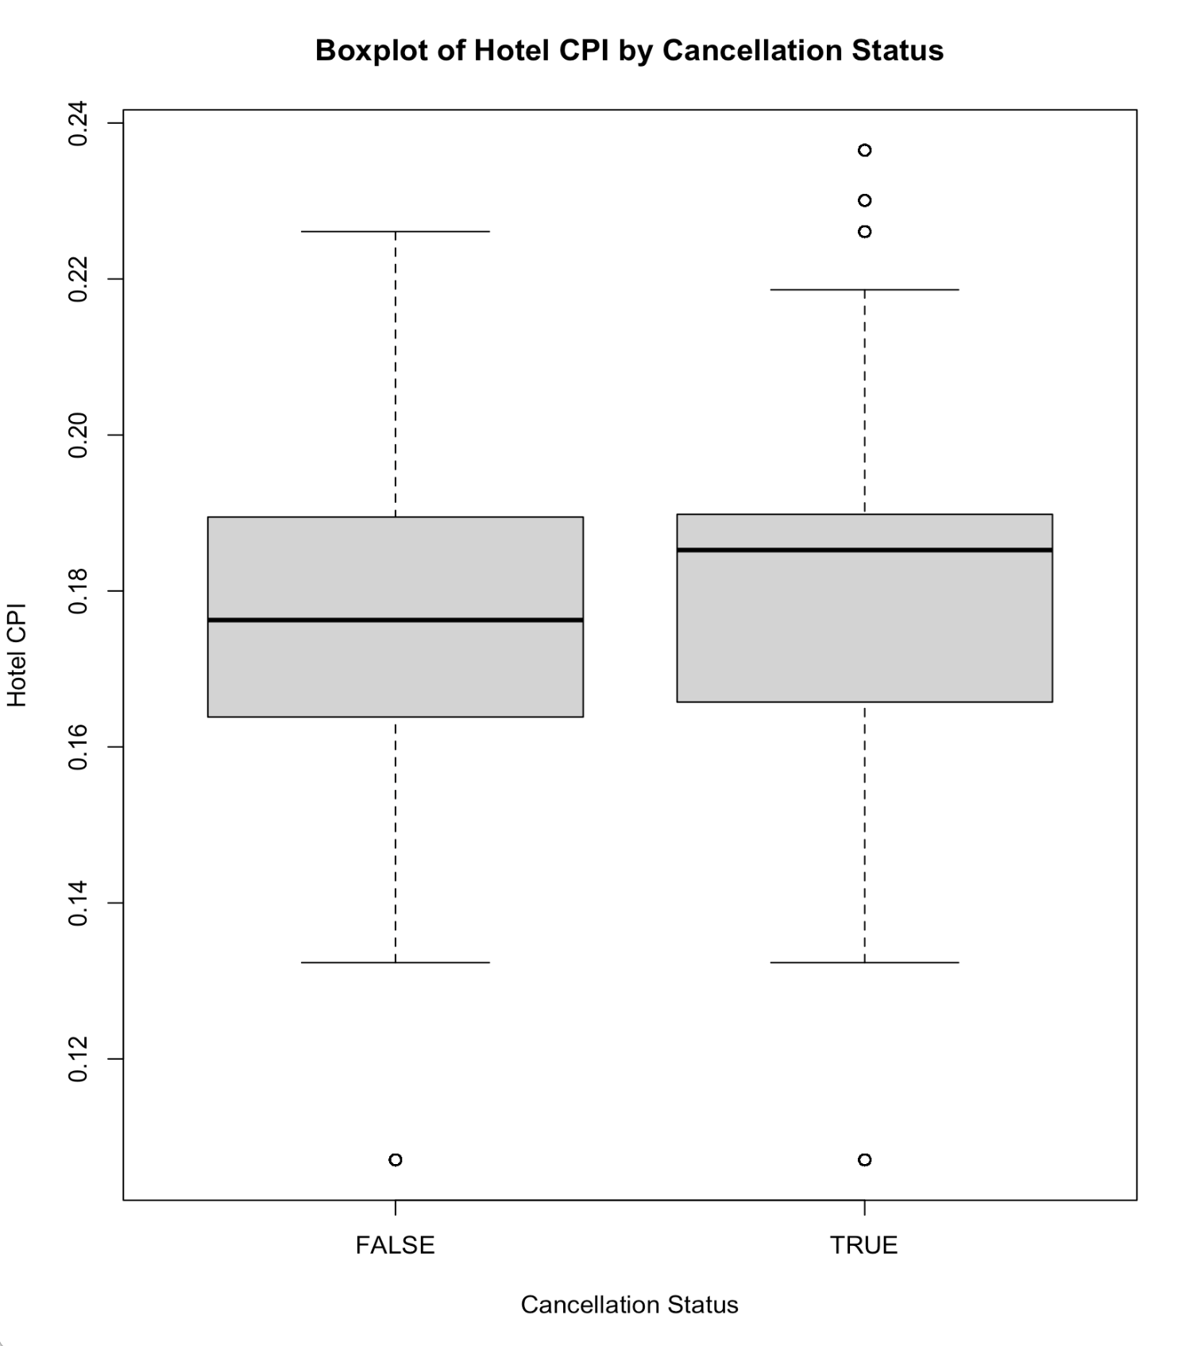
Exploratory Data Analysis

Slide 9
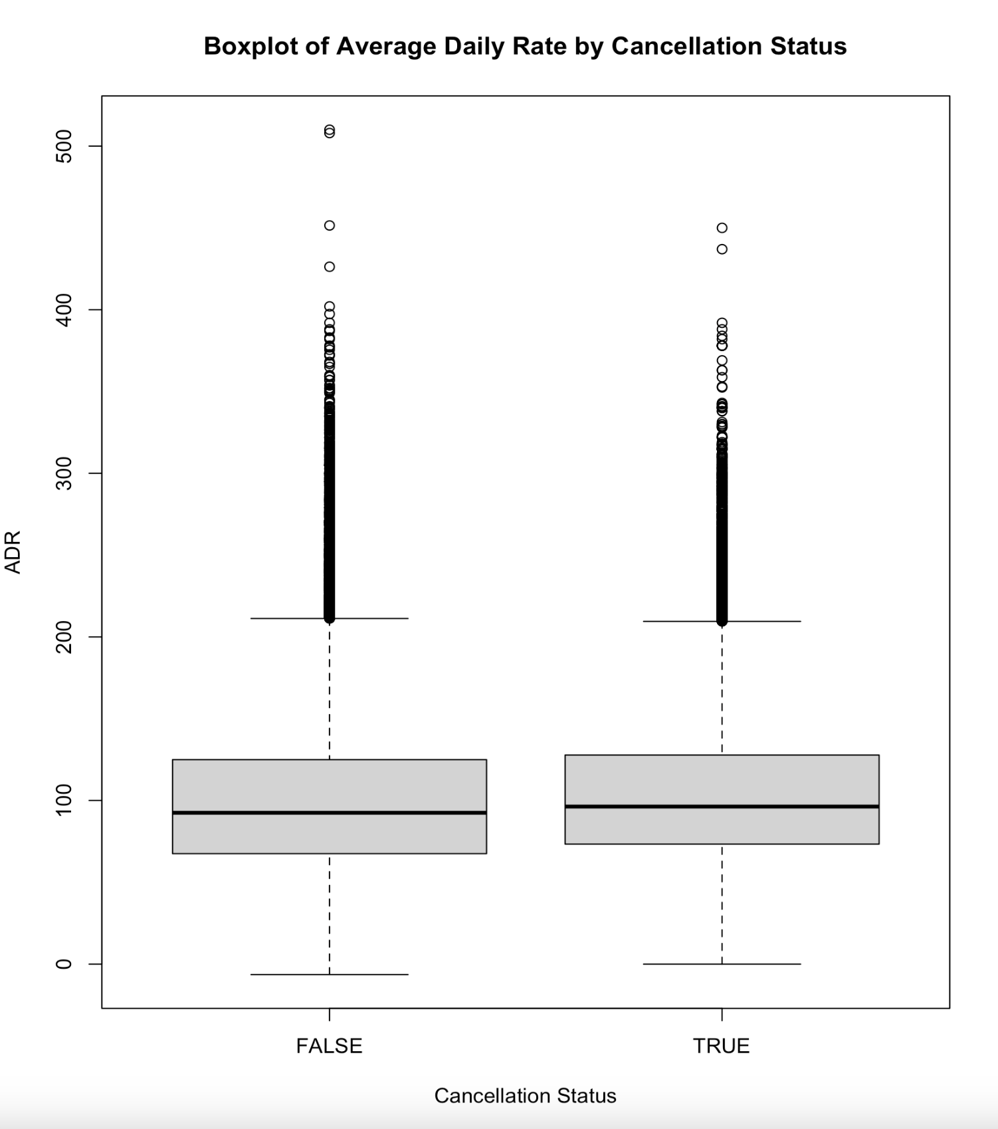
Exploratory Data Analysis

Slide 10
EDA and Our Question of Interest
Some variables seem to have a noticeable effect on Cancellation Status
Lead Time
Hotel CPI
Others have less of an effect, but are still worth investigating
ADR
Fuel Prices

Slide 11
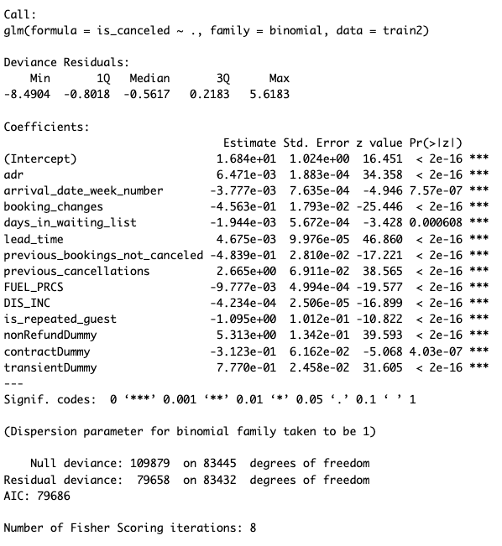
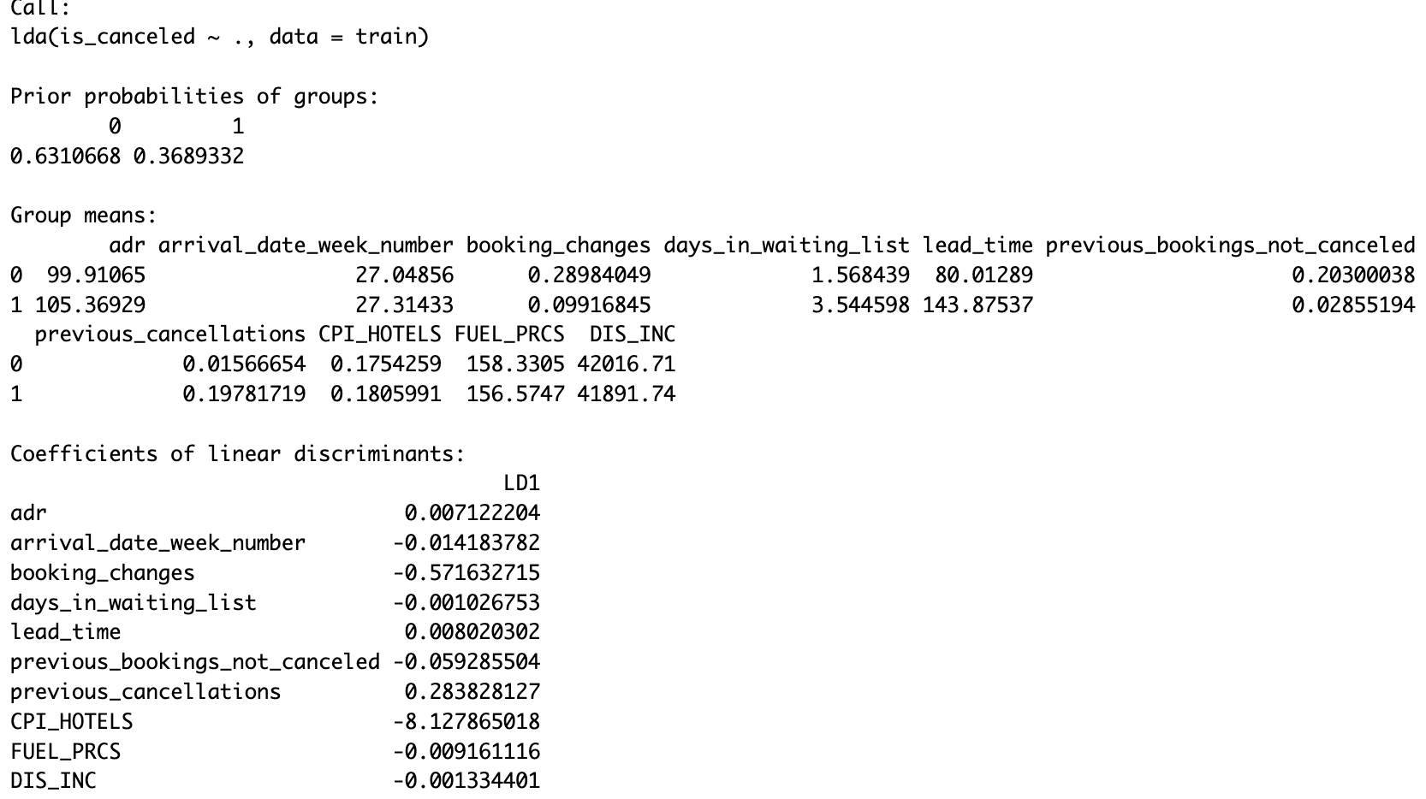
Analysis
Logistic Regression:
LDA:

Slide 12
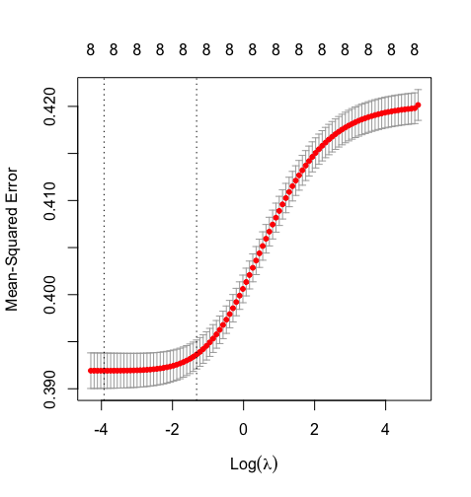
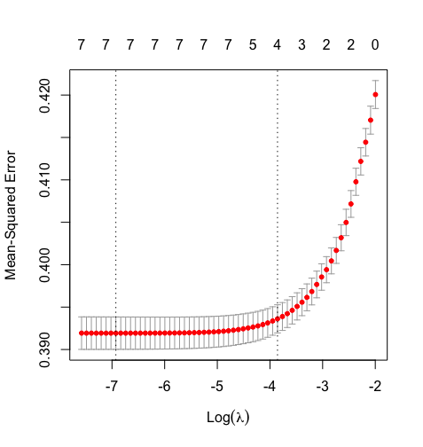
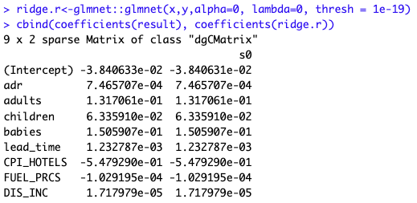
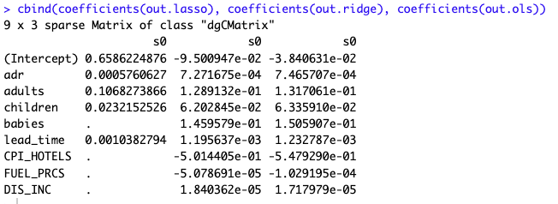
Analysis
Ridge Regression:
Lasso Regression:

Slide 13
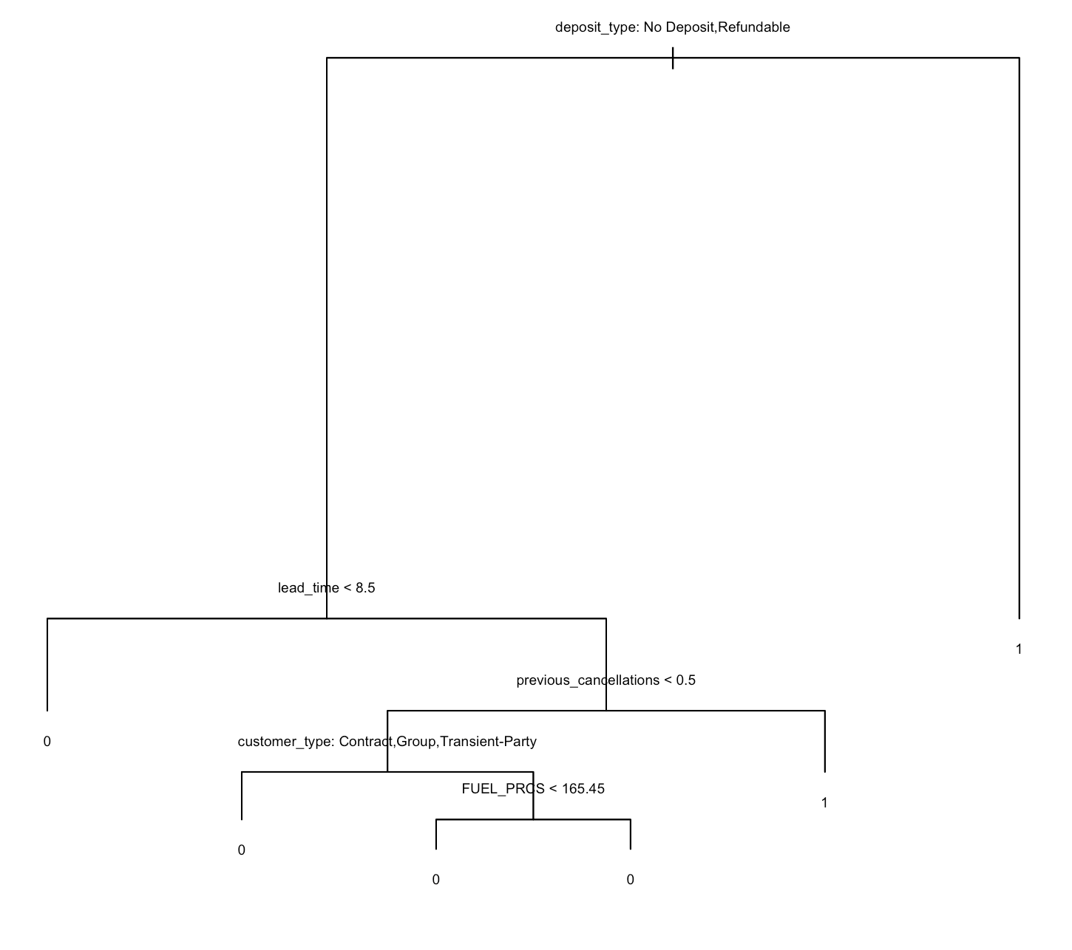
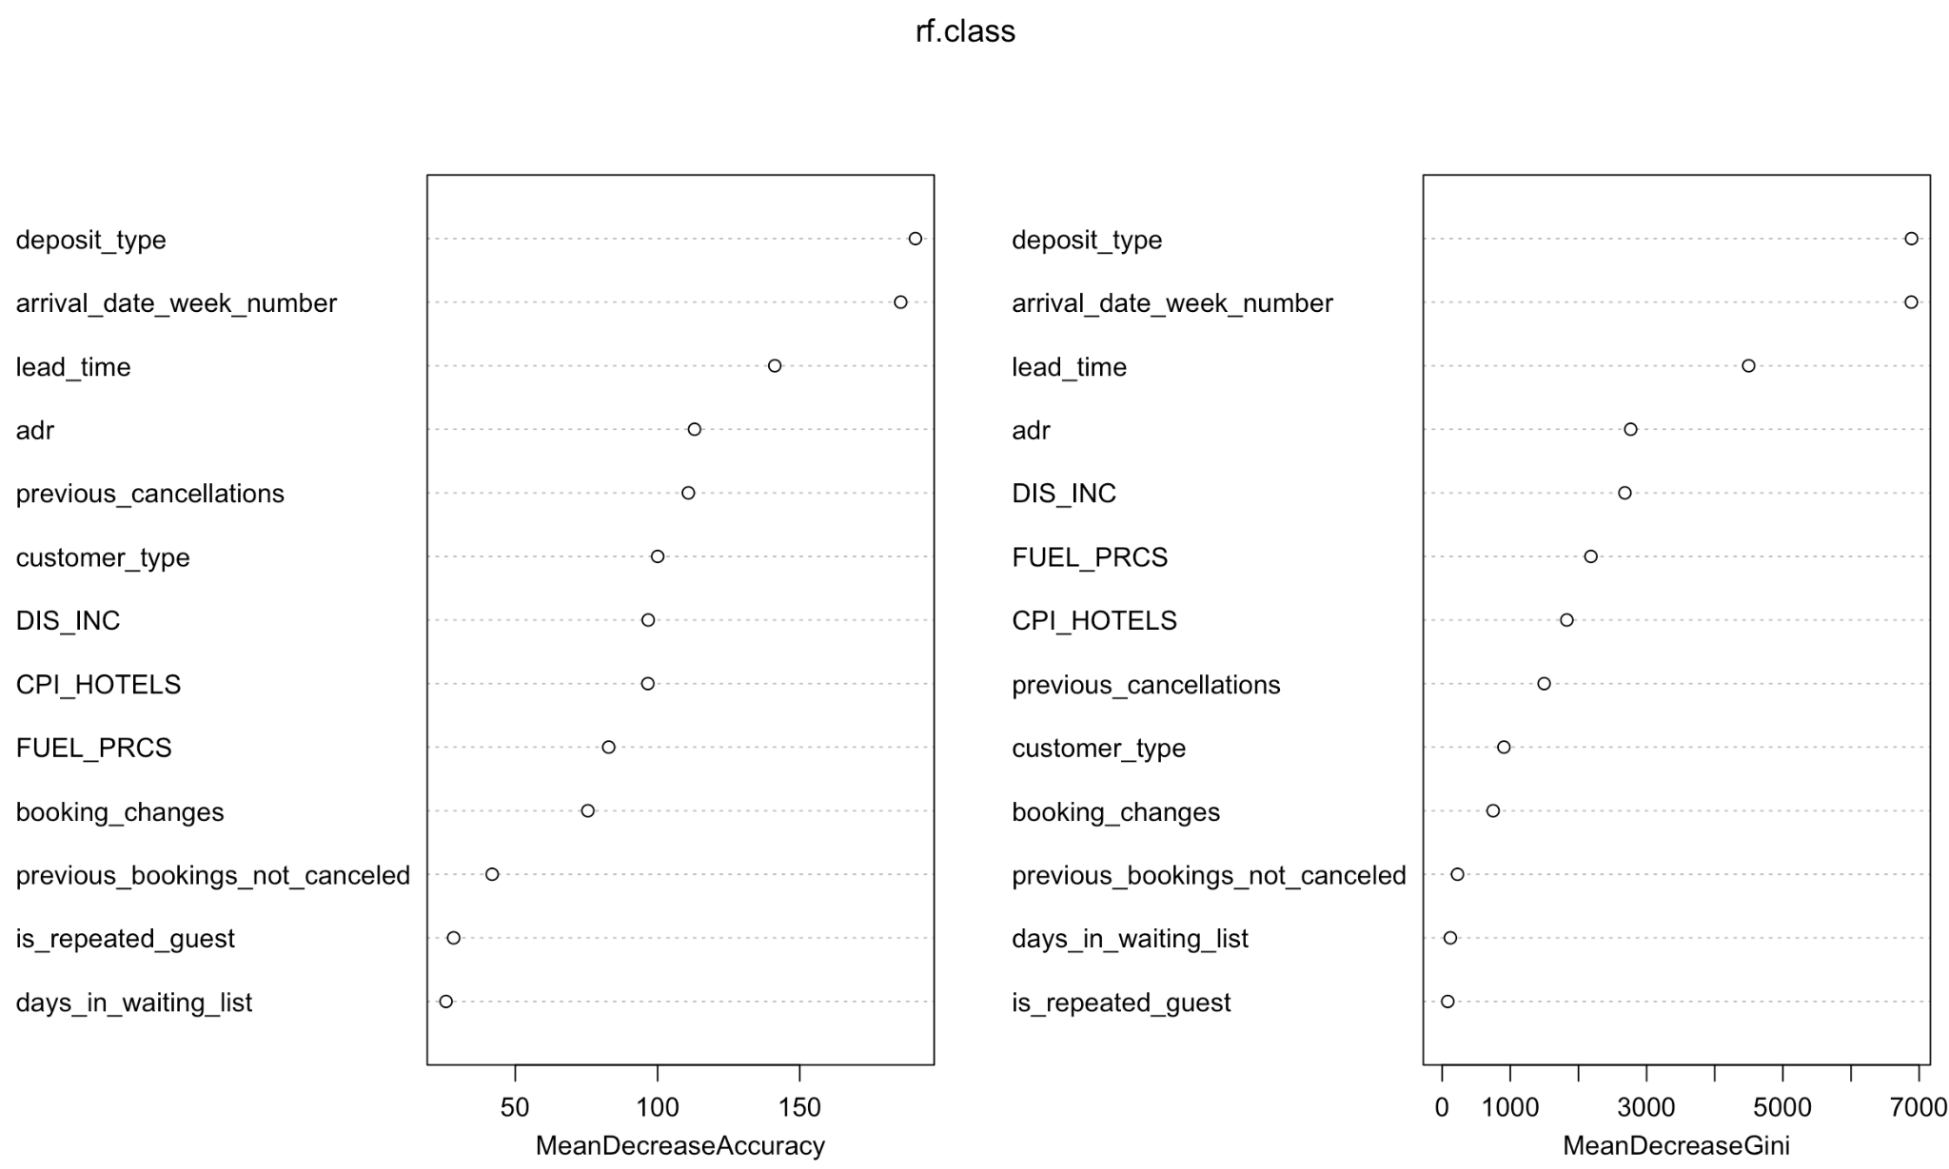
Analysis
Classification Tree (Pruned)
Random Forests:

Slide 14
Analysis
Comparisons:
Similar significant variables
Similar predictors were put in each test
Contrasts:
Different numbers of predictors used in each test
Different test error rates
Certain assumptions were not met

Slide 15
Interesting Findings
Non-refundable deposit types strongly predicted a canceled reservation
Arrival week was very important
Being a repeated guest was unimportant
Economic indicators had a moderate importance

Slide 16
Conclusions
Hotel cancellations can be predicted with high accuracy
Most important predictors
Deposit type
Arrival week number
Lead time
Average daily rate (adr)
Previous cancellations

