Slide 1
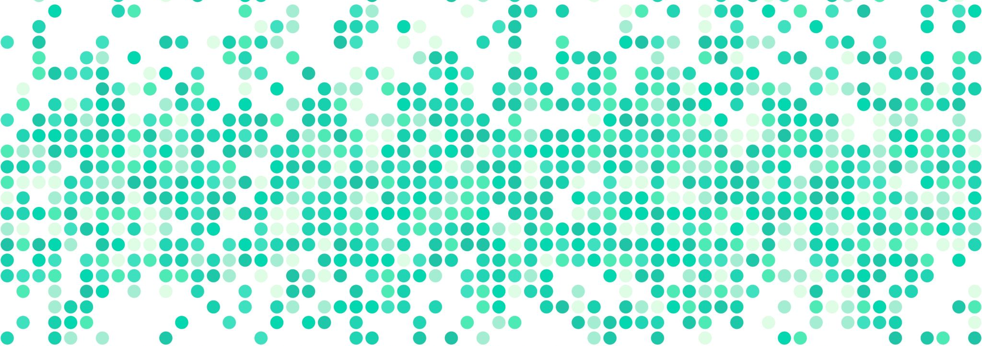
Algorithms
Presented by Prof. Goble
Dickinson College Spring 2024

Slide 2
What is an algorithm?

Slide 3
What is an algorithm?
By algorithm we mean the general process for solving a category of problems
All technology is driven by algorithms
Examples?

Slide 4
What is an algorithm?
By algorithm we mean the general process for solving a category of problems
All technology is driven by algorithms
Examples?
YouTube/Spotify’s recommendation system
Targeted ads on social media
GPS Navigation systems
And many, many, more …

Slide 5
Tools and Techniques for Creating Algorithms
When creating algorithms we need to come up with a step-by-step process in order to create a program
Top Down Refinement
Decomposing a task into smaller and simpler steps, then breaking down each step into smaller steps
Ideally we want to be able to identify the smallest step necessary to complete a task
Flow Charting
We can visually represent how the algorithm should execute and the order of steps
Pseudocode
Writing algorithms informally in a mixture of natural language and general types of code statements

Slide 6
Create an algorithm to create a PB&J Sandwich
Use top down refinement, flowcharting, and write pseudocode to do so

Slide 7
Create an Algorithm to make a number guessing game
Use top down refinement, flowcharting, and write pseudocode to do so

