Slide 1
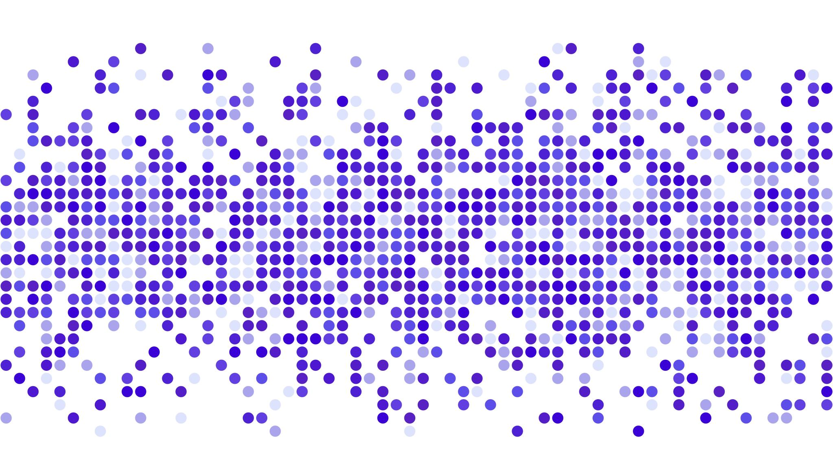
Recursion Practice
Presented by Prof. Goble
Dickinson College Spring 2024

Slide 2
Write a Python program to calculate the sum of a list of numbers using recursion
Test data: [1, 2, 3, 4, 5, 6]
Expected Results: 21

Slide 3
Write a Python program to recursively reverse a string
Test data: “Time”
Expected result: “emiT”

Slide 4
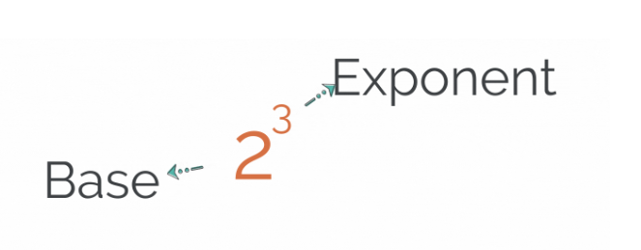
Write a Python program which uses recursion to calculate some base number to the power of some exponent
Function call: power(2, 3)
Expected result: 8

Slide 5
Write a Python program to sum nested lists using recursion
Test data: [1, 2, [3, 4], [5, 6]]
Expected Result: 21

Slide 6
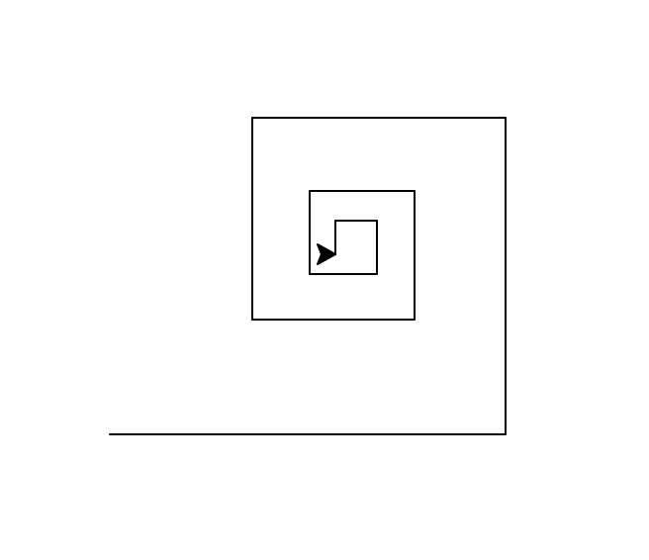
Write a recursive function which uses turtle to draw a square spiral. Function signature: spiral(tur, sideLen, angle, scaleFactor, minLength)
Function call: spiral(bob, 200, 90, 0.8, 15)
Expected drawing:

Slide 7
Implement a recursive function which solves the Tower of Hanoi puzzle
Rules:
Only one disk may be moved at a time
Each move consists of taking the upper disk from one of the stacks and placing it on top of another stack or an empty rod
No disk may be placed on top of a disk that is smaller than it

