Slide 1

Recursion
Presented by Prof. Goble
Dickinson College Spring 2024

Slide 2
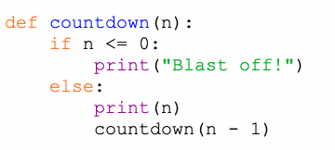
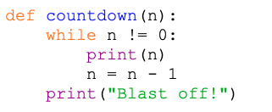
Function Calls
We have experience calling one function from another
Snowman lab
Tic-Tac-Toe
We are also able to have a function call itself

Slide 3
Why do we care about functions calling themselves?

Slide 4

Functions calling themselves
Two reasons:
Some formulas that we are trying to implement refer to themselves
Fibonacci Numbers
$F_{n}=F_{n−1}+F_{n−2} where F_{0}=0 and F_{1}=1$
Factorial Numbers
$n!=\left(n−1\right)∗\left(n−2\right)∗ …∗1$
We can also break a problem down into sub problems to make our life easier

Slide 5
Recursion
The method of having a function call itself is referred to as recursion
A recursive function contains two parts:
The recursive case
This is the part of the function that calls itself
The base case
This is what stops the function from calling itself again

Slide 6
Recursion
When writing a recursive function, we do not explicitly write a loop
If we write our function properly then the computer handle the “looping” for us

Slide 7
Recursive printing
Write a recursive function with the signature print_n(str, n) which prints out the string str n number of times

Slide 8
List length
Write a recursive function which calculates the length of a list without using the len() function

