Slide 1
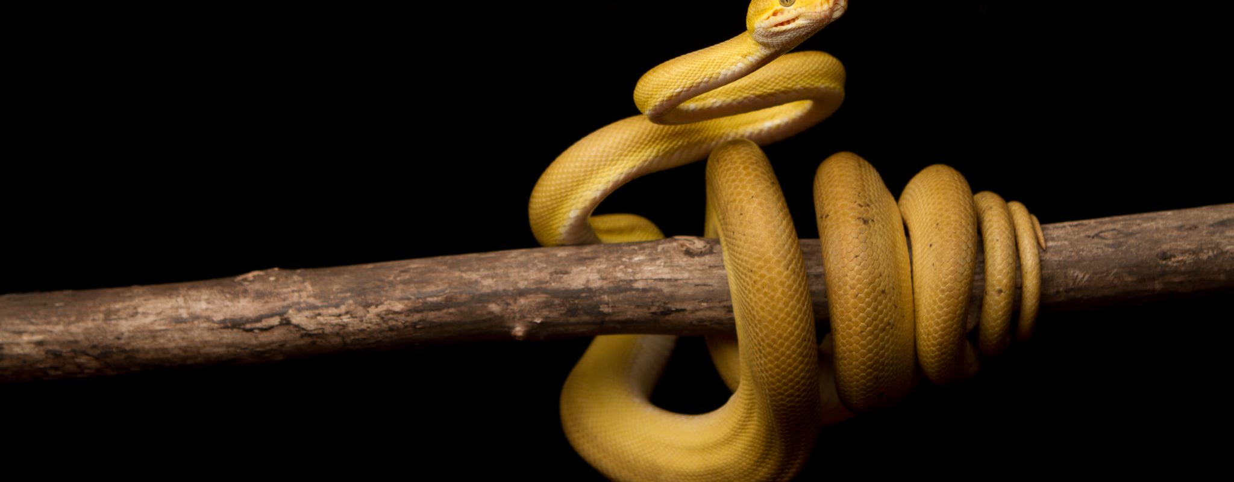
Python Strings Explained
Presented by Prof. Goble
Dickinson College 2024

Slide 2
String structure
Strings are a collection of characters
In memory, these characters are stored in a sequential order
This is why we are able to access specific indices of a string

Slide 3
Slicing Strings
Since we can accesses the indices of a string we can create substrings
A substring is a string we can extract from a preexisting string
This process is done by slicing
To slice a string we use the square bracket notation
new_word = old_word[start:stop:step]

Slide 4
Slicing Strings
New_word = old_word[start:stop:step]
If start is not mentioned, then it assumes that we want to begin at the start of the word
If stop is not mentioned, then it is assumed that we want to end at the end of the word
If step is not mentioned, then it is assumed we want a step size of 1

