Slide 1
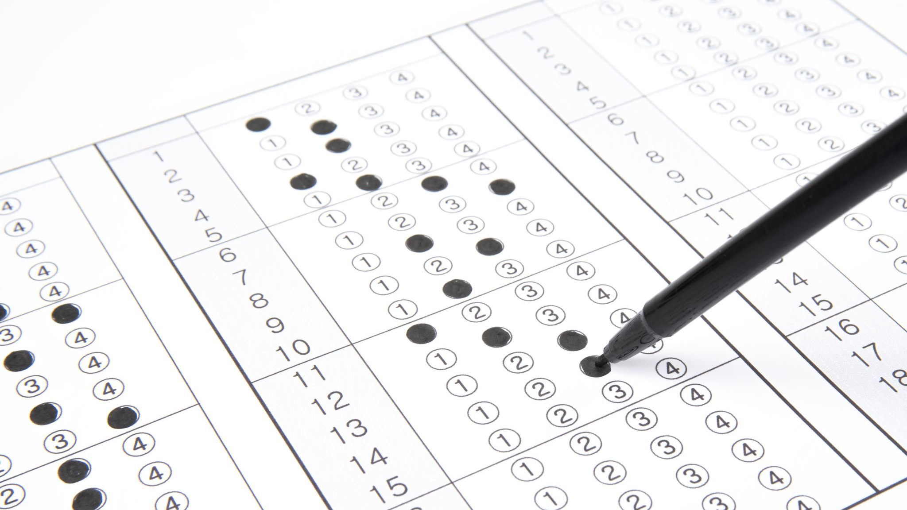
Test Functions
Presented by Prof. Goble
Dickinson College Spring 2024

Slide 2
pigLatin implementation

Slide 3
Why should we test functions?
Whenever we create a new function, we want to make sure it works as intended
Ideally, we want to test different scenarios our functions might expect
Doing so allows us to have full coverage

Slide 4
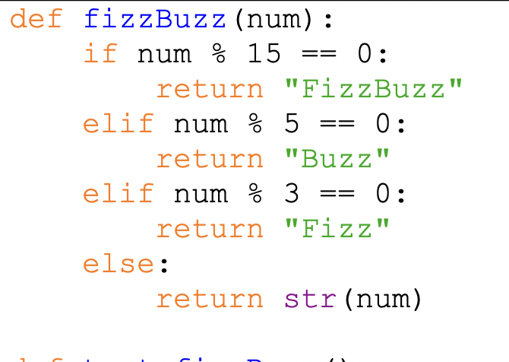
Test Functions

Slide 5
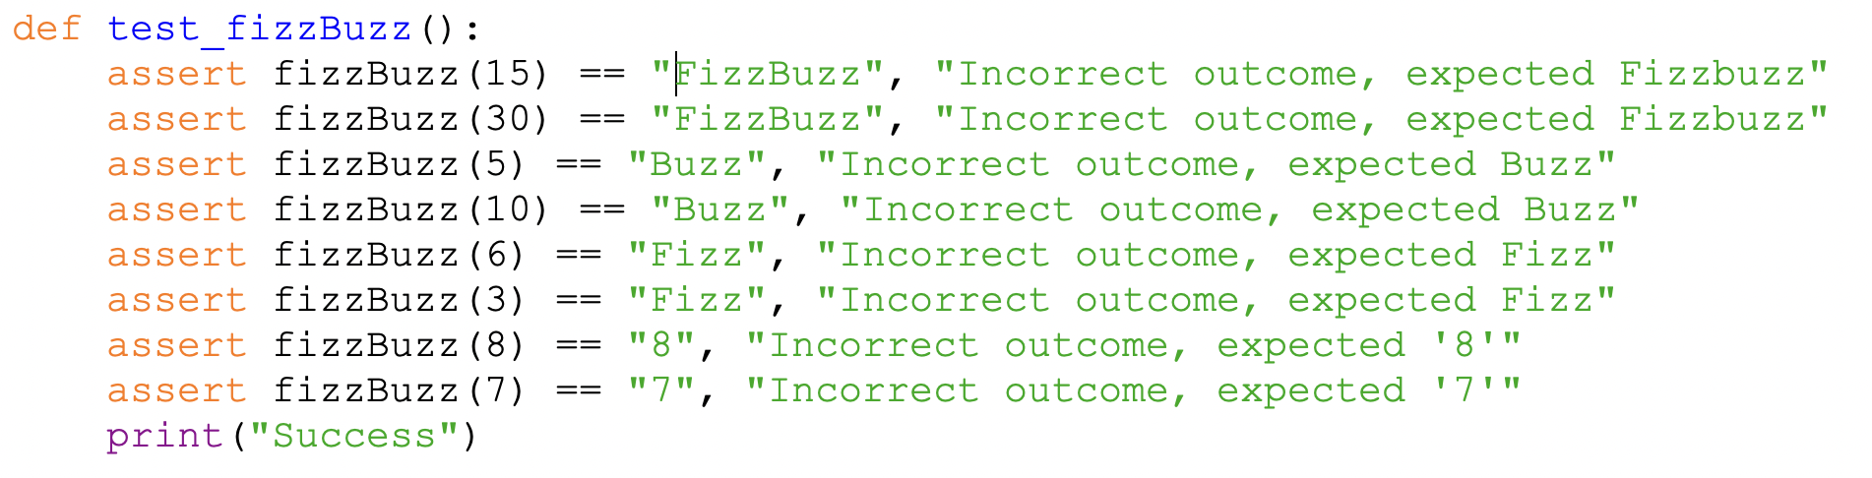
Test Functions

Slide 6
Test Functions

Slide 7
Test Functions

Slide 8
Test Functions

Slide 9
Test Functions

Slide 10
Test Functions

Slide 11
Guardian Statements

Slide 12
Guardian Statements
We want to be able to protect our function and only execute the function if it has the right arguments

Slide 13
Guardian Statements
We want to be able to protect our function and only execute the function if it has the right arguments
What should we consider when trying to protect this function?

Slide 14
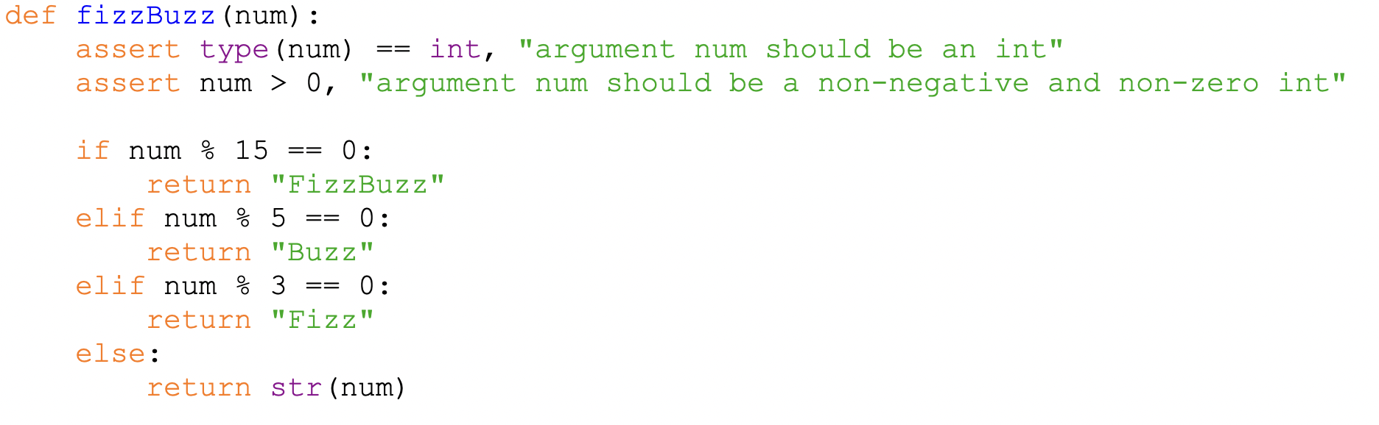
Guardian Statements

Slide 15
Guardian Statements

Slide 16
Guardian Statements

Slide 17
Guardian Statements

