Slide 1

Creating our own functions
Presented by Prof. Goble
Dickinson College Spring 2024

Slide 2
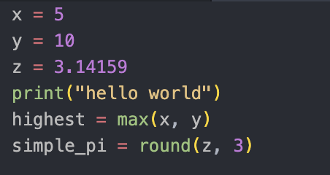
Working with functions
Consider the following code snippet
Here we see a few examples of function calls
The name of the function is the part of code to the left of the parentheses
The expression in parentheses is called the argument of the function
It is common to say that a function takes an argument and returns a result
This result is called the return value

Slide 3
Creating our own functions

Slide 4
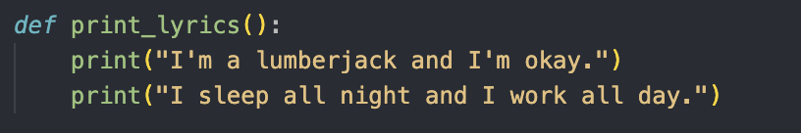
Creating our own functions
A function definition specifies the name of a new function and the sequence of statements that run when the function is called
Consider the following code snippet
The keyword def is used to indicate that we are defining a function
The name of this function is print_lyrics
The empty parentheses indicate that this function does not take any arguments when we call it
The statement inside the function will not run until we call the function

Slide 5
Function Returns
A function can fall into two categories
A fruitful function is one which returns some value
A void function does not return anything
Also referred to as a fruitless function
If we try to assign a void function to a variable we get a special object known as None
None is an object which indicates that there is no value

Slide 6
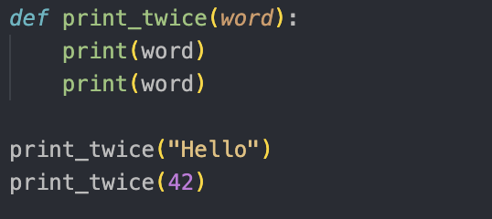
Functions with arguments
If we want to be able to pass in arguments to our functions, then we need to create variables known as parameters
When we call a function with parameters, the argument is assigned to parameters and can be used within the function body

Slide 7
Example 1
Create a function named count_x which takes in a string as an argument and returns the number of times the letter x appears in that string

Slide 8
Creating Functions
In order to create a function, we first identify a section of code that we want to use within our function
This process is known as encapsulation
We take a code snippet that we want to be able to reuse, and then encapsulate it within a function
After we create our function, we can then generalize it so it works for a number of different scenarios
Ideally we want to have incremental development as we program
Create a number of small functions that each perform one task

Slide 9
Program Structure
Import statements
Function definitions
Top Level Code

Slide 10
Variable life cycle and scope
When we start making our own functions we need to keep in mind the scope the variable belongs to
A variable can be either local or global
A local variable is a variable that only exists within a function
Once the function is no longer running, that variable ceases to exist
A global variable is a variable that can be referred to in any part of our code
Ideally we want to limit the number of global functions that we have, and instead pass arguments into functions and reference them as parameters
Using local variables instead of global variables minimizes confusion for the programmer and prevents values from being overwritten

Slide 11
Stack Diagram
We can keep track of the scope of a variable by drawing out a stack diagram
A stack diagram is an extended version of a state diagram
Instead of focusing on just the global section of our program, we now can map out how our program uses our defined functions

Slide 12
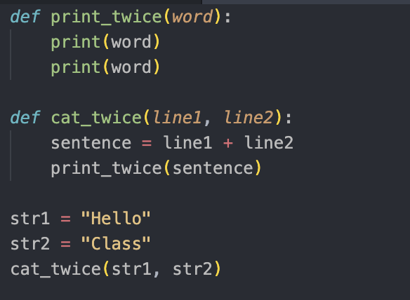
Stack Diagram Example
Consider the following code snippet

Slide 13
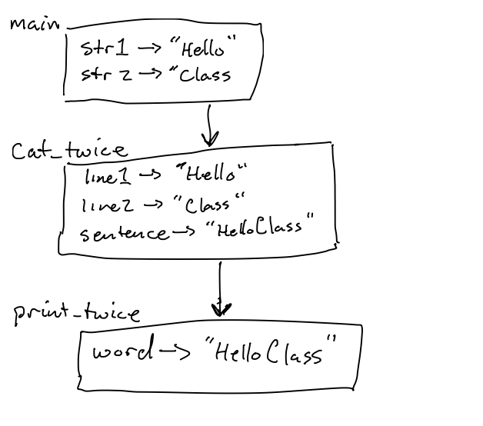
Stack Diagram Example

Slide 14
Example 2
Create a function named reverse which takes in a string and returns a reversed version of it.

