Slide 1

Debugging Practice
Presented by Prof. Goble
Dickinson College Spring 2024

Slide 2
What are the three categories of errors?

Slide 3
Consider the following code snippets
Identify what type of error(s) it contains, and state how to fix it
Assume that any reference to variables or functions are already defined

Slide 4
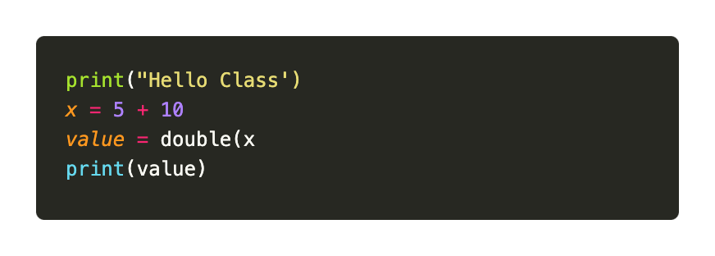
Example 1

Slide 5
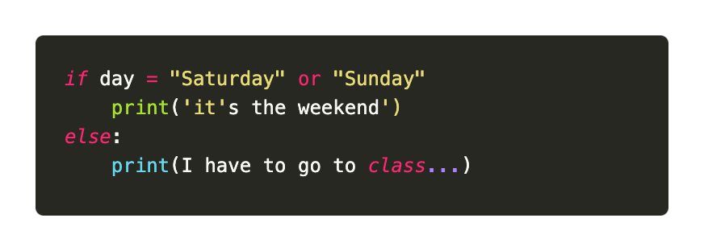
Example 2

Slide 6
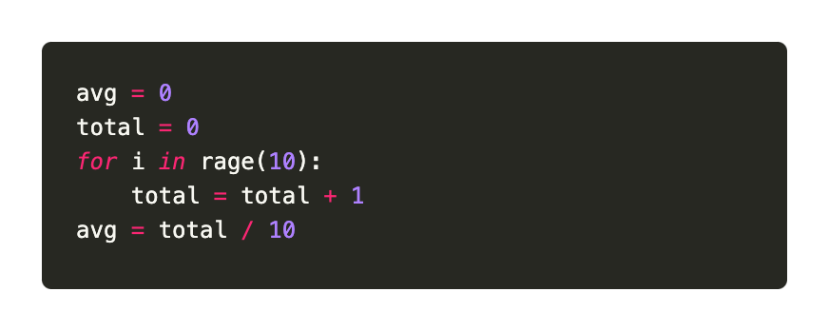
Example 3

Slide 7
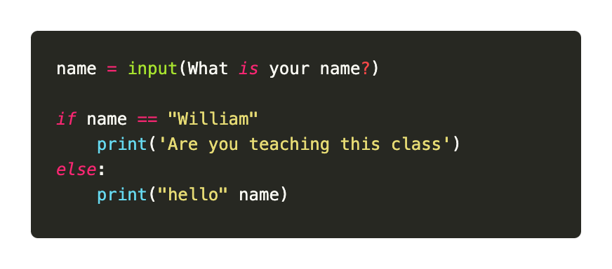
Example 4

Slide 8
Assert Statement Review

Slide 9
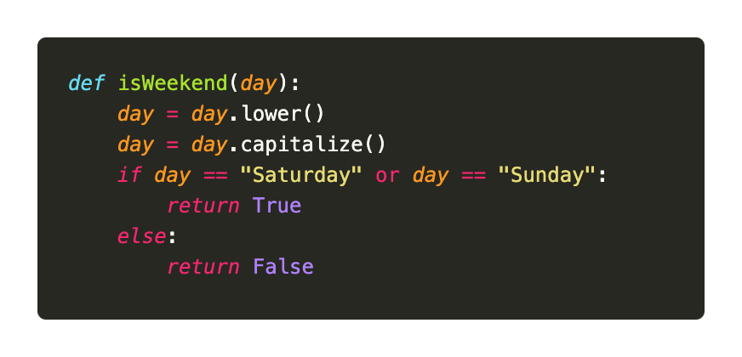
Example 5
Add guardian statement(s) to this function

Slide 10
Example 6
Write a test function for the following code snippet that provides full coverage

