Slide 1



While loops
Presented by Prof. Goble
Dickinson College Spring 2024

Slide 2
For Loop Review
for loops allow for a convenient way to loop over a code snippet
This type of iteration only works for a defined number of iteration
This is done by iterating over a collection
So far we’ve seen that we can either iterate over a range of numbers or a string
We can use an iteration variable to keep track of which step of the loop we are on and use this in our operations

Slide 3
Indefinite looping

Slide 4
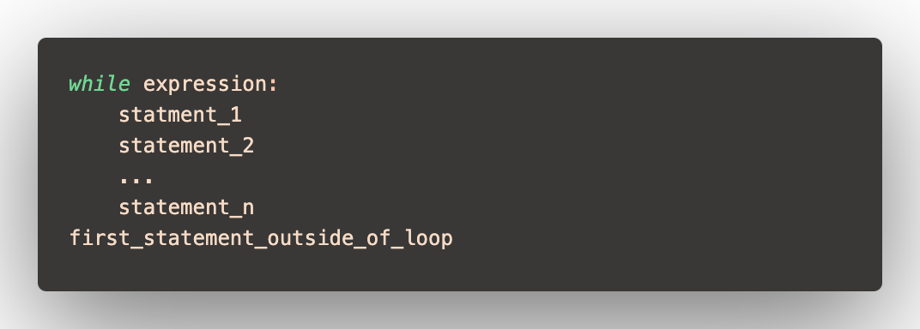
While loops
A while loop is a type of iteration that will repeat until some condition returns False
Basic structure

Slide 5

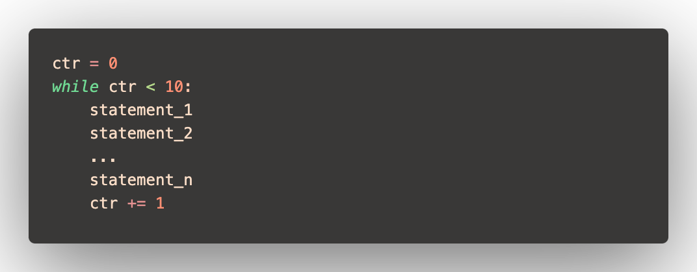
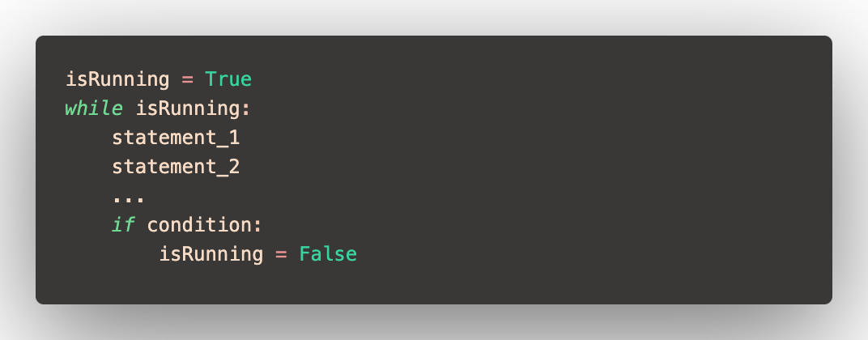
While loop expression
The expression that we use in our loop header is a Boolean value
Meaning it is either True or False
Depending on what we want to do, this expression can vary by different while loop implementations

Slide 6
Occurrence count
Write a function which has two parameters, target and word. This function should use a while loop to count the number of times the letter target appears in the argument word. Have this function return the number of occurrences

Slide 7
Guessing game
I have created a module named answer.py which contains a variable named answer. This answer relates to my favorite music genre. Write a while loop which will let a user guess what the answer is until they get it correct

Slide 8
False vs break
While loops will run until the expression is evaluated to False
When we want to end the loop we can do one of two things
Change the expression to be false
Break out of the statement
The break statement will terminate the loop without completing the remainder of the statements in the loop

Slide 9
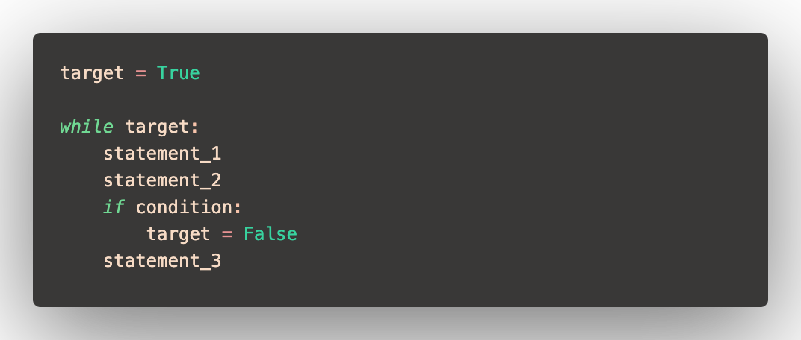
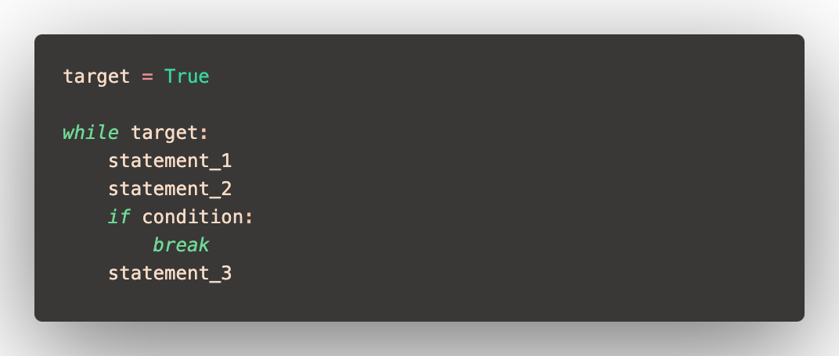
False vs break

Slide 10
Pitfalls of while loops

Slide 11
Common pitfalls
While loops are a nice way to give us a way to iterate over a code snippet an indefinite number of times
This type of iteration also gives us more control of how our program iterates
A major downside is we can easily create an infinite loop
An infinite loop is a phenomena in programming when our program gets stuck within the looping operation and can cause the program to run forever (or until it crashes)
We can avoid infinite loops by being mindful for how we update to the next iteration

