Slide 1

Error Detection
Presented by Prof. Goble
Dickinson College Spring 2024

Slide 2
Errors in programming

Slide 3
Software bugs
A software bug refers to any error, flaw, or fault in the design or execution of our program
This fault causes the program to produce an incorrect or an unexpected result
There are three categories of bugs we will focus on

Slide 4
Syntax Error
Syntax errors occur when the code is not written in a way that the interpreter can understand
This happens when there are missing (or misplaced) punctuation marks, misspelled words, or incorrect use of the programming language

Slide 5

Syntax Error

Slide 6
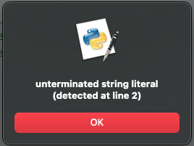
Syntax Error

Slide 7

Syntax Error

Slide 8
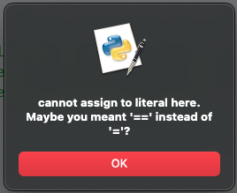
Syntax Error

Slide 9
Runtime Error
Runtime errors occur when the code is syntactically correct, but there is an error during the execution of the program
This can happen when the program tries to perform an illegal operation

Slide 10
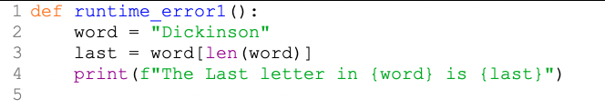
Runtime Error

Slide 11
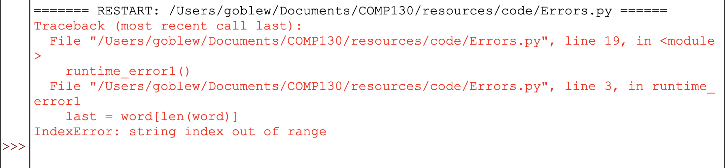
Runtime Error

Slide 12
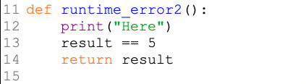
Runtime Error

Slide 13
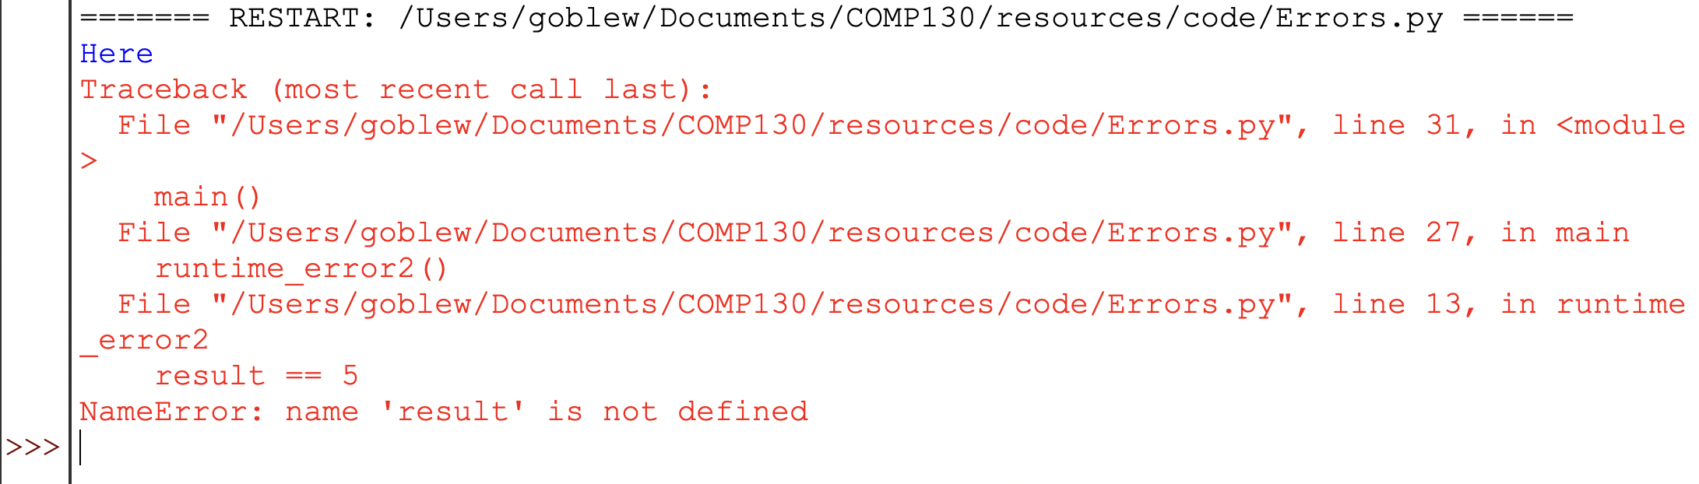
Runtime Error

Slide 14
Semantic Error
Semantic errors occur when the code is syntactically correct, and runs without a runtime error, but the program produces an unexpected result
In short, the program does what I tell it to do, not what I want it to do

Slide 15
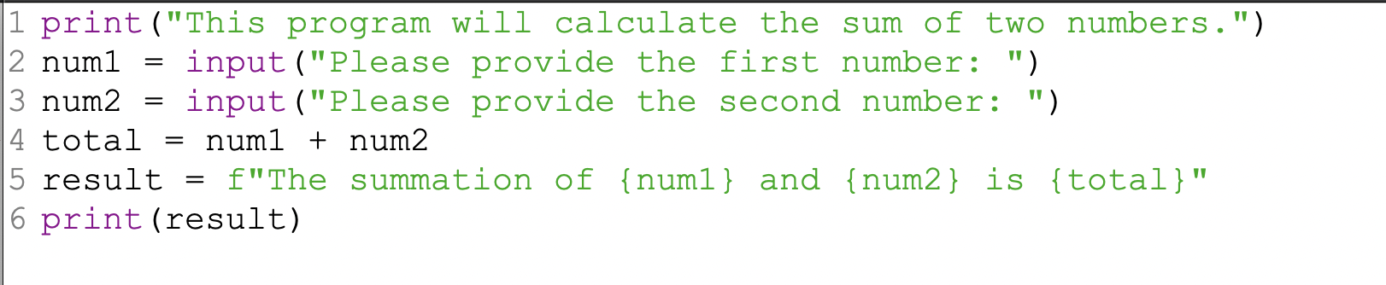
Semantic Error

Slide 16
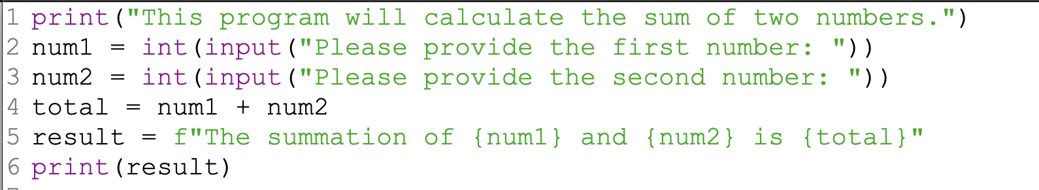
Semantic Error

Slide 17
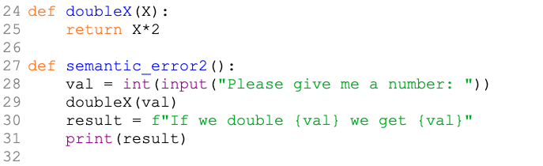
Semantic Error

Slide 18
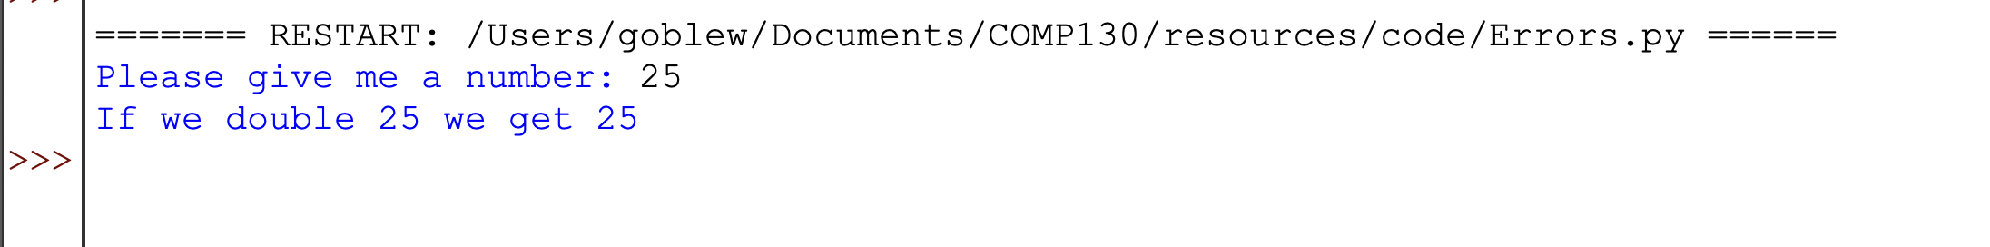
Semantic Error

