Slide 1
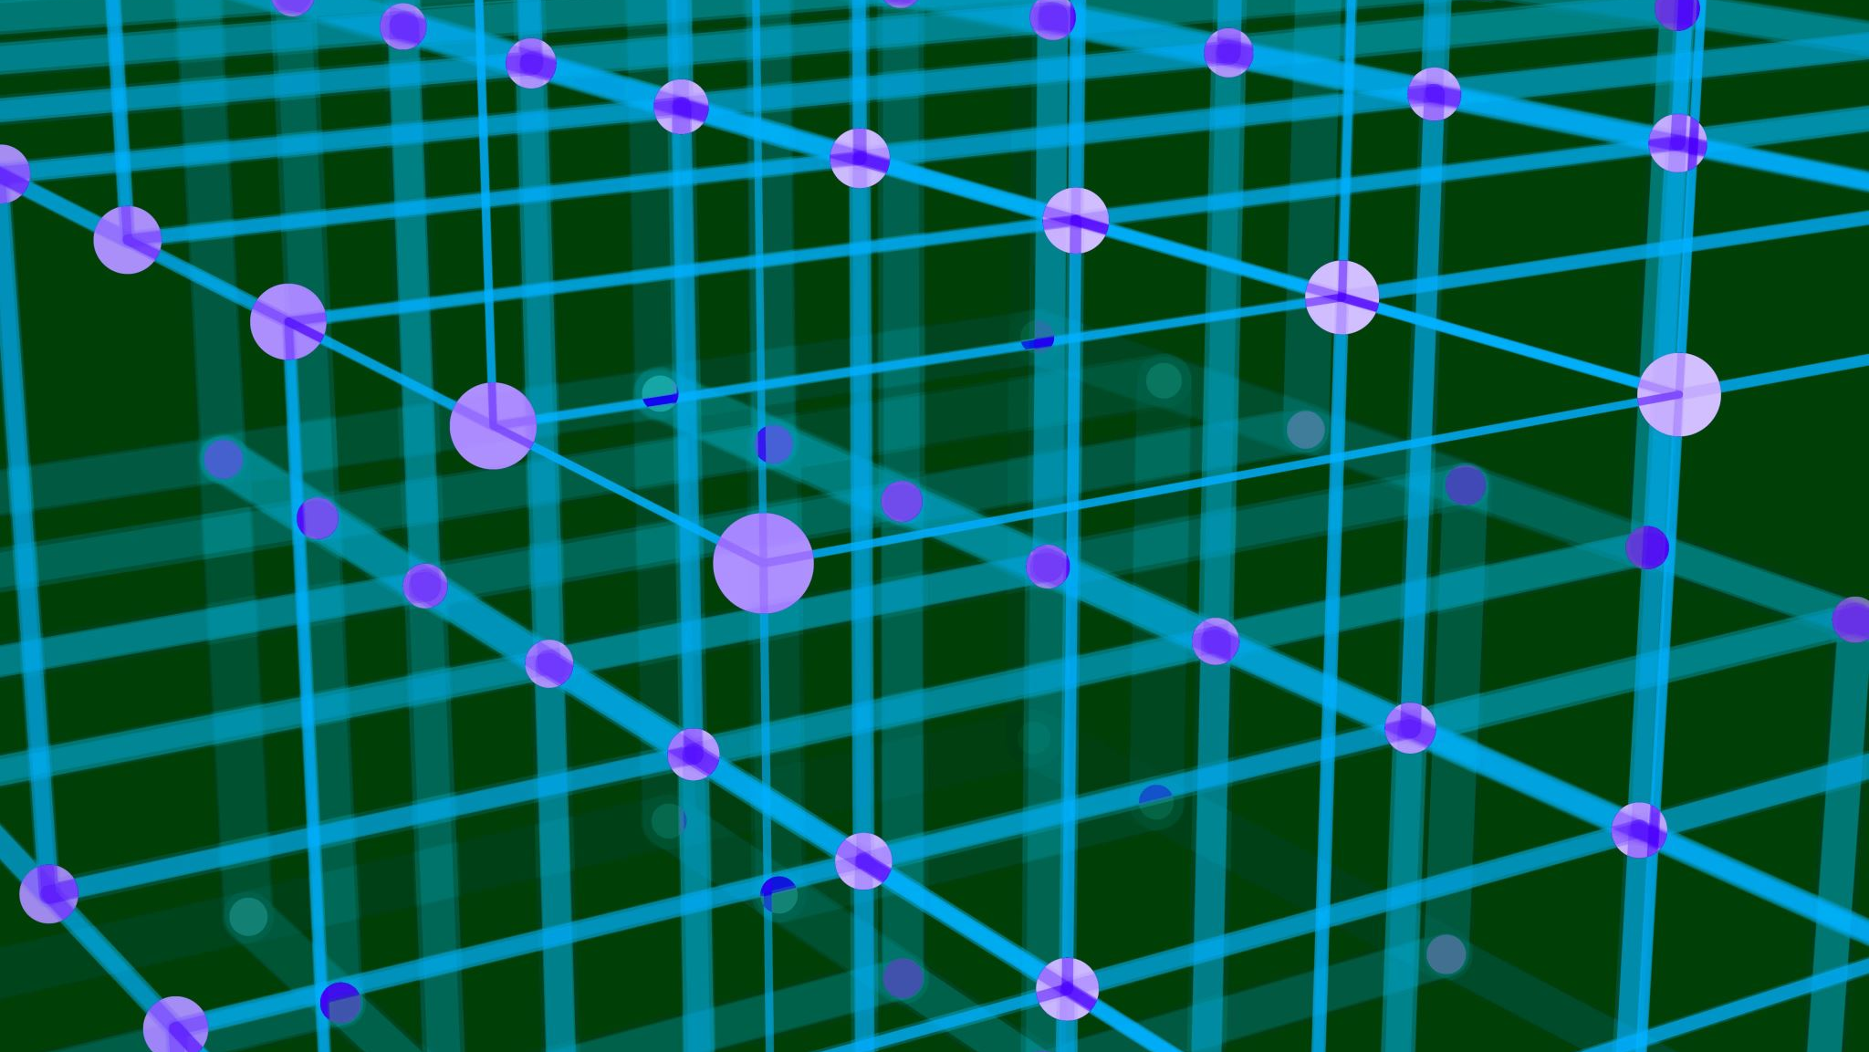
Introduction to Computation
Presented by Prof. Goble
Dickinson College Spring 2024

Slide 2
Introduction

Slide 3
Who am I?
Prof. Goble
Masters in Computer Science from Florida State University
Interests: the Phillies and Eagles
Office Hours:
M: 2-3pm; W: 1-2pm; R: 10-11am

Slide 4
Goals of this course
Understand the elementary concepts of computer programming and software development
Use scientific reasoning to evaluate hypotheses about computer program outputs
Gain an appreciation of the social, legal, and ethical issues raised by computing and computing for the greater good
Develop the ability to critically evaluate claims from a scientific perspective

Slide 5
Materials
Text book: Think Python 2nd Edition
Text Editor: IDLE and Replit

Slide 6
Grading
Class Participation: 5%
Homework: 25%
Lab Assignments: 25%
Midterms: 30%
Final Exam: 15%

Slide 7
Homework

Slide 8
Labs

Slide 9
Exams

Slide 10
What is a program?

Slide 11
Terminology
A program is a sequence of instructions that specifies how to perform a computation
Basic Instructions:
Input: Get data from the keyboard, a file, the network, or some other device
Output: Display data on the screen, save it in a file, send it over the network, etc.
Math: Basic mathematical operations, like addition and subtraction
Conditional execution: Check for certain conditions and run the appropriate code
Repetition: Perform some action repeatedly, usually with some variation

Slide 12
Ways to run Python
In order to execute python code, we need to use a tool called an interpreter
An interpreter is a program which reads and then executes Python code
The Python interpreter can be run in two ways:
Interactive mode: Here we directly interact with the interpreter and can write quick code snippets to see what the expected output would be
Script mode: Once we start writing more lines of code, we can save them in a Python script and run that program with our interpreter
Python scripts have the file extension .py to signify that it contains Python code

