Slide 1

Iteration
Presented by Prof. Goble
Dickinson College Spring 2024

Slide 2
What is Iteration?
Iteration is the ability to run a block of statements repeatedly
Iteration leverages Python’s ability for us to reassign the values that are stored at a variable
How does this look on a state diagram?

Slide 3
What is Iteration?
Iteration is the ability to run a block of statements repeatedly
Iteration leverages Python’s ability for us to reassign the values that are stored at a variable
How does this look on a state diagram?
A common type of reassignment is to update the value
Before we can update a variable’s value, we first need to initialize it with some base data

Slide 4
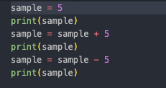
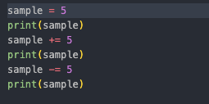
Increment or decrement a variable
If we want to increase or decrease the numerical value of a variable, we can either increment or decrement it’s value by a set number

Slide 5
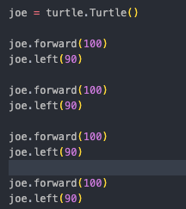
Simple Repetition
Consider the following code snippet which uses a turtle to draw a square

Slide 6
Simple Repetition
Consider the following code snippet which uses a turtle to draw a square
Can this be simplified?

Slide 7

Simple Repetition
Consider the following code snippet which uses a turtle to draw a square
Can this be simplified?
Yes

Slide 8
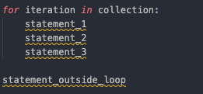
For loop structure

Slide 9
The range function
The main collection that we will work with comes from the range function
range(start, stop, step)
Start: Optional argument. An integer number specifying at which position to start. Default value is 0
Stop: Required. Argument. An integer number specifying at which position to stop (not included)
Step: Optional Argument. An integer number specifying the incrementation. Default is 1

Slide 10
Simple Example
Turtle box example

Slide 11
Example with Step
Print out only the odds or only the even values

Slide 12
Reverse ExamplE
Implement a countdown

Slide 13
Conditional Example
Print if a number is even or odd within a range of numbers

