Slide 1

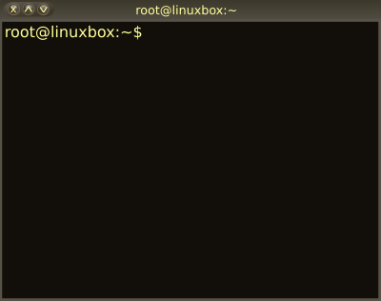

03 – Filters, Pipes and Scripts
COMP 190 – Dickinson College
Fall 2023
Images from: openclipart.org
Notes:
Look at some of the specific tools and utility programs that come with all (or nearly all) Unix distributions
And see how they are used.

Slide 2
The Unix philosophy recommended utilizing small, purpose-built programs in combination to do complex overall tasks. Phil Estes Linux vs. Unix: What's the difference?
Notes:
In A02 you learned a bit about Linux/Unix commands like ls, cd, cp, etc…
- Those are some of the small, purpose-built programs that Phil Estes is referring to in this quote.
- There are lots more of these small purpose-built programs.
Today, we’ll see how to put these programs into combination with each other
- To do more complex things.
- And in the homework - A03 - you’ll also learn a few more commands.

Slide 3
One of the underlying principles of Linux is that every item should do one thing and one thing only and that we can easily join these items together. Think of it like a set of building blocks that we may put together however we like to build anything we want.
Ryan Chadwick Ryan’s Linux Tutorial – Filters!
in combination
small, purpose-built
programs
Notes:
Here’s the other definition that we also looked at previously.
- Notice that it also emphasizes the “in combination” idea
This is the real power of the Unix/Linux command line.
Being able to connect together these “small, purpose-built” building blocks to build what we want.
Now we just need to learn about a few more blocks and and how to join them together.

Slide 4
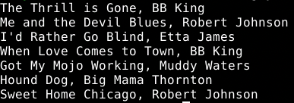

Linux/Unix Filters (i.e. commands)
A filter is a “small, purpose-built program” that a accepts a stream of text as input, processes it in some way and generates a stream of text as output.
Input Stream
Filter
head --lines=3
Output Stream
Notes:
So a filter is just a special type of command.
- takes a stream of text as input
- processes it in some way
- generates a stream of text as output.
Here is an example using the head filter
- You saw head in the first homework but didn’t define it as a filter, but technically that is what it is…
- The input is a list of songs and artists, one per line.
- The head filter, as we know, just outputs the first so many lines.
- in this case 3.
Will use command and filter mostly interchangeable.
- technically some commands are not filters (because they have no input)
- but all filters are commands.

Slide 5
Linux/Unix Standard Streams
Linux/Unix filters (and programs more generally) use three standard streams:
Standard Input (stdin)
Filters read their input from stdin.
Standard Output (stdout)
Filters print their output to stdout.
Standard Error (stderr)
Filters print error messages to stderr.
All three standard streams default to the terminal.
Input read from keyboard
Output printed to terminal window.
Notes:
Demo with head –n3
- Type 3 lines
- Input is from standard input
- Each line is read from the keyboard.
- Output is to standard output
- It is printed to the terminal
- Once three lines have been read the head program terminates.
Demo with wc –l
- Counts the number of lines read
- Input is from standard input
- I.e. it reads lines from keyboard
- Key combination CTRL-D indicates end of input.
- Output is to standard output
- It prints the number of lines read to the terminal.
But that’s not all that useful…
- would like to have these filters process the contents of files!
- Give me the first 3 lines in a file
- Tell me how many lines are in a file
- etc…

Slide 6
Redirection and Pipes
Redirection and pipes provide two ways to combine Unix filters to perform more complex tasks.
Redirection allows a filter to get its input from a file and/or write its output to a file.
A pipe allow one filter to get its input from the output of another filter.

Slide 7

Redirection
The standard streams can be redirected so that filters get their input from a file (<) or send their output to a file (>, >>)
head --lines=3 < my-music.txt
my-music.txt
head --lines=3 < my-music.txt > top3.txt
my-music.txt
top3.txt
Notes:
In the first one:
- Standard input is redirected from the file my-music.txt
- So head uses the contents of that file as its input to be processed.
- The < says, use the contents of this file as the input to the filter.
- So when that filter reads from standard input, it will get lines from the file instead of from the keyboard.
- Note: In HW02 we used head --lines=3 <file>
- That is doing the same thing as <.
- The contents of the <file> are used as the input to the filter.
- Most commands will allow some way to specify the name of a file to use.
- Can check the man pages.
- But any filter will allow redirection.
In the second one
- The input to head comes from the file guyb-music.txt
- The output goes to the file top3.txt
- The > says that when the filter prints to standard output
- Send that output to the file top3.txt instead of displaying it in the terminal.
We can also use >> to redirect output
- Using two >> instead of one > causes the output to be appended to the file, if it exists.
Do a demo here:
- Show text file.
- Show first one
- Show second one
- Cat top3.txt
- Do it again
- Show file is emptied and refilled.
- Do it again with >>
- Show file is appended
- Do it again with >
- Show file is emptied and refilled.

Slide 8

Redirection
Redirection provides one way to use the output of one filter as the input to the next.
head --lines=3 < my-music.txt > top3.txt
my-music.txt
top3.txt
sort < top3.txt
top3.txt
Notes:
The first line:
- Provides the contents of my-music.txt to head as its input
- Sends the output of the head filter to the file top3.txt
The second line:
- Provides the contents of top3.txt to the sort filter
- The sort filter just sorts the input lines
- The output is not redirected
- So it appears in the terminal.

Slide 9
Spot Check:
The prior example alphabetized the first 3 lines of my-music.txt and displayed the result in the terminal.
Write commands using redirection that alphabetizes my-music.txt and then places the first three lines alphabetically into a file named ordered3.txt.
Notes:
Note:
- On the last slide we got the first 3 lines and then alphabetized them.
- Here we want to alphabetize the whole file first and then get the first 3 lines.

Slide 10
Pipes
A pipe connects the output of one filter directly to the input of another filter.
head --lines=3 < my-music.txt
my-music.txt
sort
Notes:
Saw how to do this indirectly using redirection to an intermediate file.
- We usually don’t care about that intermediate file.
- In those cases we can use a pipe instead.
Here:
- The my-music.txt file is directed into the head filter
- The output of the head filter,
- instead of being saved to a file, is sent directly to the sort filter.
- The output of the sort filter is displayed in the terminal
- because it was not redirected.

Slide 11
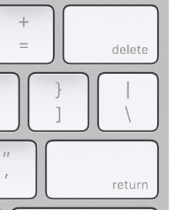
Writing a Pipe
A pipe is created by placing a pipe character ( | ) between two filters on the command line.
head --lines=3 < my-music.txt | sort
Notes:
The command line shown at the top
- Implements the pipe illustrated on the last slide
- and shown here in miniature form
The pipe character is a vertical bar
- It typically appears on the keyboard above the enter or return key.
It is also possible to
- pipe through multiple filters by using multiple | characters
- You can also redirect the output of the final filter into a file.

Slide 12
Spot Check:
The prior example alphabetized the first 3 lines of my-music.txt and displayed the result in the terminal.
Write a command using a pipe that alphabetizes my-music.txt and places the first 3 lines into a file named ordered3.txt.
Notes:
Note this is the same task as before but using a pipe instead of redirection.

Slide 13
Shell Scripts
A shell script is a text file containing a list of commands to be interpreted by the shell (e.g. bash)
Shell provides a command line interface (CLI)
Is also an interpreter for shell scripts.
A list of commands executed in order.
Also includes full language features
Variables / conditionals / loops / functions…
Syntax is a bit idiosyncratic and particular
Read: Frustrating!
Notes:
Today we’ll look at a basic shell script.
- Essentially just a list of commands to be executed in order.
But a shell script can also contain most standard language features
- Loops (for/while), conditionals (if/else), functions, etc.
- We won’t be doing this, but you will likely come across some of them.
- If you are working on a script and you think… hey I want an if/else…
- you can do it
- You just have to look up the syntax.
- It does the same thing… you just write it differently.

Slide 14
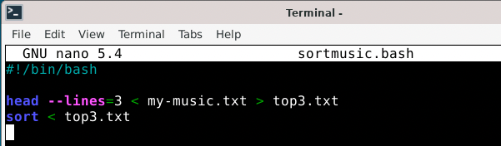
An Example Script
File extension
typically indicates type
(e.g. sh = shell script)
#!
Sha-Bang
Commands are executed
from top to bottom
Notes:
Commands in the script are saved in a text file.
- Often named .sh or .bash or something such.
- The .sh doesn’t matter to unix at all.
- It is there as a clue to the human reader that this file contains a shell script.
The Sha-Bang line defines the interpreter to be used to execute the commands.
- Sharp-Bang (i.e. exclamation)
- Sometimes you’ll also hear Shebang – as in ”the whole shebang”
- Here the Bash shell (/bin/bash) is being used.
- Recall that there are lots of shells
- Any one can be used, can even use python.
Commands appear one after the other and are executed top to bottom.
- in a basic script that has no loops, conditionals for functions.

Slide 15
Running Shell Scripts
A shell script can be run from the command line using ./<script>
./sortmusic.sh
Note: ./ is a relative path.
“In the current directory, run the program sortmusic.sh”
Will need to set the permissions before a script can be run!
Notes:
Demo:
- cat the script file.
- try to run it, show the permission error.
- use chmod u+x sortmusic.sh on the command line
- For now, this is what we need to do to tell Linux/Unix that this file is an executable program.
- I’ll cover the details of that in a moment.
- Then run it and show the output.

Slide 16
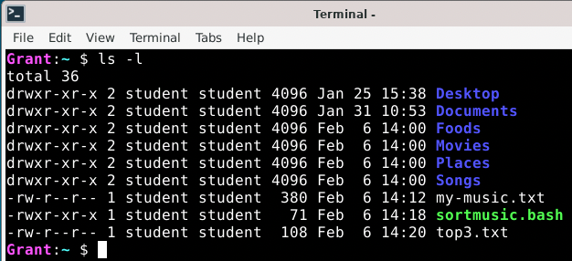
File Permissions:
Every file and directory in Unix has permissions
Username
of the file’s
owner
The group to
which the file
belongs.
Date/time the
file was
last modified
Permissions
Notes:
The ls –l command shows the “long” version of the file listing.
- This includes a lot of extra information.
- permissions – more in a moment.
- username – who owns the file
- Typically this is whomever created it, but that can be changed.
- Group
- The group is often the same as the username.
- Every user has their own group by default.
- When you create a file it is owned by you as the user.
- And it belongs to your group.
-It is possible to create other groups
- This allows files and directories to be shared with other users.
- E.g. maybe a compmajors group, or a faculty group
- All users in a specific group could then have access to a file, directory or program.
- Last modified date and time.
- Filename
The other columns are:
- Number of hard links… don’t worry about it.
- The size of the file in bytes.

Slide 17
File Permissions: User (i.e. owner)
User permissions appear first.
d = Directory
r = Read
w = Write
x = Execute
- = no permission
User (u)
Permissions
Notes:
Permissions are read/write/execute
- rwx. In that order
- a – means the permission is not granted
The first 3 specify the permissions for the user.
- Also called the u permissions.
The student user can
- read/write/execute the sortmusic.sh script
- as indicated by the rwx in the user positions.
What can the student do with
- top3.txt?
- Foods?
Note that:
- Execute permission on directory means that you can change into it.
- Can have directory without execute
- If it has write but not read permission then it would be like a drop box.
- Can put stuff into it, but can’t see what’s there.
- Usually done for the “other” users.

Slide 18
File Permissions: Group
Group permissions appear second.
d = Directory
r = Read
w = Write
x = Execute
- = no permission
Group (g)
Permissions
Notes:
Group permissions – also called the g permissions.
Users that are in the student group can
- read or execute the sortmusic.sh script
- as indicated by the r and x in the group positions.
- they cannot write it
- as indicated by the – where the w would appear.
What can members of the student group do with:
- top3?
- Places?

Slide 19
File Permissions: Others
Permissions for others (users not in the group) are third.
d = Directory
r = Read
w = Write
x = Execute
- = no permission
🚫
Others (o)
Permissions
Notes:
All other users on the system
- those that are not in the student group
- may read and execute the sortmusic.sh file.
- as indicated by the r-x in the others positions.

Slide 20
Changing Permissions
User must have execute permission for a script to run it.
chmod u+x sortmusic.sh
Can add and remove other permissions (e.g.):
u-w u+rwx
g-r o+rx-w
u-x,g+w,o-rwx
a+rw-x
Notes:
u-w
- remove write permission from the user.
u+rwx
- add read, write and execute permissions for the user.
g-r
- remove read permission from the group members.
o+rx-w
- give others not in the group read and execute, and remove write, permissions.
u-x,g+w,o-rwx
- remove execute permission from user, add write permission to the group, remove read,write,execute permissions from others not in the group.
a+rw-x
- a - sets permission for all (user, group and others) all at once.
- give user, group and others read and write, and remove execute permission.
These are just some examples…
- you can combine u, g, o with +/- rwx however you need to.
- permissions that are not explicitly mentioned in a command will be left unchanged.

Slide 21
Spot Check:
Consider the file and permissions shown below:
Who is the owner of this file?
To which group does this file belong?
What permissions does the owner have?
What permissions does the group have?
What permissions do others have?
What command would give execute access to the owner?
What command would give write and execute access to others?
What command would remove write access and give execute access to the group?

Slide 22
What’s Next?
Be sure to complete
Overdue:
Syllabus Quiz (if you haven’t already)
Quiz 01
Quiz 02
Complete HW 03
Submit to Moodle by next Thurs 1:30pm.
Complete Quiz 03
Do reading and prep for discussion.

Slide 23

Acknowledgments:
Slide Template From:
https://creativecommons.org/licenses/by/4.0/
Slide Content Licensed as:
https://creativecommons.org/licenses/by-nc/4.0/

