Slide 1

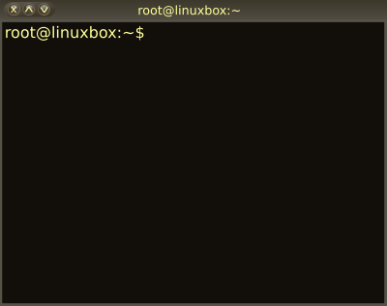

02 – Linux Command Line Interface (CLI)
COMP 190 – Dickinson College
Spring 2023
Images from: openclipart.org
Notes:
In this class and the activities, you will be learning to interact and work with Linux through the command line.

Slide 2
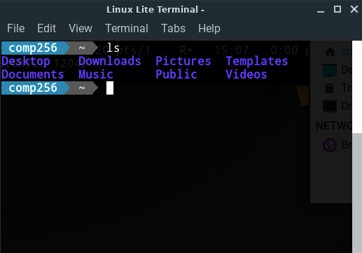
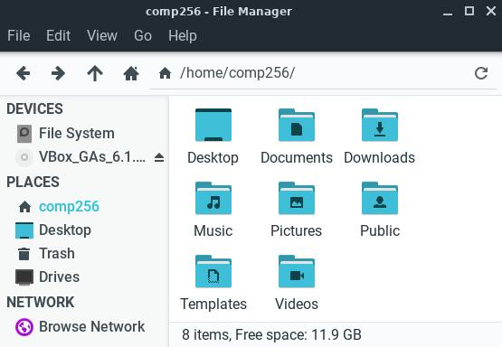
Directories (Folders) and Files
Notes:
Last time and in the first homework you got some experience working with files and directories.
In particular, it should have become clear that
- The GUI file manger view and the CLI view (via ls in the Terminal) are two different views of the same information.
- That performing operations like move, copy, delete in the GUI and CLI are equivalent.
Today we’ll dig deeper into using the CLI.

Slide 3
Linux/Unix CLI File Paths
A path expresses the location of a directory (i.e folder) or file using text.
/home/student/Notes.txt
Absolute paths
Give directions from a common reference point.
This reference point is the root directory.
Absolute paths begin with a / indicating the root directory.
Relative paths
Give directions from your current location.
Your current location is called the working directory.
Relative paths do not begin with a /
Notes:
One of the main things we’ll need to know about to use the CLI effectively are File Paths
An absolute path is like directions to your destination from the center of campus.
- To get to the Coffee Shop: From the Union building, go out the front door, turn left, go to the corner, etc…
- To get to the Gym: From the Union building, go out the back door, turn right, go to the alley, turn left, etc…
- The directions to the same place will always be the same.
A relative path is like directions from where you are right now.
- So the directions depend on where you are.
- Thus directions to the same place will be different depending upon where you are.
- To get to the Coffee Shop: turn around, go to the corner, turn right, cross the street, etc…
- To get to the Coffee Shop: Go out the front door, turn left, go to the corner, etc…

Slide 4
Linux/Unix vs Windows File Paths
Path Separator:
Linux/Unix: home/student/Notes
Windows: home\student\Notes
Root Directory:
Linux/Unix; /
Windows: C:\ D:\ etc.
Case sensitive
Paths are case sensitive
Notes:
The Path Separator is the character that is used to separate parts of the path.
- e.g. go to home then to student then to Notes
- Linux/Unix uses the / character
- Windows uses the \ character
The Root Directory
- Linux / Unix it is / and everything starts there.
- In Windows, there is one root for every disk.
- Typically, it is C:\ for the main disk drive
- If you connect an external or backup drive it will be D:\
We won’t be using Windows, but I wanted to mention this as some of you may have before or may encounter it.
Anytime you are working in Linux, even if it is in Docker w/ VNC on Windows, you will use the Linux style.

Slide 5
Absolute and Relative Paths
Which of the following are relative paths and which are absolute paths?
/home/student/Movies
student/Food/Lunches.txt
../Movies/Drama/Crawdads.txt
/usr/bin/ls
../../
/etc/passwd
Notes:
It doesn’t matter what these refer to at this point.
- We’ll get to that.
- For now, just be able to identify them as relative or absolute paths.

Slide 6


Unix File System Structure
Files and directories are organized into a tree structure.
Tree begins at the root (directory)
A sub-directory is a directory inside another directory.
bin, etc, and home are sub-directories of the root.
hoppergm and ritchied are sub-directories of home.
A parent directory is the directory that contains a sub-directory.
hoppergm is the parent directory of Documents and Images.
root
/
bin
etc
home
hoppergm
Documents
Project1
FileA
FileB
Images
FileC
ritchied
Notes:
Now let’s start to understand what relative and absolute paths mean.
Tree begins at the root (directory).
- root is a directory
- but often is just called “the root”
- So, the root and the root directory are synonymous.
What are some additional examples of
- Sub-directories?
- Parent-directories?

Slide 7
Absolute File Paths
Absolute paths: Start with a / and specify location starting from the root (directory) of the file system.
/bin
/home/hoppergm
/home/hoppergm/Images/FileC
root
/
bin
etc
home
hoppergm
Documents
Project1
FileA
FileB
Images
FileC
ritchied
Notes:
The path /bin is an absolute path.
- starts with a /
It says to
- start in the root directory (/) and then
- look there for a directory named bin.

Slide 8
Absolute File Paths
Absolute paths: Start with a / and specify location starting from the root (directory) of the file system.
/bin
/home/hoppergm
/home/hoppergm/Images/FileC
root
/
bin
etc
home
hoppergm
Documents
Project1
FileA
FileB
Images
FileC
ritchied
Notes:
The path /home/hoppergm is an absolute psth.
- it begins with a /
This path specifies that:
- We start in the root directory (/)
- Look there for a directory named home
- Look in that home directory for a directory named hoppergm.

Slide 9
Absolute File Paths
Absolute paths: Start with a / and specify location starting from the root (directory) of the file system.
/bin
/home/hoppergm
/home/hoppergm/Images/FileC
root
/
bin
etc
home
hoppergm
Documents
Project1
FileA
FileB
Images
FileC
ritchied
Notes:
The path /home/hoppergm/FileC is an absolute psth.
- it begins with a /
This path specifies that:
- We start in the root directory (/)
- Look there for a directory named home
- Look in that home directory for a directory named hoppergm
- Look in that hoppergm directory for a directory named Images
- Look in that Images directory for a file name FileC.

Slide 10
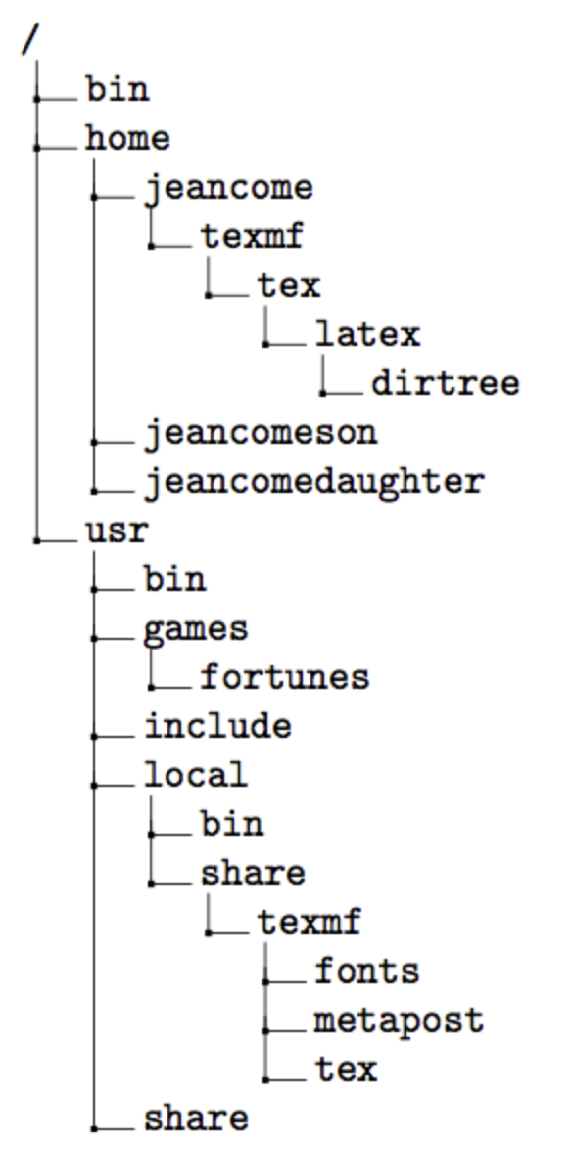
Path Practice
Write the absolute path for the following files or directories:
The usr directory
The fortunes program
The latex directory
The bin directory
Notes:
latex
- This is referring to LaTeX
- which is an advanced a type setting program.
- https://en.wikipedia.org/wiki/LaTeX
- https://www.bu.edu/math/files/2013/08/ShortTeX3.pdf
- Not a type of rubber material.
Notice there are several bin directories.
- Each one will have a unique absolute path.
File tree from: https://texblog.org/2012/08/07/semi-automatic-directory-tree-in-latex/

Slide 11
Relative File Paths
root
Relative paths: Do not start with a / and specify location starting from the working directory.
We will assume the working directory is /home/hoppergm
Documents
Documents/Project1/FileB
../ritchied
../../bin
/
bin
etc
home
hoppergm
Documents
Project1
FileA
FileB
Images
FileC
ritchied
Notes:
Any time you are working in the CLI you will have a “working directory”
- You will have seen this in the CLI in the first homework.
- When you used cd to change into a different directory
- the prompt changed to indicate which directory you were in.
- this is the directory for which the files are displayed when you use the ls command.
- The the GUI file manager
- the working directory is the directory that is being displayed.
Here we assume the working directory is /home/hoppergm
The path Documents is a relative path (no / at the start).
- It specifies that we
- Look in the working directory
- For a directory named Documents.

Slide 12
Relative File Paths
root
Relative paths: Do not start with a / and specify location starting from the working directory.
We will assume the working directory is /home/hoppergm
Documents
Documents/Project1/FileB
../ritchied
../../bin
/
bin
etc
home
hoppergm
Documents
Project1
FileA
FileB
Images
FileC
ritchied
Notes:
Here we assume the working directory is /home/hoppergm
The path Documents/Project1/FileB is a relative path (no / at the start).
- It specifies that we
- Look in the working directory
- For a directory named Documents.
- Then look in Documents for a directory named Project1
- Then look in Project1 for a file named FileB.

Slide 13
Relative File Paths
root
Relative paths: Do not start with a / and specify location starting from the working directory.
We will assume the working directory is /home/hoppergm
Documents
Documents/Project1/FileB
../ritchied
../../bin
/
bin
etc
home
hoppergm
Documents
Project1
FileA
FileB
Images
FileC
ritchied
Notes:
Here we assume the working directory is /home/hoppergm
The “..” is what the Unix CLI uses t refer to the parent directory.
So the path ../ritchied is a relative path (it does not start from the root /)
- it specifies that
- we look in the parent directory of the current directory
- i.e. in the home directory
- for a directory named ritchied
The .. Is relative to the working directory.
For example, if the working directory is:
- hoppergm then .. refers to home.
- home then .. refers to root
- Project1 then .. refers to Documents
- Documents then .. refers to hoppergm
- etc.
What is .. if the working directory is Images?

Slide 14
Relative File Paths
root
Relative paths: Do not start with a / and specify location starting from the working directory.
We will assume the working directory is /home/hoppergm
Documents
Documents/Project1/FileB
../ritchied
../../bin
/
bin
etc
home
hoppergm
Documents
Project1
FileA
FileB
Images
FileC
ritchied
Notes:
Here we assume the working directory is /home/hoppergm
So the path ../../bin is a relative path (it does not start from the root /)
- it specifies that
- we look in the parent directory of the current directory
- i.e. in the home directory
- and that we look in the parent directory of home
- i.e. in the root (/) directory
- for a directory named bin.

Slide 15
Path Practice
Assume that the working directory is jeancome.
Write a relative path for the following files or directories:
The latex directory
The jeancomeson directory
The share directory
The bin directory
Notes:
Again there are multiple bin directories.
Each will have a unique relative path from the jaencome directory.
Note that the same relative path can refer to two different directories if the working directory is different.
To which bin directory would ../bin refer to if
- games were the working directory?
- if share were the working directory?

Slide 16
Some Special Linux/Unix CLI Paths
root
/
~ Your Home Directory
Expands based on user:
/home/hoppergm
/home/ritchied
Shortcut for an absolute path
”Your home” vs /home
.. Parent Directory
Relative to current directory.
. Current Directory
Relative to current directory.
bin
etc
home
hoppergm
Documents
Project1
FileA
FileB
Images
FileC
ritchied
Notes:
There is only one root.
Every user has a home directory.
- The expansion of the shortcut ~ depends on which user is logged in.
- /home/hoppergm
- /home/ritchied
- But ~ is an absolute path because it expands (in the background) to an absolute path.
- When you used cd ~ in HW 1 it was like saying cd /home/student
Also note the distinction between “Your home directory” and the /home directory.
- Your home in our machine is /home/student.
- It is a sub-directory of /home
- which is a directory that contains all of the user’s home directories.
We’ve seen ..
.. Refers to the parent directory.
The . for the current directory has some uses that we’ll see later.
- at home it refers to home.
- at Images it refers to Images
- if the working directory is Project 1 then
- ./FileA is a relative path to FileA
- Usually the relative paths ./FileA and FileA are equivalent.

Slide 17
Paths with Wildcards
The wildcard character (*) can be used in paths to match multiple files or directories.
Doc*
Matches:
Doc
Documents
Document1.txt
DoctorsNote.docx
/home/*/Documents/*.txt
Matches:
/home/hoppergm/Documents/File1.txt
/home/ritchied/Documents/Note.txt
/home/ritchied/Documents/Paper.txt

Slide 18
Wildcard Practice
root
/
bin
etc
Which files would be deleted by the given commands?
Assume the current directory is /home/student
rm Letter*
rm *.docx
rm Documents/*2.*
rm */*.pdf
home
student
Documents
HW1.txt
HW2.docx
HW2.pdf
Images
cat.pdf
cat2.pdf
Letter.docx
Letter2.pdf
Notes.docx

Slide 19
The Unix philosophy recommended utilizing small, purpose-built programs in combination to do complex overall tasks. Phil Estes Linux vs. Unix: What's the difference?
Notes:
The homework for today introduces a lot more of these.
You’ll practice with them and learn more about them.
You’ll also be using relative and absolute paths with them.

Slide 20
Linux/Unix Commands
The Unix/Linux commands you have used are small purpose-built programs that run when their name is entered at the command prompt.
mkdir
ls
mv
rm
rmdir
whoami
cp
pwd
Notes:
Saw some of these in the first HW
Will see more of them in this homework.
To run any Unix/Linux command you type its name at the prompt.
- That causes the shell to find the program and run it.

Slide 21
Command Line Flags & Arguments
Unix/Linux commands often have options (i.e. flags) and/or arguments that can be added to modify their behavior.
Short Form (-)
Long Form (--)
ls -a
ls --all
head -n5 Notes.txt
head --lines=5 Notes.txt
Notes:
Doesn’t matter here what the flags or the commands are…
Important point is you’ll be learning about how flags work with commands
- They go right after the command
- They modify the command’s behavior.
- for ls the -a or --all flags tell ls to show us all files
- including the . and .. entries and
- hidden files, which we’ll learn about a little later.
- Sometimes the flag/option requires an argument
- E.g. head displays some number of lines from the top of a file.
- flag -n or --lines specify how many lines.
- the filename (Notes.txt) specifies which file to use.
Here the flags are
-a
--all
-n
--lines
The arguments are:
5
=5
Notes.txt

Slide 22
Useful Linux/Unix Stuff:
Command History
Use the ↑ and ↓ keys to move through past commands.
Tab Completion
Type part of a file or directory name and press “Tab”
Clear the Terminal
Use Ctrl + L to clear the Terminal window.
Notes:
Pressing the up or down arrows will let you move through past commands that you have typed.
- if you find one you want to reuse, just press “Enter” or “Return”
- the command will be executed again.
- this can save a lot of typing and prevent a lot of typos.
Pressing Tab in a command like cd or rm or mv will autocomplete names when possible.
- e.g. Typing ”cd Doc” and then Tab will complete to “cd Documents”
- Assuming there is not another file or directory in the current directory that also begins with “Doc”
- If there is more than one match the shell will not autocomplete.
- Add a few more characters and try Tab again.
- Or press Tab a second time to get a list of the matches.
- Try it…
- Make direcotries named Docs and Documents and a file named Document1.txt
- Then try:
- cd D (Tab)
- cd D (Tab Tab)
- cd Do (Tab)
- cd Docu (Tab)
- etc... To see the different behaviors.
Sometimes its nice to just have a clean terminal.
- Ctrl + L will do this.
- Particularly helpful sometimes with taking screenshots of commands.
- Consider clearing the terminal before each exercise.

Slide 23
What’s Next
Be sure to complete
Syllabus Quiz
Quiz 01
Complete A02
Submit to Moodle by next Wed 12:00 noon.
Complete Quiz 02
Do reading and prep for discussion.

Slide 24

Acknowledgments:
Slide Template From:
https://creativecommons.org/licenses/by/4.0/
Slide Content Licensed as:
https://creativecommons.org/licenses/by-nc/4.0/

