Slide 1

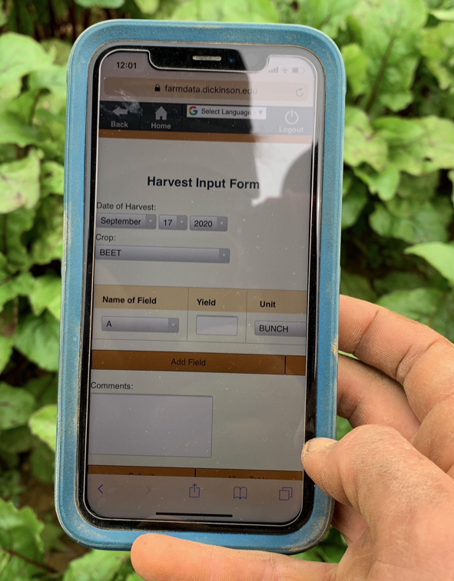

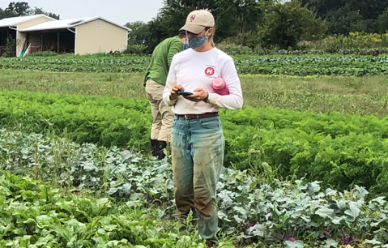
03 – JavaScript & Vue Data Binding Spike
COMP 290 – Dickinson College
Prof. Goble
Fall 2023

Slide 2
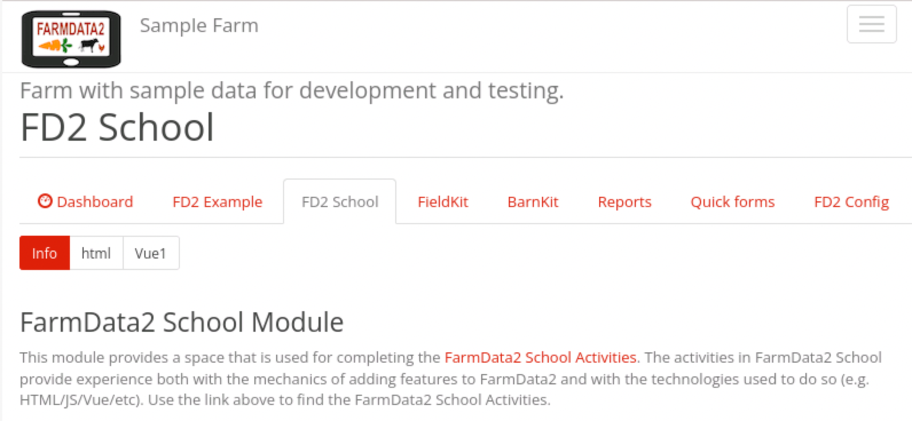
FD2School Activity Sub-tabs
Activities - Technology Spikes
02 - HTML
03 – JavaScript & Vue Data Binding
04 - Vue Events and JavaScript Functions
05 - Web APIs
06 – FarmData2 / farmOS API
07 - FarmData2 Patterns
08 - Cypress Testing
Notes:
HTML last time.
- Essentially how to place content on the page.
JavaScript and Vue Data Binding
- How to make that content dynamic
- Using the Vue.js framework.

Slide 3
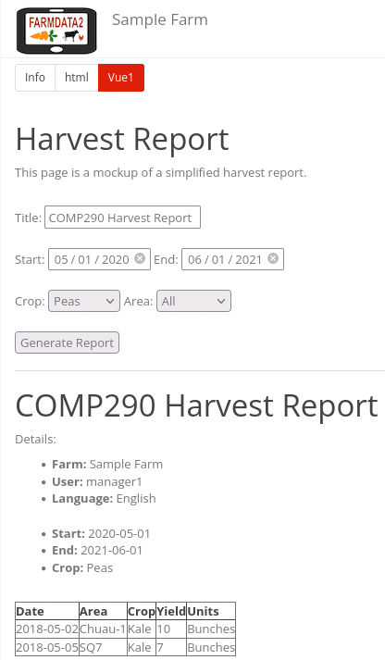
Demo What You Will Be Building
Notes:
Looks the same… but behaves differently.
- Title is linked
- Dates are linked – sort of…
- start and end are not coordinated.
- Crop is linked
- Other information is static
- Farm, User, Language are static (for now)
- Table is not yet dynamic.
But also what you can’t see…
- List of crops, list of fields, data in the table
- all produced by code from a JavaScript object rather than by hard coding in HTML
- One step closer to making the site live with real data

Slide 4
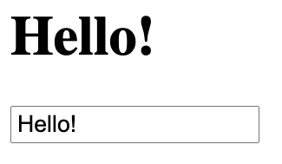
Demo A spike for your spike.
Notes:
A spike for your spike:
- You’ll try stuff in a really simple example outside of FarmData2
- Then apply it to your Harvest Report spike
- Sort of like if your Harvest Report Spike were the real project and this page is the spike.
Here the heading “Hello” uses Vue.js to
- Connect the contents of the text field to the heading.
- When the value in the text field changes…
- The value to the heading changes.
We’ll look at how that works as an example of the really big idea behind Vue.js.
- This is also very similar to what other JavaScript frameworks like React do as well.

Slide 5
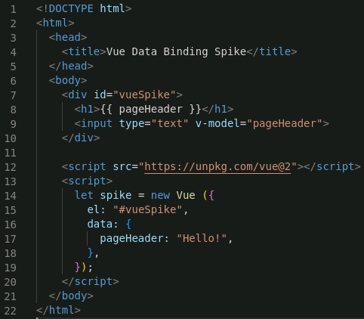
A Vue.js Page has 2 main parts.
A <div>
A <div> that specifies the rendered (i.e. visible) page.
<h1>
<input…>
A <script>
A <script> that contains JavaScript that is used by the <div>.
Vue instance
data object
Notes:
Anything you want to be visible within the page is contained within the <div>.
The code in the <div> and the <script> are then connected using Vue.js
- This allows for data and functions in the <script> to provide values that are displayed in the page.
- For example, the way the value in the text field appears as the heading <h1>
We’ll dig into how that works in the next several slides.

Slide 6
The <div> and the <script> must be connected
The value of the id attribute of the <div> element must match the value of the el property of the Vue instance in the <script>
id="vueSpike"
el: "#vueSpike"
Notes:
The value used here should be descriptive.
- I.e. Don’t use “viewSpike” for every id / el in all pages.
- Give your div an id that is descriptive of its purpose.
- E.g. “harvestReport”, ’#harvestReport’

Slide 7
Single vs Double Quotes
In HTML and JavaScript single or double quotes can be used for string values…
So the following would also work.
id='vueSpike'
el: '#vueSpike’
ProTip:
Be consistent with your use of ' and "
Notes:
We will try to use “ everywhere.
- Though when you get into FarmData2 you will see some inconsistency.
- those should eventually be fixed.

Slide 8
The Vue Instance is a JavaScript Object
The <script> creates an instance of the Vue class.
let spike = …
let defines a variable in JavaScript.
new Vue( … )
Creates an instance of the Vue class and invokes the constructor.
{ … }
Defines a JavaScript object.
Notes:
The keyword let defines a variable in JavaScript
- So, here the variable spike is a reference to an object of type Vue
- The class Vue is defined by the Vue.js library.
- Like in Java
- new Vue ( … );
- creates a new object of type Vue
- invokes the constructor to initialize that object.
The parameter to the constructor is another JavaScript object.
- The { } in JavaScript allow us to define an object.
- So this object is what is passed to the Vue constructor.
We’ll learn more about that JavaScript objects on the next slide.

Slide 9
JavaScript Objects
A JavaScript Object is made up of properties.
A property is a key/value pair.
A key is a name.
el
Each key has a value.
The value of el is "#vueSpike"
A : separates keys and values.
key/name
value
Notes:
A property is like a field in a a Java object.
It is also like a key value pair in a Map/HashMap in Java or a Dictionary in Python.
- The name is used to refer to the associated value.
Note that a property is often referred to by its key or name.
- So when we say ”the el property” we are referring to the the property with the name el.
- If we say the “value of the el property” we are referring to the string ‘#vuespike’ in this case.
- The phrase “the name of the el property” is a little redundant since the name is el.
Ask: What other properties are in the object that is passed to the Vue constructor?
Ask: What are their values.
These are clarified on the next slide.

Slide 10
JavaScript Objects
The value of the data property is another object.
The data object has a property named pageHeader.
The pageHeader property has the value "Hello!"
key/name
value
Notes:
What other properties are in this object passed to the Vue constructor?
- data
What is the value of the data property?
- It is another object.
What properties are in the data object?
- pageHeader
What is the value of the pageHeader property of the data object?
- ‘Hello!’

Slide 11
JavaScript Objects
Properties in a JavaScript object are separated by commas.
ProTip:
Include a comma after the final property in an object.
Notes:
There is a quirky convention in Vue-land where programmers include a comma after the final property in an object.
This isn’t required syntactically by the language.
However, it prevents you from forgetting to add that comma if/when you add another property to the object.
- This is one of those hear me now, believe me later things!
- When your page breaks and isn’t working, double check that you added a comma when you added a new property.

Slide 12
Vue Data Binding
Data binding connects HTML elements in the <div> with properties of the data object from the Vue instance in the <script>.
E.g. the pageHeader property of the data object is used in the <h1> and <input> elements.

Slide 13
Vue Data Binding: Double Moustache
The double moustache {{ … }} evaluates JavaScript using the Vue instance and substitutes the resulting value into the HTML.
E.g. the value of pageHeader is inserted as the content of the <h1> tag.
Notes:
This is why when the page is first loaded the <h1> heading shows “Hello!”
This is the big idea…
- If we change the value of the pageHeader the content of the <h1> also changes!
- The way this works is that Vue detects the change in pageHeader.
- Vue will then update the contents of the <h1> element
- The browser then updates the rendered page to display the new contents of the <h1> element.

Slide 14
Vue Data Binding: v-model
The v-model attribute binds a value in the HTML to a value in the Vue instance.
E.g. the value of in the input element is bound to the pageHeader property.
When two values are bound together, if one changes the other also changes.
Notes:
So here, if the value in the input element is changed
- Then Vue will change the value of pageHeader
- When the value of pageHeader is changed
- That is detected by Vue and it changes the contents of the <h1> element.
- When the contents of the <h1> element are changed
- The browser updates the rendered page to show the new value.
Conversely, if the value of pageHeader is changed
- Vue will detect that
- It will then update the value of the input element.
- Of course, it will also update the contents of the <h1> element as we saw before.
This becomes way more powerful once we start writing JavaScript code that changes properties in the data object.
- When that happens, Vue does the same thing
- If JavaScript code changes a value in the Vue Instance
- Vue detects that change
- It then updates
- The value of the input element
- The contents of the <h1> element
- The browser then renders the changed elements with their new content.
We won’t be doing this today.
- But we can see how it works using the DevTools.

Slide 15
DevTools & Vue DevTools
DevTools and the Vue DevTools are essential testing and debugging tools!
Demo!
Notes:
Open DevTools
- Go to console tab.
- Show spike object (type spike return, open object using little triangle)
- This is the Vue instance.
- So it has lots of stuff that Vue provides.
- If we scroll down we can find the data property
- Can open it and see our pageHeader property
- Can click on the >> an see its value as well.
We can also interact with our data more directly.
- type: spike._data.pageHeader to see the value.
- type: spike.$data.pageHeader – same value.
- type: spike.pageHeader – same value.
- multiple different ways to access the data.
We can also change the diata this way.
- type: spike.pageHeader = “new value”
- This will change the value in the data property
- Vue will notice that
- It will update the text field
- It will also update the <h1> element contents.
- The browser will re-render the page.
This is a hint at the power of Vue that I was talking about.
- If we modify the Vue Instance… the UI is automatically updated due to the data binding.
- The real power comes next week when we start using JavaScript to modify the Vue Instance rather than doing it by hand!

Slide 16
Getting the Vue Library
The Vue Library can be imported into a page using a <script> tag.
Notes:
The last part of the spike that we have not yet talked about is the other <script> element.
The <script> tag is generally used to include JavaScript code in a page.
- Like how we used it to create and use the Vue instance.
- It can be used to bring in an external library
- To do this we use the src attribute.
- This form of the <script> element is sort of like import in Java or in Python.
- This one pulls in the Vue.js library from an on-line (unpkg.com) site that serves libraries.
- The @2 means tell unpkg that we want version 2 of Vue.
- There is a version 3, which FarmData2 does not use.
- unpkg.com is sort of like docker hub for javascript libraries
You will need this in your spike outside of FarmData2
But you will not need it when you do your Harvest Report inside of FarmData2.
- The FarmData2/farmOS/Drupal system will ensure that you page has access to the Vue library.

Slide 17
What’s Next
Activity 03
Due next Friday 12:00pm
Start early
Okay to be productively lost
Avoid the “trying random things” time wasting trap
Ask questions about the activity in Zulip
Ask questions about your code specifically in Teams or Office hours.
No Reading Assignment This Week
Next week: Farm Visit
Depart from Kauffman Parking Lot at 1:30 sharp!

Slide 18

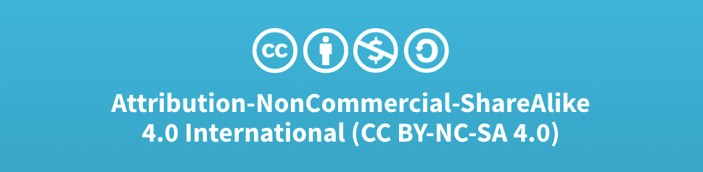
Acknowledgments:
Slide Template From:
https://creativecommons.org/licenses/by/4.0/
Slide Content Licensed as:
Creative Commons Attribution-NonCommercial-ShareAlike 4.0 International License.

