Slide 1

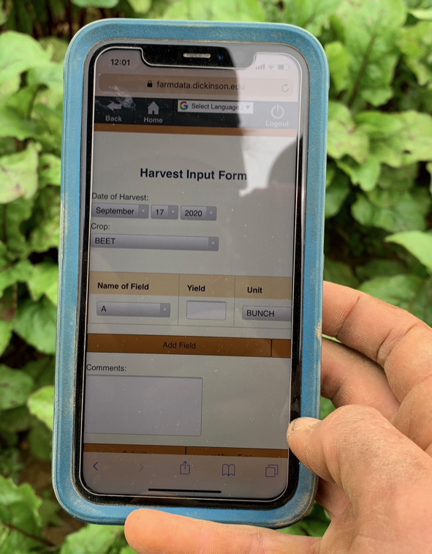

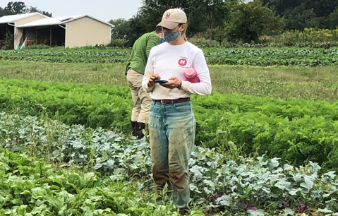
04 – Vue Events and JavaScript Functions Spike
COMP 290 – Dickinson College
Prof. Goble
Fall 2023

Slide 2
A03 Questions
What issues did you encounter?
How did you resolve them?
Any questions on:
HTML?
Vue Data Binding?
Basic JavaScript variables and objects?

Slide 3
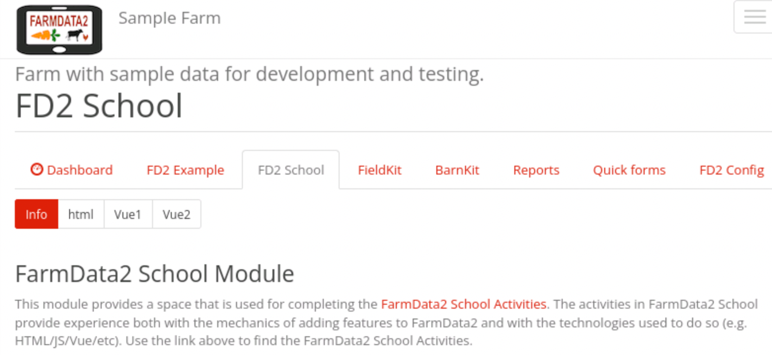
FD2School Activity Sub-tabs
Activities - Technology Spikes
02 - HTML
03 – JavaScript & Vue Data Binding
04 - Vue Events and JavaScript Functions
05 - Web APIs
06 – FarmData2 / farmOS API
07 - FarmData2 Patterns
08 - Cypress Testing
Notes:
HTML
- Essentially how to place content on the page.
JavaScript and Vue Data Binding
- How to make that content dynamic
- Using the Vue.js framework.
Vue Events and JavaScript Functions
- How to make code you write to run when the user does something
- I.e. When the user clicks a button.
- How to make the page more responsive and user friendly.
- This material:
- mostly drawn directly from the VueSchool videos
- if statements / functions / parameters that you have familiarity with from other course work.
- A lot of what you know about Java and python translates pretty easily to Javascript.
- So you’ll generalize that to JavaScript.

Slide 4
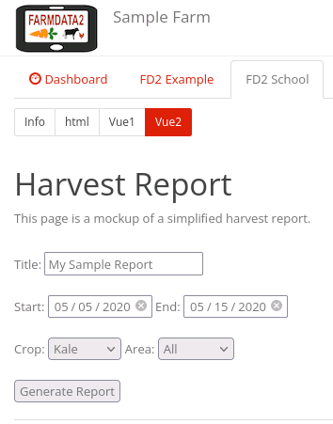
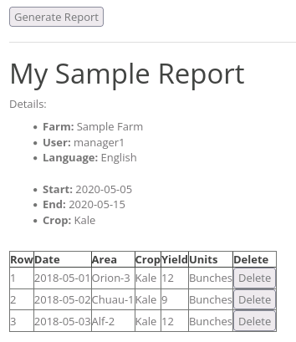
Demo: Becoming responsive to events!
Notes:
Looks mostly the same… but behaves differently.
Do the DEMO.
- Notice that the report does not appear initially.
- The dates cannot be set to illegal values
- e.g. start date cannot be set to after the end date or vice versa.
When we click Generate Report
- The report part of the page appears.
- but the report is blank with an appropriate message.
- The array of logs that you had now starts empty.
When we click Generate Report again …
- A row is added to the table
- When the button is clicked
- A JavaScript function is run.
- That function adds a log to the array in the data property of the Vue instance.
- the Vue Data binding then notices that the array has changed.
- the v-for that you have in your page then generates a row in the table.
- When the button is clicked again
- It adds another log to the array.
- This works 3 times.
Note that this data is still all hard coded in the page.
- Next week we begin to learn how to get live data.
Clicking a Delete button
- Removes the associated log from the array.
- The Vue notices that change
- The v-for in the page regenerates the table from the array.
- So the row no longer appears.
If we look at the Vue DevTools
- You can see the data property that controls visibility being changed on the first click
- Then you can see a log added to the array for the next 3 clicks.

Slide 5
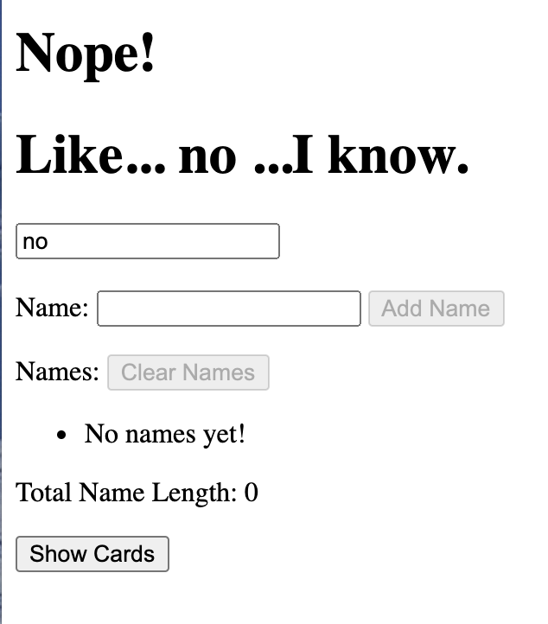
Demo: A spike for your spike.
Notes:
This page again will give you a chance to try out each of the things in a smaller context.
What you are asked to do is very closely related to the videos in VueSchool
- So if what you are asked to do doesn’t make sense
- watch the video again.
Then once you have a handle on the small example.
Generalize what you learn to add features to the FarmData2 spike

Slide 6
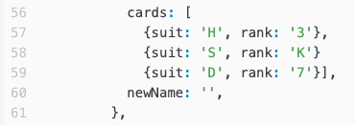
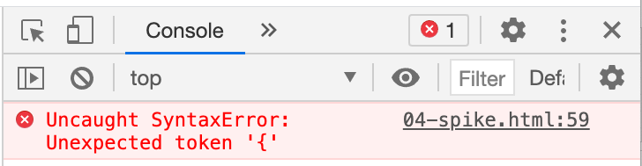
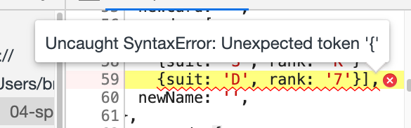
DEMO: Use the DevTools to Find Errors in your Code
Notes:
The DevTools are really helpful for finding errors in your code.
If your page does not appear when you reload it in the browser that typically means you have a syntax error of some type.
Open the DevTools Console and look for errors.
Clicking the link in the console will take you to the line in the code.
Hopefully from there you can see the mistake.
Here in this example, it was a missing ”,” after the King of Spades card.

Slide 7
Avoid the Trap:
There are no giant leaps … If you find yourself searching on-line for answers and trying things that don’t look at all familiar from the assignment or the videos… Stop… you are going in the wrong direction!
Reread assignment / Rewatch the video
Review the spikes
Reset and try again…
git restore --staged <file>
git restore <file>
git reset --soft HEAD~1
Notes:
git restore --staged <file>
- unstages a file that you have staged but not committed
- any local changes you have made to the file become unstaged changes again
git restore <file>
- restores a file to its state the last time it was committed.
- any local changes you had made to the file are discarded.
git reset --soft HEAD~1
- undo the most recent commit
- place the changes that were committed on the stage
- use git restore –staged <file> to unstage the changes if desired.

Slide 8
What’s Next
Activity 04
Due next Friday 1:30pm
Do the reading for next week and prepare something to say.

Slide 9

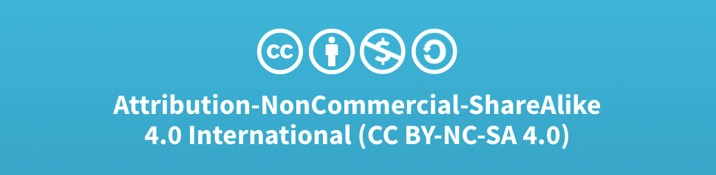
Acknowledgments:
Slide Template From:
https://creativecommons.org/licenses/by/4.0/
Slide Content Licensed as:
Creative Commons Attribution-NonCommercial-ShareAlike 4.0 International License.

