Slide 1



08 – FarmData2 Components Spike
COMP 290 – Dickinson College
Prof. Goble
Fall 2023

Slide 2
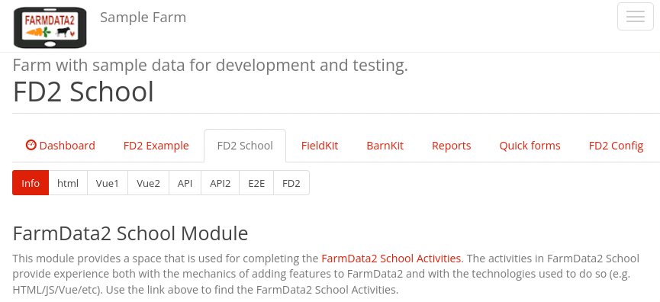
FD2School Activity Sub-tabs
Activities - Technology Spikes
02 - HTML
03 – JavaScript & Vue Data Binding
04 - Vue Events and JavaScript Functions
05 - Web APIs
06 – FarmData2 / farmOS API
07 - End-to-End Testing (Cypress)
08 - FarmData2 Components
Notes:
HTML
- Essentially how to place content on the page.
JavaScript and Vue Data Binding
- How to make that content dynamic
- Using the Vue.js framework.
Vue Events and JavaScript Functions
- How to make code you write to run when the user does something
- I.e. When the user clicks a button.
- How to make the page more responsive and user friendly.
Web API’s
- How to request data from a back-end database
- How to incorporate that data into the front-end user application.
FarmData2 / farmOS API
- How we will get data from farmOS / FarmData2
Cypress End-To-End Testing
- How we will write automated tests that support the application over time.
- Tests that can be run over and over again
- Protecting against unintentional change and the introduction of bugs.
FarmData2 Components
- A look at how we get from your Harvest Report to something that looks and feels more like a FD2 page.
- This will involve using some custom Vue Components that have been created for FarmData2.

Slide 3
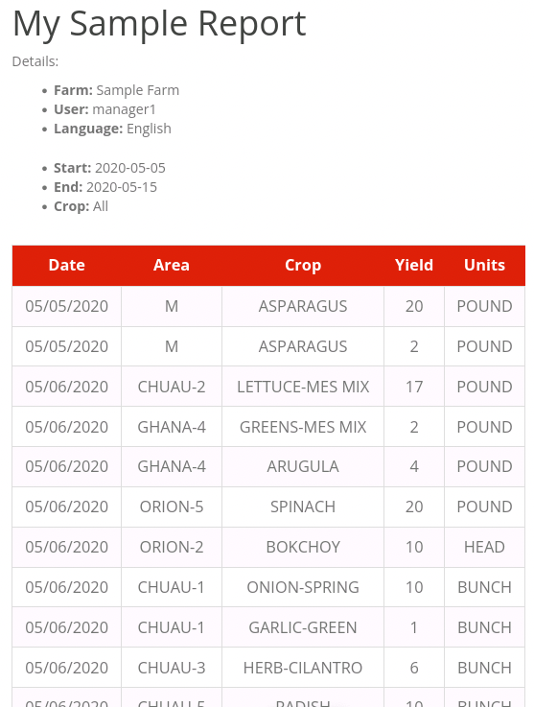
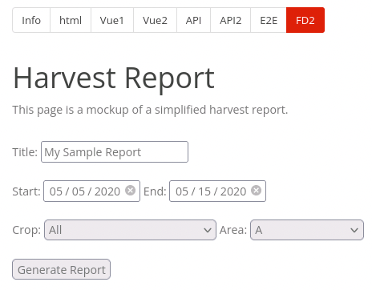
Demo
Notes:
Here:
- Crop dropdown now has an “All” option.
- You may have added that in a prior activity as an extra.
- It is a common thing to want in FD2 so there is a special component to do it.
- Table is formatted like a FD2 table.
- This is also done using a component.

Slide 4

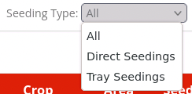
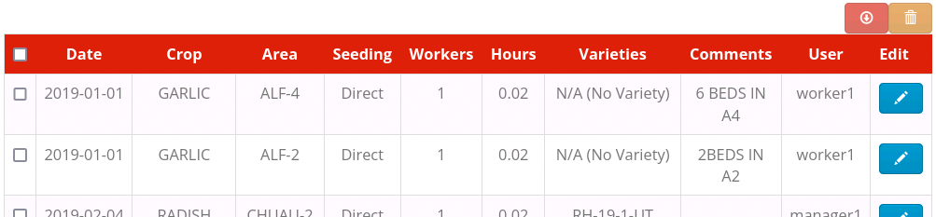
Vue Components
Vue Components provide a mechanism to create custom UI elements.
FarmData2 uses custom Vue Components to encapsulate capture common UI use patterns.
DateRangeSelectionComponent
DropdownWithAllComponent
CustomTableComponent
Notes:
DropdownWithAllComponent
- A dropdown that automatically includes All as the first element if requested.
- Includes the code to add that option.
- Used for most dropdowns in FD2 so that we can look at all crops, all areas, all seeding types, etc.
DateRangeSelectionComponent
- Allows collection of a start and an end date.
- Dates are coupled so start cannot come after end or vice versa.
- Includes the code that manages those constraints.
- Like what you did in your page, but this way that code doesn’t have to be repeated in every page.
CustomTableComponent
- Provides a consistent table appearance across pages
- Includes functionality for:
- Editing the data in a row (pencil icon)
- Deleting rows (trash icon)
- Downloading the table as CSV (down arrow icon)
There are a few others…
- DateSelectionComponent – just a single date.
- ErrorBannerComponent – consistent way to display error messages on a page.
- Has evolved to just be BannerComponent…
- Can display different kinds of messages, not just errors.
- But has not been merged into main yet.
- RegexInputComponent – allows only input that matches a particular pattern
- E.g. only integers, or only decimals, or whatever you need.
- User specifies the pattern.

Slide 5
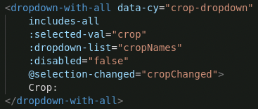
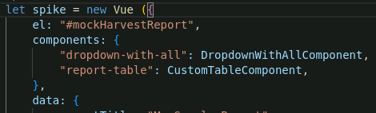
Vue Components
Custom Vue Components are added to pages by:
Assigning an HTML tag name to the component in the components property of the Vue instance.
Using that HTML tag in the page.

Slide 6
Vue Components
Pages interact with Vue Components via props (properties) and events.
Props are used by the page to configure and control the component.
Events are used by the component to signal changes and return information to the page.

Slide 7
Vue Component Props
Props can be bound to Vue properties.
data properties
computed properties
Boolean props
includes-all, disabled
Included → true
Omitted → false
Or use binding
:includes-all="true"
:disabled="cropEnabled"
Notes:
Some props are just for initialization.
- the value is set using the value of the bound variable at the moment the component is created in the page.
Other props are dynamic:
- So if the data to which the prop is bound changes, then the component will notice that change and adapt.
- For example in the DropdownWithAll component
- selected-val – if the value of crop is changed in the page, then the selected crop will change in the dropdown.
- dropdown-list – if the cropNames array is changed in the page, then the options in the dropdown will change.
- Changes to the includes-all prop do not affect the component after creation.
- It either has All or it does not.
Refer to the documentation if you need to know.

Slide 8

Vue Component Event Handlers
Vue Components emit events and have event handlers like other HTML elements.
Vue Events can have payload(s).
Payload(s) are passed to event handlers as parameter(s).
Notes:
The DropdownWithAllComponent emits the event ”selecton-changed” when the selected item changes.
Here the cropChanged function is assigned as the eent handler for the “selection-changed” event.
- Thus, the cropChanged function is called anytime the selected item is changed in the dropdown menu.
The cropChanged function has one parameter.
- This is because the “selection-changed” event has a payload.
- A payload is an argument that is passed to the event handler
In the case of the ”selection-changed” parameter
- The payload is a string that indicates the newly selected item.
- In this case, that’s the crop so the parameter was named newCrop.

Slide 9
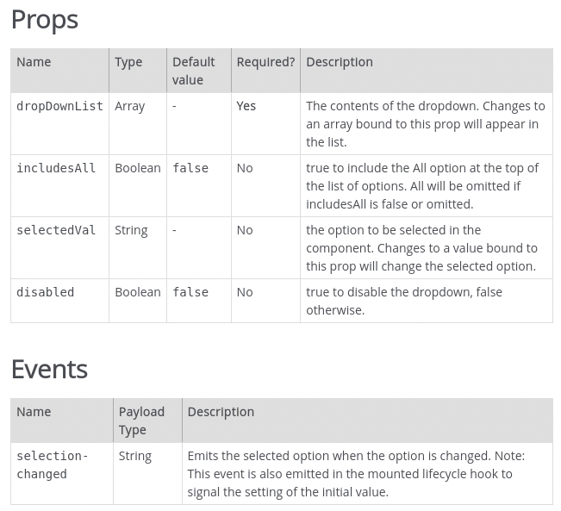
Vue Component Documentation
The FarmData2 documentation contains information about the Props and Events provided by each of the components.
Notes:
The documentation contains the information about what props and events a component provides.
Use the docs!

Slide 10
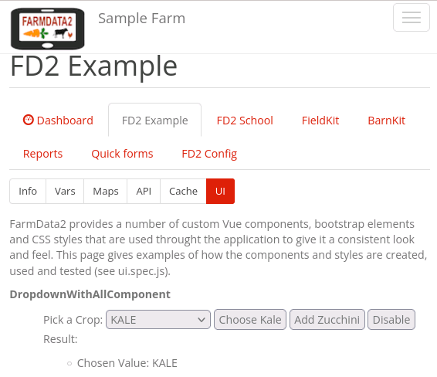
The FD2 Example Tab
The sub-tabs on the FD2 Example tab provide examples of how to do different things in FarmData2.
E.g. The UI sub-tab gives an example of using each of the custom Vue components.
Look at the associated .html files for the code.
Notes:
This is a resource you can use to find sample code that illustrates how to do things.
- in this activity you’ll use the UI sub-tab
- The API subtab is particularly useful when interacting with the database
- creating logs
- deleting logs
- modifying logs.

Slide 11
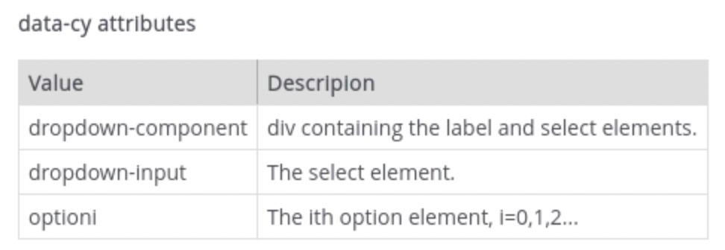
Vue Components and data-cy
Each component has data-cy attributes to facilitate testing pages with components.
cy.get("[data-cy=option0]").should("have.text","All")
cy.get("[data-cy=crop-dropdown] > [data-cy=dropdown-input] >
[data-cy=option0]").should("have.text","All")
Notes:
If there is one DropdownWithAllComponent
- Then [data-cy=option0] uniquely identifies the first option in the component.
But each DropDownWithAllComponent will have the same data-cy attributes.
- Thus, if there are multiple DropDownWithAllComponents then we need to be more specific.
- We start with the component itself.
- [data-cy=crop-dropdown]
- For example, you would need to change this to whatever data-cy value to assigned to the component in your page
- Then within that component we get the element with [data-cy=dropdown-input]
- This is the <select> element.
- Then inside the select element we get the element with [data-cy=option0]
- This is the <option> element containing the name of the crop.
This can get tricky to get correct.
- Sometimes you have to go look at the code in the component itself to understand the structure enough to get it right.
- Not ideal. But we try to minimize it.

Slide 12
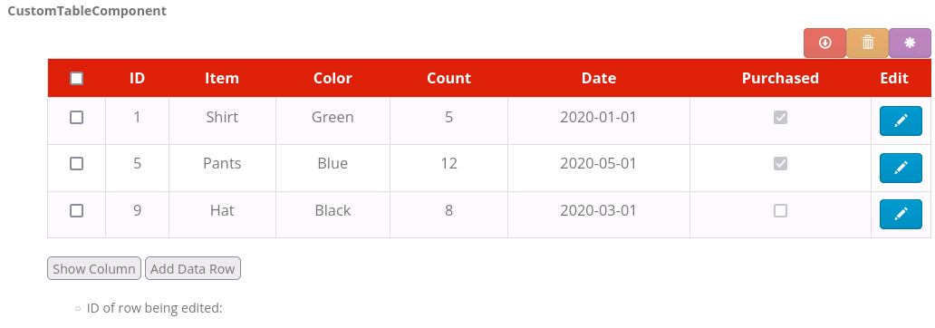
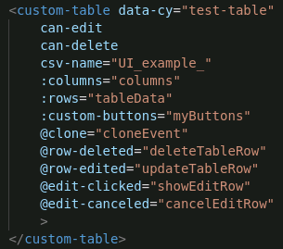
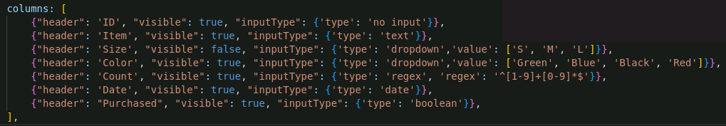
The CustomTableComponent (Columns)
Notes:
There is a lot to the CustomTableComponent…
- The important stuff for this assignment is really just understanding how to specify the columns and rows.
- This slide shows the CustomTableComponent example from the UI sub-tab in the FD2 Example tab.
The columns prop is bound to an array named columns in the Vue instance data.
The columns array specifies each of the columns.
- there is one object in the array for each column.
- In that object the properties are
- header – the text that appears at the top of the column.
- visible – indicates if the column is visible in the table.
- allows columns to be shown and hidden.
- inputType – provides information about how the value in the column is displayed and edited if the edit button is clicked.
- we won’t be too worried about this in this activity.

Slide 13
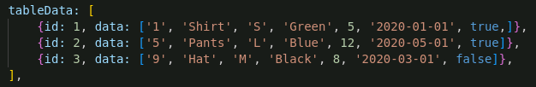
The CustomTableComponent (Rows)
Notes:
There is a lot to the CustomTableComponent…
- The important stuff for this assignment is really just understanding how to specify the columns and rows.
- This slide shows the CustomTableComponent example from the UI sub-tab in the FD2 Example tab.
The row prop is bound to an array named tableData in the Vue instance data.
- there is one object in the array for each row of the table.
- The properties in the object are:
- id: an identifier for the row.
- This is used to map from the table row, back to the data in the page that generated it.
- useful for editing and deleting rows.
- data: An array containing the data for the row.
- One array entry for each column in the table.

Slide 14
What’s Next
Activity 08
Due next Friday at 1:30pm
Reading and prepare for discussion.

Slide 15

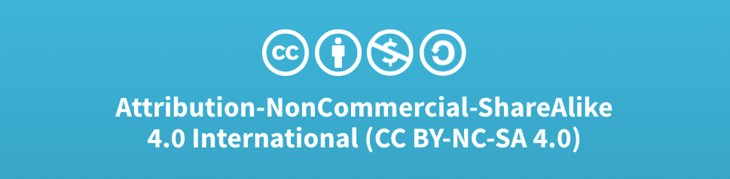
Acknowledgments:
Slide Template From:
https://creativecommons.org/licenses/by/4.0/
Slide Content Licensed as:
Creative Commons Attribution-NonCommercial-ShareAlike 4.0 International License.

