Slide 1
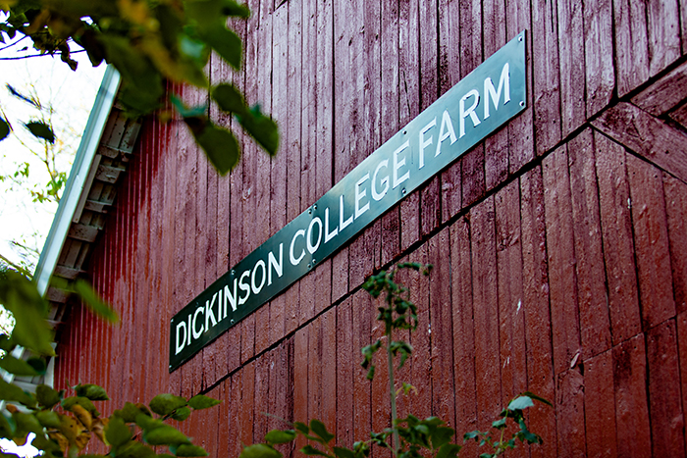
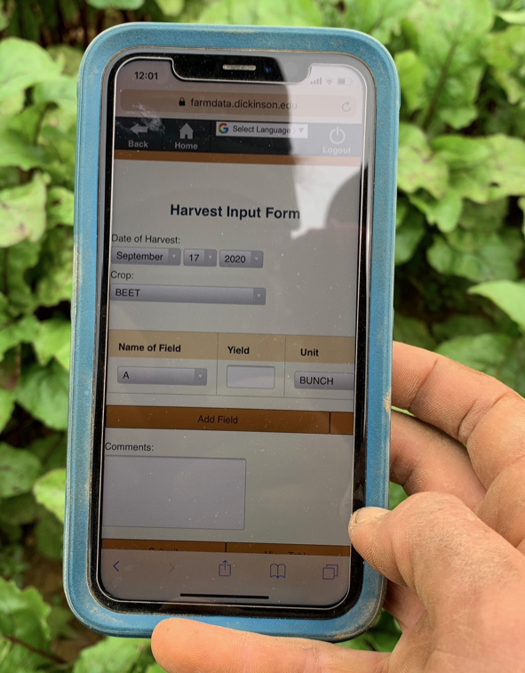
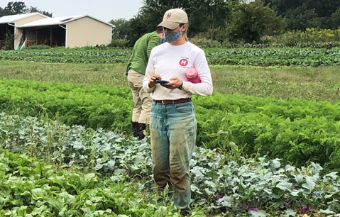
02 – HTML Technology Spike
COMP 290 – Dickinson College
Prof. Braught
Spring 2023

Slide 2


FarmData2 Technology Stack
farmOS is a free and open-source web-based application for farm management, planning, and record keeping. It aims to provide a standard platform for agricultural data collection and management.
Drupal is a highly customizable free and open-source web content management system. It provides user account registration and maintenance, menu management, taxonomy, and system administration.
Notes:
FarmData2 is built as a set of ”modules” that plug into farmOS and farmOS is built using Drupal.
farmOS
- is a FOSS project
- provides a set of tools for farm management, planning and record keeping.
- Is general purpose and can be used in a wide range of applications.
- all different kinds of farms
- all different types of work processes
- very flexible
- Called “unopinionated” in tech talk.
- does not impose a particular style or way of working.
- great because it allows you to work your way.
- but also makes it more complicated and harder to use
- Because it is trying to be all things to all people.
Drupal
- Is a FOSS web content management system.
- It makes it easy to build systems with
- User accounts and menus
- Highly customizable
- Taxonomies – terms that have meaning in an application.
- E.g. Farming – field names, crop names, equipment names.
- Ensures data consistency.
- Provides a base on which farmOS can build so that it doesn’t have to create those things from scratch.
FarmData
- FarmData builds on farmOS for similar reasons…
- It does not have to define many of the things that are needed to manage data about farms.
- It focus just on adding modules to farmOS for its purpose.
- Its purpose is to support small organic vegetable farmers
- intended to directly support the way they work and the information they need.
- Called “opinionated” in tech talk
- Imposes a style or way of working
- But makes it easier and faster
- Great if that style fits you.

Slide 3
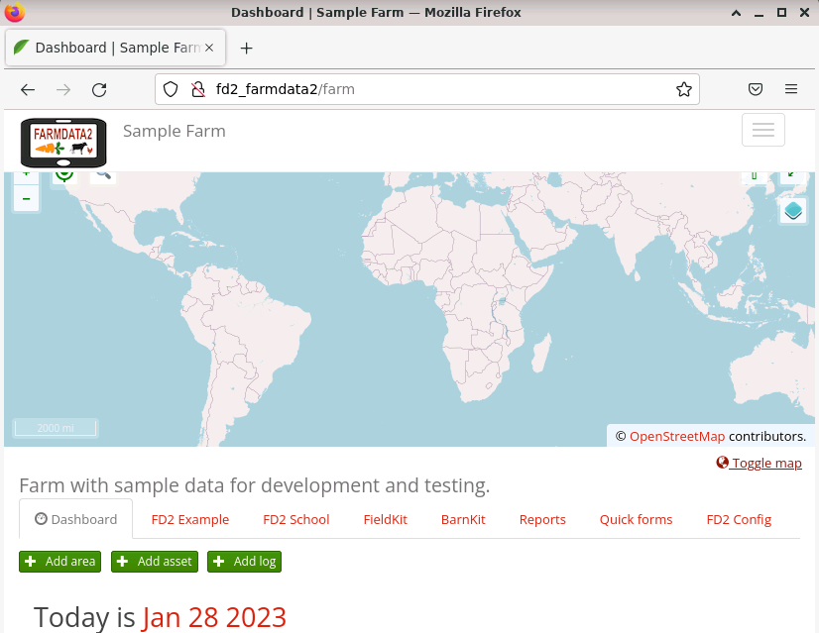
FarmData2 Tabs in FarmOS
Notes:
As you have seen the FarmData2 features appear within ”Tabs” in farmOS.
- The rest of the functionality that exists is provided by farmOS
- FarmData2 just plugs in these new features.
The activities that you’ll be doing will be working within these FarmData2 Tabs.

Slide 4
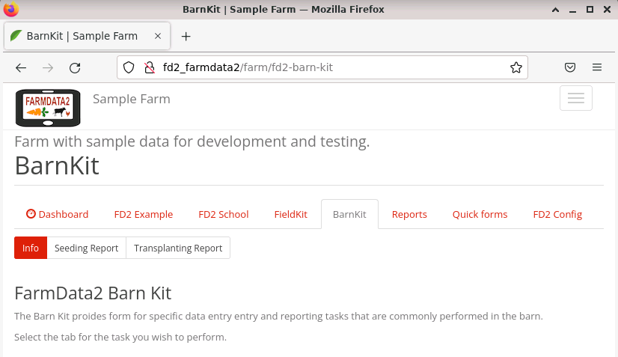
FarmData2 Sub-tabs
Notes:
Each FarmData2 tab has sub-tabs that provide individual functions.
Here the BarnKit tab contains sub-tabs for
- The Seeding Report
- The Transplanting Report
In each of the activities you do you will
- Build a sub-tab in the FD2School Tab
- Each one will introduce you to one of the technologies that you need to know to work on FarmData2

Slide 5
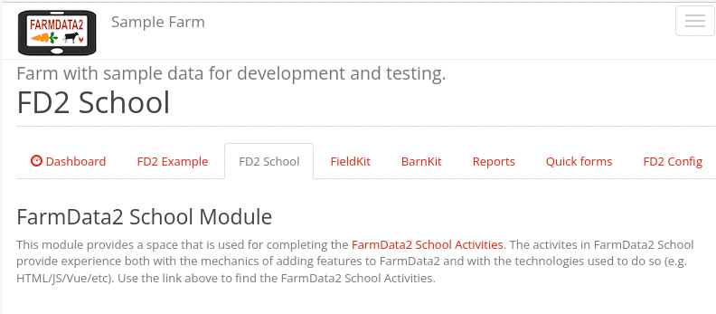
FD2School Activity Sub-tabs
Activities - Technology Spikes
02 - HTML
03 – JavaScript & Vue Data Binding
04 - Vue Events and JavaScript Functions
05 - Web APIs
06 – FarmData2 / farmOS API
07 - FarmData2 Patterns
08 - Cypress Testing
Notes:
HTML – page content
Vue Data Binding – how to make page rendering responsive to program data.
Vue Events and JS functions – how to use JS and event handlers to make page responsive to user action.
Web API – general topic on how to bring data from a database into a page
FarmData2 / farmOS API – how to work specifically with the Web API for FarmData2.
FarmData2 Patterns – how to go from the basic pages you have created in prior activities to ones that look like full FarmData2 features
Cypress Testing – how to create automated tests that check that pages are working correctly.
- super important as many people are changing parts of the program.

Slide 6
Activities as Technology Spikes
A Technology Spike is an Agile Software Development technique where time is set aside to learn new technologies, experiment with a new tool, language, library, and/or evaluate alternative approaches.
Has minimum essential functionality
Keep it simple & focused
Kept separate from the project
Don’t let experimental code leak into the project.
Trash it and write it clean.
Notes:
We will read more about Agile Software Development as we go along.
When a team runs into a part of the project where they are unsure how to proceed they will often perform a spike.
- A spike is a basic example that has the minimum essential properties of the project.
The spike will let them figure out how to do new things, evaluate different approaches, better understand a technology
It is kept separate from the project so that experimental stuff doesn’t leak into the project
- You often do things wrong and make a change and tinker with it while you are learning.
- Often that leaves a residue in the program
- Probably not that big a deal in a course assignment.
- But not something we really want in production code.
Keeping the spike separate from production code helps keep the project clean
- Step aside, experiment, learn
- Then once you have a handle on how to do it go back to the project.
- Write it clean from scratch.

Slide 7
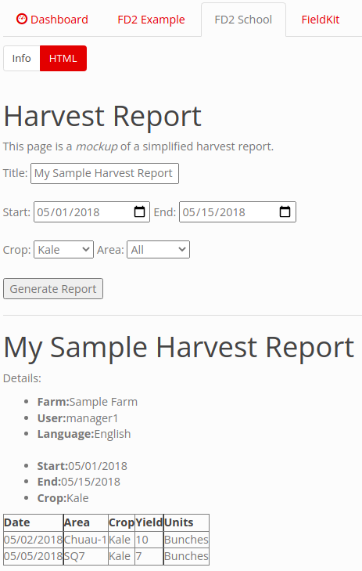
02 - HTML Technology Spike
Notes:
Over the course of this activity you’ll build a page that looks approximately like this.
- This page will be static at this point.
- It won’t do anything
- But you’ll learn how to
- create these elements
- organize them on the page
Later activities will have you:
- Make them active
- Connect them to real data
- Style them to match FarmData2
- Create automated tests that ensure that the page works correctly

Slide 8
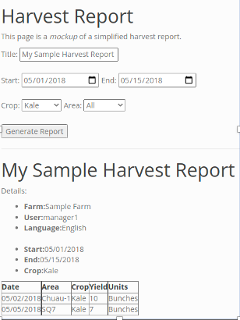
HTML
Basic HTML
HTML Forms
HTML Tables
Notes:
Basic HTML
- text, headings, boldface, lists, etc…
HTML Forms
- input elements
- text, dates, dropdowns, buttons
HTML Tables
- Rows, columns and headers

Slide 9
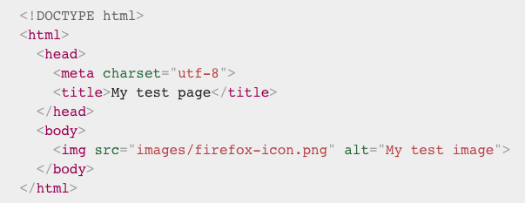
HTML in 1 Minute:
Notes:
Tags
Content
Attributes
That’s about it

Slide 10
Using Feature Branches
Each activity will be done on a feature branch that begins from the end of the prior activity.
main
02-HTML
RULE: Only commit to feature branches. Maintainers will merge accepted changes into the main branch.
03-VUE
04-JS
Notes:
The activities each build on the prior one.
So you’ll make a new feature branch from the end of your prior feature branch for each activity.
The activities will each remind you to make that feature branch and will give you a name for that branch.

Slide 11
Making Commits
Each activity will ask you to make multiple commits to your feature branch.
Commit: Each commit describes a set of changes for a “nameable unit of work”.
The changes made.
Who made them.
When they were made.
A short commit message
Describes the changes and their purpose.
A unique identifier (hash).
Use descriptive commit messages.
”Added the HTML subtab to the FD2School tab”
“Added sample harvest report to HTML sub-tab”
Etc..
Notes:
This models the way that developers tend to work
They work on a particular task which can be broken into sub-tasks.
When a “nameable sub-task” is complete, it becomes a commit with a useful description.
Then there are often many commits that collectively achieve the task.
The activities are structured that way as well.
As you may recall, git and GitHub allow you to look at the repo at any commit.
So, this also lets the instructor look at your repository at each point along the way.

Slide 12
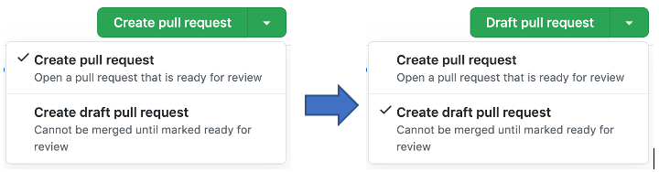
Draft Pull Requests
Like a pull request, but for code not ready to be merged into the upstream yet.
We will use these so that the instructor can see and run your work by pulling your branches from the upstream.
Projects use them when someone starts working on a feature that will require time / discussion / review.
Notes:
Convert to PR at end of assignment
- to indicate that it is complete
- and ready for review.

Slide 13
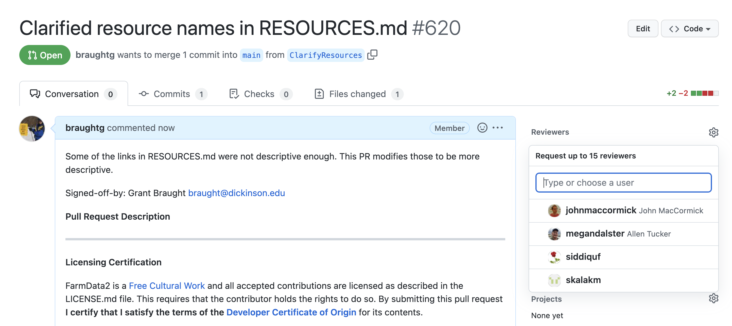
Requesting Reviews
When you make a pull request to a project it will be reviewed by a maintainer before it is merged into the main branch.
Notes:
Some projects will use formal requests for reviews to assign particular maintainers to review particular PRs.
For this class you will formally turn in the work that you’ve done on your feature branch by requesting a review by your instructor.

Slide 14
What’s Next
Activity 02
Due next Wednesday 12:00pm
Reading Assignment
Have one thing you found interesting, a question, or a thought on the article ready to raise for discussion in class.

Slide 15

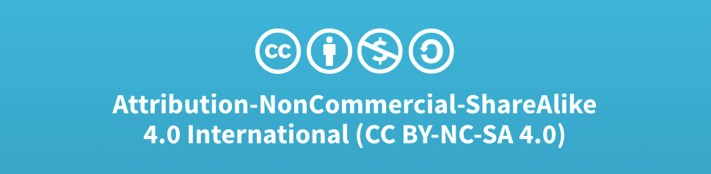
Acknowledgments:
Slide Template From:
https://creativecommons.org/licenses/by/4.0/
Slide Content Licensed as:
Creative Commons Attribution-NonCommercial-ShareAlike 4.0 International License.

