Slide 1

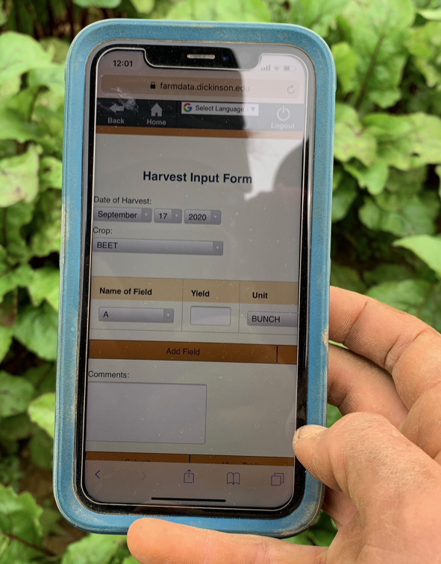
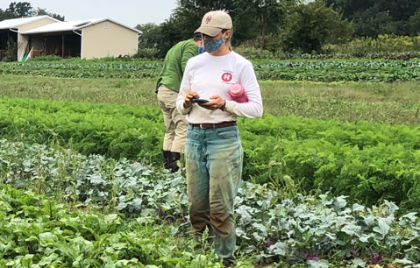
05 – Web APIs and Axios Library Spike
COMP 290 – Dickinson College
Prof. Braught
Spring 2023

Slide 2
A04 Questions
What issues did you encounter?
How did you resolve them?
Any questions on:
Vue Events?
JavaScript?

Slide 3
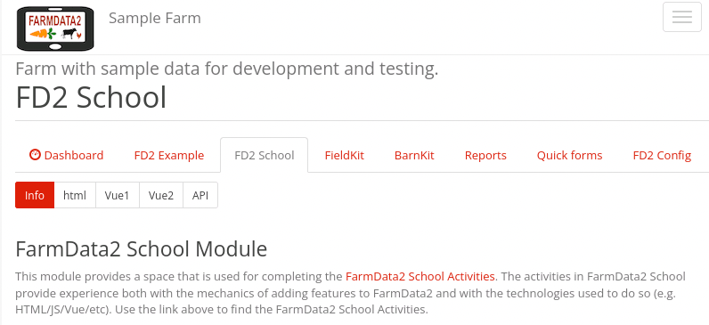
FD2School Activity Sub-tabs
Activities - Technology Spikes
02 - HTML
03 – JavaScript & Vue Data Binding
04 - Vue Events and JavaScript Functions
05 - Web APIs
06 – FarmData2 / farmOS API
07 - FarmData2 Patterns
08 - Cypress Testing
Notes:
HTML
- Essentially how to place content on the page.
JavaScript and Vue Data Binding
- How to make that content dynamic
- Using the Vue.js framework.
Vue Events and JavaScript Functions
- How to make code you write to run when the user does something
- I.e. When the user clicks a button.
- How to make the page more responsive and user friendly.
Web API’s
- How to request data from a back-end database
- How to incorporate that data into the front-end user application.

Slide 4
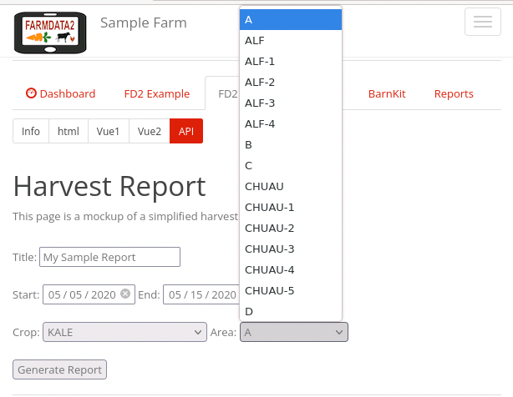
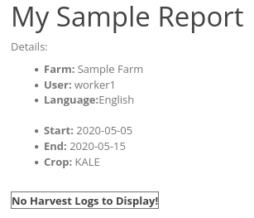
Demo: Getting some real data
Notes:
Pretty much like last time…
- But the list of crops and areas are populated from the database
- Some of the information in the report comes from the database too
- Farm Name
- Username
- Language
We will be learning
- how to request that information from the database
- how to integrate it into our pages using Vue

Slide 5
Web APIs
A Web Application Programming Interface (API) allows client-side code to access and manipulate server-side resources through a well-defined set of API endpoints (i.e. URLs).

Slide 6
REST APIs
REST – Representational State Transfer
Set of API design conventions.
Fast and Lightweight
Runs over HTTP (Hypertext Transfer Protocol)
Stateless
Cacheable

Slide 7
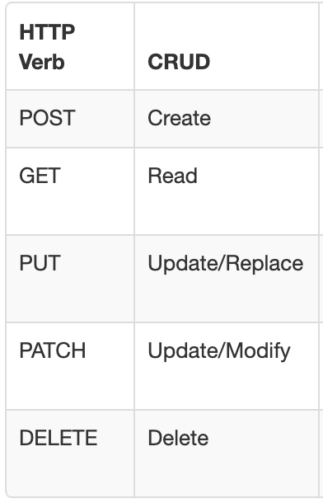
HTTP Request Methods:
The HTTP provides request methods that are used to build REST API’s.
CRUD – alternative formulation of operations in a non-protocol specific way.
Notes:
https://restfulapi.net/http-methods/

Slide 8
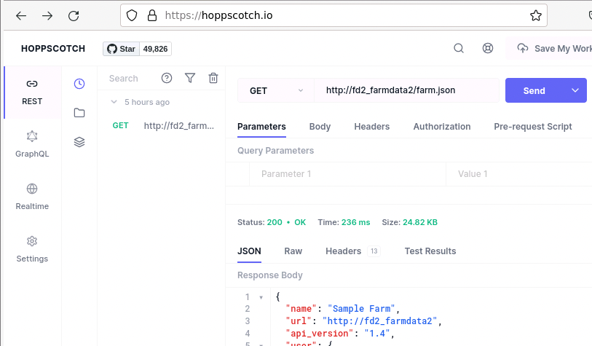
Demo Hoppscotch w/ farmOS API
The Hoppscotch Application
﻿https://hoppscotch.io
The /farm.json endpoint
GET http://fd2_farmdata2/farm.json
Notes:
Convenient way to examine and test API responses.
Recall FarmData2 is built on farmOS
farmOS manages the data about crops, areas, and plantings and harvests, etc.
FarmData2 accesses the data in farmOS via the farmOS API

Slide 9
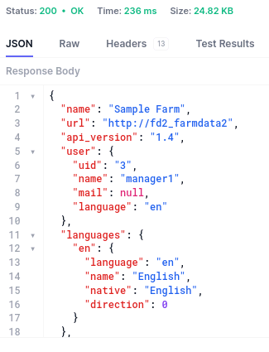
JSON Responses:
The /farm.json Endpoint
Responses from the farmOS API are in JavaScript Object Notation (JSON).
Use dot notation to reference properties in the response:
name
user.name
languages.en.name

Slide 10
The Axios Library
axios.get('api/endpoint/goes/here') // this line sends the request.
.then((response) => {
// Block A:
// Code here executes when the response is received.
// response is an Object created from the “Response Body” JSON.
})
.catch((error) => {
// Block B:
// Code here executes if an error occurs processing the request.
// error is an Object describing the error that occurred.
})
// Block C:
// Code here runs immediately after the request is sent,
// which will be before the code in then() or catch(),
// and before the response is received.
Axios is the JavaScript library that FarmData2 uses to make and process API requests.
Notes:
Idea of asynchronous processing here.

Slide 11
The Axios response Object:
Axios wraps the JSON API response (i.e. what you see in Hoppscotch) in the data property of the response object
So, to access an element of the JSON response you need to use:
response.data.name
response.data.user.name
response.data.languages.en.name
Notes:
Just what we saw earlier
- But because we are getting the data from Axios
- It wraps the JSON in the data property inside the response object.
- So just use response.data before whatever else you would have used.

Slide 12
Vue Lifecycle Hooks
Lifecycle hooks are methods that are run as a Vue instance enters or leaves different states.
created
mounted
updated
destroyed
…
let spike = new Vue ({
el: '#axiosspike’,
data: { …
},
created() { …
<initialization code>
},
methods: { …
},
});

Slide 13
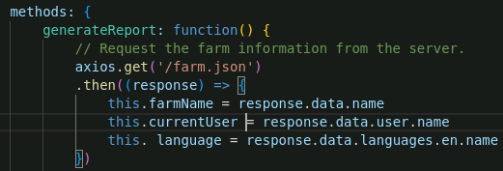
Remember this…
Don’t forget this.
I’ll bet you forget this!
Notes:
When you are accessing properties in data in any of the code in the Vue instance
- In the methods, life-cycle hooks, or computed properties
- you need to use this in order to access the property
- e.g. this.farmName where farmName is a property defined in the data object.

Slide 14
What’s Next
Activity 05
Due next Wednesday 12:00pm
Prepare for discussion of the posted reading.

Slide 15

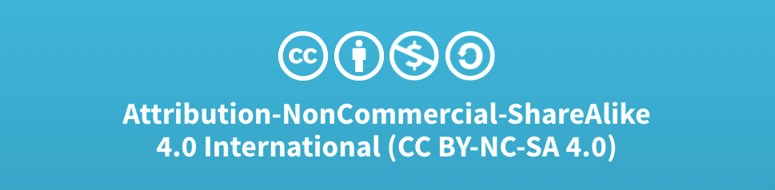
Acknowledgments:
Slide Template From:
https://creativecommons.org/licenses/by/4.0/
Slide Content Licensed as:
Creative Commons Attribution-NonCommercial-ShareAlike 4.0 International License.

Slide 16
Summer Openings!!!
Two 8-week summer positions
FarmData2 Development
Includes stipend and (hopefully) room and board.
First preference will be for 190/290 students
Look for announcement in the next week.

