Slide 1


07 – Cypress End-2-End Testing Spike
COMP 290 – Dickinson College
Prof. Braught
Spring 2023

Slide 2
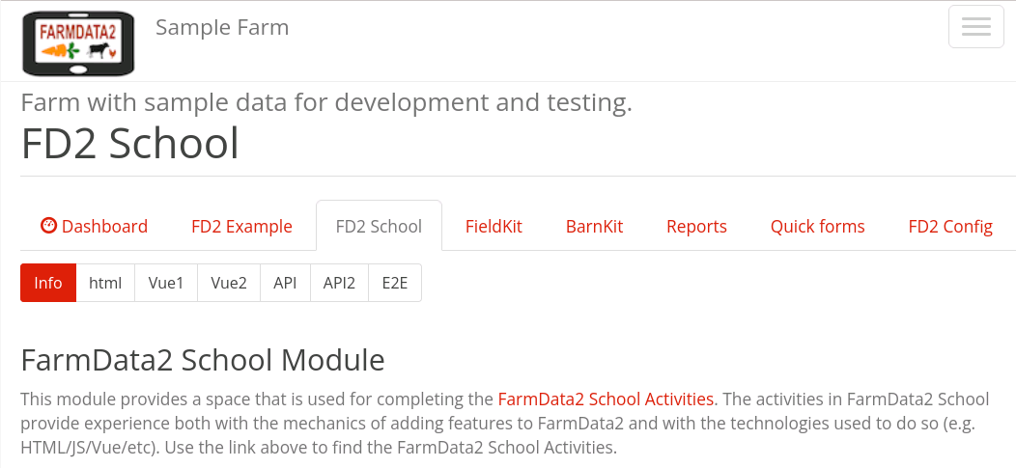
FD2School Activity Sub-tabs
Activities - Technology Spikes
02 - HTML
03 – JavaScript & Vue Data Binding
04 - Vue Events and JavaScript Functions
05 - Web APIs
06 – FarmData2 / farmOS API
07 - End-to-End Testing (Cypress)
08 - FarmData2 Patterns
Notes:
HTML
- Essentially how to place content on the page.
JavaScript and Vue Data Binding
- How to make that content dynamic
- Using the Vue.js framework.
Vue Events and JavaScript Functions
- How to make code you write to run when the user does something
- I.e. When the user clicks a button.
- How to make the page more responsive and user friendly.
Web API’s
- How to request data from a back-end database
- How to incorporate that data into the front-end user application.
FarmData2 / farmOS API
- How we will get data from farmOS / FarmData2
Cypress End-To-End Testing
- How we will write automated tests that support the application over time.
- Tests that can be run over and over again
- Protecting against unintentional change and the introduction of bugs.

Slide 3
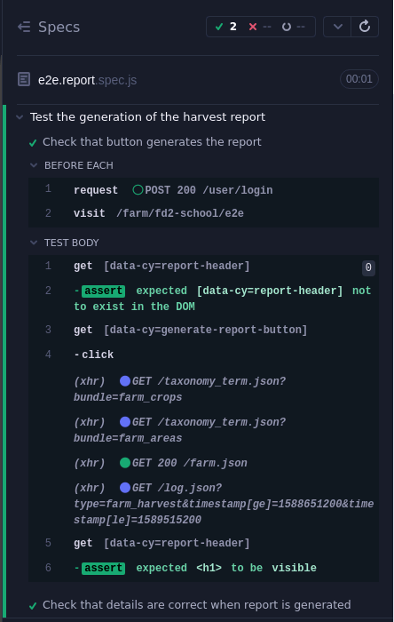
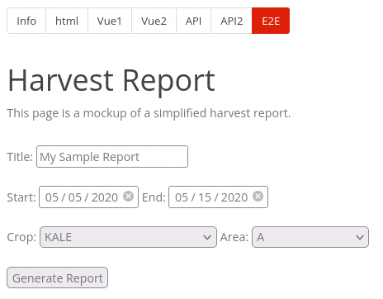
Demo
Notes:
Demo of Cypress tests running.
- Run the e2e.generate.spec.js tests
- Hard to see it but it is clicking the generate report button
- But can go to the steps
- Point at the “get” – show highlight in the browser pane of cypress.
- Point at the ”click” – show before and after views
- Show the assert statements…
- Header doesn’t exist before click
- Header is visible after click
- Simulating use of the application
- automated verification that it behaves as expected.

Slide 4
Testing
Manual Testing
Done by hand, often by a developer as code is written to check that it is working as expected.
Slow and tedious to repeat.
Automated Testing
Done by a program/script that executes other code or emulates a user to and check that the code or application behaves as expected.
Fast and simple to repeat.
Notes:
Easy misconception…
- That automated tests are written to check if the software works.
- Really they are to check that it “still works” weeks or months or years later.
- Or they are there to detect unintentional breaking changes.
- So they are not for you as a developer…
- They are for developers that come after you!
- They may cost you time to write…
- But they will be used in lieu of your manual testing by many developers
- So in some sense they can be thought of as saving massive amounts of time for the project.
- In reality no one would actually do all that manual testing over and over again.
- So it would be more accurate to say that they make it possible to actually do the checks over and over again.

Slide 5
Automated Testing in FarmData2
Unit Tests
Testing of components and functions in isolation.
Verify behavior of the component or function independent of the application.
E.g. getCropToIDMap, getAllPages
End-To-End Test
Testing that tabs/sub-tabs behave correctly.
Verify correct behavior of (aspects of) the application.
Simulate user actions and ensure that correct page contents or database changes are produced.
E.g. Report is generated and has correct date range.
Notes:
We’ll be focusing on End-To-End tests in this activity.
And then later in some of the project work.

Slide 6
FarmData2 End-To-End (E2E) Tests in Cypress
Typically 4 (or sometimes 3 or sometimes more) steps:
Log in as the appropriate user
guest, worker, manager admin
Visit the FarmData2 page to be tested.
Simulate user interaction
Get element(s) on the page
Interact with element(s)
Verify correct behavior
Get element(s) on the page
Make assertions about the elements.
Notes:
Step 3 may be omitted if we are just checking a page’s initial contents
Step 3 and/or 4 may be repeated multiple times if there is a complex operation being tested.

Slide 7
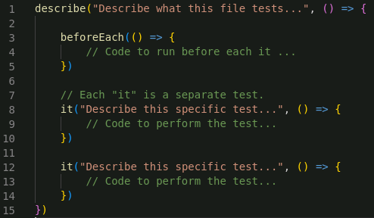
Cypress Spec (Test) Files
Notes:
Made up of describe, beforeEach (optional) and it (multiple)
- Describe is a collection of tests.
- Each test is an “it”
- beforeEach can contain code that runs before each of the individual tests
- Helps to reduce repeated code
- very often things like logging into the system
- visiting a specific page that is being tested by all of the tests in this file.
Notice that:
- describe is a function that is called with
- a descriptive string
- an anonymous function that contains everything else.
- before each is a function that is called with
- an anonymous function that contains the code to run before each test.
- each it is a function that is called with
- a descriptive string
- an anonymous function that contains the test code.

Slide 8
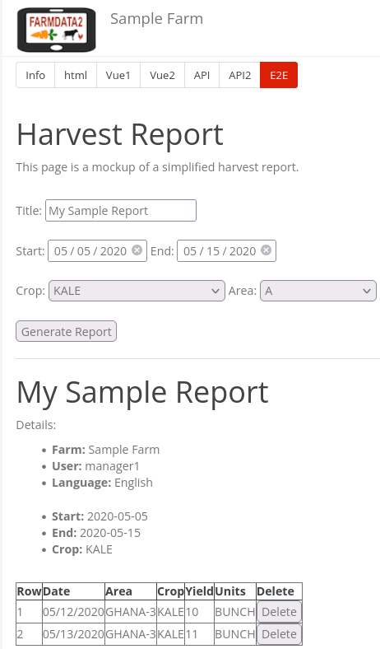
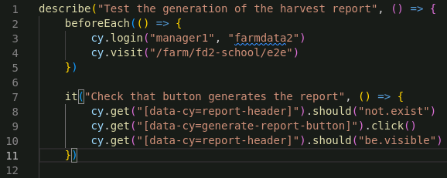
A Sample Spec
Notes:
This is the spec from the earlier demo.
- Don’t get too wrapped up in the precise syntax here.
- Get a feel for how the test flows…
The describe...
- Describes the overall goal of the test
- Encapsulates the content of the test
The before each…
- Logs in to FarmData2 as manager1 with password farmdata2
- visits the e2e page
cy is an object provided by Cypress
- It contains all of the useful test functions.
The it contains the test code…
- Gets the report header element and states that it should not exist.
- this is the header that appears in the report at the bottom of the page
- it does not exist until the button is clicked
- recall that this was controlled by a v-if in your code.
- gets the generate report button and clicks it.
- that will generate the report and make it appear.
- gets the header again and says that it should be visible.
- which it should be now because the report has been generated.

Slide 9
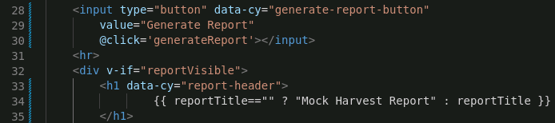
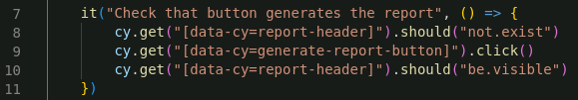
Getting HTML Elements using a data-cy Attribute
Adding a data-cy attribute to HTML elements makes them easy to use in Cypress tests via the cy.get function.
Notes:
When a data-cy attribute is added to an HTML element
- it can be used in the cy.get function to easily get that element.
The <h1> element holding the header
- has the data-cy attribute with the value report-header
- is used in cy.get in line 8 of the test to get that element.
- so that we can say that it should not exist yet on line 10
- and is used again on line 10 of the test to get that element again
- so that we can say that now it should be visible.
The input button
- has the data-cy attribute with the value generate-report-button
- is used in line 9 of the test to get the button
- so that we can click on it.
All testing in FarmData2 uses data-cy attributes to get the target elements.

Slide 10
Assertions and Actions
An assertion makes a statement about an HTML element that must be true for the test to pass.
The Cyprsss should function is used to make assertions about HTML elements.
.should(“not.exist”)
.should(“be.visible”)
.should(“have.text”)
An action simulates some user interaction with an HTML element.
Cypress provides functions for performing operations on HTML elements.
.click()
.type(“Hello World”)
Notes:
There are lots of different assertions that can be made.
There are lots of different actions that can be done.
You’ll get some experience with others in the assignment.

Slide 11
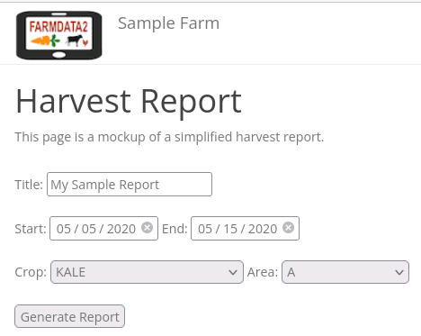
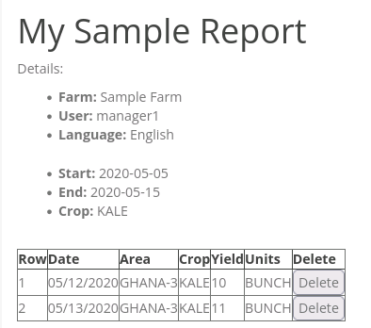
What Might We Test?

Slide 12
What’s Next
Activity 07
Due Wednesday after break at noon.
Reading and prepare for discussion.

Slide 13

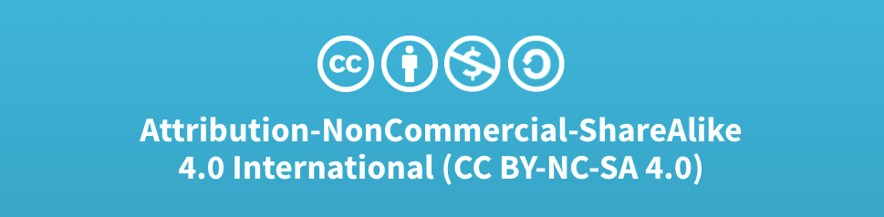
Acknowledgments:
Slide Template From:
https://creativecommons.org/licenses/by/4.0/
Slide Content Licensed as:
Creative Commons Attribution-NonCommercial-ShareAlike 4.0 International License.

