Slide 1
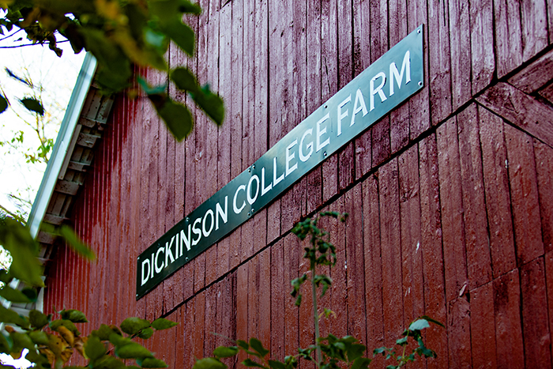


09 – FarmData2 Project Work
COMP 290 – Dickinson College
Prof. Goble
Fall 2023

Slide 2
Activities and Deliverables
Project work will be assessed based on the following activities and deliverables:
FarmData2 Contributions
Team Meetings
WiD Assignment
Final Team Presentation
Notes:
FarmData2 Contributions
- Teams will collaboratively produce, test, revise and contribute code that addresses FarmData2 issues.
Team Meetings
- Class time will be allocated (weekly or bi-weekly announced in the prior class) for meetings between the team and the instructor.
WiD Assignment
- Each individual will complete a Writing in the Discipline (WiD) assignment for this course.
Final Team Presentation
- Each team will give a final presentation of their project work.

Slide 3
FarmData2 Contributions
Project teams will work to address issues listed in the Issue Tracker:
Good First Issues
Testing that does not require tests to perform database operations.
Good Second Issues
Testing that may require tests to perform database operations.
Additional Issues:
More testing issues.
Bug fixes
Feature enhancements
Notes:
Teams will complete and issue labeled “Good First Issue”
- These will interact with pages to ensure that they are working correctly.
- But they will not make any changes to the database that need to be checked.
Teams that complete a “Good First Issue” will work on a “Good Second Issue”
- These will interact which pages that modify the database
- Thus, they will require that the tests directly access the database to check the operations.
Teams that complete a “Good Second Issue” will work on additional issues:
- These issues will be drawn from the current issue tracker in the ”live” FarmData2 project.
- They will include:
- Additional testing issues.
- Bug fixes for known bugs that exist in the live FarmData2 application.
- Enhancements to existing FarmData2 features.

Slide 4
Team Workflow

Slide 5
Forking Workflow
FD2School-FarmData2
Individual’s
GitHub
Fork
Individual’s
Local
Clone
Notes:
This is what you learned in COMP190
And what you have been using for the 290 activities up until now.
You fork the upstream repository into your own GitHub space.
You then clone that to your local machine where you work on the files using the Development Container.

Slide 6
Forking Workflow
FD2School-FarmData2
Individual’s
GitHub
Fork
Individual’s
Local
Clone
Notes:
Then when working locally you:
- Create a feature branch for the work you want to do.
- Switch to that feature branch.
- Edit the local files (in the Development Container) to implement your changes.
- When you have completed a nameable unit of work
- Stage your changes
- Commit them to your feature branch
- Repeat edit / stage / commit as much as necessary to complete the larger task.

Slide 7
Forking Workflow
FD2School-FarmData2
Individual’s
GitHub
Fork
Individual’s
Local
Clone
Notes:
When you have completed you work
- Or have work you want feedback on
Push the feature branch to the origin (on GitHub)
Make a pull request to the upstream for your branch.
- If you are looking for feedback on your work and it is not finished yet this should be a draft PR
- When your work is ready for review, this should be switched to a full PR.

Slide 8
Forking Workflow
FD2School-FarmData2
Individual’s
GitHub
Fork
Individual’s
Local
Clone
Notes:
When changes have been merged into the upstream main branch…
- Either changes from you or changes from other contributors
You synchronize your main branch by
- pulling the up to date main branch from the upstream repo.
- pushing the up to date main branch to your origin.
Then you are ready to begin work on a new issue.

Slide 9
Modified Feature Branch Workflow
FD2School-FarmData2
Fork in
Team’s GitHub
Organization
Team
Member’s
Local Clone
Team
Member’s
Local Clone
Notes:
When your teams are working you will
- Create a GitHub organization for your team.
- Add all team members as owners or admins of the organization.
- This will give all of the team members write access to the repositories in the organization.
- Fork the upstream into your Team’s organization
Then each team member will fork the repository from the organization.

Slide 10
Modified Feature Branch Workflow
FD2School-FarmData2
Fork in
Team’s GitHub
Organization
Team
Member’s
Local Clone
Team
Member’s
Local Clone
Notes:
When the team wants to begin work on a new issue or feature…
The team creates a feature branch in the repo in the organization (i.e. in the origin)
- This is the branch that the team will use to create a PR to the upstream.
- Can’t do that yet though… because it does not have any changes in it
Every team member pulls the new branch.

Slide 11
Modified Feature Branch Workflow
FD2School-FarmData2
Fork in
Team’s GitHub
Organization
Team
Member’s
Local Clone
Team
Member’s
Local Clone
Notes:
Each team member will be doing some work and

Slide 12
Modified Feature Branch Workflow
FD2School-FarmData2
Fork in
Team’s GitHub
Organization
Team
Member’s
Local Clone
Team
Member’s
Local Clone
Notes:
When a team member has code to share
- with the rest of the team or with the upstream
They push the branch to the origin.
The team then make a Pull request for that branch to the upstream.
- Probably a draft pull request at this point.
- Lets the project know that some work is going on.
- In class, it lets the instructor know you are working.

Slide 13
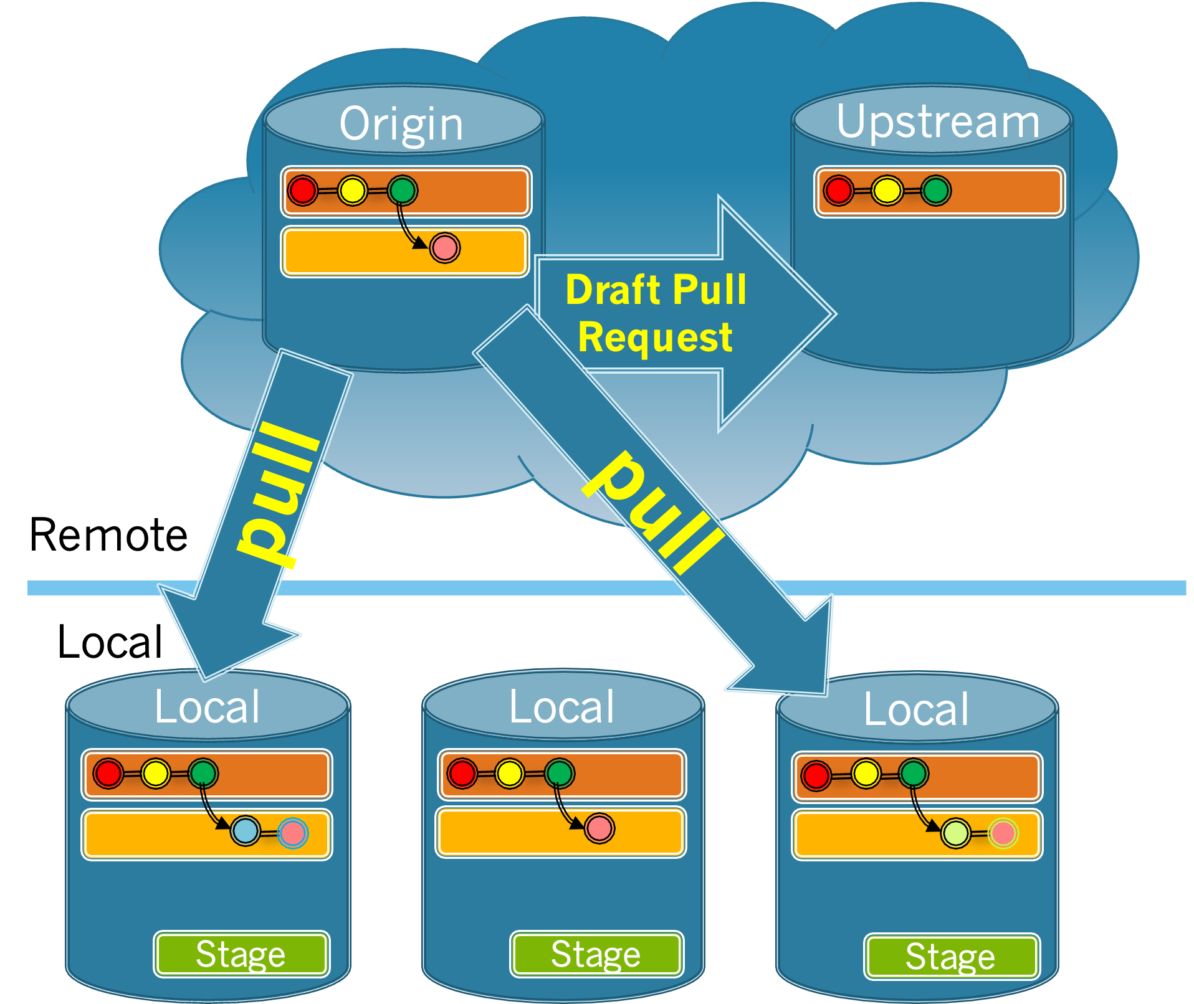
Modified Feature Branch Workflow
FD2School-FarmData2
Fork in
Team’s GitHub
Organization
Team
Member’s
Local Clone
Team
Member’s
Local Clone
Notes:
Other teammates will need to pull the changes to the feature branch.
Remember that pull will attempt to merge changes in the origin into your local branch.
- If the changes do not conflict then this will be easy.
- If the changes conflict, then this will require you to resolved the merge conflicts.
- VSCode has a pretty good tool for doing that.
- Meld (which we used in COMP190) is also available in the Development Environment.
Getting practice with merging your code is part of the the experience you are supposed to have.
- So while it may be easier and faster to just rewrite stuff
- Take the time and try the merges so that you gain practice with them.

Slide 14
Avoiding (minimizing) Merge Conflicts
Work on different files.
Work on different parts of a file.
Create a base file as a starting point.
Add the beforeEach and an it for each team member.
Limit changes to your part of the file.
Pull frequently:
Pull before working
Pull before pushing
Pull if it’s been a while since you pulled
Push complete work frequently
Notes:
That said, you still want to minimize the number of conflicts and the time spent doing merges.
Here are some strategies…

Slide 15
Recovering by Resetting
You will git into situations that are difficult to resolve…
One quick solution:
Copy your local work to a scratch file.
Reset your branch to match the origin
git fetch origin <branch>
git reset --hard origin/<branch>
Readd your work.
Pull any new changes from the origin.
Push the branch to the origin.
Notes:
Note: Instead of copying your work to a scratch a more “git” way to do this is to use ”git stash
- git stash
- places your uncommitted changes on a stack
- then do the fetch and reset
- git stash pop
- pops your changes off of the stack into the current branch
- stage and commit.

Slide 16
Co-Authoring Commits
If you collaborate on the code in a commit, then make the commit a co-authored commit:
git commit (without the -m "…")
The nano editor will open
Enter the commit message
A blank line
Co-authored-by: NAME <NAME@EXAMPLE.COM>
Use the e-mail that your co-author used to create their GitHub account.
Can have multiple Co-authored-by: lines.

Slide 17
Testing Tips:
A few helpful tips for working on testing issues:
Use the source code for the page being tested to find the data-cy attributes for elements you need.
Add data-cy attributes to elements in the page as necessary.
Pick elements carefully.
Choose meaningful values.
You can use the dayjs library in your tests. Add the following line above the describe:
const dayjs = require('dayjs')
Notes:
Not every page will have data-cy attributes for every element that you need.
There are a lot of them in there, but you may want/need others.
If so, add them carefully and precisely.
- Think about exactly which element you need and why
- Think about exactly what that data-cy attribute value should be
- Make the value descriptive.
- Use the values of other data-cy attributes as examples.
You might know what data-cy=test1 means now…
- but someone reading that later will have no idea what that means.
- and remember the code you are writing is not for this assignment…
- it is going into the FarmData2 product
- others will have to deal with what you write later.
- be helpful and kind to them.

Slide 18
Team Meetings
10-15 minute meetings with team and instructor during class time.
Identify what each team member has accomplished since the prior meeting.
Demonstrate the progress that has been made since the prior meeting.
Describe any challenges that are currently being faced by the team.

Slide 19
Writing in the Discipline (WiD)
Post a question to an Issue Ticket or a PR at some point during the project work.
Review the readings on how to write good questions.
Write your question for the community, not for your instructor.
Follow up on comments that your question receives.
Post a PDF of the entire Issue Ticket or PR containing your question to your WiD repository.
Notes:
You may get responses that refer you to the readings and ask for clarification of your question, revision of the question or additional information. You are expected to respond to those requests.

Slide 20
Final Presentation
15-20 minutes during the final exam period.
Present at least one issue on which the team worked.
The issue should be explained so that the audience can understand the issue.
Demonstrate and explain the code in the team’s the pull request for the issue.
Discuss some of the challenges faced.
Reflect on what was learned during the project work.
Involve approximately equal participation by all team members.

Slide 21
The Teams:
Team1: Fofang, Aidan, Aleksandar #11
Team2: Eden, Monica, Ha #14
Team3: Hutter, Vy, Giang #13
Team4: Ben, Caleb, Minh #10
Team5: Charlie, Allison, Trang #12

Slide 22
What do you need to do:
Review the assignment sheet.
Begin working through the steps in the FarmData2 Contributions Section.
It is expected that you will spend ~4 hours/week on the project work.
Come next week prepared for a team meeting.
Keep an eye out for opportunities to post your WiD question.

Slide 23

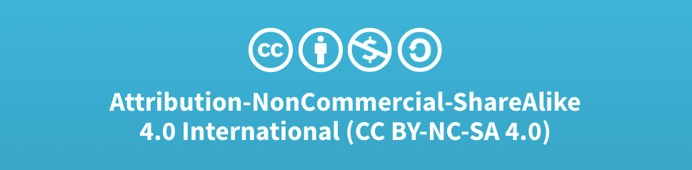
Acknowledgments:
Slide Template From:
https://creativecommons.org/licenses/by/4.0/
Slide Content Licensed as:
Creative Commons Attribution-NonCommercial-ShareAlike 4.0 International License.

