Slide 1
Group Project: Sixes Wild
Standard single-player game
Flash screen appears (your group and names)
Main screen of app which allows two navigations
Play any accessible level
See past level accomplishments
Play Level
Game play starts at level 1
Completing level n allows player to play level n+1

Slide 2
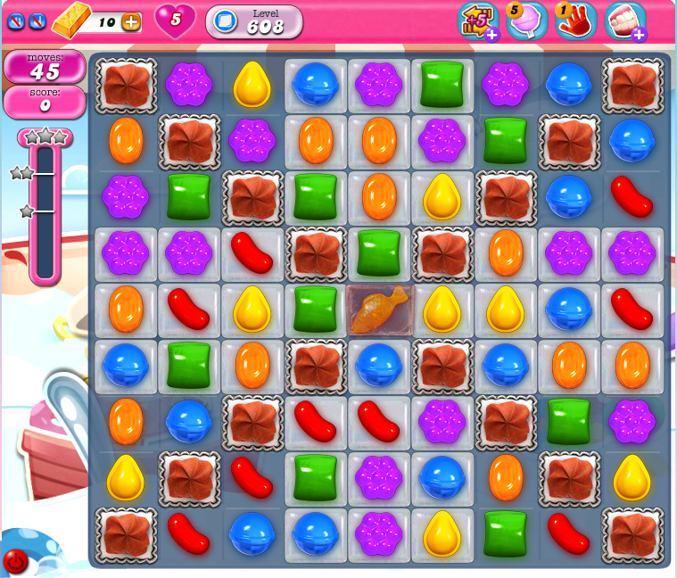
Candy Crush
Current Level
Special Moves
Remaining Moves
Score
Progress Towards
1,2,3 stars

Slide 3
Candy Crush With Numbers
Play proceeds in a grid of up to 9x9 squares
Each square contains number from 1-6
Each move constructed by swiping neighboring cells horizontally or vertically
Goal is to find group – in any order – whose total equals six
(1,1,1,1,1,1),(2,1,1,1,1),(3,1,1,1),(3,2,1),(4,1,1),(4,2),(5,1)
Squares with 6 already are “Blocks”
1
2
3
4
5
6
1
2
3
4
1
2
1
2
3
4
5
6
1
2
3
5
6
1
1
2
3

Slide 4
Play and Points
Each move is assigned points
Simple moves are worth 10 x number of squares in move
Base points are then from 20 to 60
Squares may be given “bonus multipliers” (up to x3)
Score is enhanced by product of bonuses
Example: 10 x 3 x (2 x 3) = 180
What is maximum move score?
1
2
3
x2
x3

Slide 5
Playing A Level
Level Completion is one of the following
Fixed number of moves to make
Fixed time during which moves can be made (lightning)
Target to be completed (release)
Fixed point levels to achieve 1- or 2- or 3-star status
Recorded with each level completion
If you don’t achieve 1-star then you don’t complete the level

Slide 6
Levels: Four Kinds Of Levels
Puzzle
Each move removes squares from grid
Contents repopulated by shifting downward to fill in holes, with new squares appearing at top
Lightning
Complete as many moves within fixed time period
Elimination
Each selected square is marked
Level complete once all squares are marked in the grid
Release
Each “6” is a block
As regions are formed, the “6” fall downward
Once all are moved to their proper place, level completes

Slide 7
Special Moves
Reset Board
Always available but counts towards move total; randomly reassigns all squares
Remove Square
Selectively remove one square and shift down all squares above
Swap two Squares
Swap contents of two squares next to each other

Slide 8
Level Builder
Utility to design levels that are played by engine
Separate GUI to allow user to design a level
Numbered (1 to …)
Size (up to 9x9) and
Type (Puzzle, Lightning, Elimination, Release)
Special Moves allowed or disallowed
Frequency of bonus squares

Slide 9
Important
Each project team designs its own Level Builder and its own Sixes Wild player
No need to worry about interoperability with other teams
There will be minimum number of levels that have to be designed and/or played
To be decided once we get underway

Slide 10
Achievement Badges
Teams with six members must implement additional feature
Record achievements as badges that can be secured during game play
A number of badges are defined (up to you; must have at least ten)
Recorded to be reviewed by player
Player can reset all badges at any time

