Slide 1

The Royal Bank of Canada and Borealis AI
COMP-2040 PYTHON ESSENTIALS WITH DATA ANALYSIS
Research on data science and machine learning
Notes:
Good day.
This is Jerry and today I would like to share with you how the Royal Bank of Canada, RBC, is using data science and machine learning to help their businesses.

Slide 2




Agenda
Describe the RBC and what they do.
Explain how the RBC is using machine learning and data science.
Explain how using these technologies has helped them.
Notes:
Here is the agenda.
First, I will briefly describe the businesses of the RBC
Then proceed to explain how the RBC is using machine learning and data science
and at last, how these technologies have helped them and their customers

Slide 3

The RBC and what they do.
The Royal Bank of Canada
Businesses
One of Canada's biggest banks, and among the largest in the world based on market capitalization.
One of North America's leading diversified financial services companies.
Serve 17 million clients in Canada, the U.S. and 27 other countries.
Have more than 89,000 employees worldwide.
Personal & Commercial Banking - Retail banking
Wealth Management - Asset management products and services to high-net-worth clients
Investor & Treasury Services - Custodial, advisory and financing services of institutional investing clients
Capital Markets - Investment banking and global markets
Insurance - Insurance and reinsurance advice and solutions
Notes:
Let me give some background information of the RBC
The Royal Bank of Canada (RBC) is a Canadian multinational diversified financial services company.
It is the largest bank in Canada by market capitalization.
The bank serves over 17 million clients and has more than 89,000 employees in Canada, the US and 27 other countries.
Their businesses include Personal & Commercial Banking, Wealth Management, Investor & Treasury Services, Capital Markets and Insurance.

Slide 4





How RBC is using machine learning and data science… Borealis AI
Founded by the RBC
Partner closely with the main lines of business within RBC.
Research, design, and build AI products and technologies that transform RBC businesses.
Notes:
How does the RBC use data science? They build Artificial Intelligence and make AI work for their customers.
In order to realize the potential for Artificial Intelligence to help better serve their clients, RBC founded Borealis AI, a research institute with a focus on state-of-the-art and ethical AI
Enabled by the large data sets from the RBC, Borealis AI focuses on developing machine learning products that supports RBC business interests.

Slide 5
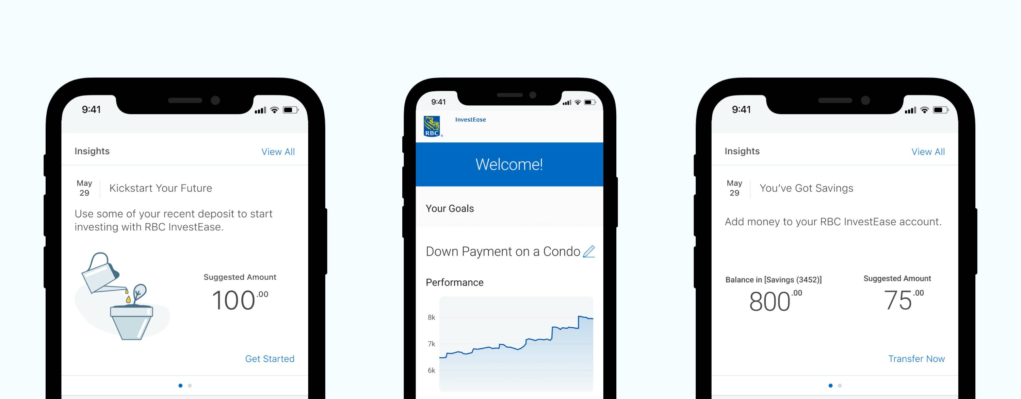

How RBC is using machine learning and data science.
Aiden
Capital markets
NOMI Forecast
Retail banking
An AI-powered electronic trading platform with improved execution quality and insights for the clients.
Use Deep Reinforcement Learning to learn from its experiences in the market and adjust to changing trading conditions in real-time.
A digital platform to keep clients connected to their money, offering personalized insights and advice to empower better financial decision.
Capture actionable patterns through analysis of time-series data to make accurate cashflow predictions.
Notes:
One of the products is called Aiden, which is a reinforcement learning-based trade execution system used by RBC’s Capital Markets business. Aiden use Machine Learning to help clients with large orders to plan their trades to get better returns. The model responds in real time to changes in markets. It is more dynamic and more flexible than traditional trading algorithms.
Another product in use is called Nomi Forecast, it is incorporated into RBC’s personal banking mobile app. by forecasting upcoming preauthorized payments such as mortgage, loan and subscription service payments. Nomi Forecast helps their customers manage their cash flow, and hence make better financial decisions.

Slide 6
How using machine learning and data science has helped RBC.
Be Client First
Be Digital & Innovation
Make social impact
Deepen relationship with clients.
Maintain client's loyalty with competitive edge in AI-enabled products and services.
Increase customers’ satisfaction by development services focused on client.
Take the lead in Digital & Innovation in financial services to create exceptional values.
Able to tackle banking’s most challenging problems.
Stay connected with customer expectations.
Create positive social and community impact.
Make technology accessible
Borealis AI maintains platform to contribute knowledge, algorithms, programs, and tools to help build technology that moves society forward.
Notes:
Let’s see how using machine learning and data science has helped the RBC.
The RBC values client first. It strikes to be their client first choice, by delivering insights and value their customer can’t find anywhere else.
With the AI enabled products, they can deepen their relationship with clients, increase their satisfaction and maintain their loyalty.
With the innovation in digital transformation, RBC takes the lead in their financial services. Using AI, the bank is able to solve challenging problems in finance and help them stay within customer expectation.
RBC creates a positive social and economic impact in the community by making advanced technology accessible to people.
At Borealis AI, the dedicated researchers and scientists maintain an AI platform to contribute knowledge to help build technology that moves society forward.

Slide 7

Thank You
Wai Ping (Jerry) Kwok
References:
www.rbc.com
www.rbccm.com/rbccm/insights/ai.page
www.borealisai.com
https://kpmg.com/xx/en/home/insights/2021/03/machine-learning-applied-royal-bank-of-canada-borealis-ai.html
Notes:
These are some references of the RBC and Borealis AI.
This is the end of my presentation.
Thank you.

