Slide 1
Yelp Dataset Analysis
Eric Kannampuzha
Walter Niederer

Slide 2
Goal
Scan reviews with poor ratings for most popular words and phrases
Understand the most common reasons for complaints and low ratings against businesses
Find trends within businesses that share similar poor ratings and complaints
Try to filter outliers and dishonest reviews

Slide 3
Yelp Dataset
7.35 GB uncompressed
6 .json files
business.json
review.json
user.json
checkin.json
tip.json
photo.json
10.7 GB of photos

Slide 4
Example
{ // string, 22 character unique review id "review_id": "zdSx_SD6obEhz9VrW9uAWA", // string, 22 character unique user id, maps to the user in user.json "user_id": "Ha3iJu77CxlrFm-vQRs_8g", // string, 22 character business id, maps to business in business.json "business_id": "tnhfDv5Il8EaGSXZGiuQGg", // integer, star rating "stars": 4, // string, date formatted YYYY-MM-DD "date": "2016-03-09", // string, the review itself "text": "Great place to hang out after work: the prices are decent, and the ambience is fun. It's a bit loud, but very lively. The staff is friendly, and the food is good. They have a good selection of drinks.", // integer, number of useful votes received "useful": 0, // integer, number of funny votes received "funny": 0, // integer, number of cool votes received "cool": 0 }

Slide 5
Data Analysis Flow
Word count of reviews per business_id
*.json
Group business_id by categories
List of reviews by business_id
Filter by ratings < 3 stars
Combine with tips.json by business_id

Slide 6
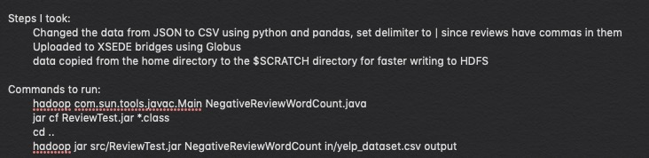
Implementation

Slide 7
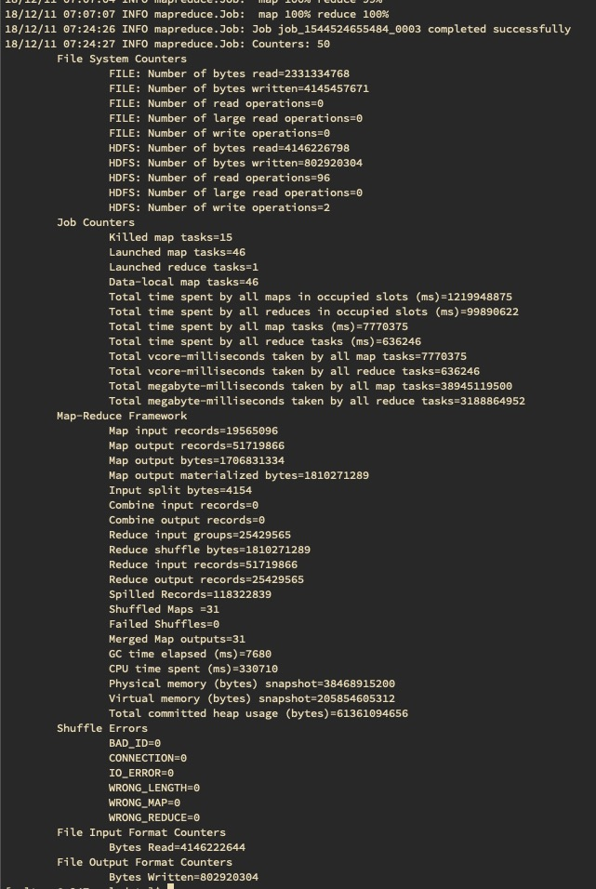
Execution Statistics
Total time spent by all map tasks: 7770.375 (s)
Total time spent by all reduce tasks: 636.246 (s)
GC time elapsed: 7.680 (s)
CPU time spent: 330.710 (s)

Slide 8
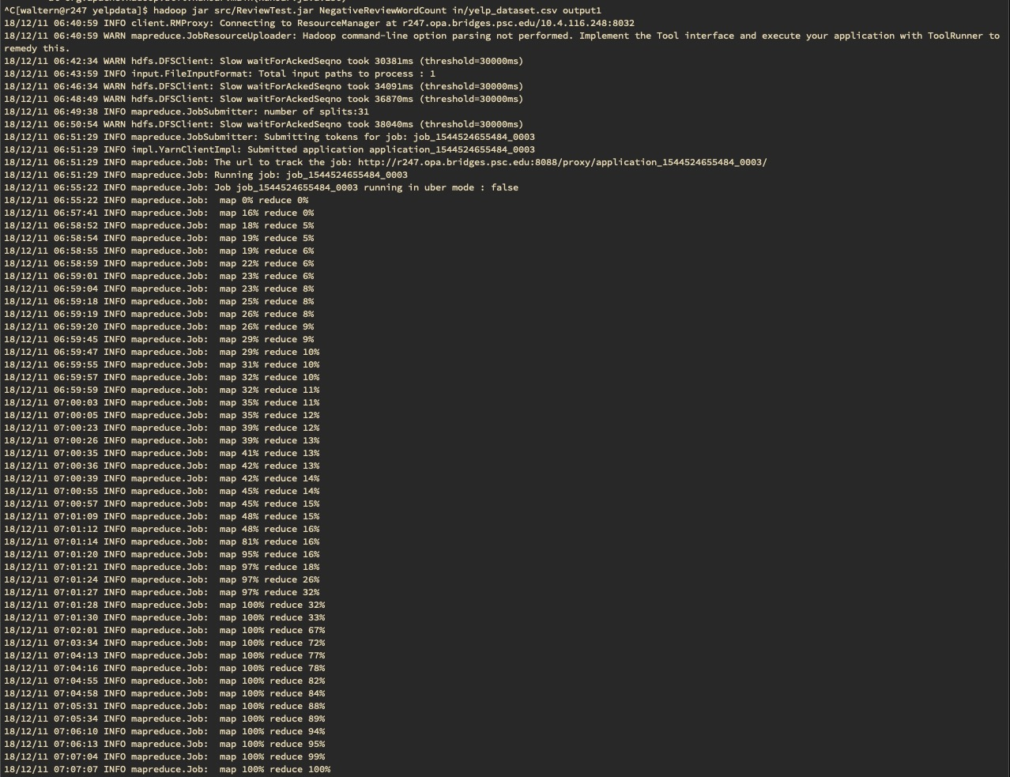

Slide 9
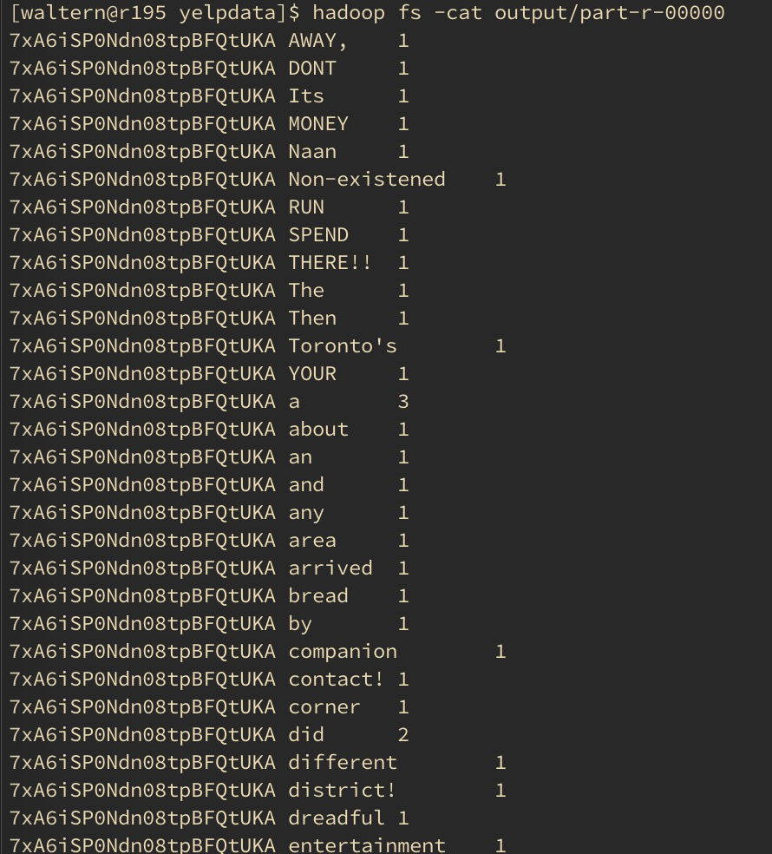
Output
Output before articles and connectives are removed
Counting occurences of words
Final output contains a lot of swearing

Slide 10
Analysis
We wanted to list the top 10 words for each restaurant but it doesn’t reveal as much useful information as we had hoped
Common negative adjectives and useful nouns:
Price
Service
Dietary restrictions
Portions
People have a more diverse vocabulary than expected

