Slide 1
HPAS Referral Pathway
Second release: what we did in the last few days
Advanced Information Systems Development - presentation
Business Process Modelling and Enterprise Architecture - full portfolio

Slide 2
What the system is
A UK hospital referral pathway modelled and executed in Camunda 8
• Eight processes, nine BPMN models. Referral intake, clinical review, appointment scheduling, patient notification, outpatient letter, funding determination, payment processing, enquiry routing.
• Six external participants. GP, patient, funder, external scheduling service, external correspondence service, payment provider - joined to the hospital by message flows.
• 37 Camunda Forms, 31 job workers. Three Java projects: shared workers, P10 letter workers, P7 funding workers.
• One workflow engine as the orchestrator. The BPMN model is the program: human tasks go to Tasklist, automated steps run as job workers.

Slide 3
What we built
Numbers from the final package
Artefact | Count | Artefact | Count
BPMN models | 9 (15 process definitions) | Relational tables | 11 (109 columns)
Camunda Forms | 37 | Role groups | 13
Job workers | 31 methods in 13 files | Documented SQL | 14 statements
i* models | SD + SR (13 / 12 actors) | Read-only demo endpoints | 13

Slide 4
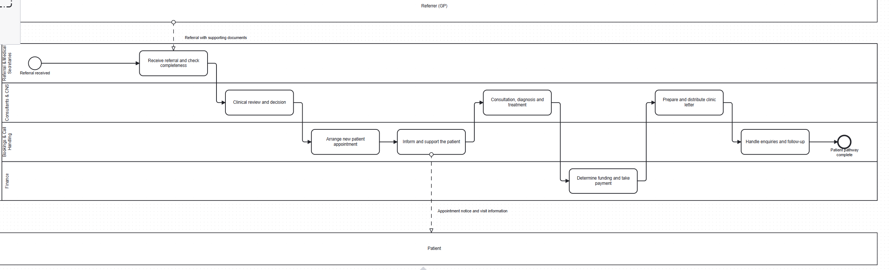
Strategic view of the pathway
High-level model: who is responsible for what, and how it links to the operational processes
• Four lanes inside the hospital (Referral & Medical Secretaries / Consultants & CNS / Bookings & Call Handling / Finance) plus two external pools.
• One referral runs left to right; each box is delivered by one of the operational processes shown in the next slides.

Slide 5
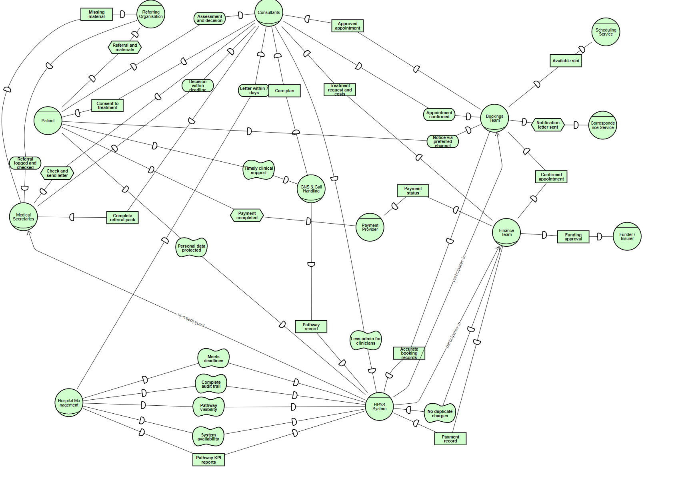
i* model 1: Strategic Dependency (SD)
Who depends on whom - 13 actors, 32 dependencies
• Each line is a dependency: the depender needs the dependee for a goal, a task, a quality or a resource.
• It shows the collaboration boundary: hospital roles, and the six external participants they rely on.

Slide 6
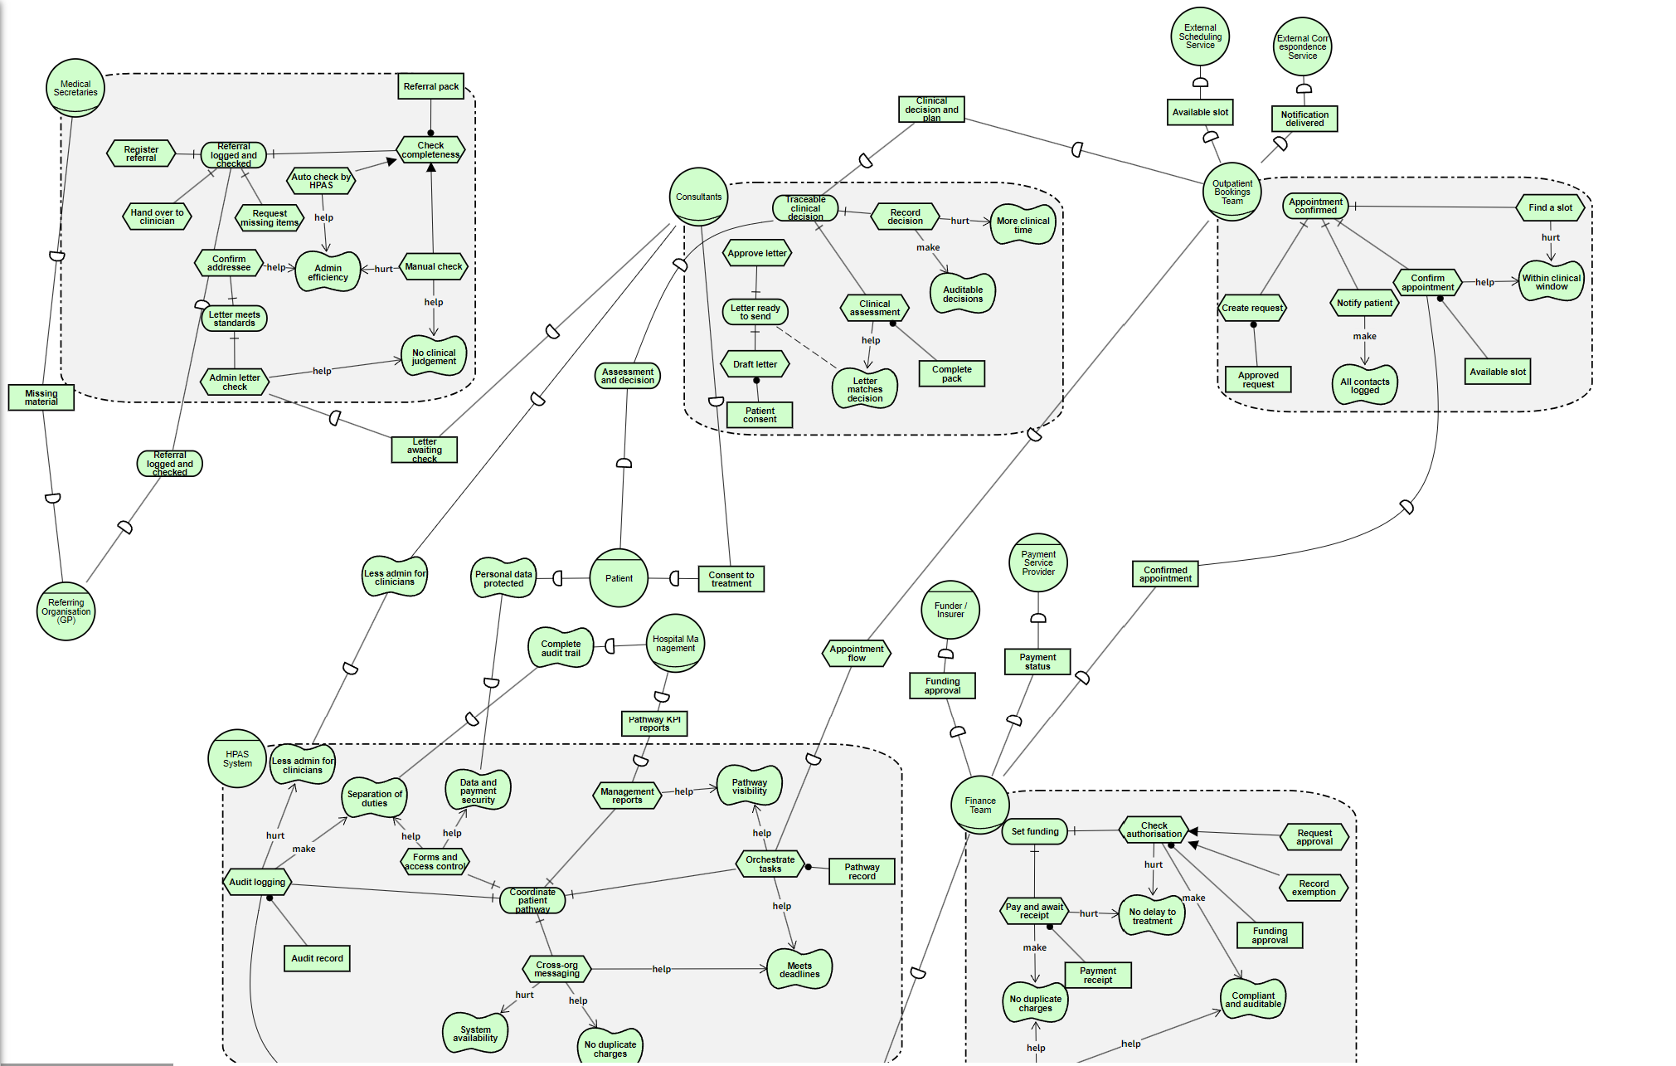
i* model 2: Strategic Rationale (SR)
Why each role is designed that way - 12 actors, 59 intentional elements, 17 cross-actor dependencies
• Goals (rounded), tasks (hexagons), soft goals (clouds) and resources (rectangles) inside each role.
• AND/OR refinements decompose goals; contribution links (help / make / hurt) show which tasks support which soft goal - for example manual checking hurts administrative efficiency, automation helps it.

Slide 7
Response to the five review points
Each point, what we changed, and how it is verified
Review point | What we changed | Evidence
1. Merging gateways | 4 converging gateways added (P1, P2, P3, P4), in the same lane, with diagram interchange | structural check: 0 implicit merges
2. Distinct pathways | 7 decision conditions made null-safe; the two-week test now compares dates, not strings | inspection + one end-to-end run
3. Form validation | 37 forms: 131 fields with rules, 99 required, 19 patterns, 123 length limits, 11 fields retyped | form comparison against the original package
4. Database persistence | 11 tables, one write service, every worker persists and audits; duplicate payment refused | 11 tables populated; survived restart
5. Role-based access | candidate groups on every user task (including the 3 that had none); group names unified | task query per group: others see nothing

Slide 8
Further development
The improvements made after the first release
• Operational BPMN. Explicit merging gateways, hardened conditions, role groups on every user task, and all nine models translated to English (73 documentation blocks).
• Camunda Forms. Validation added field by field; money fields are numeric, dates use a date control; three fields deliberately left optional because a blank value carries meaning.
• External workers. All 31 workers persist what they learn and write an audit row; date parsing made tolerant after a silent fallback was found; 43 output strings translated.
• Integration. Process variables to workers to a relational store, plus deployment and demonstration scripts so the whole system can be reproduced.

Slide 9
Evidence
What we can show, and how it was checked
Check | Result
BPMN structure (dangling refs, cross-process flows, child order, orphans, DI, implicit merges) | 9 of 9 models: every counter 0
Form change safety (field keys, option values, component ids) | identical to the original package
Java build | 3 of 3 projects compile
Referral end to end | COMPLETED, 0 incidents, data persisted
Persistence across restart | identical row counts
Duplicate payment for the same case | refused; one row remains
Role visibility | each task visible only to its group
i* models | 0 iStar 2.0 violations, 0 isolated elements

Slide 10
How to run it in three steps
• Deploy. python deploy-package.py - nine models and 37 forms in one call, 15 process definitions and 37 form versions.
• Run the workers. Start WorkerApplication: jobs are picked up, every step is persisted and audited on port 8090.
• Show it. Tasklist for the human tasks; the summary and chain endpoints for the database evidence; stop and restart to prove persistence.
What to look for: the form refuses a blank required field; the referral completes with no incident;
a second payment for the same case is refused; the row counts are the same after a restart.

Slide 11
Known limitations and next steps
Stated openly rather than left to be found
• Duplicated workers. Three job types are implemented in two projects; only one application may run at a time. Next: remove the duplicates.
• Demonstration database. A single-file store, so concurrency is untested. Next: move to a server database and test concurrent instances.
• No automated regression suite. Verification is scripted and manual. Next: turn the scripts into tests that run on every build.
• Not yet built. A live pathway dashboard, encryption at rest, measured administrative burden. Each is a small, clearly scoped piece of work.

Slide 12
References
Sources used for the notation, the models and the implementation
• Object Management Group. Business Process Model and Notation (BPMN), version 2.0.2. OMG, 2013.
• Camunda. Camunda 8 documentation: BPMN coverage, job workers, forms, Zeebe. docs.camunda.io (accessed 2026).
• Dalpiaz, F., Franch, X. and Horkoff, J. iStar 2.0 Language Guide. arXiv:1605.07767, 2016.
• piStar modelling tool, version 2.1.0 (iStar 2.0). github.com/jhcp/piStar.
• Spring Boot reference documentation, version 4.x. spring.io/projects/spring-boot.
• Java Platform, Standard Edition 21 API specification. Oracle.
• H2 Database Engine documentation, version 2.4. h2database.com.

Slide 13
Thank you - questions welcome
Supporting documents: requirements traceability, acceptance criteria evaluation, further development, i* model guide

