Slide 1
Automatic detection of angle and length of lines in images
~Project for MLDDS~
By: Hubert Pauwels

Slide 2

OBJECTIVE
Detecting angles, as well as lengths, of lines in images has practical usage in various fields such as robotics, engineering, medicine and biology.
The project’s objective is to try out, and compare various Machine Learning Algorithms as to train models that can automatically detect angles and lengths of single lines in images.

Slide 3
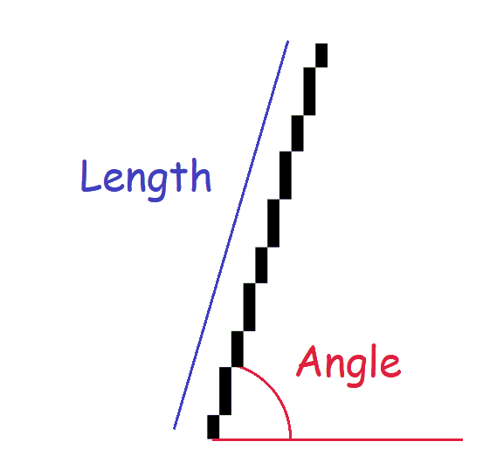
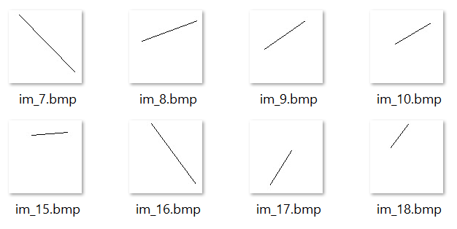
PROBLEM FORMULATION
The problem is how to best train a machine learning model in order to determine the length and angle of a single line displayed in an image.

Slide 4
APPROACH
Train three different models each of them to perform a specific task:
Line Angle Predictor ( for ascending lines only)
Line Angle Classifier ( 4 classes, Horizontal, Vertical, Ascending, Descending)
Line Length Predictor
Each model will be trained with a tailor-made dataset best suited as to allow for most optimal training
Models expected to ‘work’ together, so as to do better predictions:
-E.g. for instance Classifier to determine if line is Descending, then rotate image and
predict angle with Line Angle Predictor(trained for ascending lines), then multiply by -1.

Slide 5
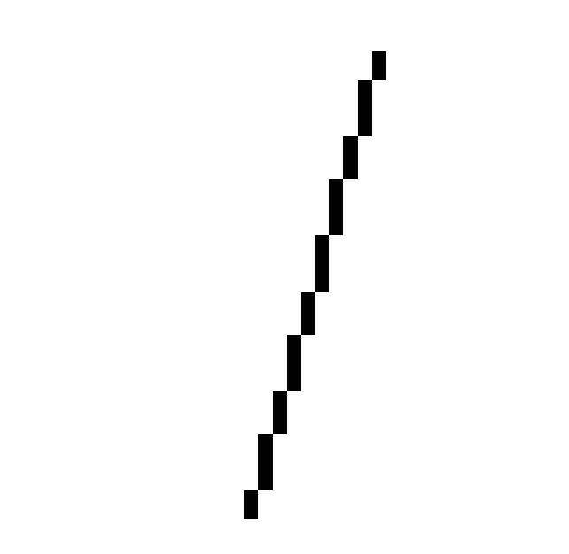
DATA PLAN
Three data sets for the purpose of training three different models:
[1] Line angle predictor ( Linear Regression)
[Trained for ascending lines only]
[2] Line angle classifier (Logistic Regression)
[3] Line length predictor ( Linear Regression)
Using the ‘Bresenham’ algorithm as to generate lines.
The training images contain a single line with a pixel width of 1.

Slide 6
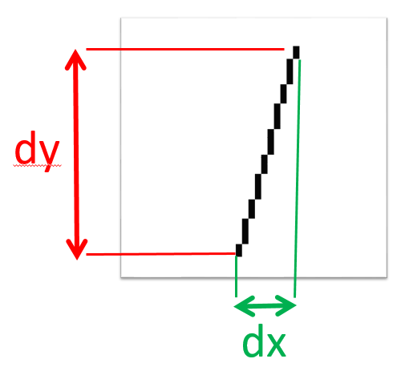
FEATURE EXTRACTION
Rather than passing complete image as feature, I project a “shadow” of the line on both the y and x-axis. I then use these “shadows” as features as to train the model.
Take note that dx and dy can of course also be used directly to calculate angle and length of lines (actually I conveniently use that later as to check if our predictions of test images we produce on the fly are correctly predicted)

Slide 7
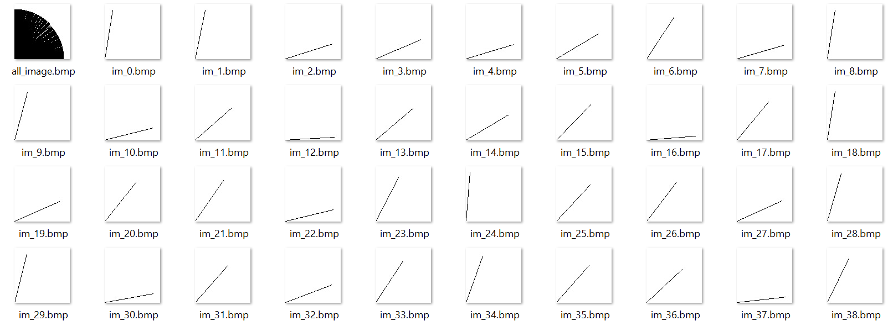
DATA SET 1: FOR LINE ANGLE PREDICTION
Ascending lines with random angles and fixed length
All lines starting in the origin
Total of 1000 images of size 100x100 pixels

Slide 8

DATA SET 2: FOR LINE ANGLE CLASSIFICATION
Random lines with variable lengths
Random angles
Random locations
Total of 1000 images of size 100x100 pixels
25% Horizontal
25% Vertical
25% Ascending
25% Descending

Slide 9

DATA SET 3: FOR LINE LENGTH PREDICTION
Random lines with variable lengths
Random angles
Random locations
Total of 1000 images of size 100x100 pixels

Slide 10
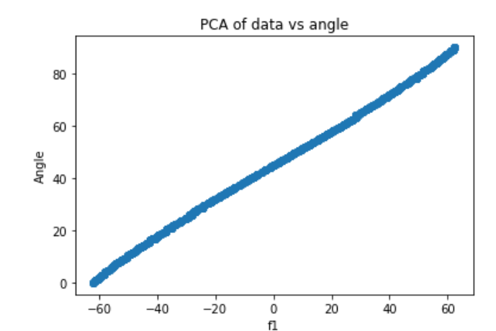
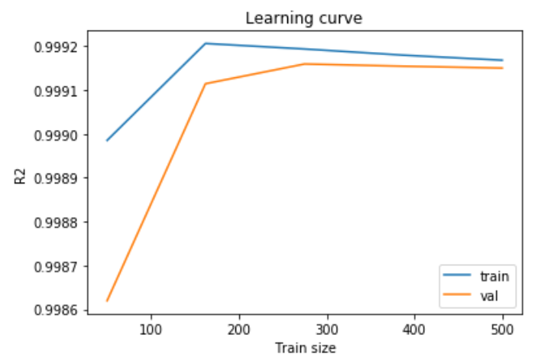
EVALUATION – Line Angle Predictor
MSE: 0.5173063540368755
MAE: 0.5985518233919727
R2: 0.9991722186754859

Slide 11
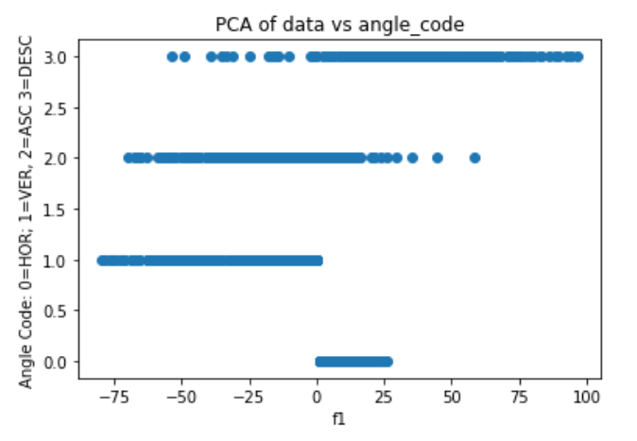
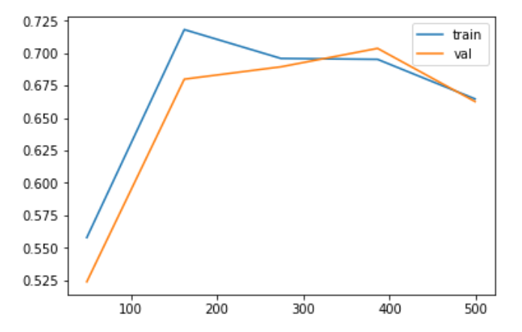
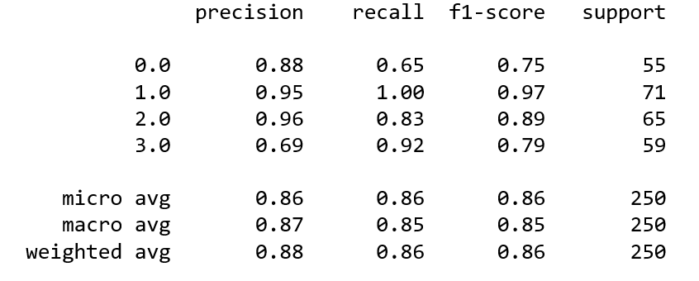
EVALUATION – Line Angle Classifier
# Classes of angles
HOR= 0
VER= 1
ASC= 2
DSC= 3

Slide 12
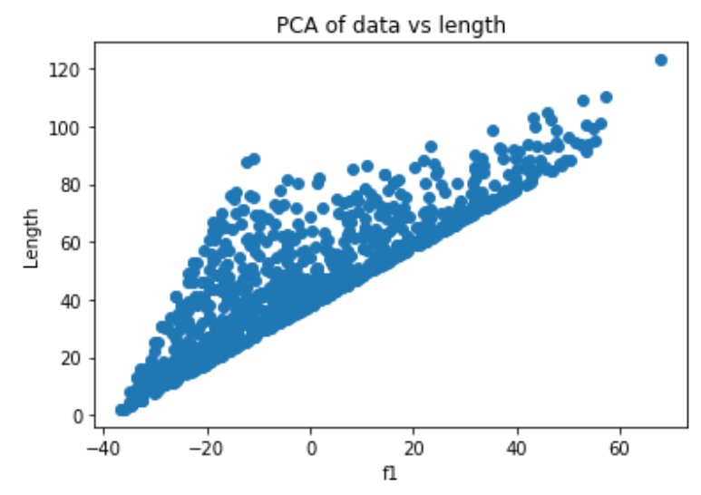
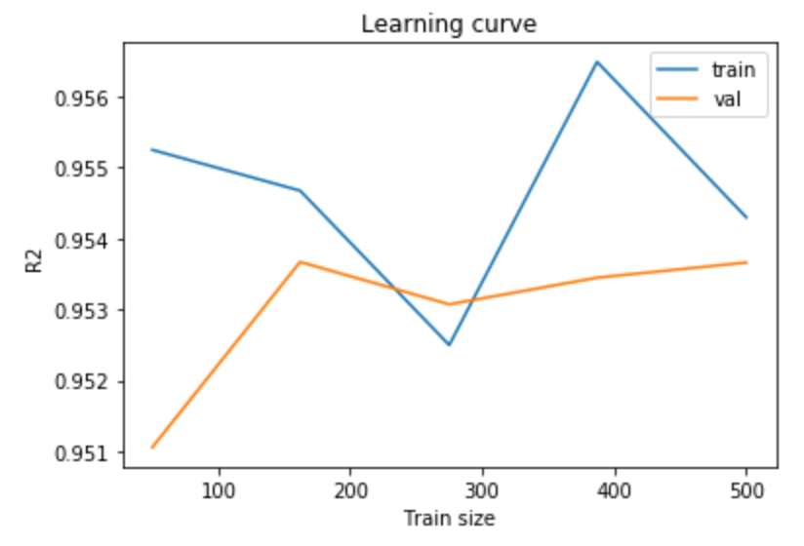
EVALUATION – Line Length Predictor
MSE: 19.98019253869187
MAE: 3.629338985946194
R2: 0.9594533763149377

Slide 13
~DEMO~

