Slide 1
Breast Cancer Detection using Classification and Regression Algorithms

Slide 2
Introduction
Breast cancer is the most common cancer diagnosed among U.S. women with about 252,710 new cases expected to be diagnosed in 2017.
It is the second leading cause of cancer death among women in the U.S., after lung cancer.
Currently, the most used techniques to detect breast cancer in early stages are: Mammography, FNA with visual interpretation and surgical biopsy.

Slide 3
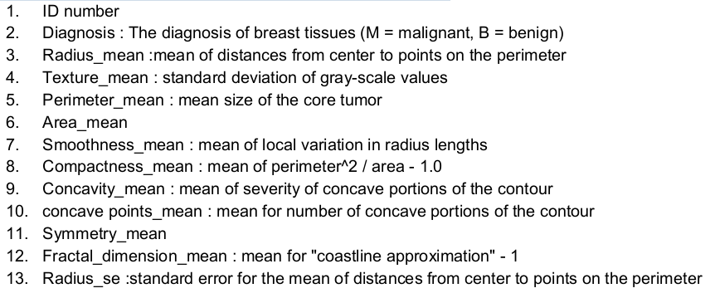
Dataset
We are using the Breast Cancer Wisconsin (Diagnostic) Data Set - Predict whether the cancer is benign or malignant from Kaggle.
This dataset consists of 32 features and 569 patients records

Slide 4
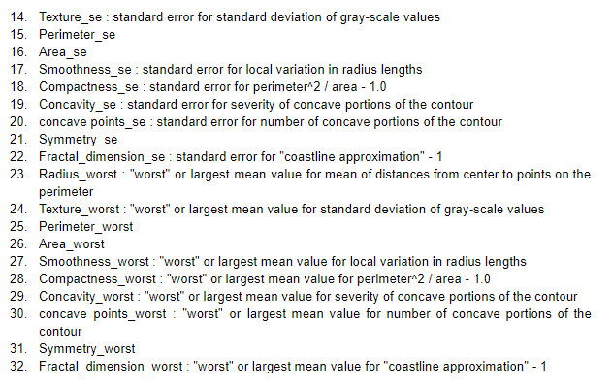
Dataset

Slide 5
Implemented Algorithms
KNN
Logistic Regression
Linear Regression
SVM
Naïve Bayes Classifier
Decision Tree
Linear Discriminant Analysis(LDA)
Random Forests
Deep Learning (Neural Networks)

Slide 6
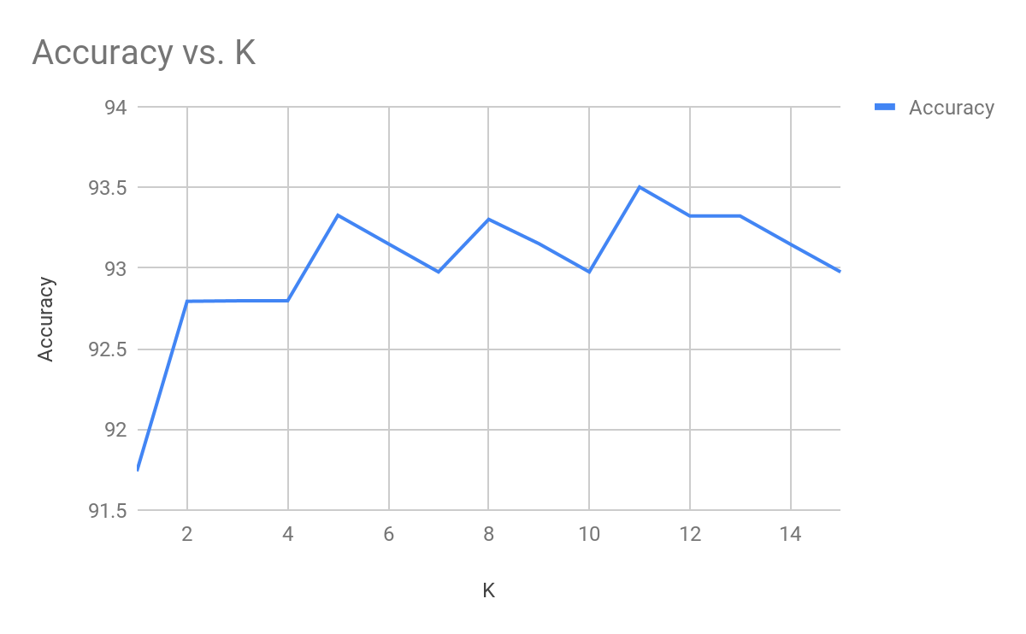
KNN

Slide 7
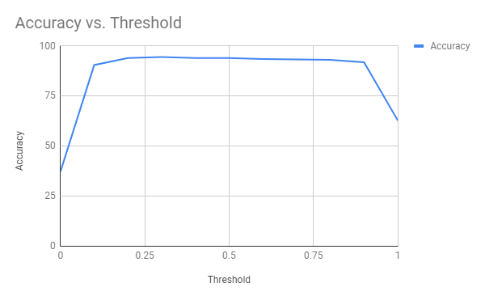
Logistic Regression

Slide 8
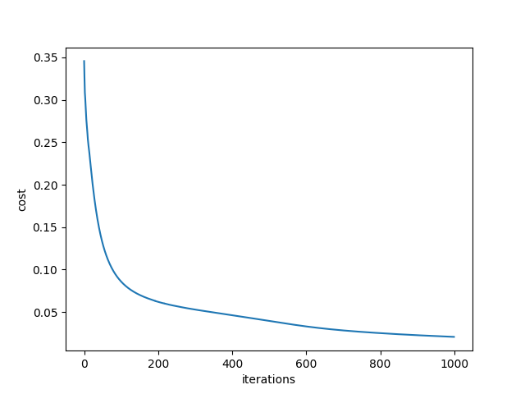
Deep Learning (Neural Networks)
Parameters
Learning Rate - 0.0005
Epochs - 1000
Batch Size - 100
Input Layer - 30
Hidden Layer - 20
Output Layer - 2
Adam optimizer

Slide 9
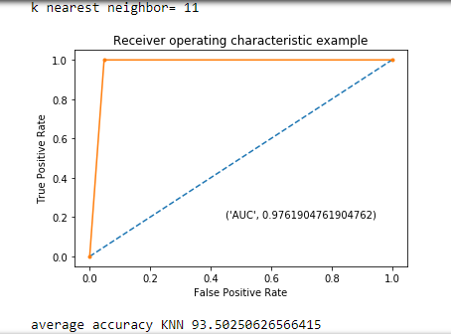
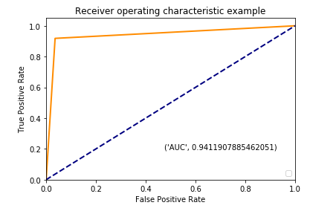
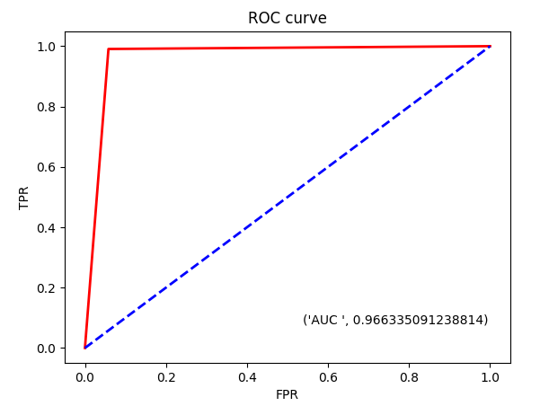
ROC and AUC for different algorithms
KNN
Logistic
Linear

Slide 10
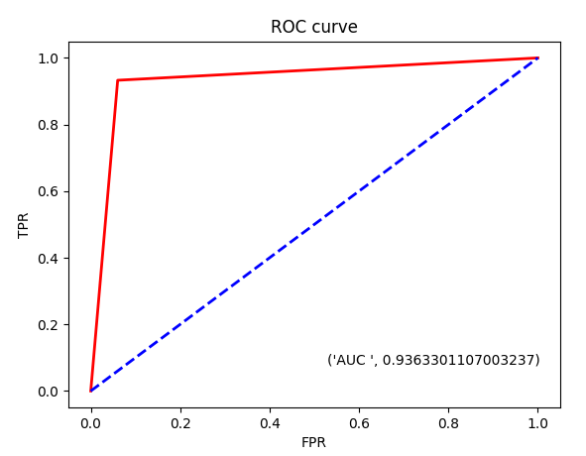
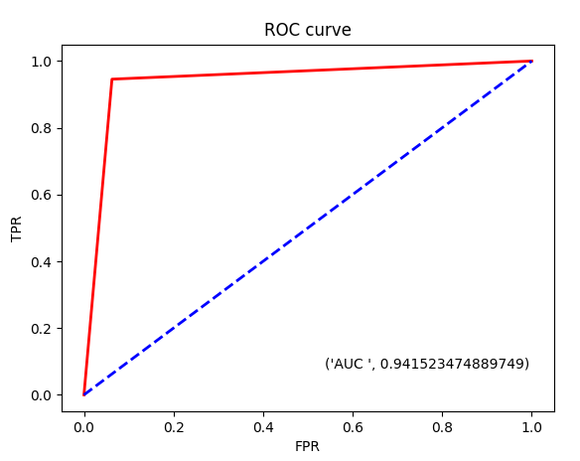
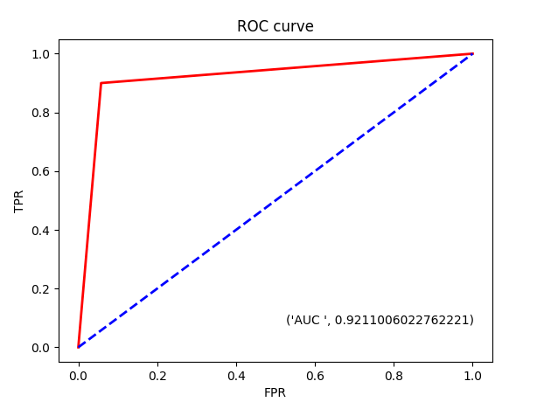
ROC and AUC for different algorithms
SVM
Naive Bayes
Decision Tree

Slide 11
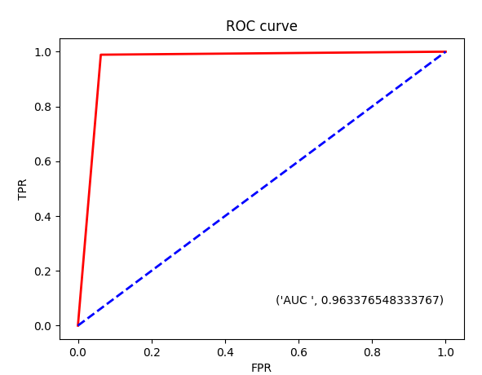
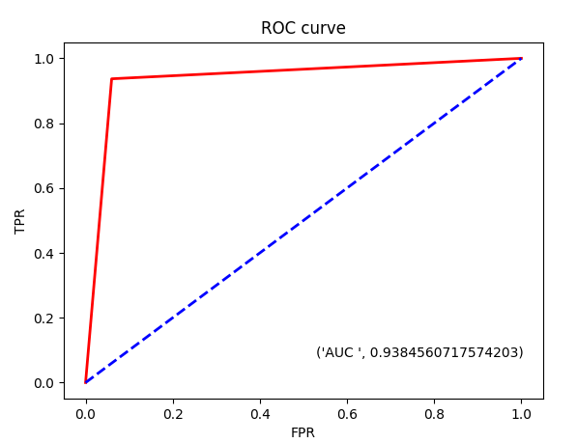
ROC and AUC for different algorithms
Random Forest
LDA

Slide 12
Experimental
Results
Algorithm | Accuracy %
KNN | 93.50
Linear Regression | 95.78
Logistic Regression | 94.72
SVM | 94.37
Naive Bayes | 94.02
Decision Tree | 94.20
LDA | 95.61
Random Forest | 94.55
Deep Learning (Neural Networks) | 94.02

Slide 13
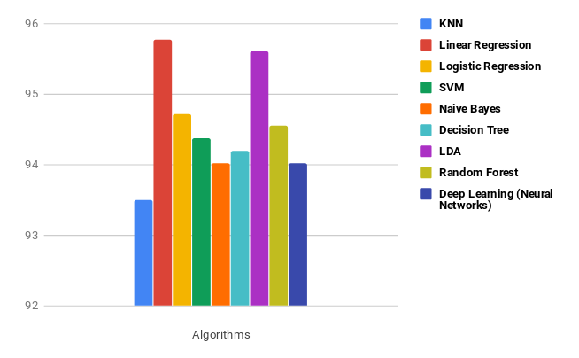
Comparison

Slide 14
Thank You!

