Slide 1
FEATURE FLAG SYSTEM
PRODUCT CODE BASE
ON
if (flag ON)
else
code path #1
test path #1
code path #2
test path #2
OFF
Feature Flag ❶

Slide 2
FEATURE FLAG SYSTEM
PRODUCT CODE BASE
ON
if (flag ON)
else
code path #1
test path #1
code path #2
test path #2
OFF
Feature Flag ❶
2
if (flag 2)
else (flag 1)
else
code path #3
test path #3
1
code path #4
test path #4
OFF
code path #5
test path #5
Feature Flag ❷

Slide 3
FEATURE FLAG SYSTEM
PRODUCT CODE BASE
ON
if (flag ON)
else
code path #1
test path #1
code path #2
test path #2
OFF
Feature Flag ❶
2
if (flag 2)
else (flag 1)
else
code path #3
test path #3
1
code path #4
test path #4
OFF
code path #5
test path #5
Feature Flag ❷
dependency in feature ❷ value 2
ON
if (flag ON)
else
code path #6
test path #6
code path #7
test path #7
OFF
Feature Flag ❸

Slide 4
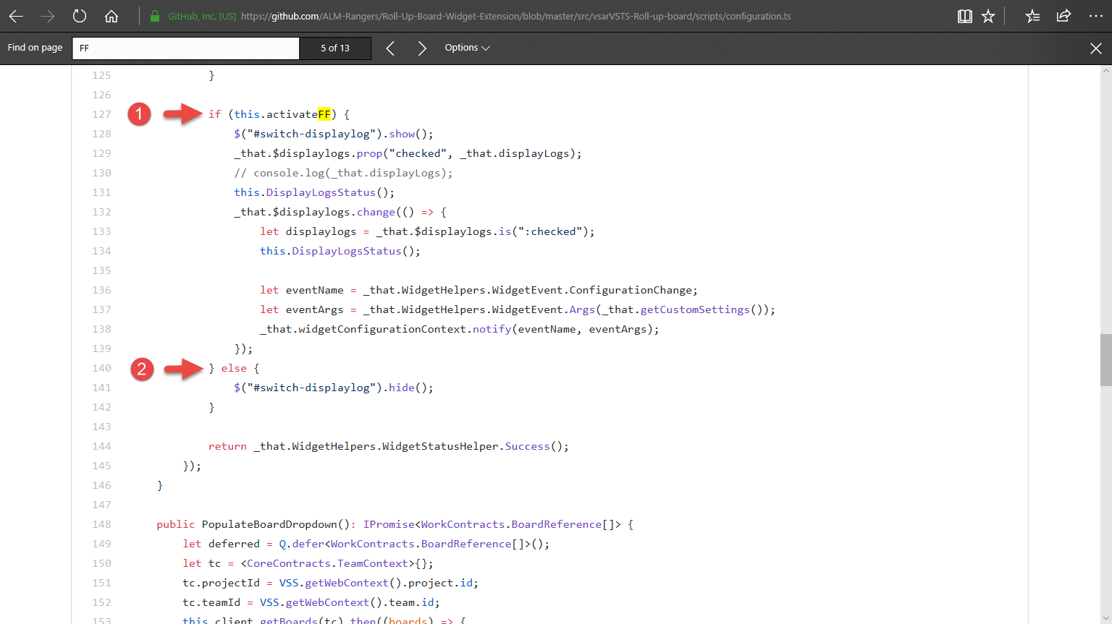

Slide 5
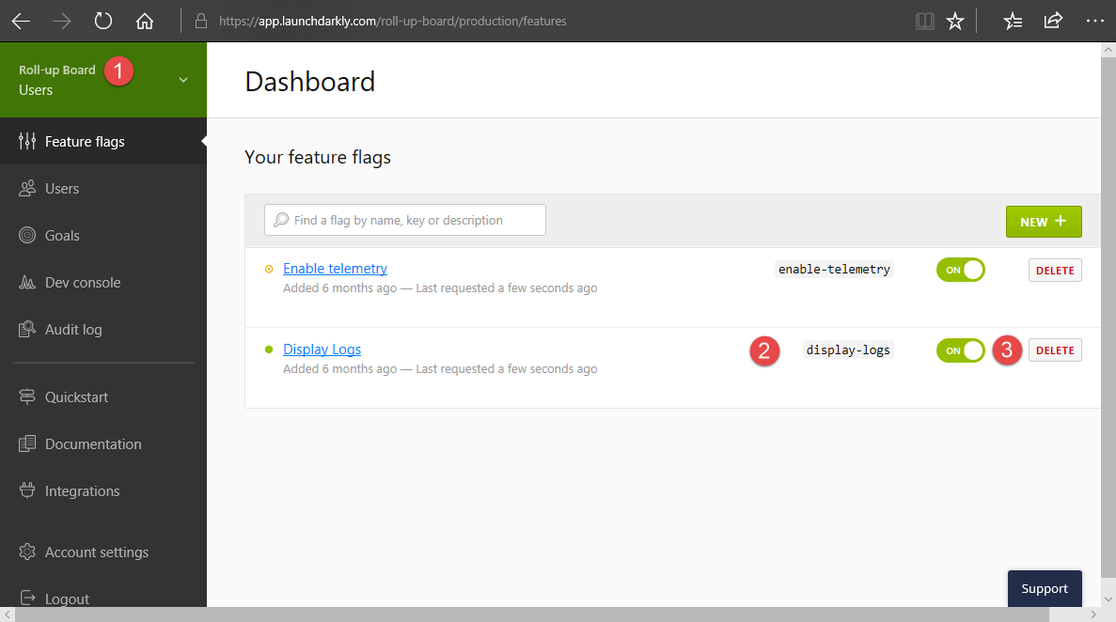

Slide 6
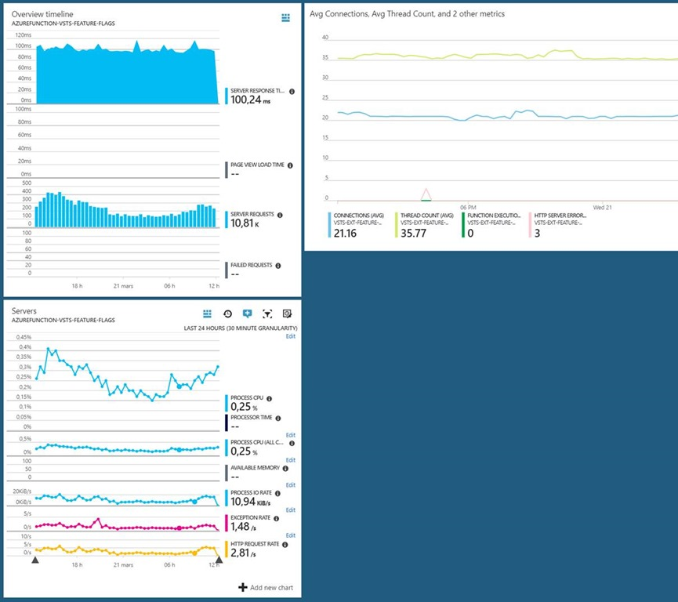
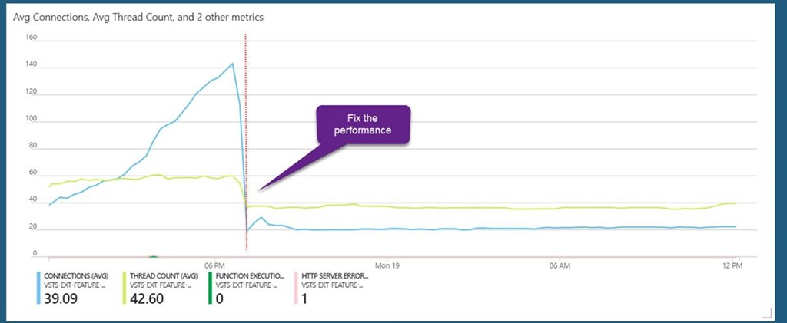
Learning from mistakes ☺

