Slide 1
Impute Missing Data with BLIMP

Slide 2
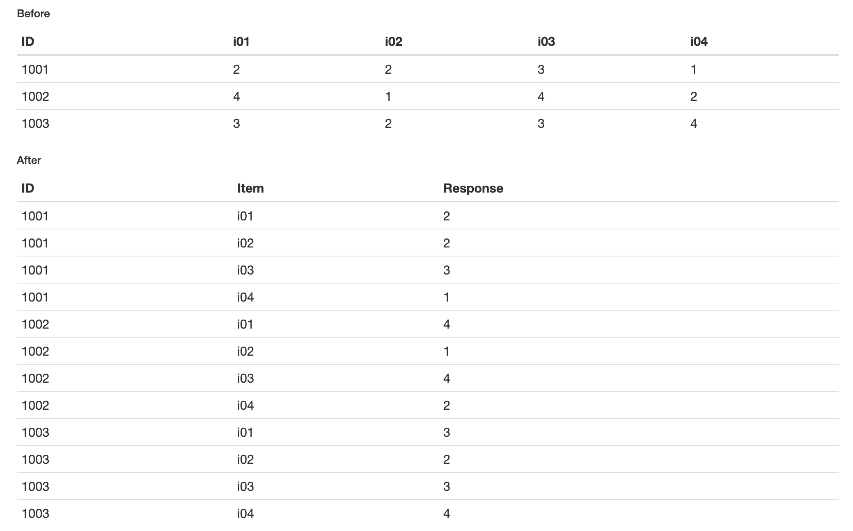
Reshaping Data

Slide 3
Missing Data Mechanisms
Missing Not At Random (MNAR)
Probability of missing on Y related to values of Y itself
Missing At Random (MAR)
Probability of missing on Y related to another measured variable, but not to values of Y itself
Missing Completely At Random (MCAR)
Probability of missing on Y unrelated to other measured variables or values of Y itself

Slide 4
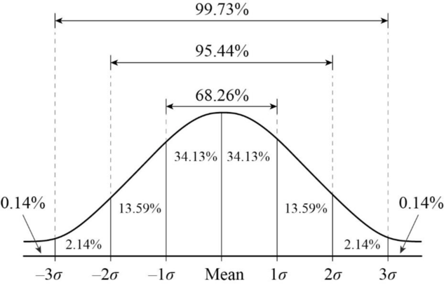
Univariate Parameters: Summarizing a Distribution

Slide 5
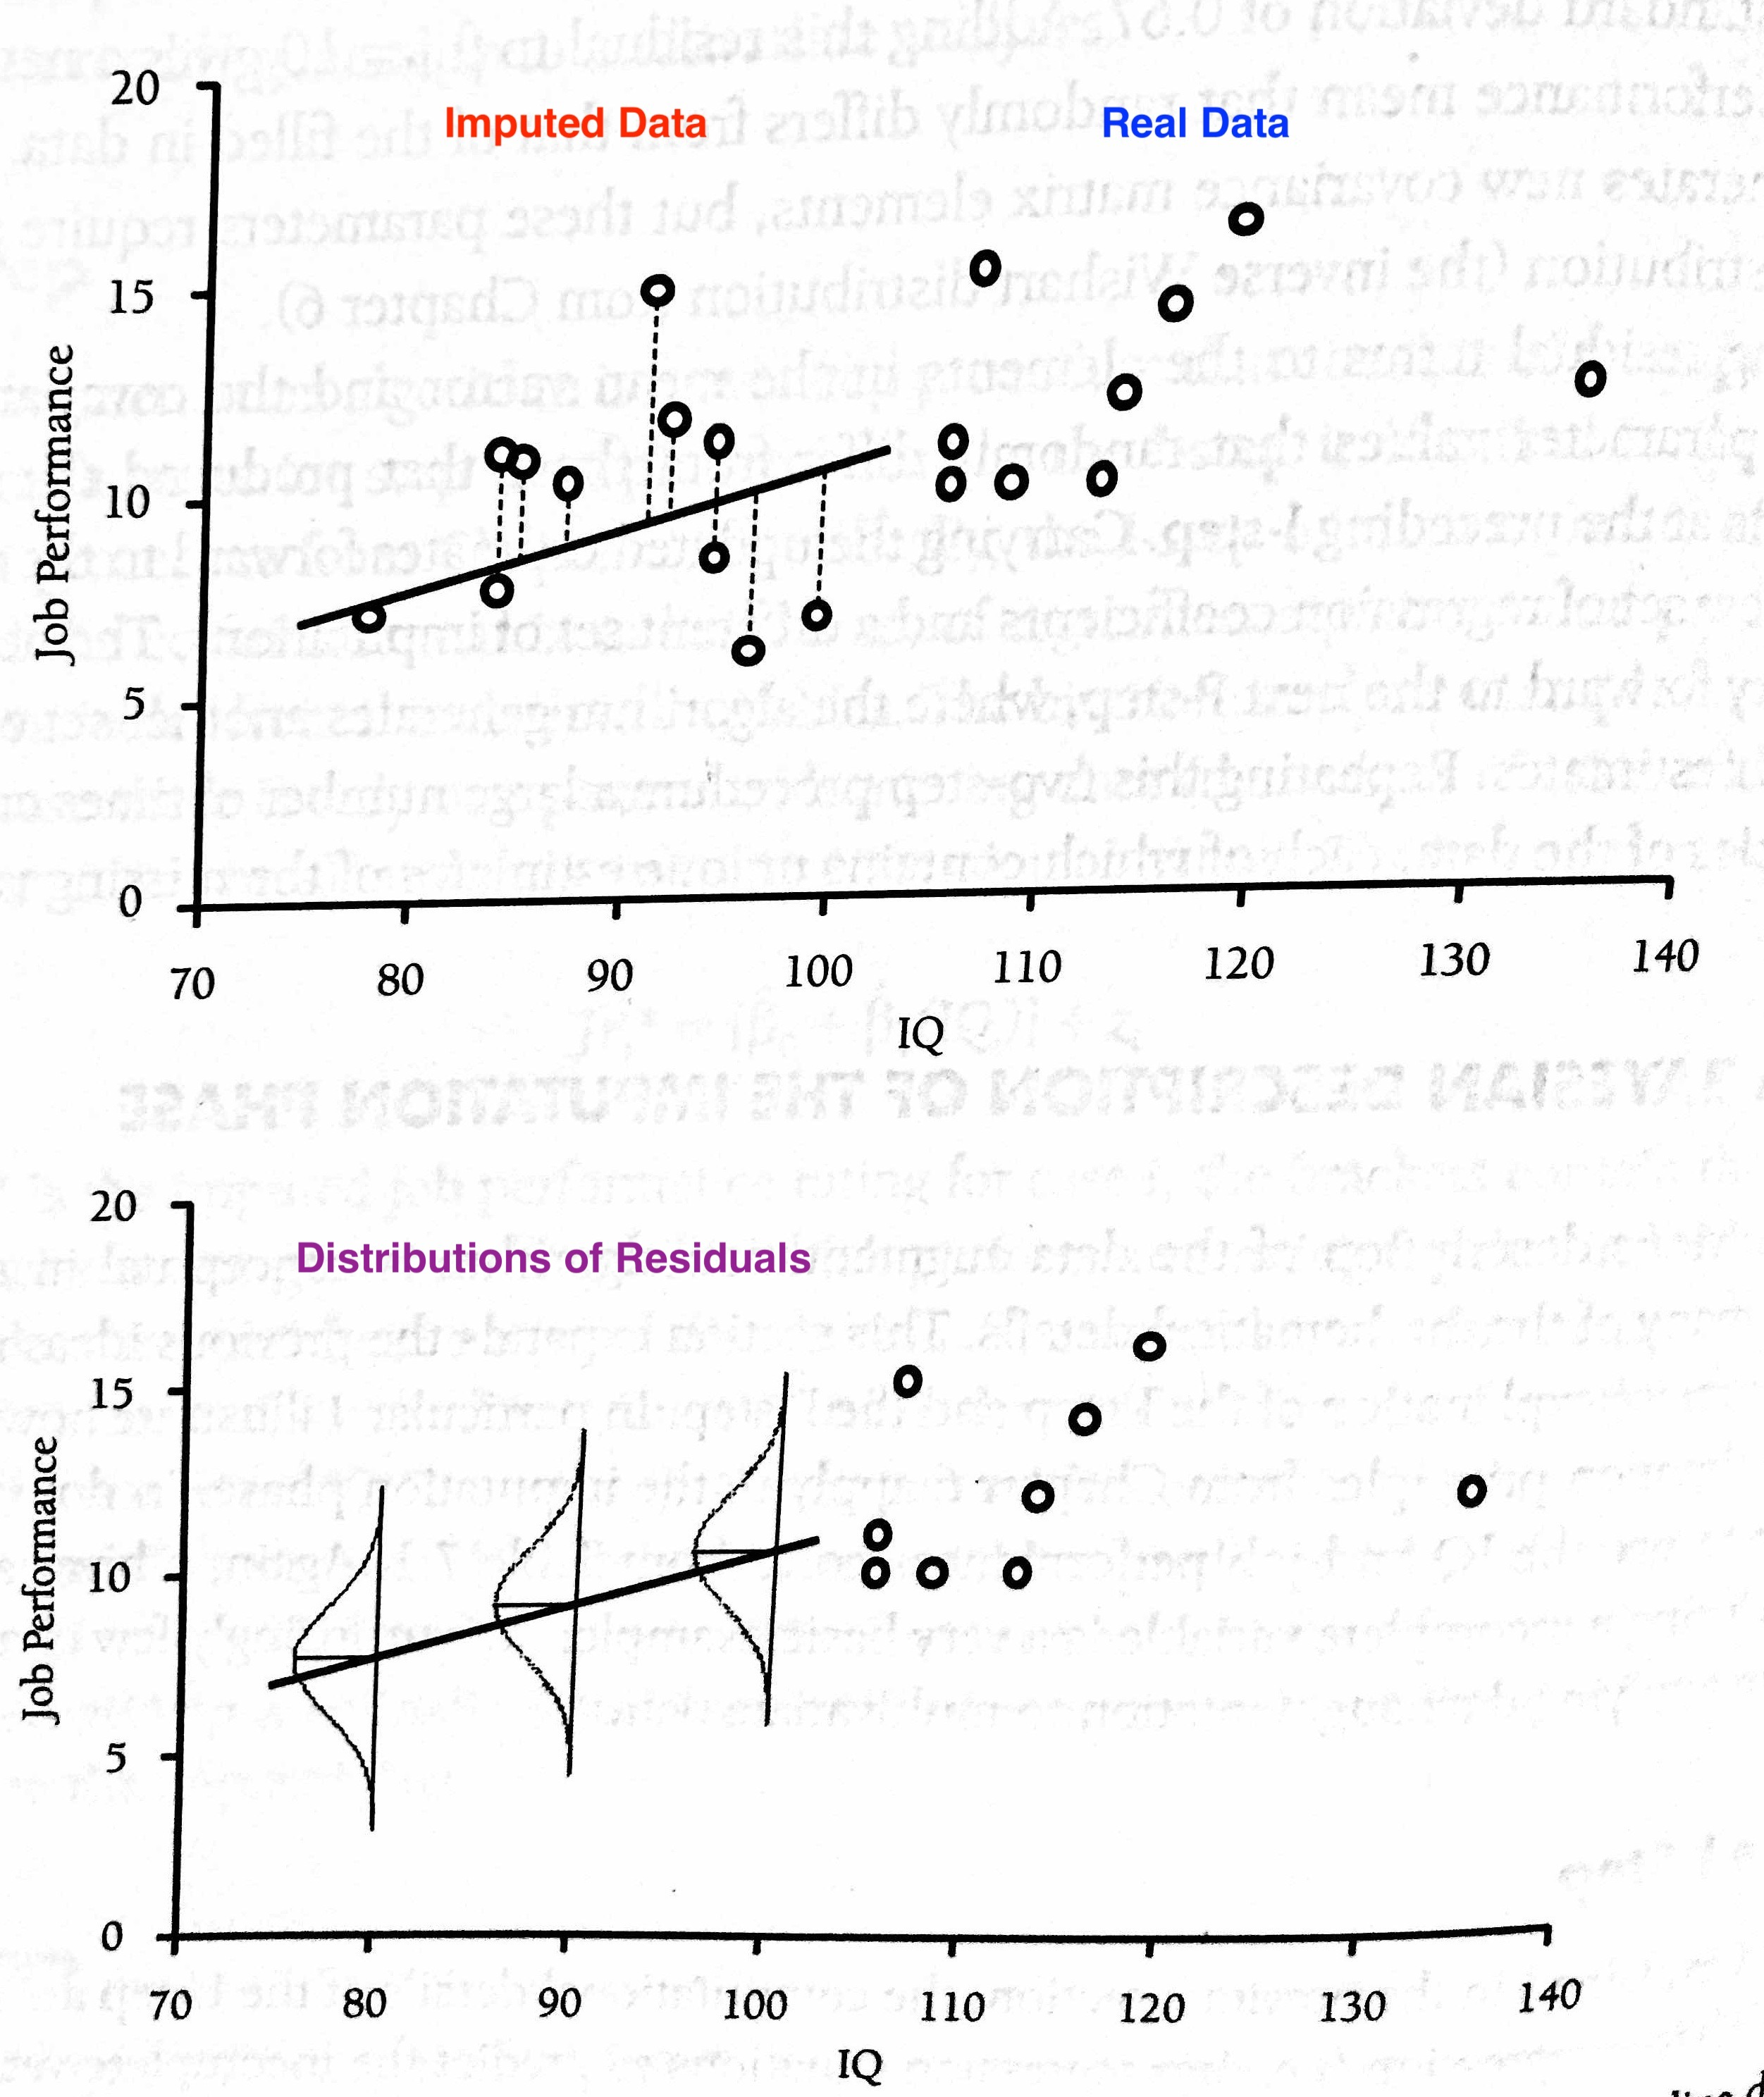
Bivariate example: Predicting job performance from IQ
Mean Vector contains
means of each variable
Covariance Matrix contains
variances of each variable, plus covariances between each pair of variables

Slide 6
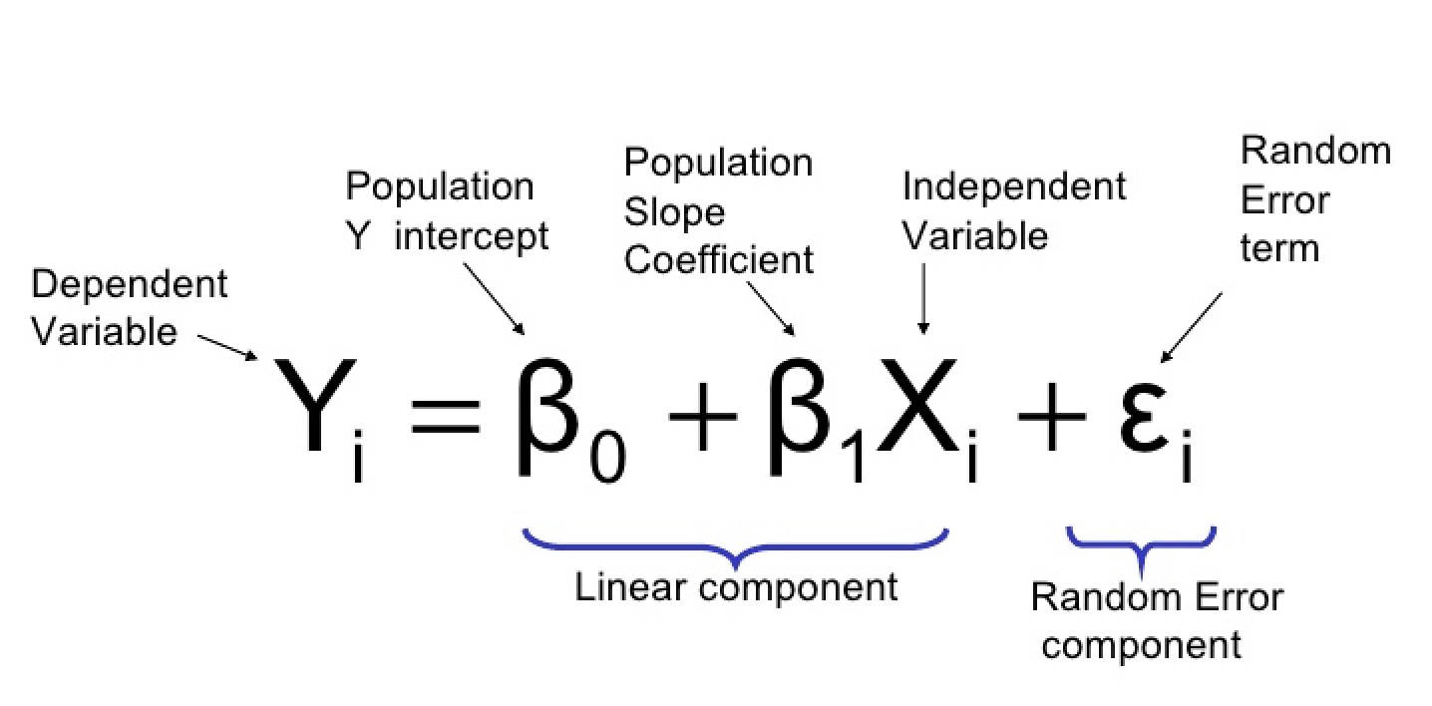
Linear Regression
Y = Job Performance Rating
X = IQ score

Slide 7
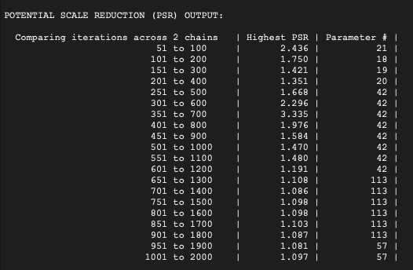
PSR measures convergence

