Slide 1
Weight for it . . .

Slide 2
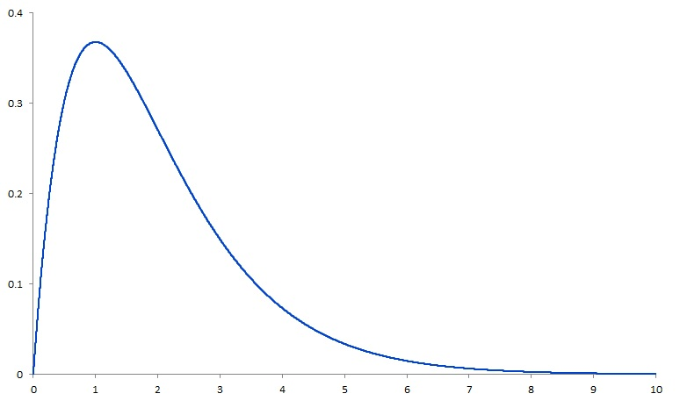
Weighting Data with the R Survey package
What does it mean to ”weight” data?
It’s all about “numerical impact”
Granular application: items v. persons
When to deploy - a judgement call
Cases
per
unit
time

Slide 3
Definitions
Marginal distribution: distribution of cases within a certain demographic cell (e.g., white females with a college degree)
Population margins: U.S. census targets for a cell
Sample margins: actual cases in that cell
Sampling probability: magnitude of difference between sample and population margins
Demographic weighting multiplier: value used for arithmetic transformation of data
Post-transformation: numerical impact of each cell is what it would be if sample margin = population margin

Slide 4
Demographic Crossings (Cells)
Var
Gender
Educ
Ethnic
Region
Hispanic
Asian
Black
White
Other
No HS
HS grad
Some college
BA plus
Northeast
South
Midwest
West
Male
Female
Cat
X
X
X
= 160 cells

Slide 5
How are weighting multipliers determined?
Raking: quantifying the difference between sample and population margins to estimate sampling probability
Iterative post-stratification: method by which sampling probabilities are transformed into weighting multipliers
Algorithm posits starting values for cell-wise multipliers, evaluates effects on all sample margins simultaneously
Iterative: incremental adjustments to multipliers until convergence (i.e., equalization of numerical impacts of sample and population margins
For math background, see Kolenikov (in press)

