Slide 1
Weighted
continuous norming
Tutorial on applying raking
in regression-based
norming with cNORM
by Sebastian Gary and Alexandra Lenhard

Slide 2
Agenda
Problem: Non-representative norm samples
Raking approach
Combining raking and regression-based norming
Tutorial
Simulation studies
Structure
Results
Conclusions & Recommendations

Slide 3
Problem of non-representative norm samples
Non-representative samples: Samples with deviation in proportions of stratification variables compared with the target population
Problem: Deviations with respect to variables influencing the latent ability can reduce norm score quality
Example: Ethnicity in language tests
Underrepresentation of non-native-born people with can result in downward-biased norm scores
 | Female | Male
Population | 48% | 52%
Sample | 30% | 70%

Slide 4


Raking as iterative post-stratification
Idea: Weighting every case with respect to the ratio between the proportion in the population and the proportion in the norm sample.
 | Female | Male
Population | 48% | 52%
Sample | 30% | 70%
$$w_{female}=\frac{48\%}{30\%}=1.60$$
$$w_{male}=\frac{52\%}{70\%}=0.74$$

Slide 5
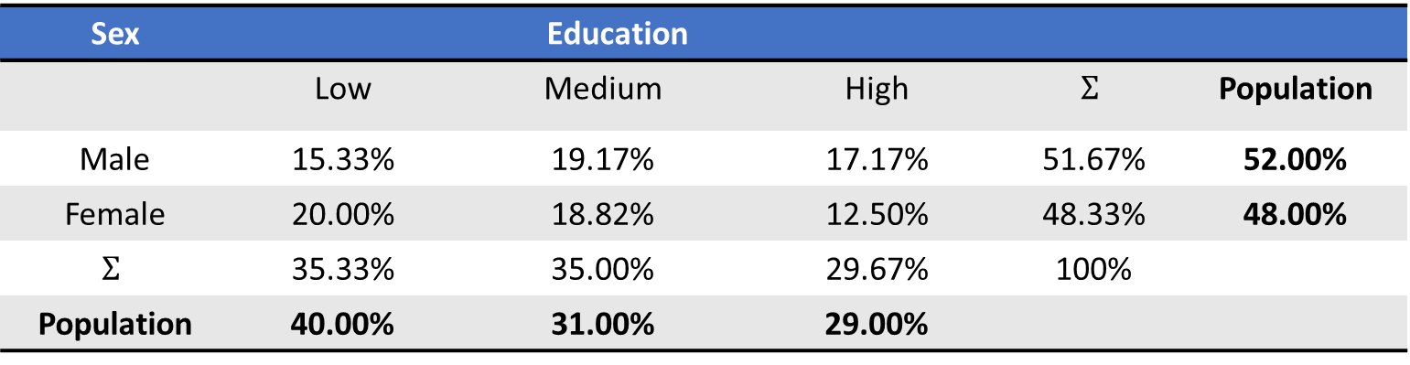
Raking as iterative post-stratification
Idea: Weighting every case with respect to the ratio between the proportion in the population and the proportion in the norm sample.
Raking: Successive post-stratification for one variable at a time
Iterated until the weights have converged
Sex | Education
 | Low | Medium | High | $$Σ$$ | Population
Male | 15.33% | 19.17% | 17.17% | 51.67% | 52.00%
Female | 20.00% | 18.82% | 12.50% | 48.33% | 48.00%
$$Σ$$ | 35.33% | 35.00% | 29.67% | 100%
Population | 40.00% | 31.00% | 29.00%

Slide 6
Raking as iterative post-stratification
Step | Education | Sex
0 |  | Female | Male
0 | Low | 1.0000 | 1.0000
 | Medium | 1.0000 | 1.0000
 | High | 1.0000 | 1.0000
48%
52%
Step | Education | Sex
 |  | Female | Male
3 | Low | 1.0498 | 1.1921
 | Medium | 0.8351 | 0.9483
 | High | 0.9260 | 1.0514
Step | Education | Sex
 |  | Female | Male
1 | Low | 0.9290 | 1.0759
 | Medium | 0.9290 | 1.0759
 | High | 0.9290 | 1.0759
48%
52%
Step | Education | Sex
 |  | Female | Male
4 | Low | 1.0514 | 1.1939
 | Medium | 0.8346 | 0.9476
 | High | 0.9247 | 1.0500
Step | Education | Sex
 |  | Female | Male
6 | Low | 1.0516 | 1.1938
 | Medium | 0.8347 | 0.9475
 | High | 0.9249 | 1.0499
40%
40%
31%
31%
29%
29%
48%
52%
Step | Education | Sex
 |  | Female | Male
2 | Low | 1.0391 | 1.2033
 | Medium | 0.8266 | 0.9573
 | High | 0.9165 | 1.0613
Step | Education | Sex
 |  | Female | Male
5 | Low | 1.0516 | 1.1937
 | Medium | 0.8347 | 0.9475
 | High | 0.9249 | 1.0499
40%
31%
29%

Slide 7
Combining raking and regression-based norming
How to integrate raking weights into regression-based norming?
X: Multiplying test raw scores with respective weights directly
Approach: Integrating raking weights using weighted rank estimation and weighted regression
Three-step approach
Computing and standardize Raking weights
Ranking raw scores using the standardized weights
Using the raking weights as regression weights in cNORM

Slide 8


Step 1
Computing raking weights based on norm sample and population marginals
Standardizing weights
Dividing all weights by the smallest raking weight
Ratio between the weights doesn’t change
$$w_{1}=1.8, w_{2}=1.6, w_{3}=0.7$$
$$→ {\tilde{w}}_{1}=2.57,{\tilde{w}}_{2}=2.29,{\tilde{w}}_{3}=1.00$$
$\frac{{\tilde{w}}_{1}}{{\tilde{w}}_{2}}=$ $\frac{\frac{w_{1}}{w_{3}}}{\frac{w_{2}}{w_{3}}}=\frac{w_{1}}{w_{2}}$
Computing and standardize raking weights
Ranking raw scores using the standardized weights
Using the raking weights as regression weights in cNORM

Slide 9
Step 2
Initial ranking of raw scores with raking weights
Actual start point of the regression-based norming process in cNORM
Using weighted ranking
Based on the standardized raking weights
Computing and standardize raking weights
Ranking raw scores using the standardized weights
Using the raking weights as regression weights in cNORM

Slide 10
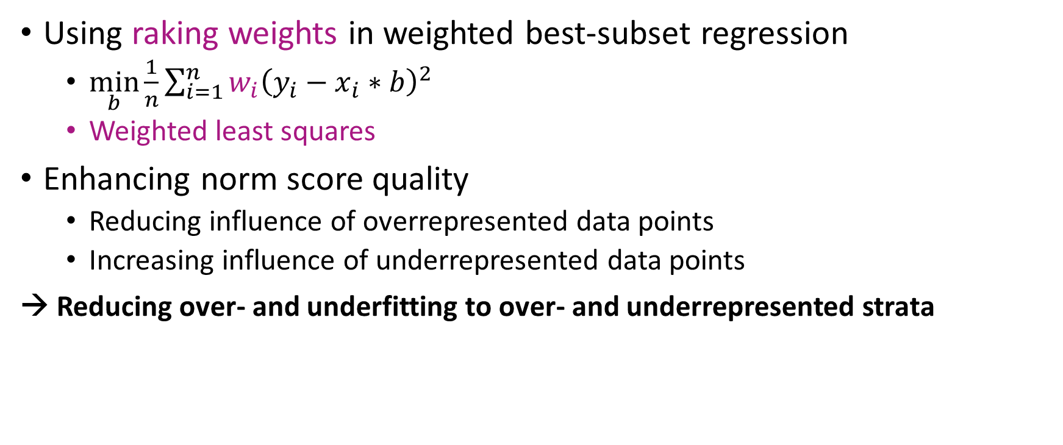
Step 3
Using raking weights in weighted best-subset regression
$\min_{b}{\frac{1}{n}\sum_{i=1}^{n}{{w_{i}\left(y_{i}−x_{i}∗b\right)}^{2}}}$
Weighted least squares
Enhancing norm score quality
Reducing influence of overrepresented data points
Increasing influence of underrepresented data points
→ Reducing over- and underfitting to over- and underrepresented strata
Computing and standardize raking weights
Ranking raw scores using the standardized weights
Using the raking weights as regression weights in cNORM

Slide 11
Integration of raking in cNORM
Integration in two steps
computeWeights(): Computes, standardizes and returns the raking weights for every subject in the norm sample
cnorm():
Integrates raking weights into the initial ranking process automatically, if raking weights are available
Conducts the weighted regression

Slide 12


Tutorial

Slide 13
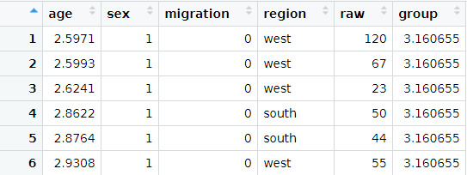
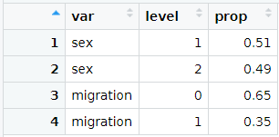
Tutorial
Loading data set ppvt
Loading population marginals

Slide 14
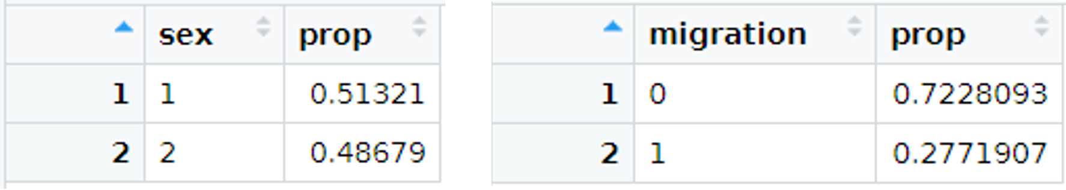
Tutorial
Computing marginal of the current norm sample

Slide 15
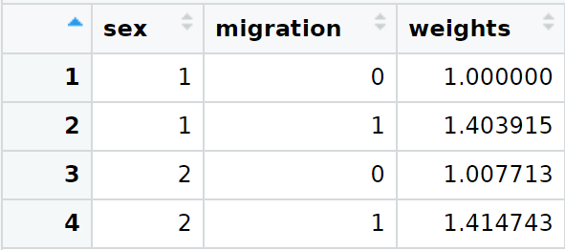
Tutorial
Step 1: Computing and standardizing raking weights

Slide 16
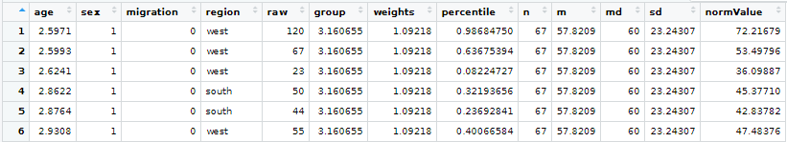
Tutorial
Step 2: Ranking with raking weights using Harrell-Davis-quantile estimation
Computing powers and interactions of variable group, normValue and their interactions

Slide 17
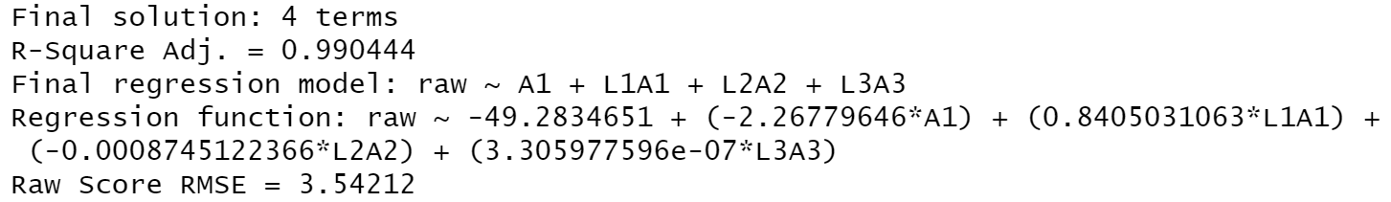
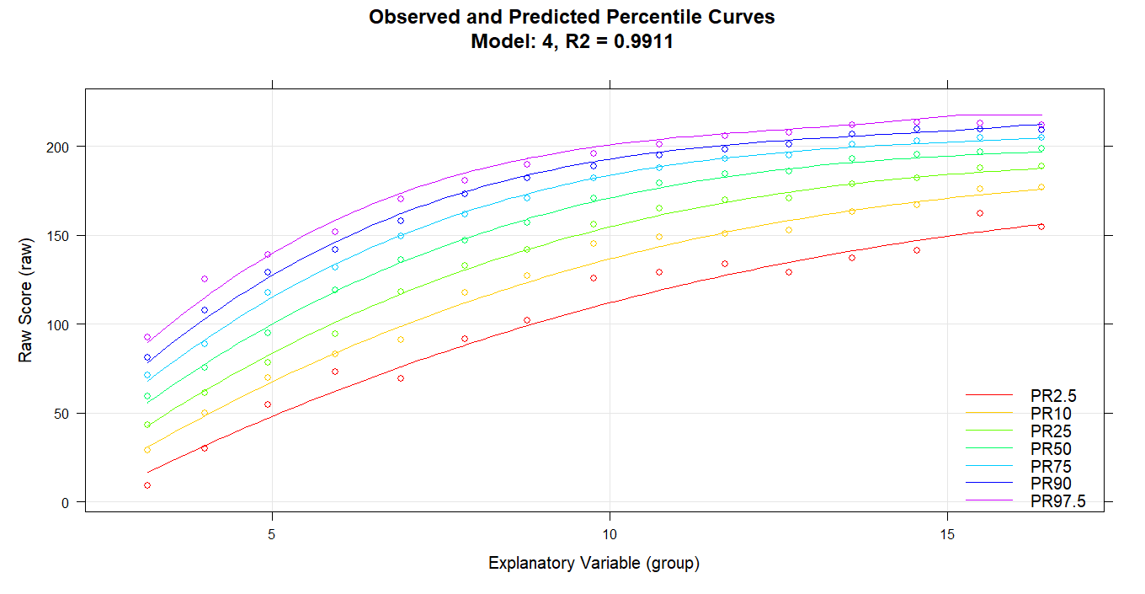
Tutorial
Step 3: Using raking weights in weighted best-subset regression

Slide 18
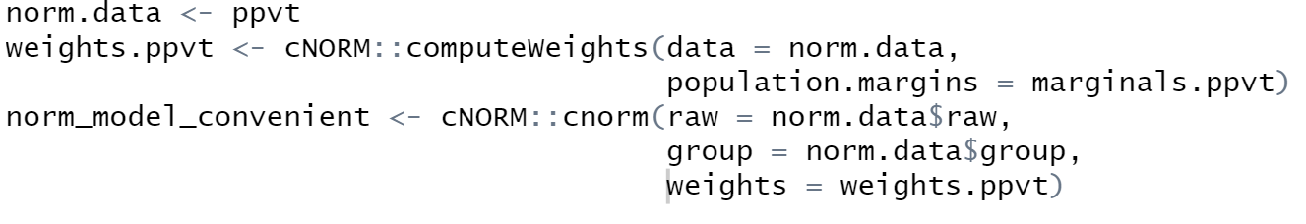
Tutorial
Shortcut: Using cnorm() function
→ Returns equal results

Slide 19
Simulation studies
Aims
Comparing unweighted continuous norming (SCN) to weighted continuous norming (WCN) in biased and unbiased norm samples
Comparing different types and degrees of non-representativeness
(Comparing different types of weighted ranking procedures)
Method:
Modelling a typical cognitive variable during adolescence
Modelling three stratification variables within the population
Modelling a psychometric test with 30 items (based on IRT)
Drawing unbiased or (deliberately) biased norm samples (n = 100 per age cohort)
Applying weighted and unweighted continuous norming (with cNORM)
Comparing the results to the exact norm scores in the population by means of RMSE and MSD
Notes:
Therefore, we generated representative and non-representative norm samples based on a latent ability model describing the relationship between age, a variety of stratification variables and a person’s latent ability.
Based on these different norm samples representing different types and severities of non-representativeness, norm models were computed, i.e., computed with and without Raking, and the resulting norm models were used to predict norm scores for representative validation sample, which already contained ideal norm scores.

Slide 20
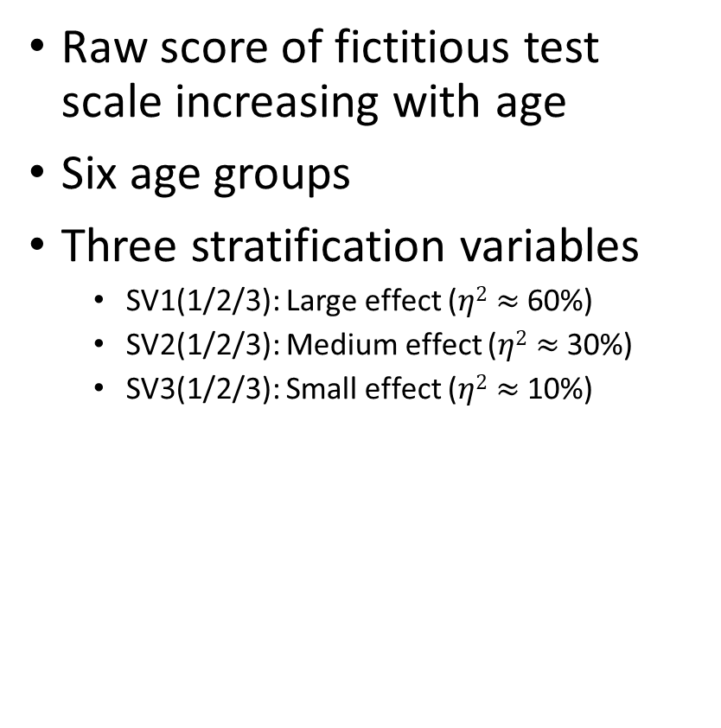
Population model
Raw score of fictitious test scale increasing with age
Six age groups
Three stratification variables
SV1(1/2/3): Large effect ($η2≈$60%)
SV2(1/2/3): Medium effect ($η2≈$30%)
SV3(1/2/3): Small effect ($η2≈$10%)

Slide 21
Sampling Condition 1: unbiased sample
All marginals at least approximately correct
Representativeness only limited by sample size of n = 100 per age cohort
100 repetitions
5.0
4.5
4.0
3.5
3.0
2.5
2.0
1.5
1.0
0.5
0.0

Slide 22
Sampling Condition 2
5.0
4.5
SV1 | Level 1 | Level 2 | Level 3
Target | 40% | 20% | 40%
Actual | 28% | 20% | 52%
4.0
3.5
3.0
2.5
2.0
1.5
1.0
0.5
0.0

Slide 23
Sampling Condition 3
5.0
4.5
SV1 | Level 1 | Level 2 | Level 3
Target | 40% | 20% | 40%
Actual | 20% | 20% | 60%
4.0
3.5
3.0
2.5
2.0
1.5
1.0
0.5
0.0

Slide 24
Sampling Condition 4
5.0
4.5
SV1 | Level 1 | Level 2 | Level 3
Target | 40% | 20% | 40%
Actual | 57% | 20% | 23%
4.0
3.5
3.0
2.5
2.0
1.5
1.0
0.5
0.0

Slide 25
Sampling Condition 5
5.0
4.5
SV1 | Level 1 | Level 2 | Level 3
Target | 40% | 20% | 40%
Actual | 60% | 10% | 30%
4.0
3.5
3.0
2.5
2.0
1.5
1.0
0.5
0.0

Slide 26
Sampling Condition 6
5.0
4.5
SV1 | Level 1 | Level 2 | Level 3
Target | 40% | 20% | 40%
Actual | 30% | 40% | 30%
4.0
3.5
3.0
2.5
2.0
1.5
1.0
0.5
0.0

Slide 27
Sampling Condition 7: Clustered sampling
Biased marginals in each single age cohort
Correct marginals on average
Example: Children with high parental education overrepresented in grade 1, 3 and 5 but unrepresented in grade 2, 4 and 6
5.0
4.5
4.0
3.5
3.0
2.5
2.0
1.5
1.0
0.5
0.0

Slide 28
Sampling Condition 8: Biased joint probabilities
Unbiased marginals, biased joint probabilities
5.0
4.5
4.0
SV1 | SV2 | SV3 | Target | Actual
1 | 1 | 1 | 13.0% | 7.2%
1 | 1 | 2 | 1.0% | 2.4%
1 | 1 | 3 | 1.0% | 2.4%
1 | 2 | 1 | 9.0% | 9.6%
1 | 2 | 2 | 2.0% | 3.2%
1 | 2 | 3 | 7.2% | 1.6%
⁞ | ⁞ | ⁞ | ⁞ | ⁞
3 | 3 | 3 | 2.8% | 2.4%
3.5
3.0
2.5
2.0
1.5
1.0
0.5
0.0

Slide 29
Using cross-classifications
SV1 | SV2
Level 1 | Level 1
Level 1 | Level 2
Level 1 | Level 3
Level 2 | Level 1
Level 2 | Level 2
Level 2 | Level 3
Level 3 | Level 1
Level 3 | Level 2
Level 3 | Level 3
Cross-classification
SV1: 1 & SV2: 1
SV1: 1 & SV2: 2
SV1: 1 & SV2: 3
SV1: 2 & SV2: 1
SV1: 2 & SV2: 2
SV1: 2 & SV2: 3
SV1: 3 & SV2: 1
SV1: 3 & SV2: 2
SV1: 3 & SV2: 3
New SV ordered
Highest performance, m₁, var₁
⁞
⁞
⁞
⁞
⁞
⁞
⁞
Lowest performance, m₉, var₉

Slide 30
Using cross-classifications
SV1 | SV2
Level 1 | Level 1
Level 1 | Level 2
Level 1 | Level 3
Level 2 | Level 1
Level 2 | Level 2
Level 2 | Level 3
Level 3 | Level 1
Level 3 | Level 2
Level 3 | Level 3
Cross-classification
SV1: 1 & SV2: 1
SV1: 1 & SV2: 2
SV1: 1 & SV2: 3
SV1: 2 & SV2: 1
SV1: 2 & SV2: 2
SV1: 2 & SV2: 3
SV1: 3 & SV2: 1
SV1: 3 & SV2: 2
SV1: 3 & SV2: 3
New SV ordered
Highest performance
⁞
⁞
⁞
⁞
⁞
⁞
⁞
Lowest performance
New SV reduced
High performance m₁, var₁
Average performance m₂, var₂
Low performance m₃, var₃

Slide 31
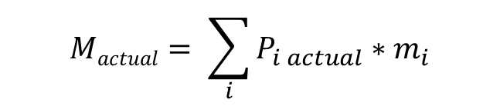
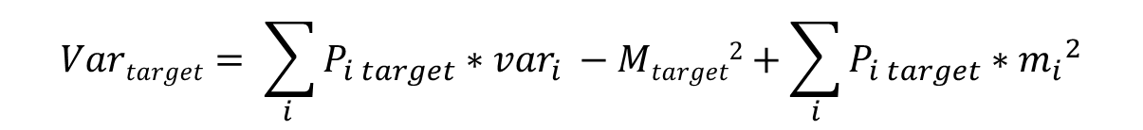

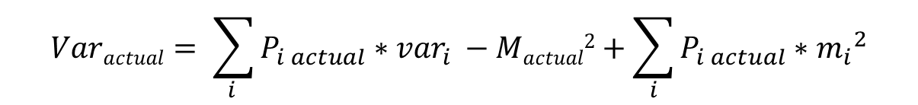
Comparing mean and variance
$$Mactual= \sum_{i}{P_{i actual}}∗m_{i}$$
$$Varactual= \sum_{i }{P_{i actual}}∗{var}_{i }−Mactual2+\sum_{i}{P_{i actual}}∗{m_{i}}^{2}$$
$P_{i actual}$ = Proportion of subsample i in biased sample
$$Mtarget= \sum_{i}{P_{i target}}∗m_{i}$$
$$Vartarget= \sum_{i }{P_{i target}}∗{var}_{i }−Mtarget2+\sum_{i}{P_{i target}}∗{m_{i}}^{2}$$
$P_{i target}$ = Proportion of subsample i in representative sample

Slide 32
Conclusions
Non-representativeness in most cases leads to (moderately) increased error of the normed scores
In most but not in all cases, WCN can reduce negative effects of non-representative norm samples
With cNORM, representativeness need not necessarily be established in every single age group
Data collection should be as random as possible
Only use stratification for variables with considerable influence on the dependent variable
If available, the probabilities of cross-classifications of the stratification variables can be used
Avoid too many levels of the different stratification variables (the weights should not get too high!) -> Grouping of different levels

Slide 33
Thank you for your attention!
Any questions?

