Slide 1

Background
Order for surgery
Admission
OS
A
[ Input ]
Start
Treatment Proposal
A a process specification N
Log trace with time and other properties
Sorting transactions by time does not follow the model
TP
Electrocardiography
Discharge
K
D2
VS
PA
Visit Surgeon
SP
Preoperative
Assessment
End
Surgery
Proposal
eg : TP – VS – K – PA – SP - ……
Activity | Resource | Date/Time
Treatment Proposal | …… | 2019.09.21/00:00
Visit Surgeon | …… | 2019.09.21/02:00
K | …… | 2019.09.22/04:20
PA | …… | 2019.09.22/05:00
SP | …… | 2019.09.22/11:23
…… | …… | ……

Slide 2
Background
Minimum Edit-Distance （MED）
You have the following 3 operations permitted on a trace:
Insert a character
Delete a character
Replace a character
Minimum Time-Distance （MTD）
∃ σ[i] ∈ σ with timestamp t_{i} and ∃ σ[j] ∈ σ with timestamp t_{j} （i < j）
The cost of moving σ[j] to the front of σ[i] is defined as : | t_{i} – t_{j} |
Eg: min( (2*t4-t3-t2) ,(t4-t2) )
start
a
b
event | a | c | d | b
time | t1 | t2 | t3 | t4
d
c
end

Slide 3
A * algorithm
Process definition：
start
A
B
C
D
E
end
H
G
F
Pre:
Event | A | B | D | C | G | H | E | F
Time | t1 | t2 | t3 | t4 | t5 | t6 | t7 | t8
Adjust:
Event | A | B | D | C | G | E、F、H
Time | t1 | t2 | t3 | t4 | t5 | t6
Cost = (t7-t6+t8-t6)

Slide 4
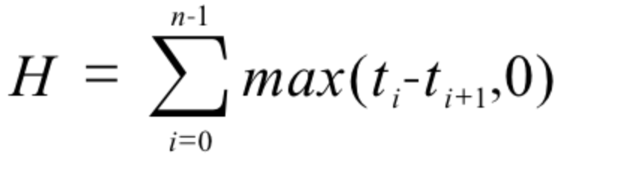
Greedy Best-First-Search
Greedy Best-First-Search ：F = G + H ，H is an estimate of future costs.
Example of calculation H
H = 4-2 = 2
event | a | c | d | b
time | 1 | 2 | 3 | 4
start
a
b
d
c
end

Slide 5
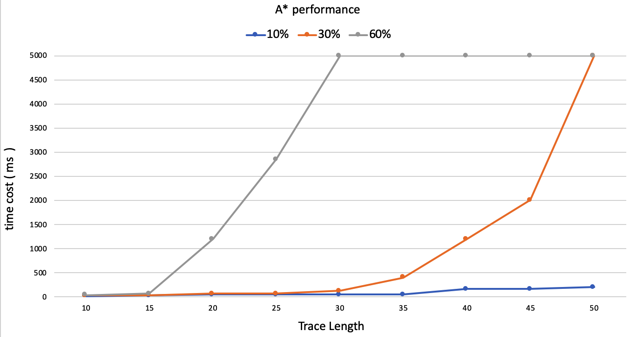
A * algorithm

Slide 6
A * algorithm
Start
End
Model priority annotation：multi level and multi branch
Priority structure：P₁ / [Branch]-P₂ / [Branch]-P₃ / ……
A
B
C
D
G
I
E
F
H
Transition | Priority
A | 0
B | 1
C | 1/[0]-0
D | 1/[0]-1
Transition | Priority
E | 1/[1]-0
F | 1/[1]-1
G | 2
H | 3
I | 4
Transition | Priority
I | 4

Slide 7
A * algorithm
H is a maximum lower bound of prediction
σ[ x ]
σ[ x+1 ]
time
t0
t1
t2
t3
t4
Adjustment | Cost σ[ x ] | Cost σ[ x+1 ] | Sum Cost
t0 | t1-t0 | t3-t0 | (t3-t1)+2(t1-t0)
t2 | t2-t1 | t3-t2 | (t3-t1)+
t4 | t4-t1 | t4-t3 | (t3-t1)+2(t4-t3)

Slide 8
Use cost estimation to find the best adjustment event directly.
Start
End
A
B
C
D
G
H
E
F
event | Cost G | Cost H
B | 2 | 4
A | 2 | 4
C | 6 | 2
D | 4 | 2
G | 6 | 2
H | 0 | 6
event | B | A | G | D | C | H
time | 1 | 3 | 4 | 6 | 8 | 11
event log
Notes:
B：
C:

Slide 9
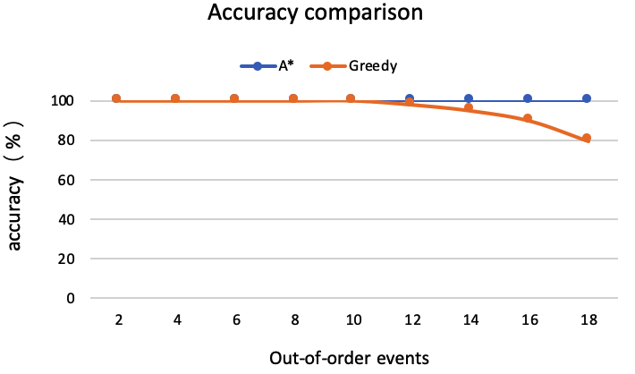
A * algorithm
Trace size: 20 events.。Without loop.

Slide 10
A * algorithm
Subordination of sub loop and branch section
L
Start
A
B
C
D
G
I
J
K
M
E
F
H

Slide 11
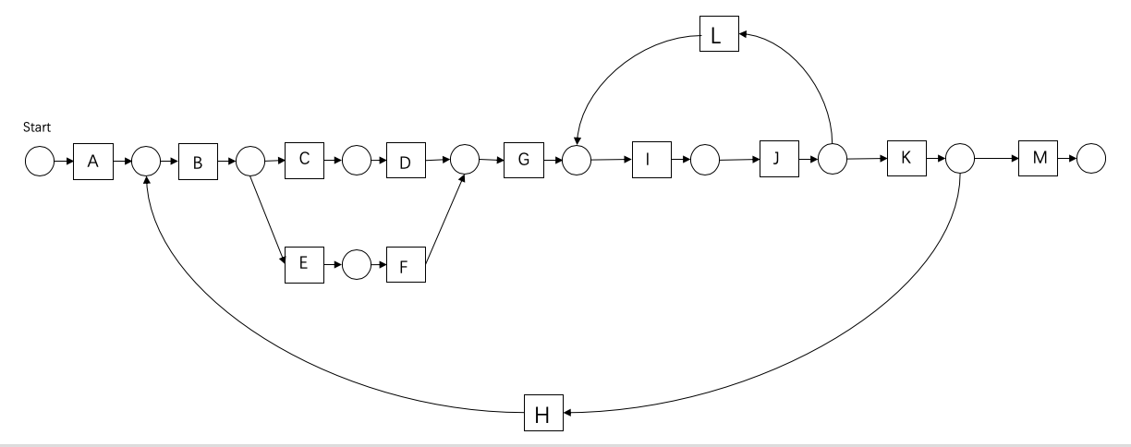
A * algorithm
Subordination of sub loop and branch section: min(costH)
Eg: AB CEFD G IJIJLL GKKM

