Slide 1

Let's Look At An Example

Slide 2

I Start A New Project!

Slide 3

Add A Checkpoint
Initialize Project

Slide 4
I work on the navbar
Initialize Project

Slide 5
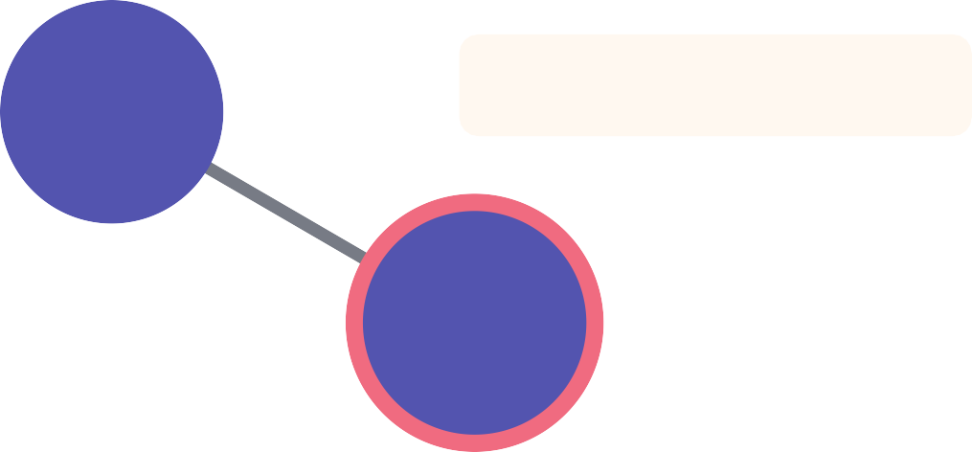
Add A Checkpoint
Initialize Project
Add Top Navbar

Slide 6
I add some content
Initialize Project
Add Top Navbar

Slide 7
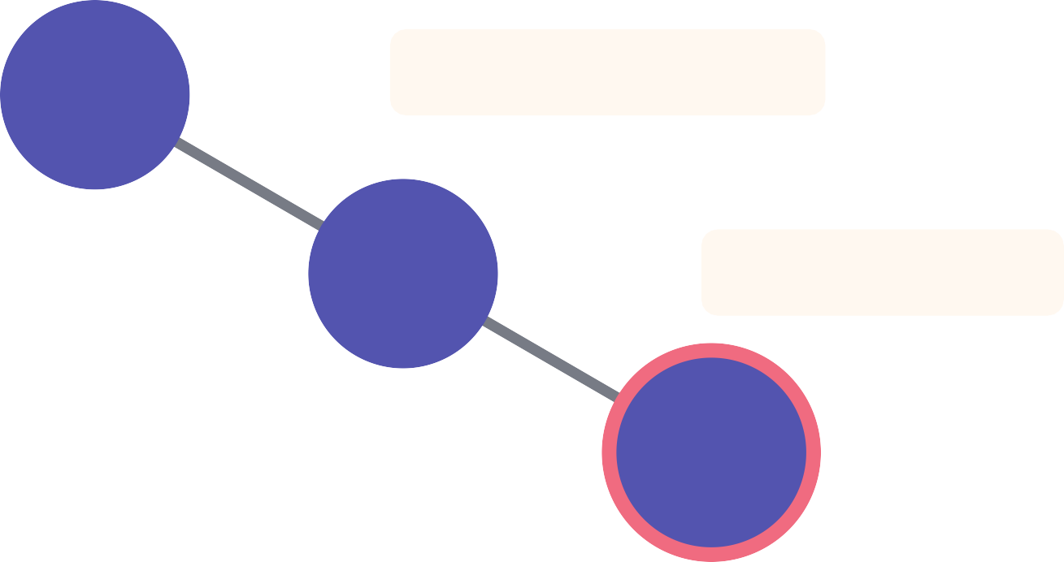
Add A Checkpoint
Initialize Project
Add Top Navbar
Add First Row

Slide 8
I add more content
Initialize Project
Add Top Navbar
Add First Row

Slide 9
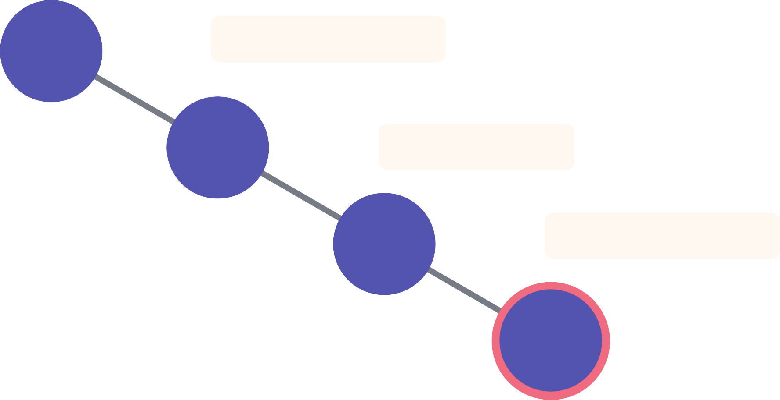
Add A Checkpoint
Initialize Project
Add Top Navbar
Add First Row
Finish Bottom Row

Slide 10


I change the theming
Initialize Project
Add Top Navbar
Add First Row
Finish Bottom Row

Slide 11
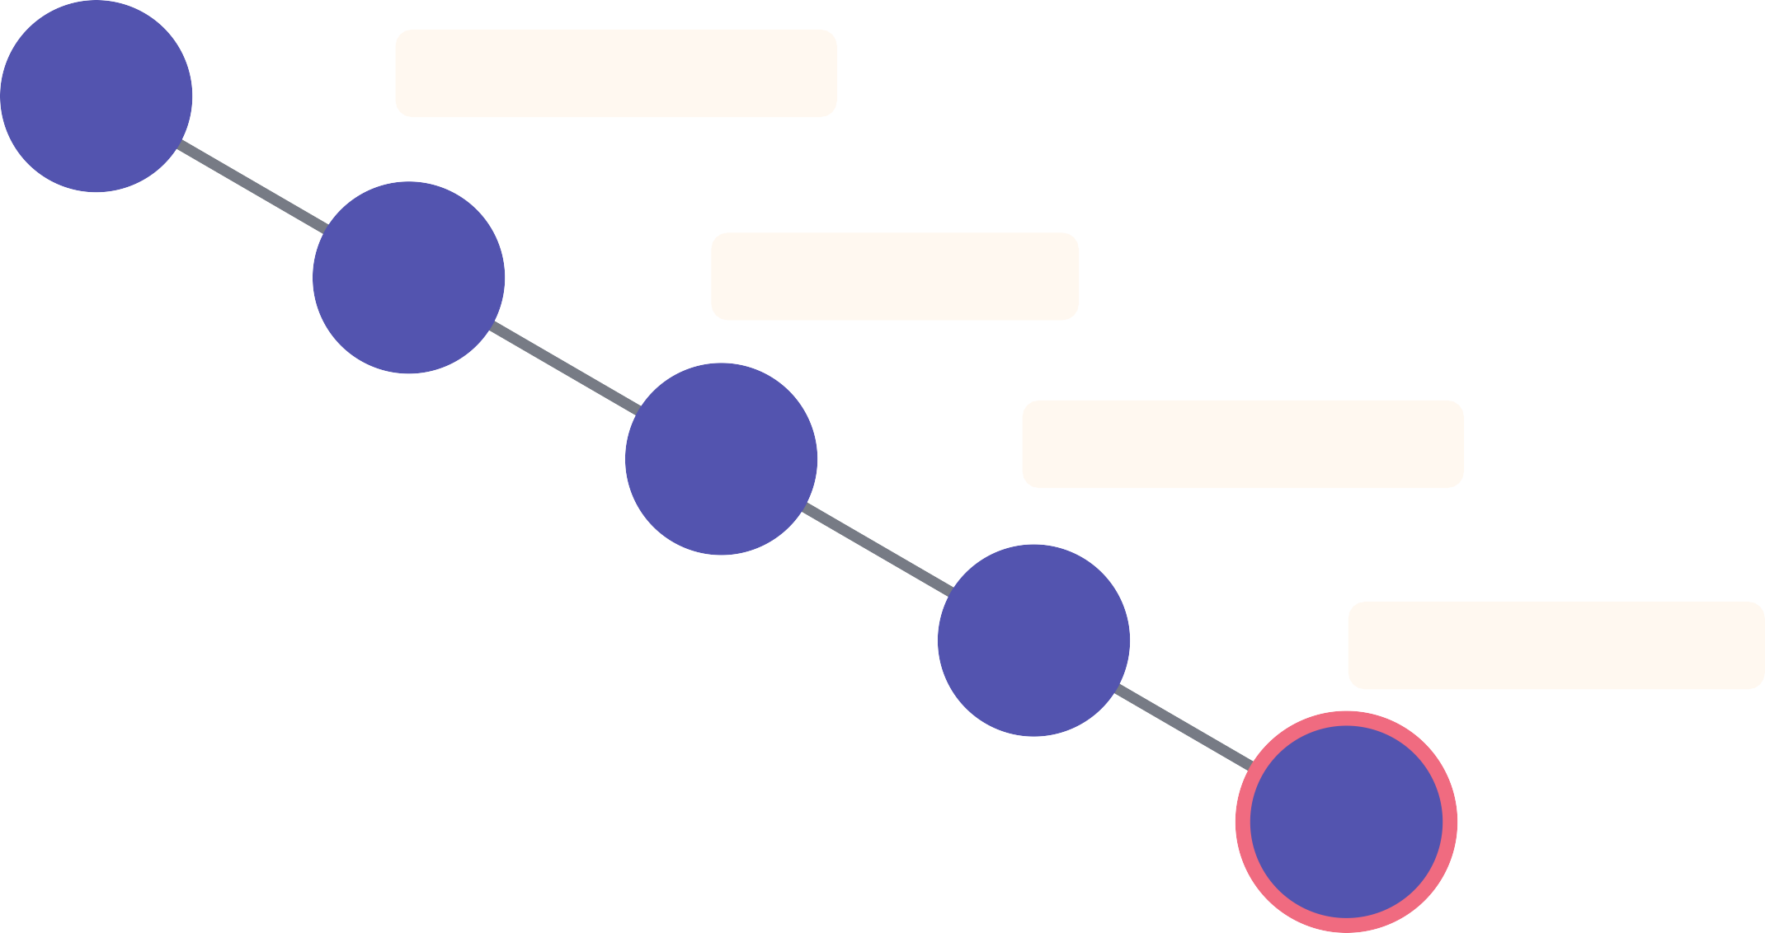
Add A Checkpoint
Initialize Project
Add Top Navbar
Add First Row
Finish Bottom Row
Add Dark Theme

Slide 12


I alter the navbar
Initialize Project
Add Top Navbar
Add First Row
Finish Bottom Row
Add Dark Theme

Slide 13
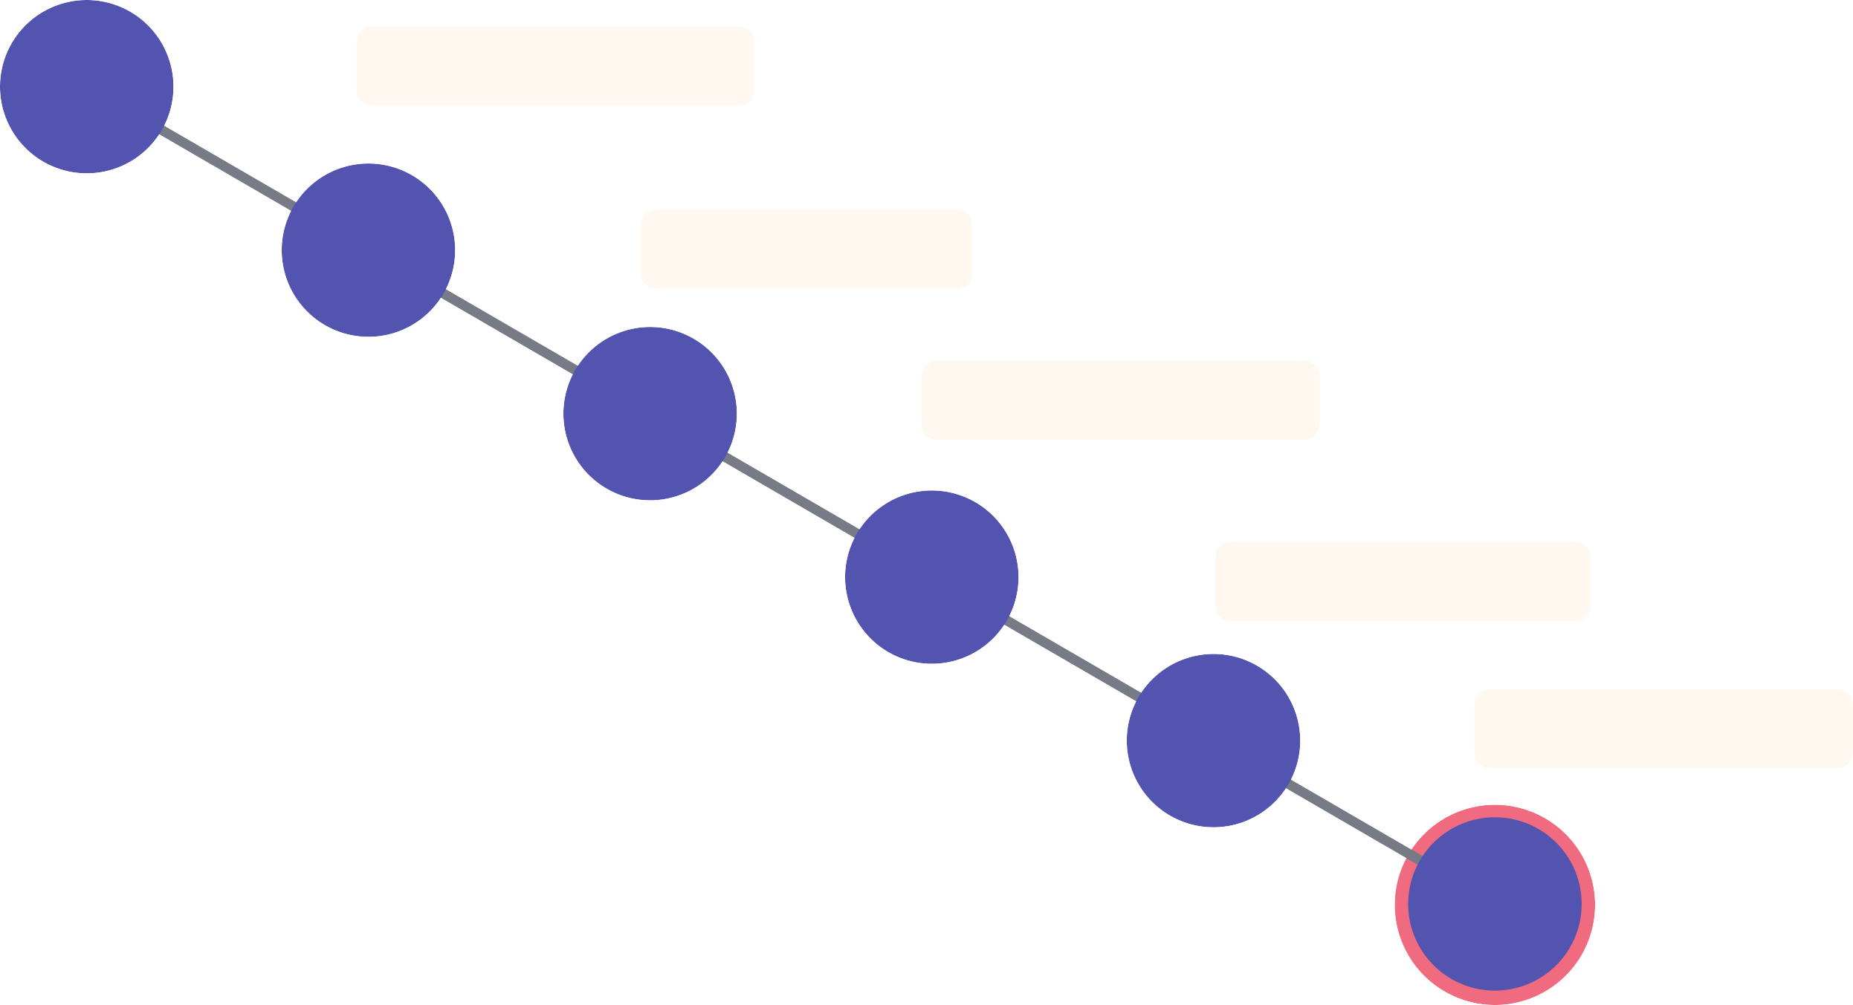
Add A Checkpoint
Initialize Project
Add Top Navbar
Add First Row
Finish Bottom Row
Add Dark Theme
Update Navbar

Slide 14

ANGRY BOSS SAYS . THE COLORS ARE BAD!

Slide 15

No problem!
Initialize Project
Add Top Navbar
Add First Row
Finish Bottom Row
Add Dark Theme
Update Navbar

Slide 16
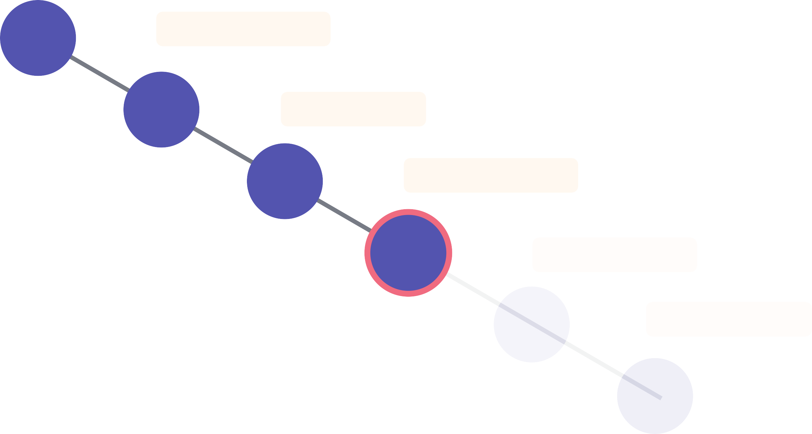
I can go back to prior checkpoints I made!
Initialize Project
Add Top Navbar
Add First Row
Finish Bottom Row
Add Dark Theme
Update Navbar

Slide 17


I can even start more work o f of an old checkpoint
Initialize Project
Add Top Navbar
Add First Row
Finish Bottom Row
I add more content!
Add Dark Theme
Update Navbar

Slide 18
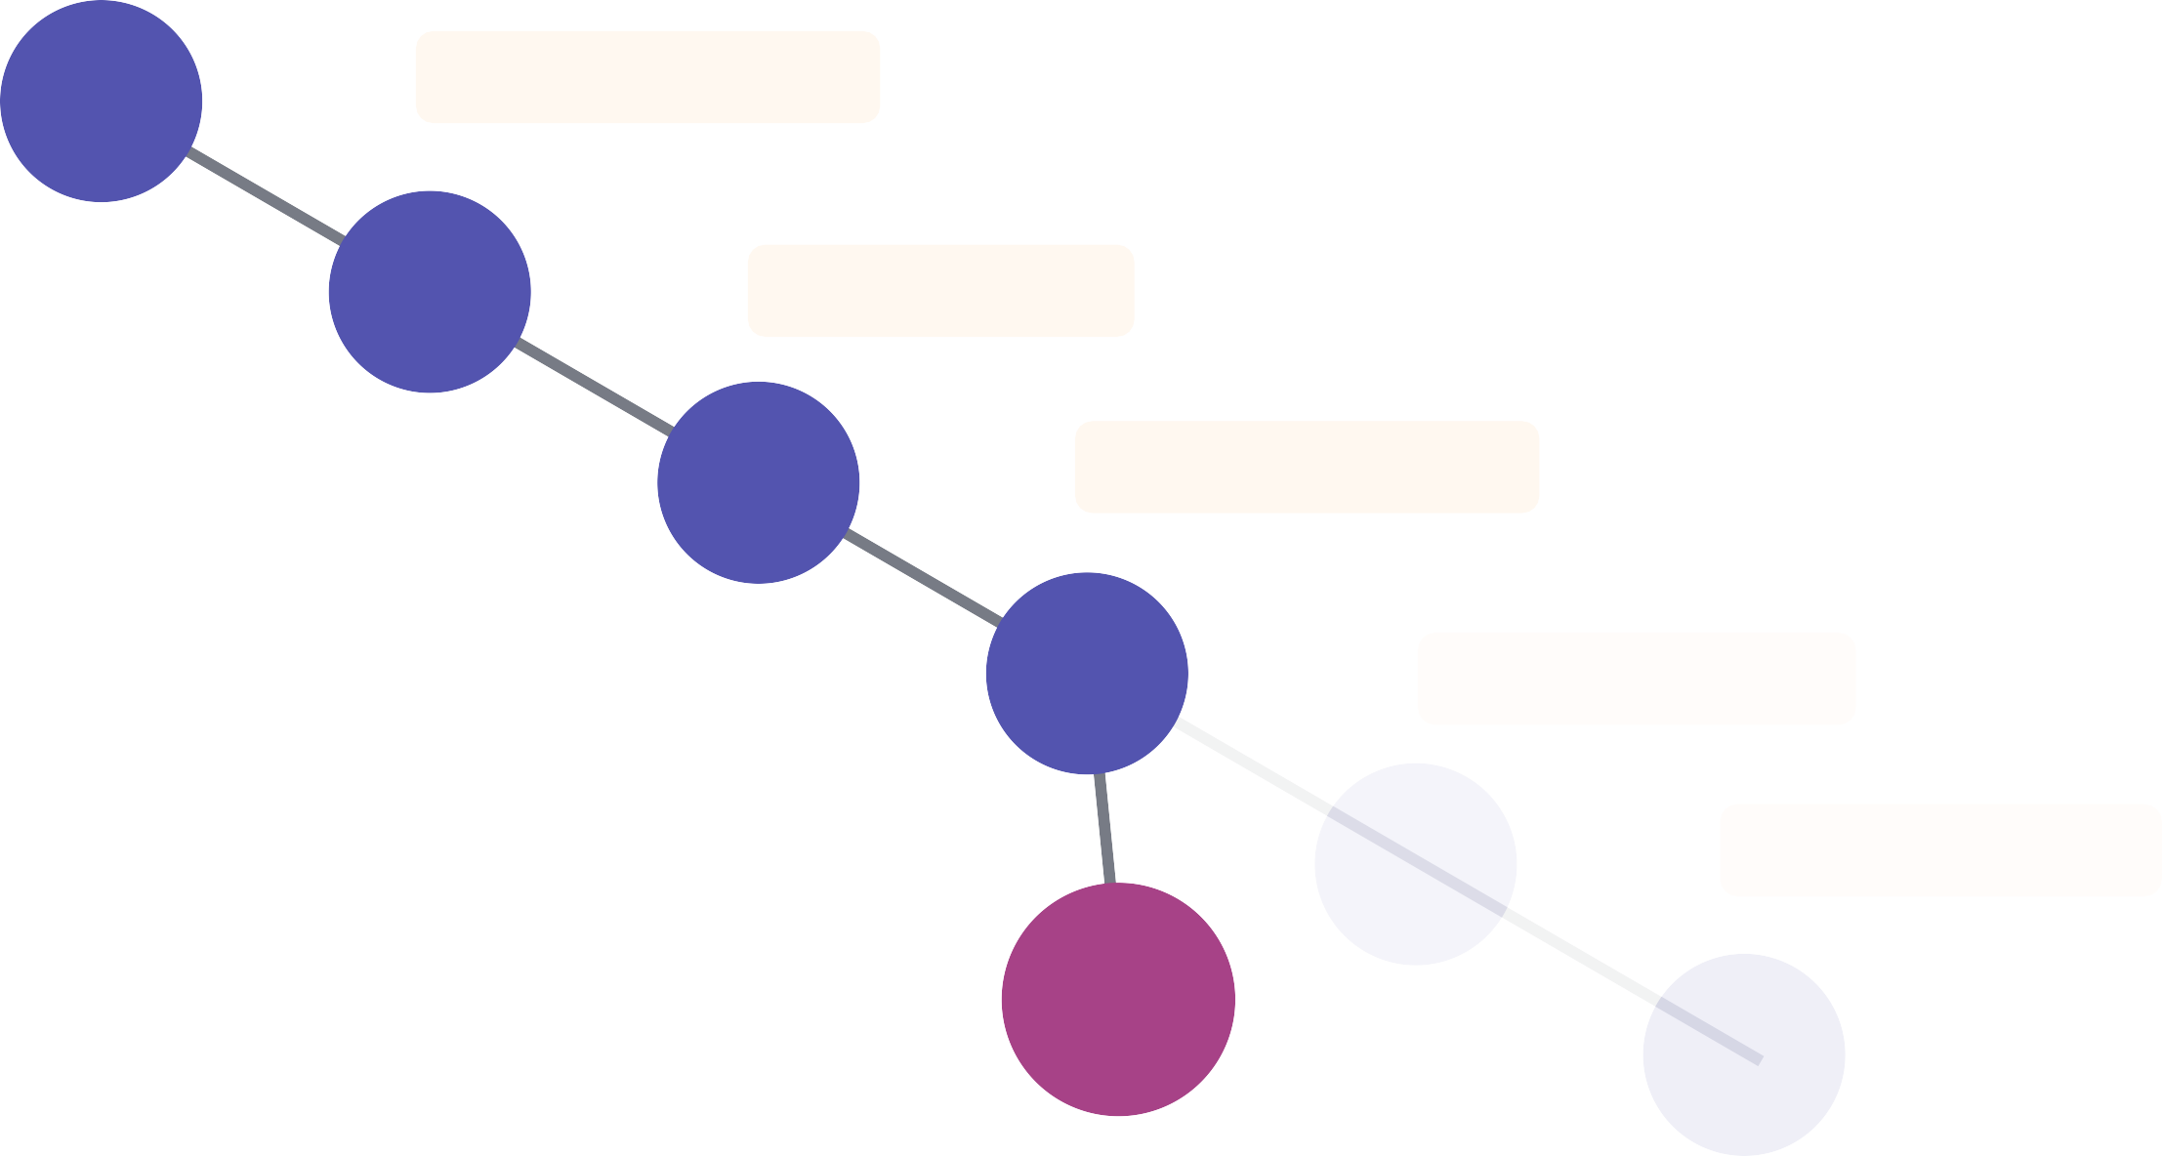
I add a new checkpoint!
Initialize Project
Add Top Navbar
Add First Row
Finish Bottom Row
Add Dark Theme
Update Navbar
Add Third Row

Slide 19

I add a new footer
Initialize Project
Add Top Navbar
Add First Row
Finish Bottom Row
Add Dark Theme
Update Navbar
Add Third Row

Slide 20
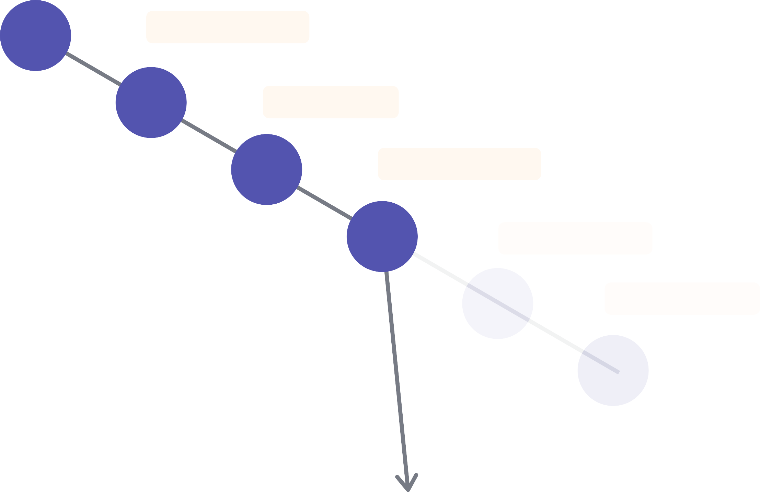
Another checkpoint!
Initialize Project
Add Top Navbar
Add First Row
Finish Bottom Row
Add Dark Theme
Update Navbar
Add Third Row
Add Footer

Slide 21
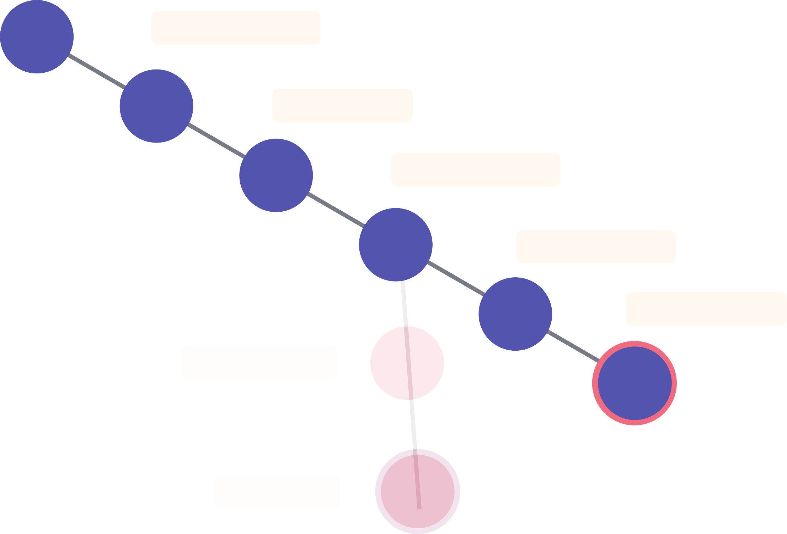
I can switch back to a dark mode checkpoint
Initialize Project
Add Top Navbar
Add First Row
Finish Bottom Row
Add Dark Theme
Update Navbar
Add Third Row
Add Footer

Slide 22

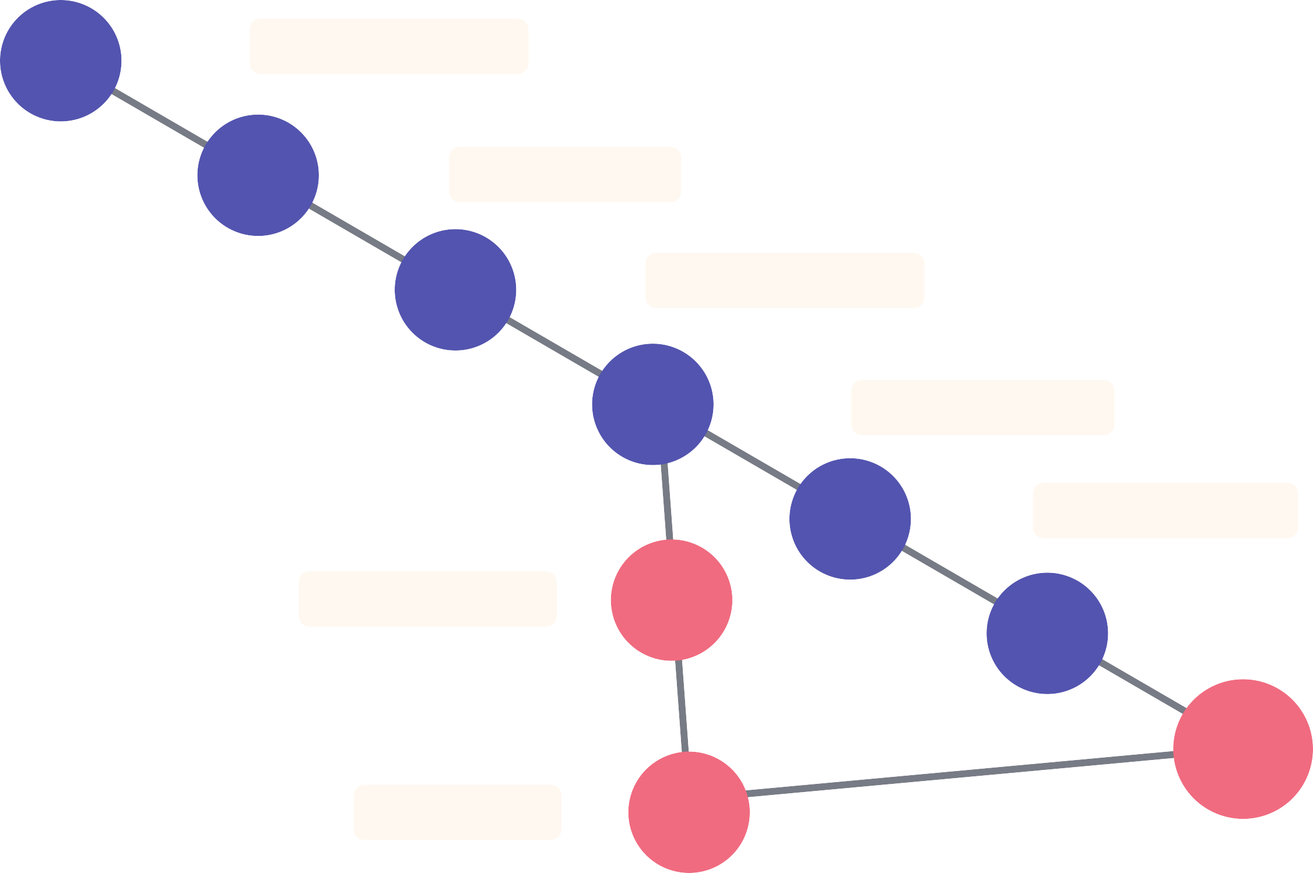
And I can even combine checkpoints!
Initialize Project
Add Top Navbar
Add First Row
Finish Bottom Row
Add Dark Theme
Update Navbar
Add Third Row
Combination
Add Footer

