Slide 1

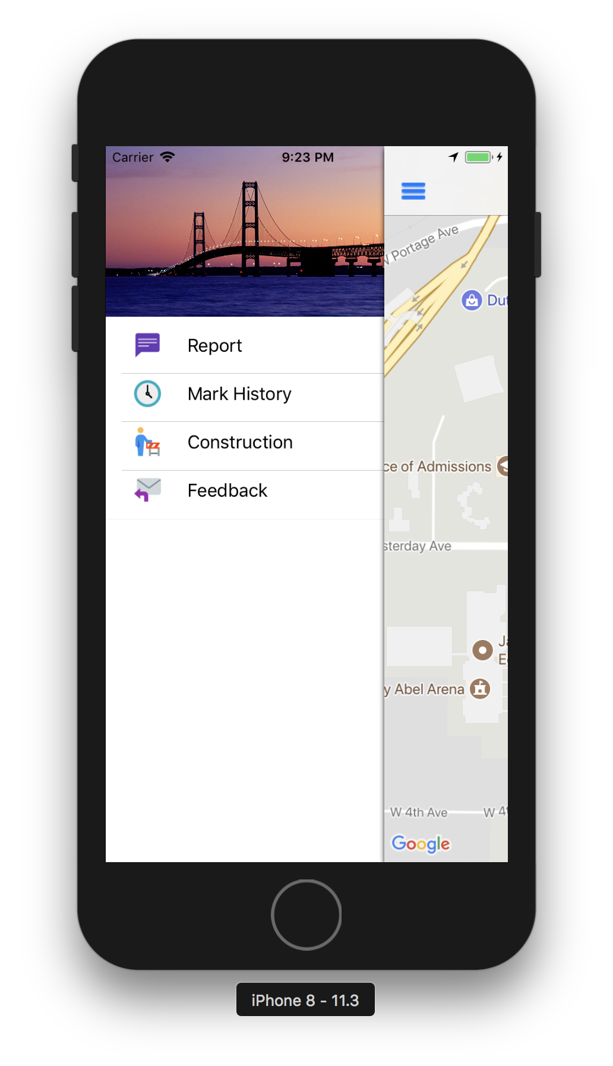
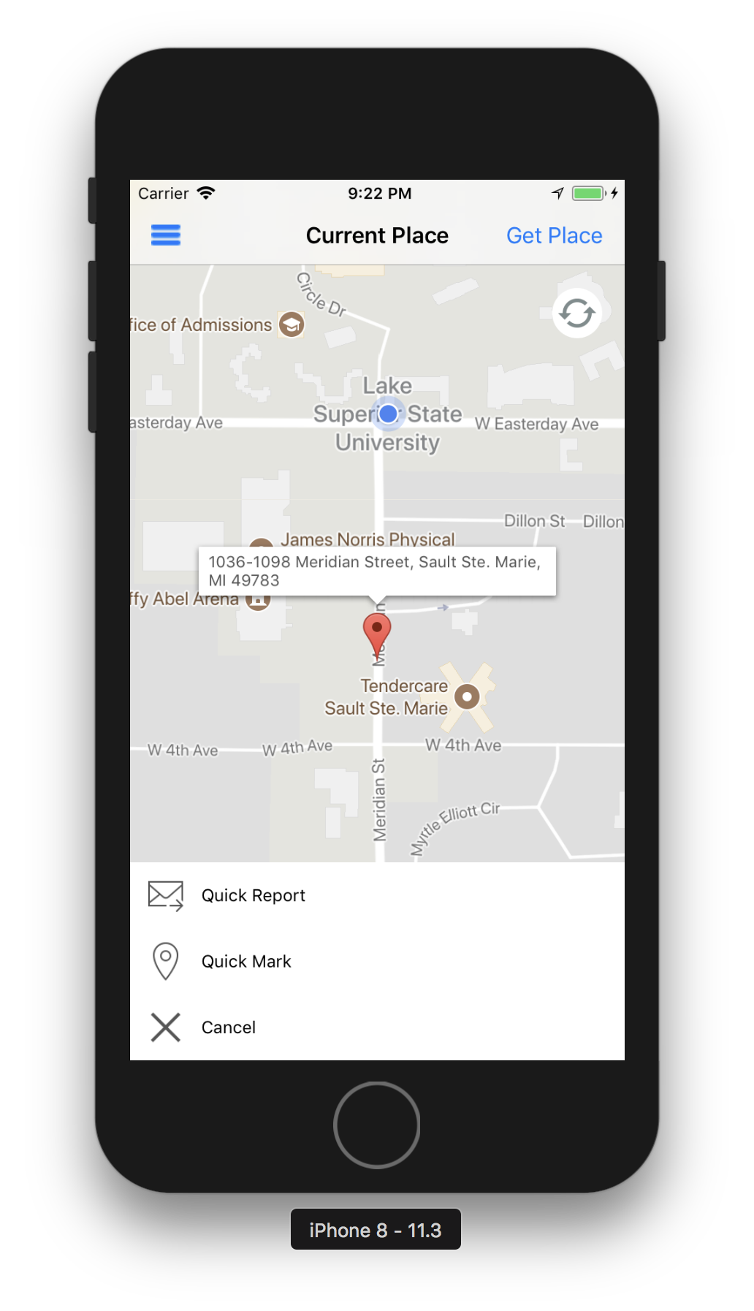
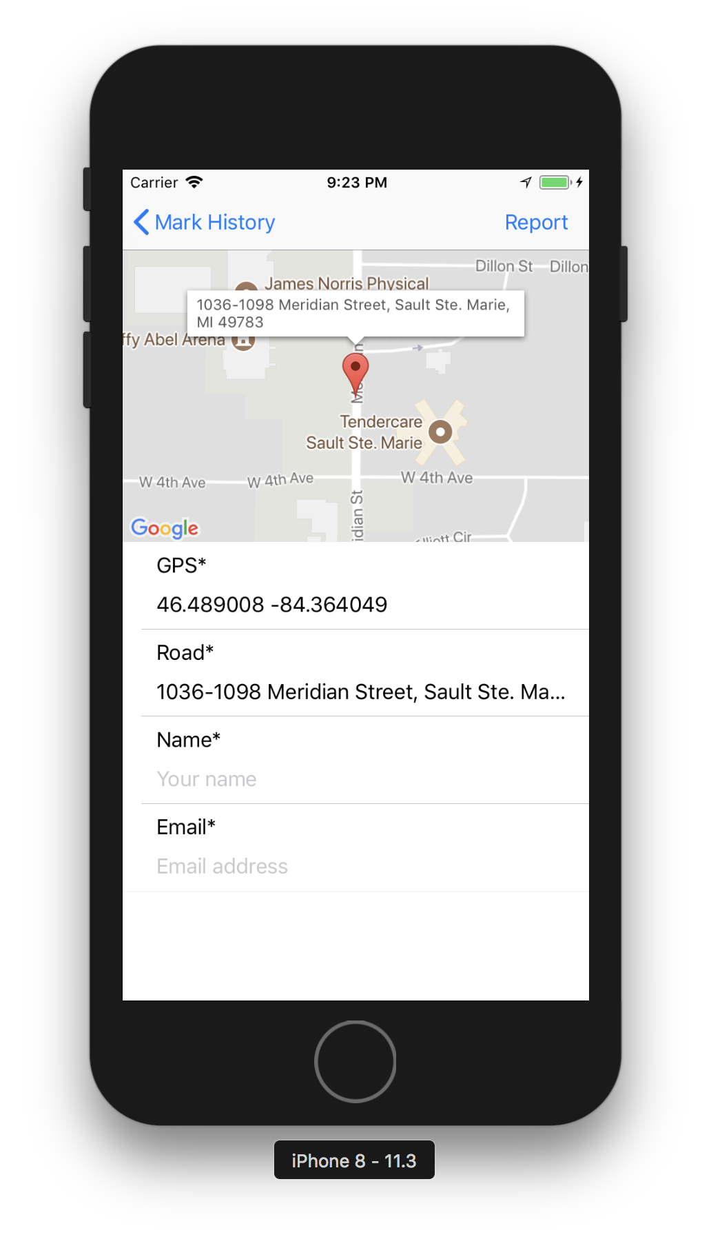
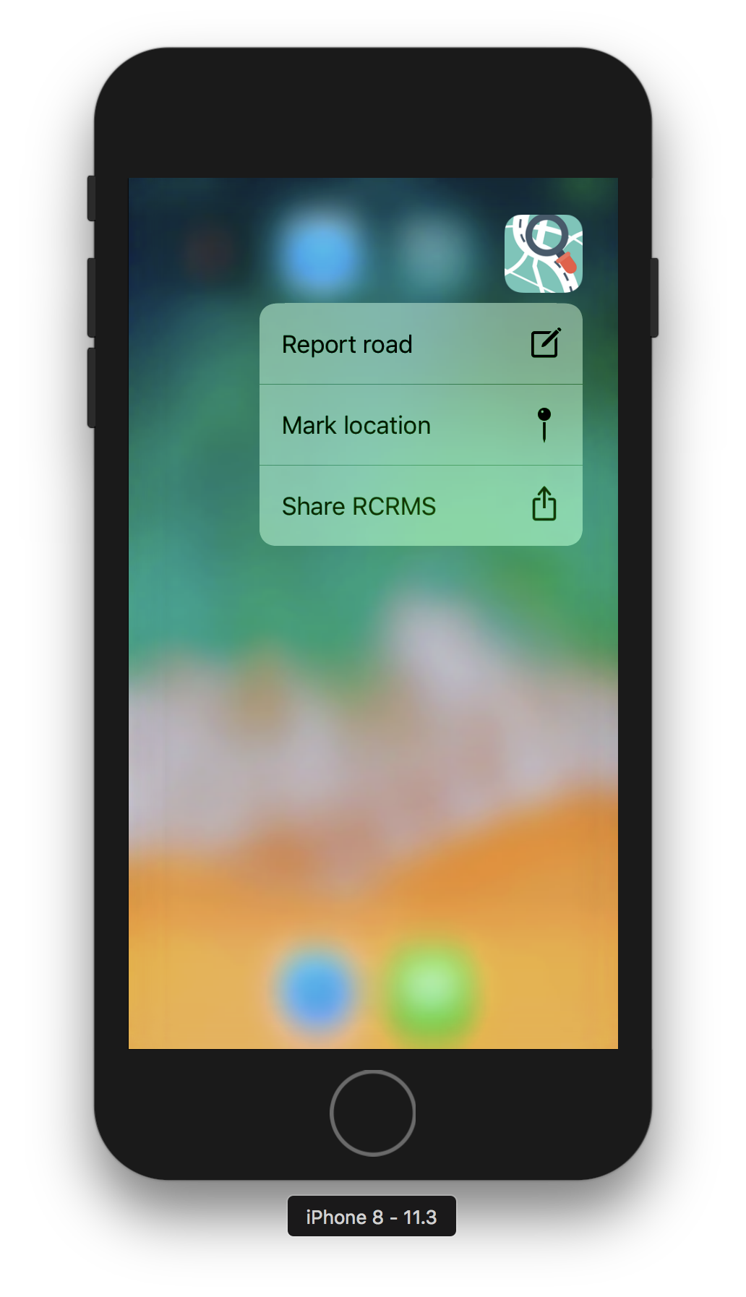
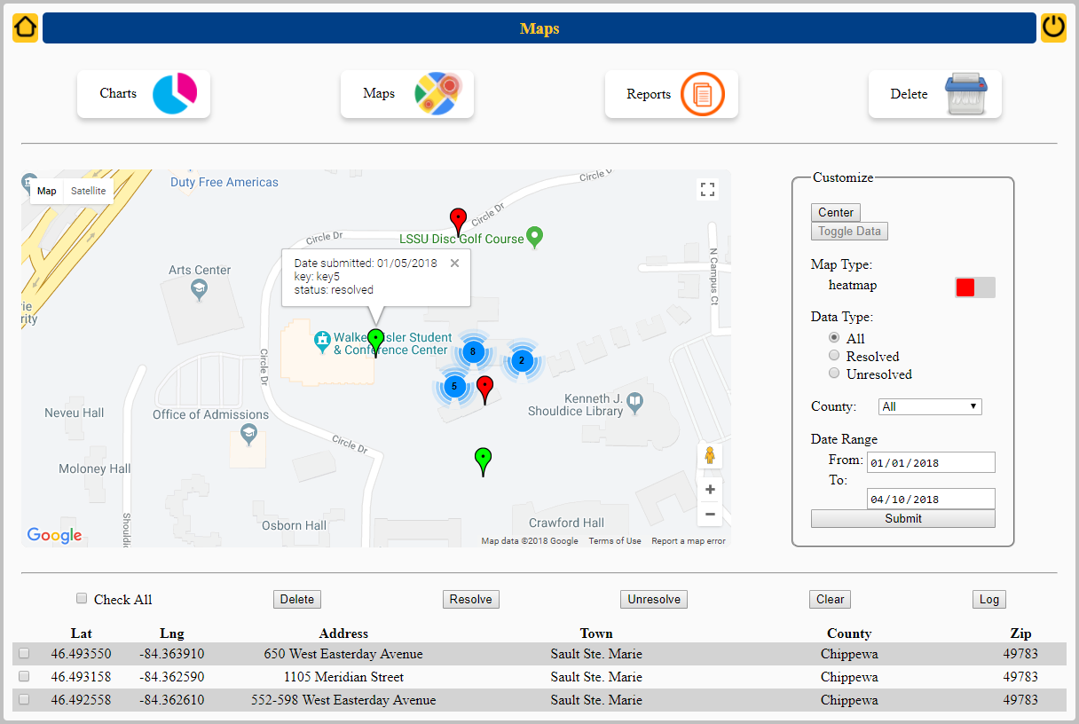
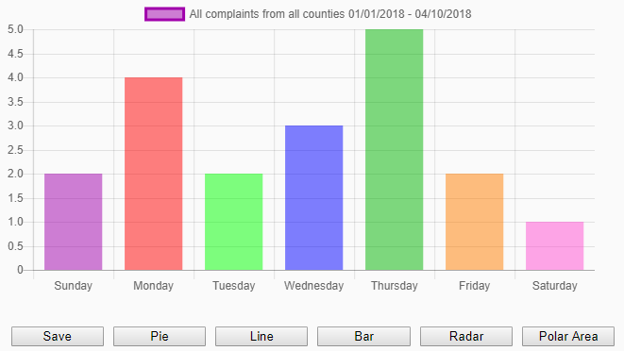
Road Condition Reporting and Management System
Wei Qian, Tamara Novic, Matthew Butler, Matthew Zahara
School of Mathematics and Computer Science
Lake Superior State University
Client: Christopher Smith Assitant Professor at LSSU
Problem
Functional Requirements Cont.
Our initial client was looking for a technology based solution to streamline the data collection and maintenance of Michigan roads. This included gathering public complaints pertaining to road conditions; as well as an interface to the data collected. This data was meant to assist in the allocation of Michigan Department of Transportation resources.
The current solution consists of having a maintenance crew drive every road to assess its condition. This process was very slow and costly.
Web Application Functional Requirements:
To serve the primary function, the web application must accomplish the following:
Short term retention of client specific reports
Ability to present data in jurisdiction specific reporting
Report maintenance(i.e mark reports as having been completed)
Client specific assessment of needs
Retention of client specific GPS data
Ability to track client specific goals and outcomes
Ability to share road quality reports across agencies
Overview
The Road Condition Reporting and Management System (RCRMS) was developed to collect complaints of road conditions and present the data, in various forms, to a party which may be able to positively affect the road conditions. To that end, we developed an iOS mobile application and a web application.
The mobile application is the interface which the public may use to report various road complaints to our database.
The web application serves as the portal to visualize the data, from the database, for the administrative users.
Side Menu
Quick Reporting
Learning Outcomes
Technologies:
Xcode IDE
Swift 4.0
SiriKit
Google Maps APIs
HTML, CSS, JS, Firebase
Nodejs, npm, Firebase CLI
Deal with missing client and pivot into an alternate client; along with changing the requirements mid project.
Practice working with other developers, in different scopes, toward the same end.
Working knowledge of code repositories like GitHub, and the collaboration benefits therein.
Current State:
Working iOS application prototype
Functional web application
Moving Forward:
Publish iOS application
Application email verification
Meta data collection
Handle Firebase querying quirk
Functional Requirements
The client requires a proof of concept technology based solution for a community-wide data collection and management system whose primary function is to:
Streamline the process of reporting problems with Michigan roads
Summarize data and generate maps through an automated process on the database server
Deliver summary reports to administrators
Measure progress in making road repairs
Measure performance of individual programs and the system as a whole
Mobile Application Functional Requirements:
The mobile application will serve the primary function in the following ways:
Reports data to the backend
Simplistic user interface to prevent driving distractions
Report Page
3D Touch
Map View
Chart View

