Slide 1
Pocket mole
Team: Little Cutie
Yihan Li
Gaomeizhu Qu
Wenqian Ma

Slide 2
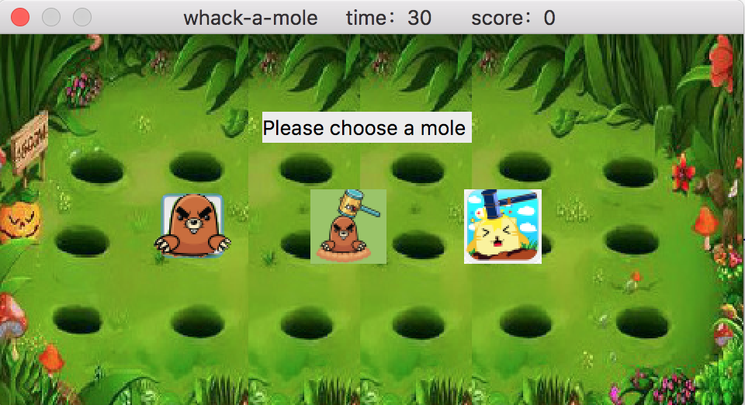
Background
Idea: Inspired by the classic Japanese pocket game Whac-A-Mole
Software: Qt
Use:
Gumstix (verdex pro)
Samsung 4.3” touchscreen LCD panels
microSD cards.

Slide 3
Introduction
Divided the screen into 18 parts, and the mole will randomly show in the screen. Touching the screen to beat the mole when it shows, then you can score. Or you can’t score if not touching the button. The time will count down when you are playing, and the game will end when the time counts to 0.
Pocket Mole
Game Over
Score: 23
Starting part
Choosing picture
Playing game
ending

Slide 4
Diagram of modules
TimeCount()
TimeCount()
Set time to 30s and count down
Reset the time and score
When time counts to 0 show text ’gameover’ and again button
again()
Main()
Choosepic()
showButton()
handleButton()
Set window title to show the time and score
Resize the window to fit the screen
Set three pictures
as buttons(moles) to be picked by player
Make mole shows randomly
Make the mole show every 0.3s after beating the mole
Count the score when beating the mole
Set the cursor as hammer

Slide 5
Assignment:
Display pictures on LCD ---- Yihan Li
Read images from SD card ---- Yihan Li
Send and receive data between gumstix and touchscreen ---Gaomeizhu Qu
Design algorithms to process data received from touchscreen ---Wenqian Ma

Slide 6
Thanks

