Slide 1
实体关系抽取

Slide 2
Outline
问题描述
相关工作
我的思路

Slide 3
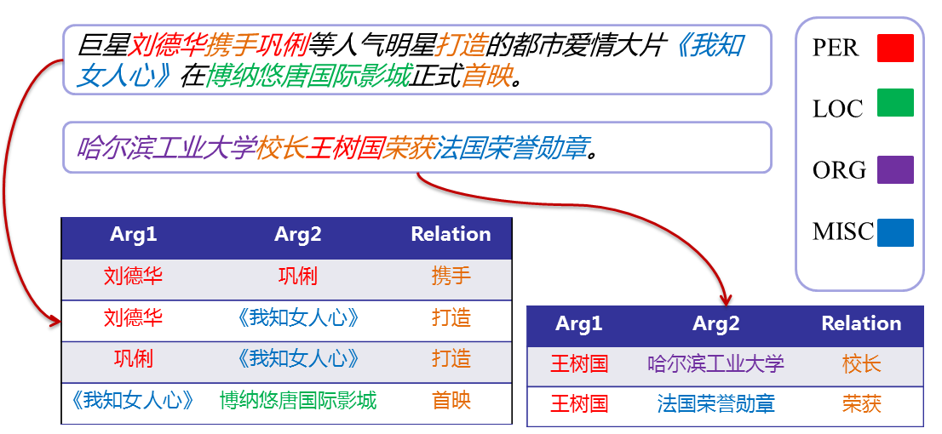
问题描述

Slide 4
相关工作
Supervised approaches
  Feature based
  Kernel based
Semi-supervised approaches
  Bootstrapping
Unsupervised approaches

Slide 5
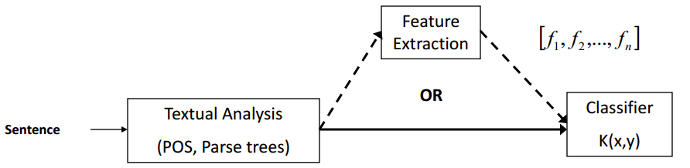
Feature based
-Li W, Zhang P, Wei F, et al. A Novel Feature-based Approach to Chinese Entity Relation Extraction.[C] ACL 2008
Notes:
这类方法将关系抽取任务看作一个分类问题，首先需要人工标注大规模训练语料库，然后在已标注好的语料库基础上进行特征抽取和选择，通过利用不同的机器学习算法训练学习分类模型，用于抽取新的实体对。

Slide 6
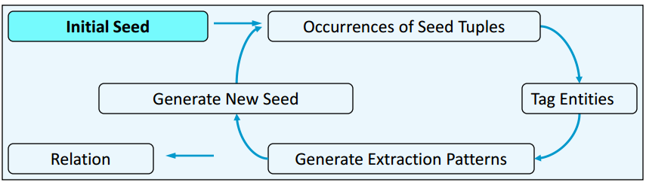
Bootstrapping
-Agichtein E, Gravano L. Snowball : extracting relations from large plain-text collections[C]// ACM Conference on Digital Libraries. ACM, 2010:85-94
Notes:
构造初始关系种子集，然后利用Web或者大规模语料库信息挖掘对应的关系描述模式，并通过模式匹配抽取新的关系实例，迭代地生成关系描述模式。

Slide 7
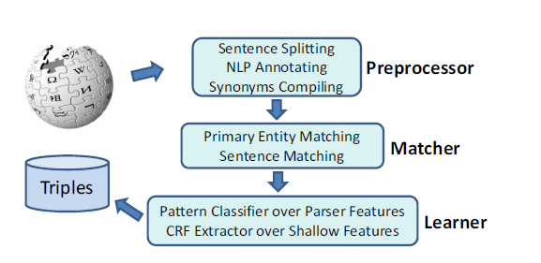
Unsupervised approaches
-Wu F, Weld D S. Open information extraction using Wikipedia[C] ACL 2010

Slide 8
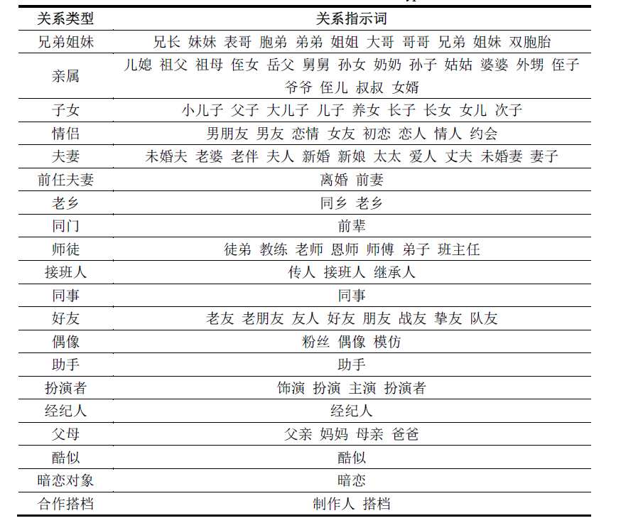
我的想法
Notes:
通过某种启发式搜索方法，利用百度百科或者中文wiki，自动得到某种类型实体下的关系体系，来做开放式的中文实体关系抽取

Slide 9
参考文献
Wu, F., & Weld, D. S. (2010). Open information extraction using Wikipedia. ACL 2010, Proceedings of the, Meeting of the Association for Computational Linguistics, July 11-16, 2010, Uppsala, Sweden (pp.118-127).
Agichtein, E., & Gravano, L. (2010). Snowball : extracting relations from large plain-text collections. ACM Conference on Digital Libraries (pp.85-94). ACM.
Li, W., Zhang, P., Wei, F., Hou, Y., & Lu, Q. (2008). A Novel Feature-based Approach to Chinese Entity Relation Extraction. ACL 2008, Proceedings of the, Meeting of the Association for Computational Linguistics, June 15-20, 2008, Columbus, Ohio, Usa, Short Papers (pp.89-92).
王莉峰. (2011). 领域自适应的中文实体关系抽取研究. (Doctoral dissertation, 哈尔滨工业大学).

