Slide 1
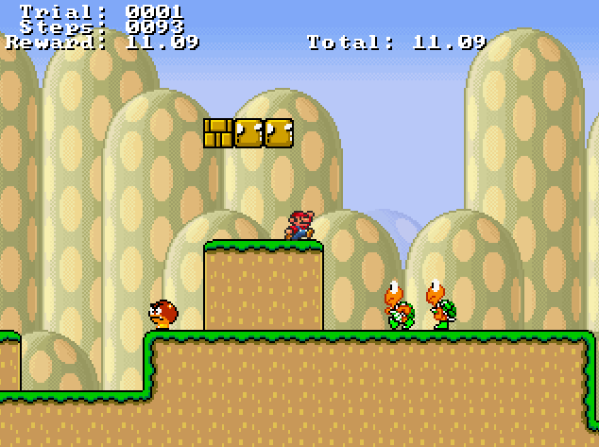
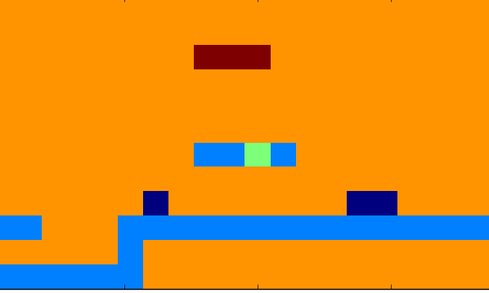

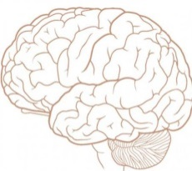
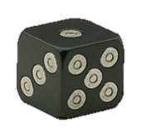
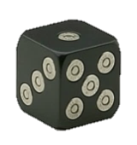
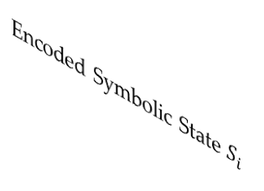





BroadMind - Approach
Forward-Propagate Policy Evaluation
$$A_{i}=argmax\left(x\right)$$
$$Q=max\left(x\right)$$
Q-Values
Hidden Layer
Controller Action
Encoded Symbolic State $S_{i}$
Raw Pixel Game State
Back-Propagate Training Experience
Neural Q-Network with Impactful Experience Replay enables reinforcement learning in large and partially observable state/action spaces.
Experience
Pool
$$S_{x}A_{x}R_{x}S_{x+1}A_{x+1}$$
$Q^{∗}(S_{i}|A_{i})=R_{i}+ γ$ Q($S_{i+1}|A_{i+1}$)
$$S_{y}A_{y}R_{y}S_{y+1}A_{y+1}$$
$$…$$

Slide 2
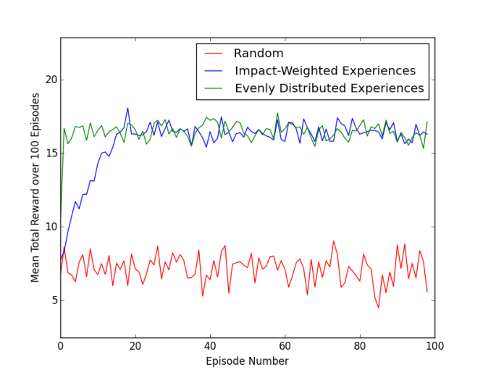
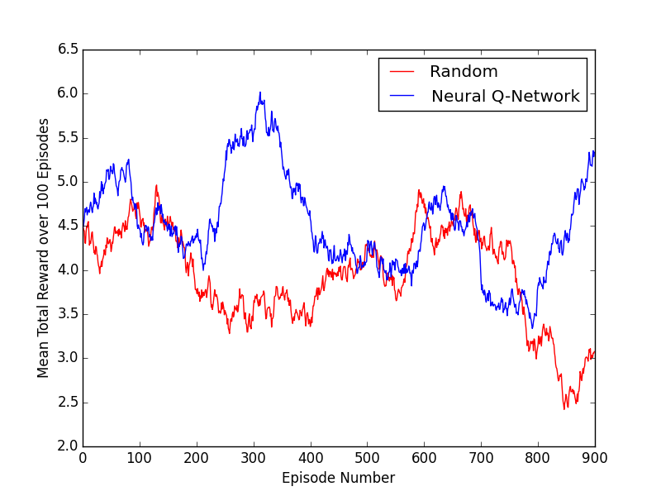
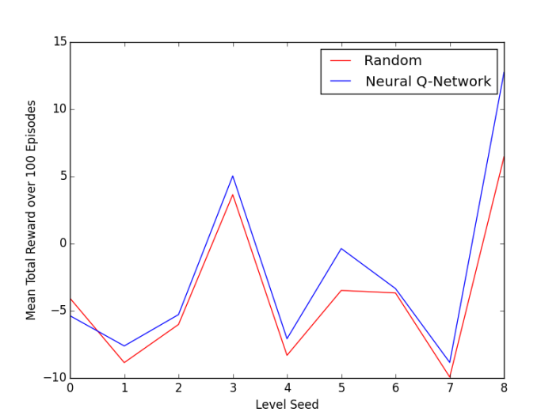
BroadMind - Results
Impact-weighted experience remembrance slows the learning rate, and achieves the same long-term performance when trained on only one Generalized Mario level.
Using a multiple-substrate state representation of background, enemy, and reward layers does not exceed random performance the way that a larger single layer can.
Agents trained on one Mario level achieve good performance when transferred to a new, unseen level.

