Slide 1
Joint Hand Motion and Interaction Hotspots Prediction from Egocentric Videos
Accepted by CVPR-2022
Presenter: Qitong Wang
Date: Aug. 16th, 2022

Slide 2

New Task on Egocentric Video Learning
Given observation frames of the past, it predicts future hand trajectories (green and red lines) and object interaction hotspots (heatmaps).
Notes:
Why this paper? New task…
Left input, right output.

Slide 3
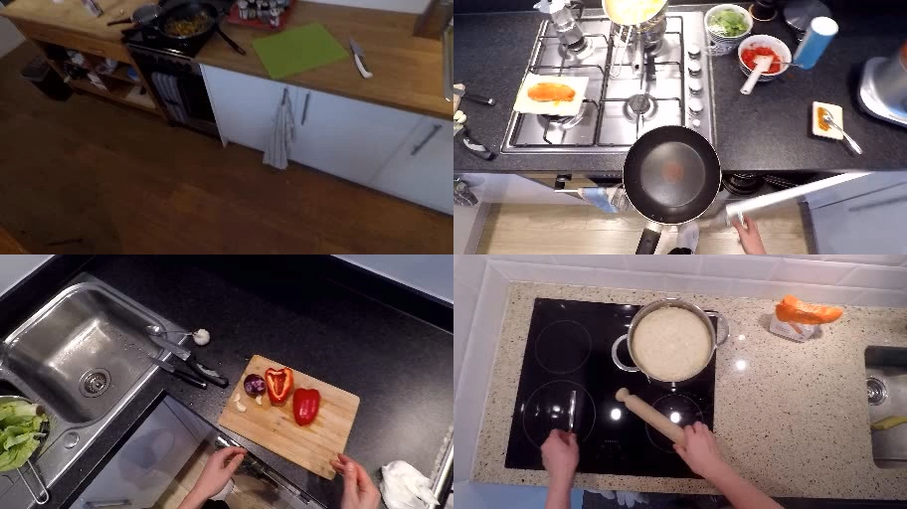
New Task on Egocentric Video Learning

Slide 4
MOtivations
Achieving the ability to predict a person’s intent, preference and future activities is one of the fundamental goals for AI systems.
AI system could provide useful and timely guidance.
AI system can react and collaborate with the human more smoothly.
Action recognition & anticipation frameworks [1-4], which predict a semantic label, does not reveal how the human moves and what the human will interact with in the future.
Some works [5-8] try to predict future pixels of videos.
Challenging due to its high dimension outputs with large uncertainties.

Slide 5
MOtivations
It proposes to jointly predict hand trajectory and interaction hotspots from egocentric videos, and collect new training and test annotations.
Trajectory not only provides a concrete description of motion, but also is a much smaller space to predict compared to pixel prediction [9].
It proposes an automatic manner to collect the data in a large-scale.
A novel Object-Centric Transformer which models the hand and object interactions for predicting future trajectory and affordance.

Slide 6
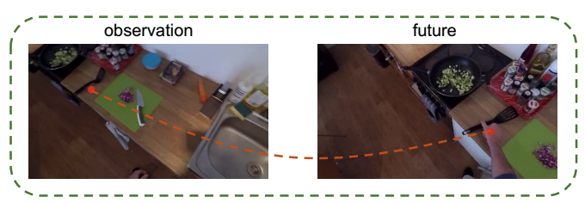
Training Data Generation
How to collect training labels of future hand trajectory H and object hotspots O from future key frames automatically without manual labor.
Firstly running an off-the-shelf hand-object detector.
Assume that the global motion between two consecutive frames is usually small, and they can be related by a homography.
Project back to observation by homography.
Connect projection of each future frame.

Slide 7
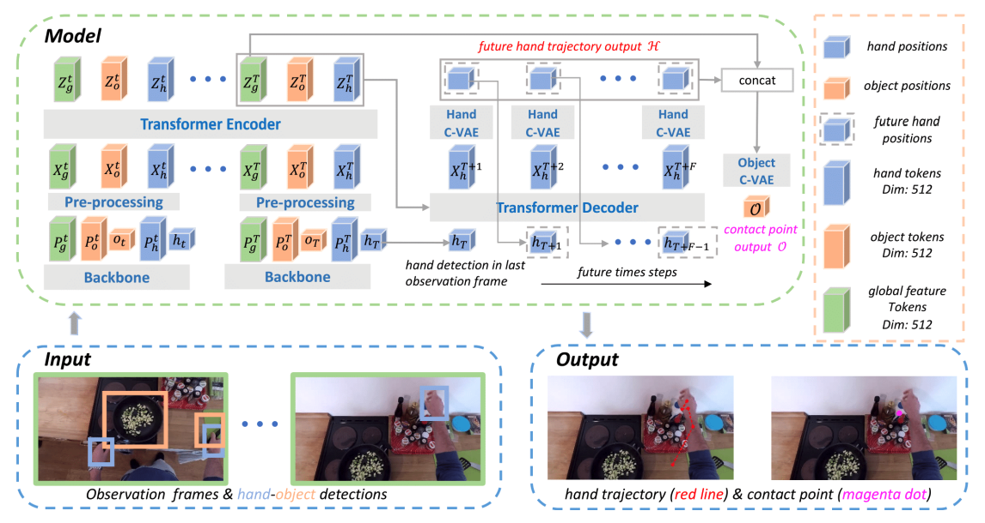
Object-Centric Transformer
Notes:
encoder-decoder architecture
Encoder:
Spatial & temporal attention for embeddings.
(time-step: 0-T)

Slide 8
Object-Centric Transformer
Notes:
encoder-decoder architecture
(time-step: T-T+F)
The decoder D predicts future hand feature XT+t one at a time
The predicted features XT+t are then sent to the trajectory head network to predict the future hand location hT+t.
two heads; one for hand trajectory estimation

Slide 9


Object-Centric Transformer
Notes:
encoder-decoder architecture
the hand C-VAE takes hand locations hT+t as input, and conditioned on the hand feature tokens XT+t (Sec. 4.2) from the decoder output.
C-VAE contains two functions: an encoding function Fenc which encodes the input x and condition c into a latent z-space parameterized by mean µ and co-variance σ, and a decoding function Fdec which decodes sampled z from the latent space and condition c to reconstruct input x
The Fenc and Fdec are implemented as a MLP.
that regularizes the latent z-space close to normal distribution N(0,1)

Slide 10

Object-Centric Transformer
Conditioned on global features.
Notes:
encoder-decoder architecture
the hand C-VAE takes hand locations hT+t as input, and conditioned on the hand feature tokens XT+t (Sec. 4.2) from the decoder output.
C-VAE contains two functions: an encoding function Fenc which encodes the input x and condition c into a latent z-space parameterized by mean µ and co-variance σ, and a decoding function Fdec which decodes sampled z from the latent space and condition c to reconstruct input x
The Fenc and Fdec are implemented as a MLP.
that regularizes the latent z-space close to normal distribution N(0,1)

Slide 11
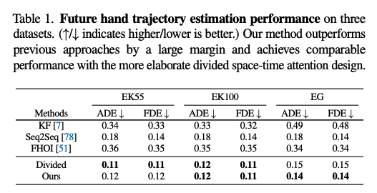
Experiments Hand Trajectory Performance
Average Displacement Error (ADE). ADE is calculated as the ℓ2 distance between the predicted future and the ground-truth averaged over the entire trajectory and two hands.
Final Displacement Error (FDE). FDE measures the ℓ2 distance between the predicted future and ground truth at the last time step and averaged over two hands.

Slide 12
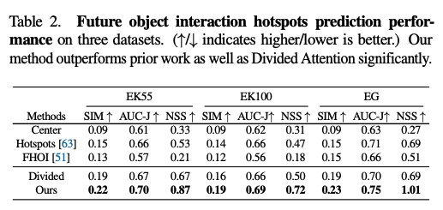
Experiments Future object interaction hotspots prediction
Similarity Metric (SIM): SIM [10] measures the similarity between the predicted affordance map distribution and the ground-truth one. It is computed as the sum of the minimum values at each pixel location between the predicted map and the ground-truth map.
AUC-Judd (AUC-J): AUC-J is a variant of AUC proposed by Judd et al. [11]. The AUC evaluates the ratio of ground-truth captured by the predicted affordance map under different thresholds.
Normalized Scanpath Saliency (NSS): NSS [12] measures the correspondence between the predicted affordance map and the ground truth. It is computed by normalizing the predicted affordance map to have zero mean and unit standard deviation and averaging over ground truth locations..

Slide 13
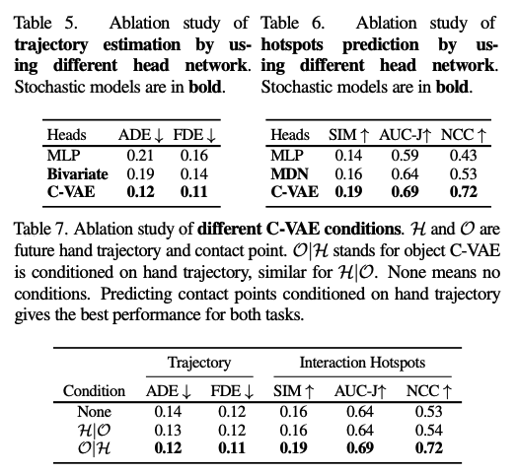
Ablation Studies Effectiveness of C-VAE head
Adopting C-VAE against MLP improves the trajectory estimation performance by 75.0% on ADE and 45.5% on FDE, also obtains +5%, +10%, and +29% gain on SIM, AUC-J, and NCC of hotspots prediction.
C-VAE achieves better results compared to Bivariate and MDN.
Notes:
MLP deterministically outputs the future hand locations.
while the Bivariate [1] assumes the future hand location follows a bivariate Gaussian distribution at each time step and explicitly samples from the predicted distribution during inference.
Bivariate

Slide 14
Ablation Studies C-VAE condition
Conditions:
None: no condition between the hand trajectory and object contact point.
H|O: hand trajectory is conditioned on object contact point.
O|H: object contact points is conditioned on hand trajectory
Explicitly incorporating the conditional dependency in C-VAE improves the overall performance.
It suggests that the two tasks are intertwined and modeling their relation explicitly benefits the performance.
Notes:
MLP deterministically outputs the future hand locations.
while the Bivariate [1] assumes the future hand location follows a bivariate Gaussian distribution at each time step and explicitly samples from the predicted distribution during inference.
Bivariate

Slide 15
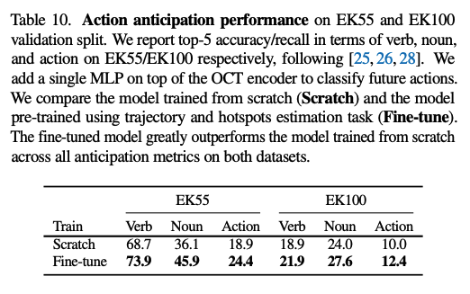
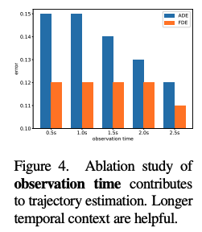
More Experiments

Slide 16
Conclusion
It proposes to forecast future hand-object interactions in egocentric videos.
It solves this task by proposing an automatic way to collect training data, and a novel Object-Centric Transformer (OCT) model that jointly predicts future hand trajectory and interaction hotspots given a sequence of observation frames as input.
It easily adapts to action anticipation task.
Training dataset generation process relies on widely used off-the-shelf tools such as active hand-object detectors.
Incorporating self-supervision signals during training to make our model more robust to label noise could be one promising future work.
Notes:
Thus the ground-truth annotations for training might be affected by the bias and errors from the off-the-shelf tools.

Slide 17
References
[1] Antonino Furnari and Giovanni Farinella. Rolling-unrolling lstms for action anticipation from first-person video. IEEE transactions on pattern analysis and machine intelligence, 2020.
[2] Antonino Furnari and Giovanni Maria Farinella. What would you expect? anticipating egocentric actions with rolling-unrolling lstms and modality attention. In Proceedings of the IEEE/CVF International Conference on Computer Vision, pages 6252–6261, 2019.
[3] Rohit Girdhar and Kristen Grauman. Anticipative video transformer. arXiv preprint arXiv:2106.02036, 2021.
[4] Fadime Sener, Dipika Singhania, and Angela Yao. Temporal aggregate representations for long-range video understanding. In European Conference on Computer Vision, pages 154–171. Springer, 2020.
[5] Wonmin Byeon, Qin Wang, Rupesh Kumar Srivastava, and Petros Koumoutsakos. Contextvp: Fully context-aware video prediction. In Proceedings of the European Conference on Computer Vision (ECCV), pages 753–769, 2018.
[6] Sangmin Lee, Hak Gu Kim, Dae Hwi Choi, Hyung-Il Kim, and Yong Man Ro. Video prediction recalling long-term motion context via memory alignment learning. In Proceedings of the IEEE/CVF Conference on Computer Vision and Pattern Recognition, pages 3054–3063, 2021.
[7] William Lotter, Gabriel Kreiman, and David Cox. Deep predictive coding networks for video prediction and unsupervised learning. arXiv preprint arXiv:1605.08104, 2016.
[8] Yunbo Wang, Lu Jiang, Ming-Hsuan Yang, Li-Jia Li, Mingsheng Long, and Li Fei-Fei. Eidetic 3d lstm: A model for video prediction and beyond. In International conference on learning representations, 2018.
[9] Zhe Cao, Hang Gao, Karttikeya Mangalam, Qi-Zhi Cai, Minh Vo, and Jitendra Malik. Long-term human motion prediction with scene context. In European Conference on Computer Vision, pages 387–404. Springer, 2020.
[10] Michael J Swain and Dana H Ballard. Color indexing. International journal of computer vision, 7(1):11–32, 1991.
[11] Tilke Judd, Krista Ehinger, Fredo Durand, and Antonio Torralba. ´ Learning to predict where humans look. In 2009 IEEE 12th international conference on computer vision, pages 2106–2113. IEEE, 2009.
[12] Robert J Peters, Asha Iyer, Laurent Itti, and Christof Koch. Components of bottom-up gaze allocation in natural images. Vision research, 45(18):2397–2416, 2005.

Slide 18
Thanks ☺

