Slide 1


Project presentation
Are you
Happy?
By Zening Li and Qingxu Wang

Slide 2
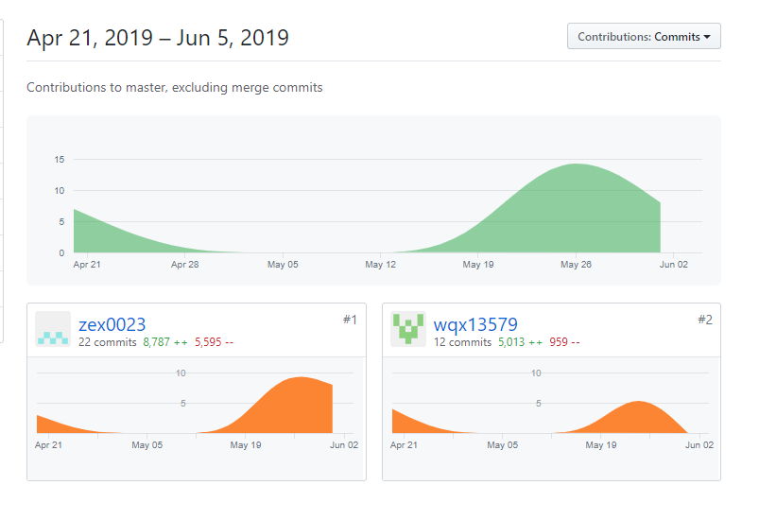
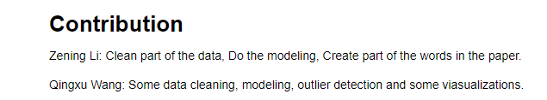
Github Link https://github.com/wqx13579/Happiness
Contributions
Zening Li: zex0023
Qingxu Wang: wqx13579

Slide 3
Dataset and motivation
Question:
What is the relationship between region of living and happiness level of people?
Can we predict whether people are happy or sad given their region of living and other factors like income and family?
Both question will be solved by a logistic regression model.
Our dataset from:
https://www.kaggle.com/unsdsn/world-happiness/downloads/world-happiness-report.zip.

Slide 4
Data munging and statistical summary
Drop some of the columns which will not be used
Rename the columns in happy_2017
Concatenate all data frames together into one final data frame named 'happy’
Fill the missing Region values by using the same Regions for country from the data frame happy_2015 and happy_2016
Add the region the rest two ‘NaN’ rows
add a new column called "happy sad“(which is binary) to show 1(happy) if ‘Happiness Score’ is above average and 0 for else.

Slide 5
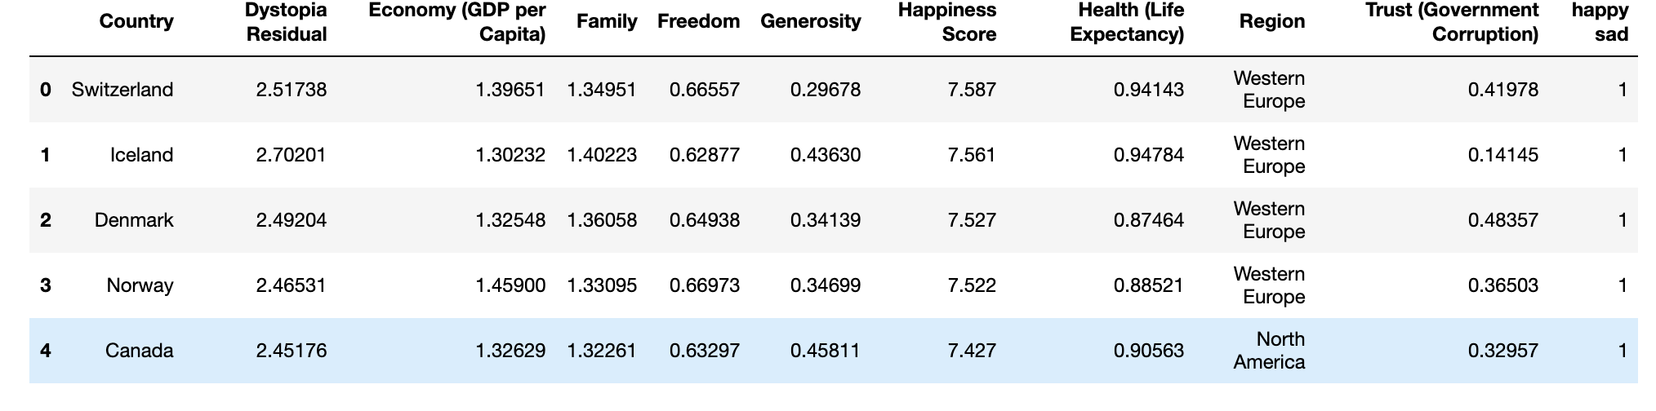

Slide 6
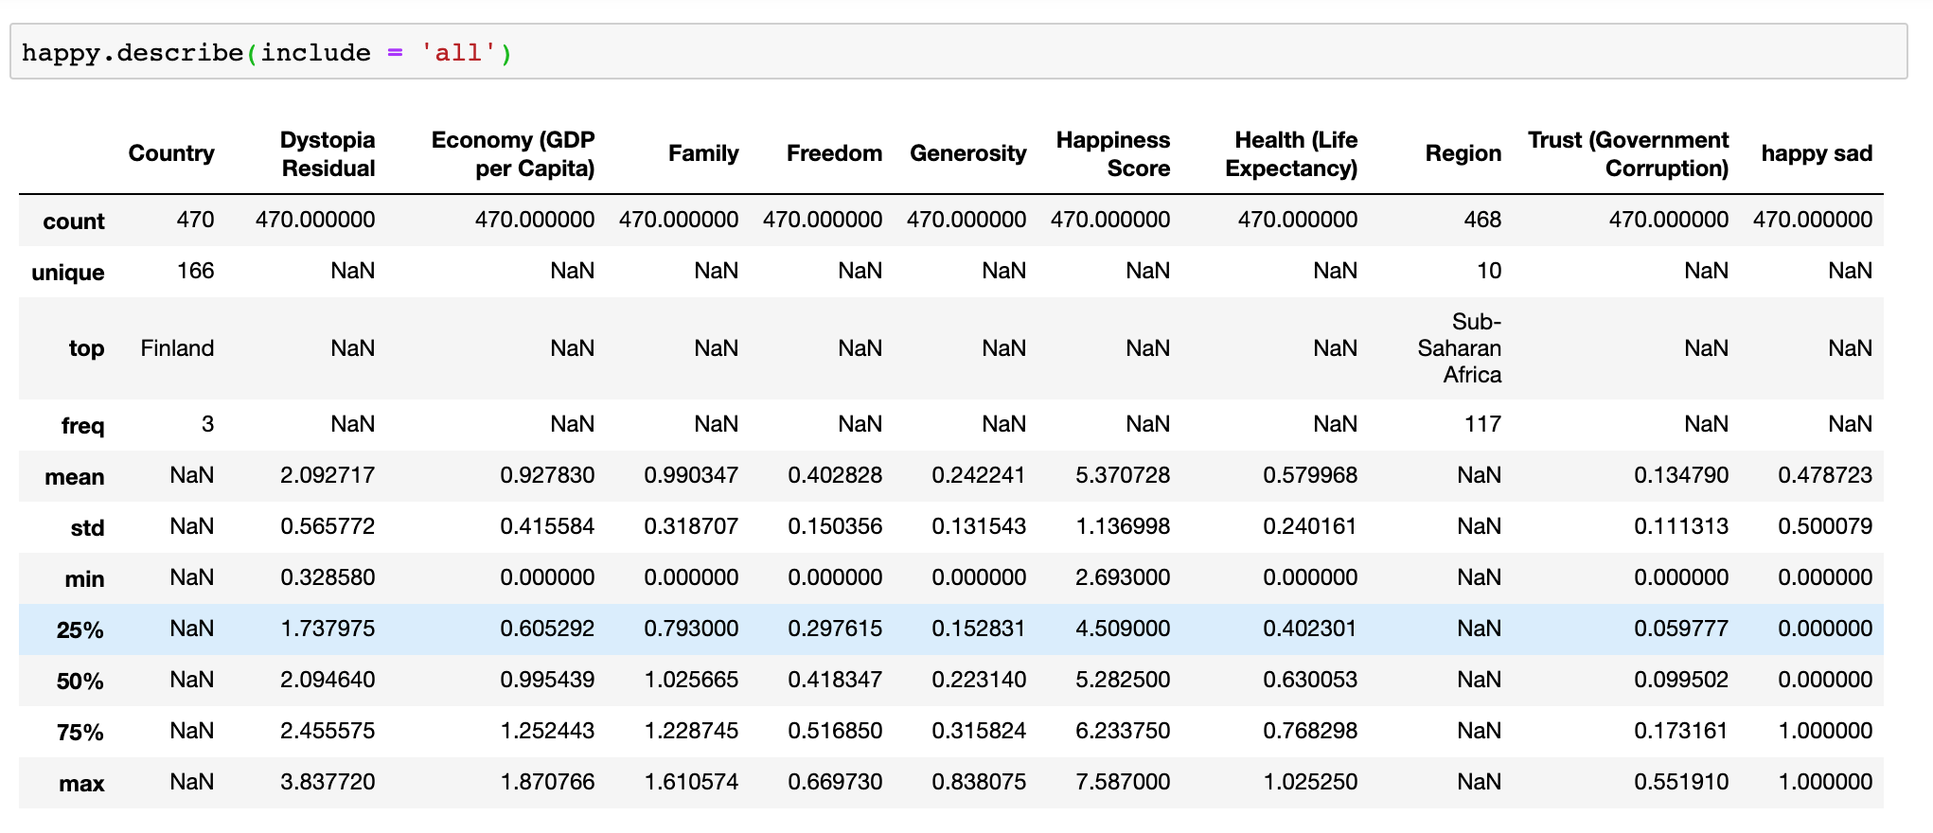
statistical summary

Slide 7
Statistical Summary
From the summary, we can see that almost all of our data columns are numerical, so we can find the mean, standard deviation, min value, 25 percent quantile, 50 percent quantile, 75 percent quantile, and max value. We can see the mean score of "Happiness Score". We use it as a guide to create the "happy sad" column.
We are unable to tell anything interesting using this summary because these values are transferred based on some calculation that we don’t know. Such as family situation, it is just an indicator transferred to numerical, however if you know the data source and their calculations, these numbers could be useful.

Slide 8
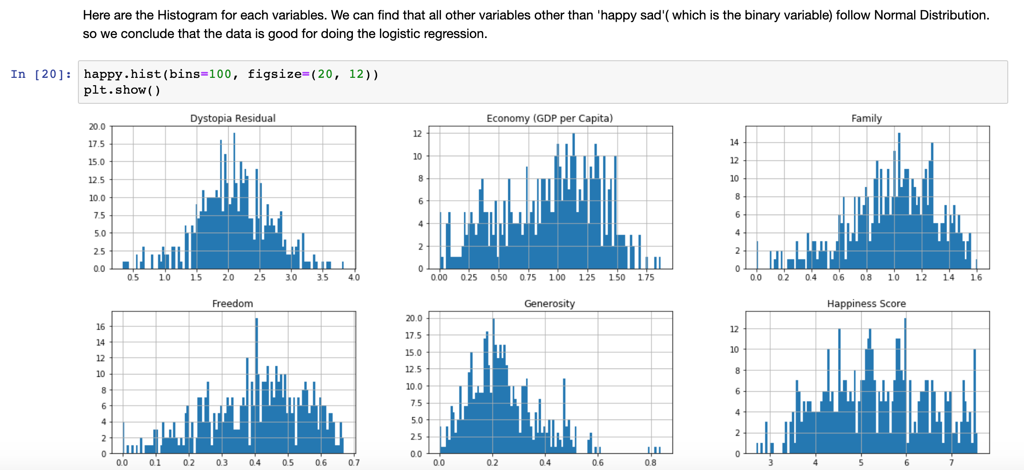
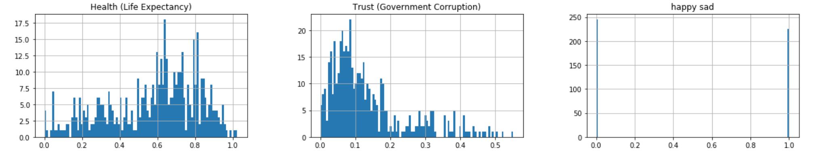
Main visualization

Slide 9
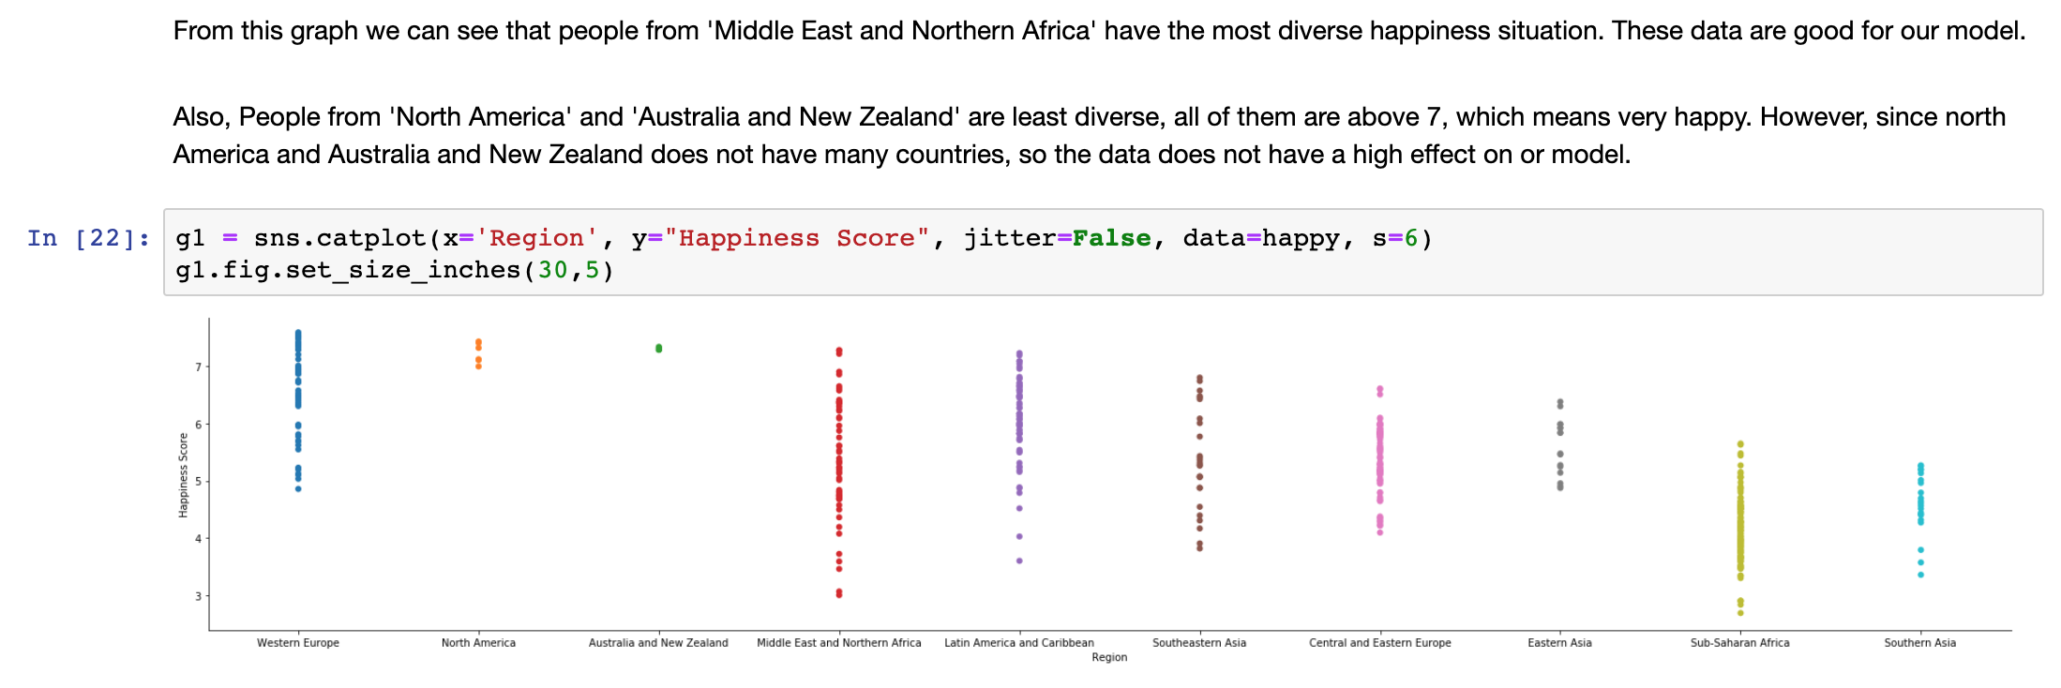
Main visualization

Slide 10
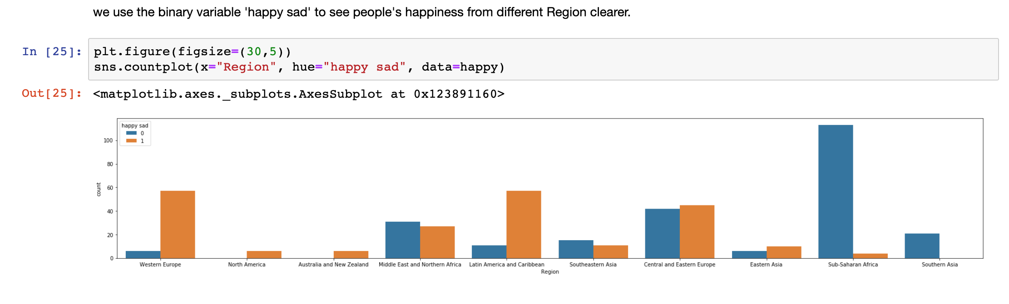
Main visualization

Slide 11
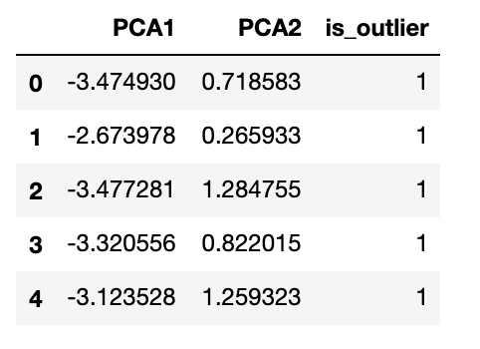
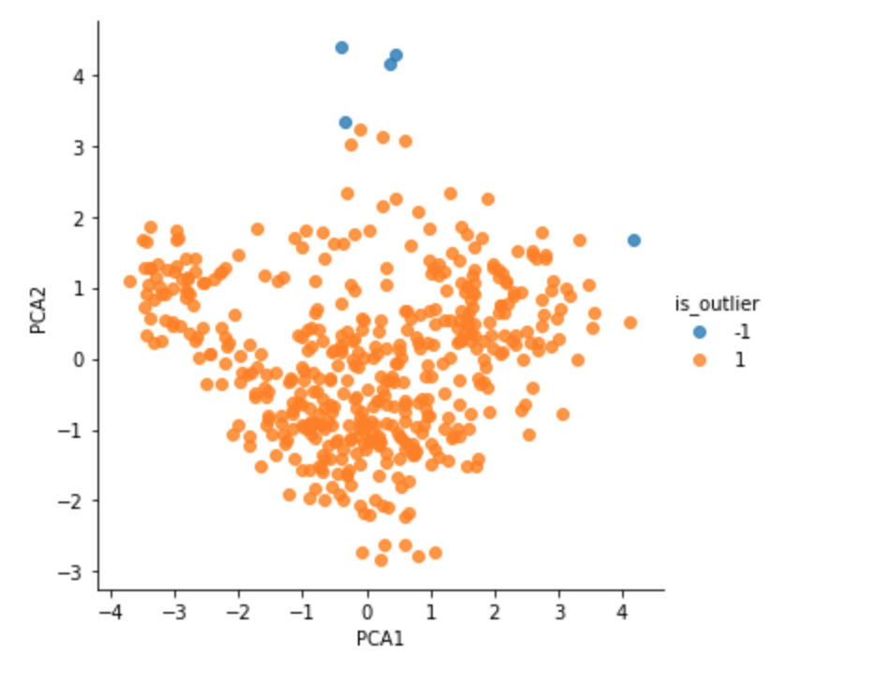
Outlier Detection
We don't remove any outliers though we can see some.
This dataset is not an experimental dataset, we don’t have to remove those ‘outliers’, there is just no mismeasurement or something like that.

Slide 12
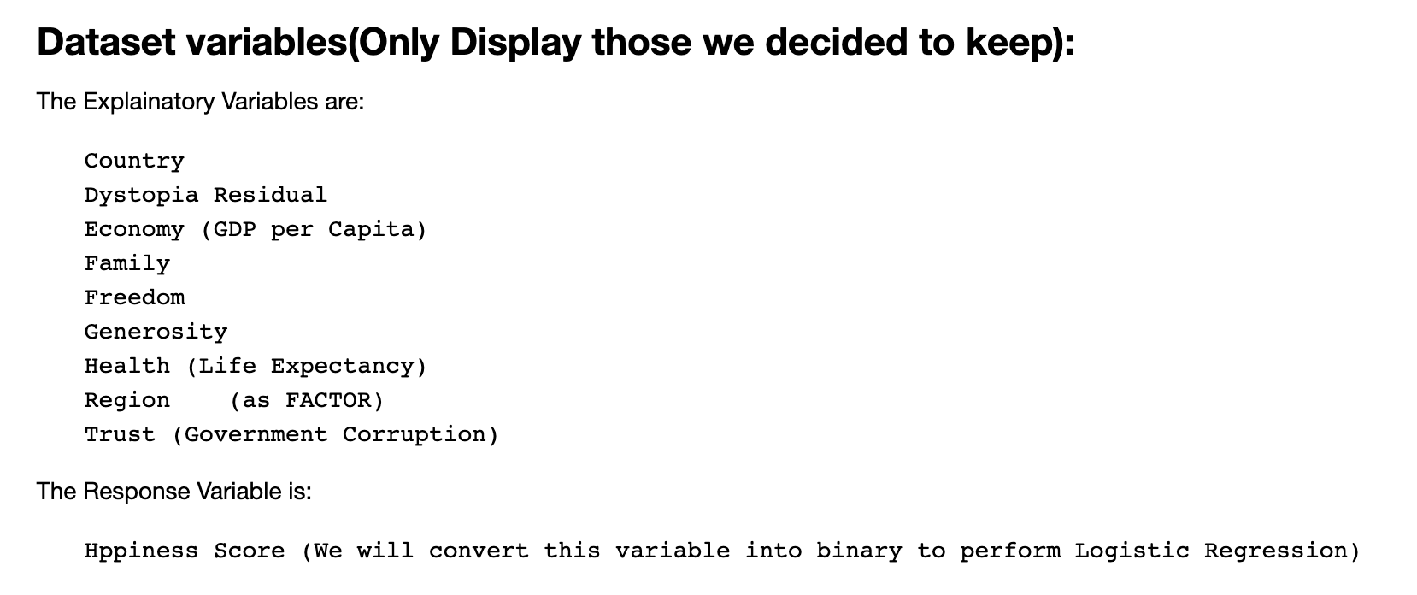
Modeling
* Independent variables may not include those two regions we talked about
‘happy sad’ is binary, so we use logistic regression

Slide 13
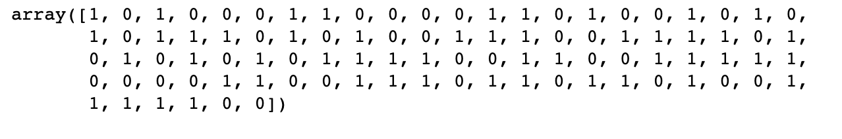
Modeling
We split the data frame into X as independent variables and y as dependent variable.
We do the train-test split with 0.2, 0.8 ratio.
We use logistic regression cross validation with 5-folds to train the data and predict the y_values using test data of X.

Slide 14
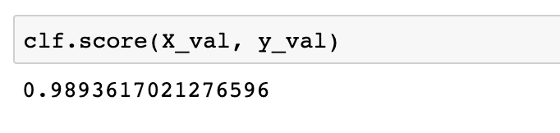
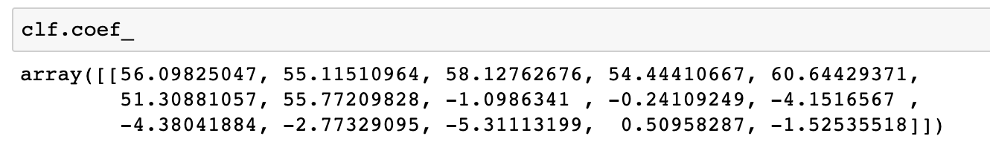
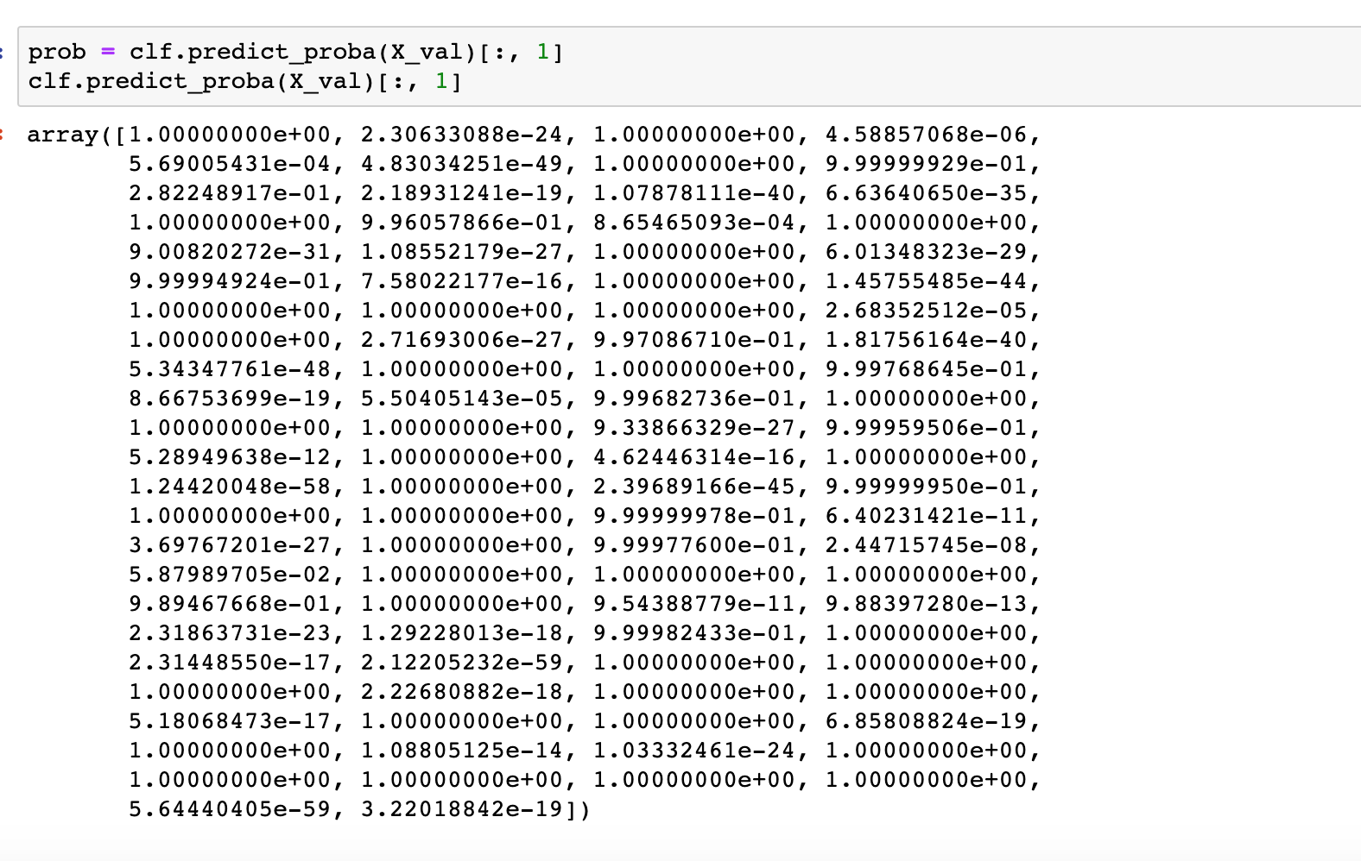
Modeling

Slide 15
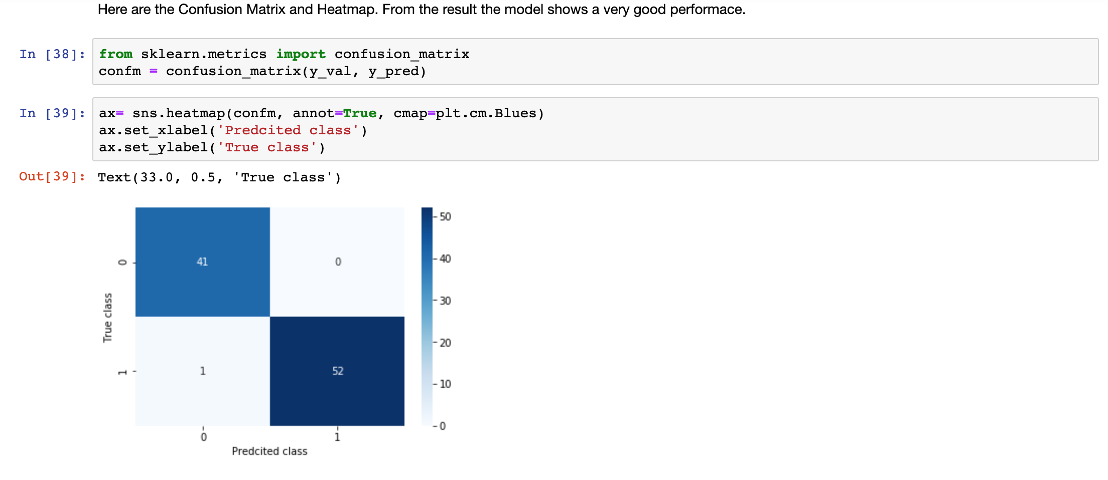
Modeling

Slide 16
Conclusion
From the coefficients of the final model, Our conclusion is that Region has a huge effect on people’s happiness even though they have the same Income, health, family situations. However, we cannot tell in all other factors which factor is more important, because these factors are transferred to numerical using different methods, we are unsure about how they are measured.
The model we got is 'clf', it is a relatively good model which is tested can precisely predict a country's 'happy or not’. With enough data for a person or people from a country, we can predict if he or she is happy or not since it is a accurate model.

Slide 17
The aim of research is just to predict, however, your personal happiness is in your control, not based on all these measurement or just simply a model.
Maybe you own nothing but happy,
And……….

Slide 18

Maybe you own everything but …
Easley, J., & Senior White House. (2017, February 21). Keep It Up Liberals, Donald Trump Says Your Activism Is Making Him Sad. Retrieved June 3, 2019, from https://www.politicususa.com/2017/02/21/liberals-donald-trump-activism-gop-town-halls-making-sad.html
Wish you all happy!

