Slide 1
Project presentation Happiness Analysis
Written by Zening Li and Qingxu Wang

Slide 2
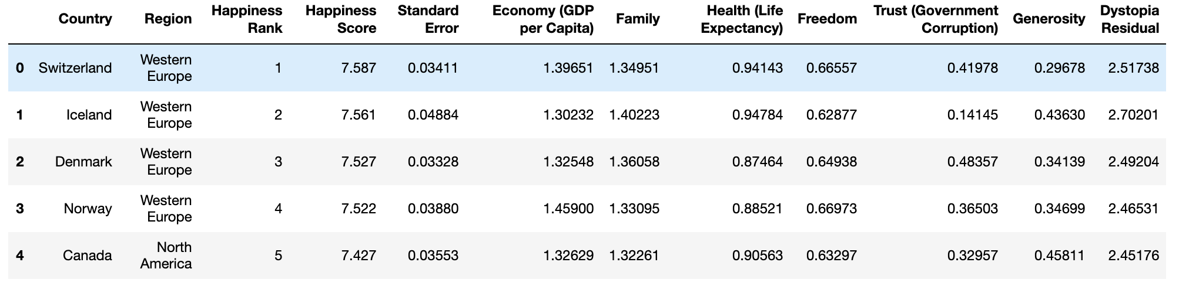
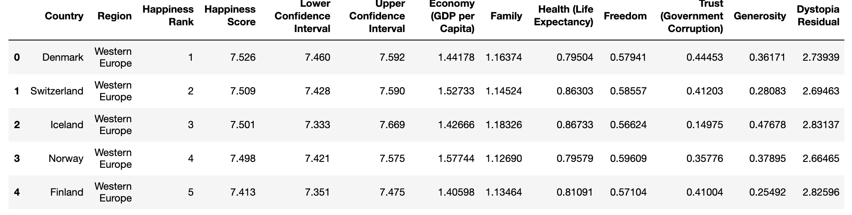
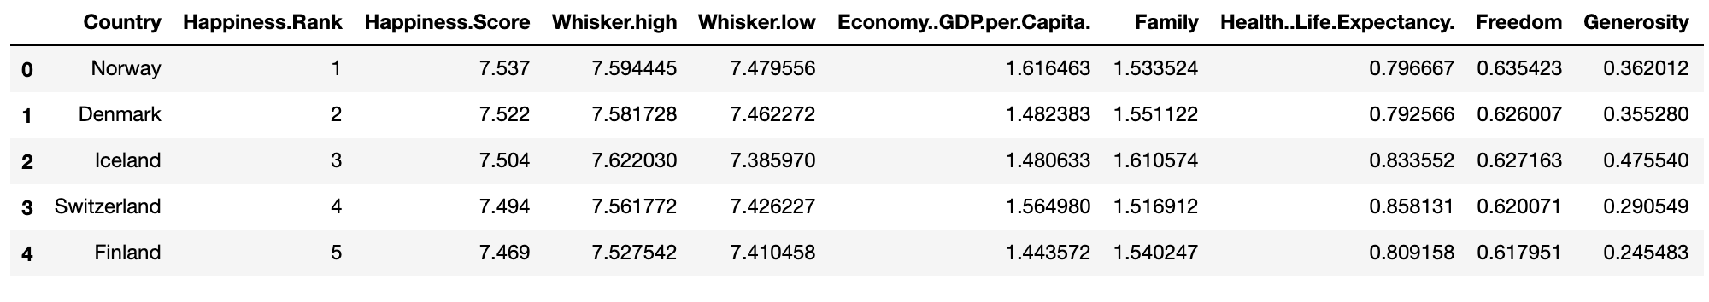
Dataset and motivation

Slide 3
Dataset and motivation
Question:
What is the future happiness level in our world?
Can we create a model of whether people in different region are happy or sad?
All the question will solved by a logistic regression model.
The input is the raw data. The output is the logistic regression model. It have the prediction data, the accuracy score, the coefficient, and the predict probability.
Our dataset from:
https://www.kaggle.com/unsdsn/world-happiness/downloads/world-happiness-report.zip/2#2016.csv.

Slide 4
Data munging and statistical summary
Drop some of the columns which will not be used for
Rename the columns in happy_2017
Concatenate all dataframes together into one final dataframe named 'happy’
Fill the missing Region values by using the same Regions for country from the dataframe happy_2015 and happy_2016
Add the region the rest two NaN rows
add a new column called "happy sad"

Slide 5
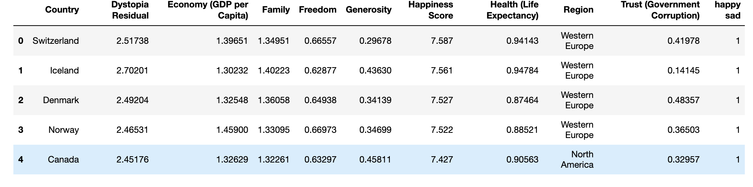

Slide 6
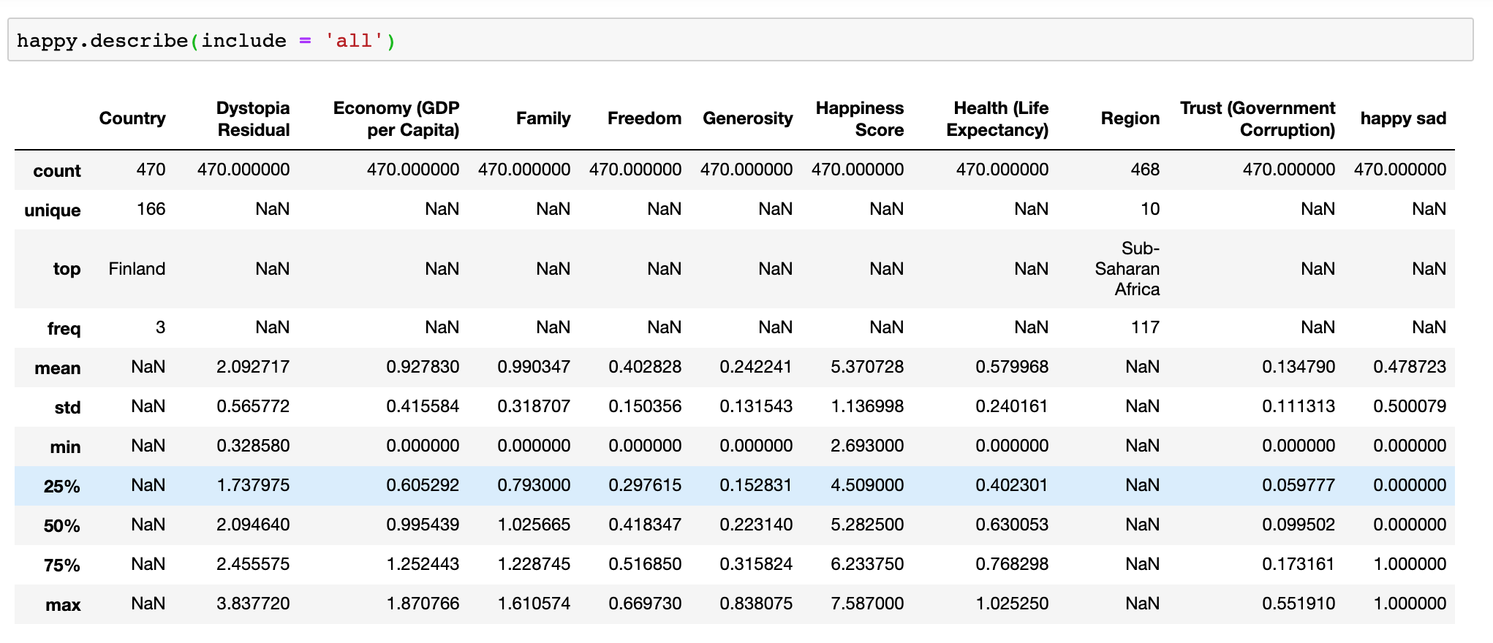
statistical summary

Slide 7
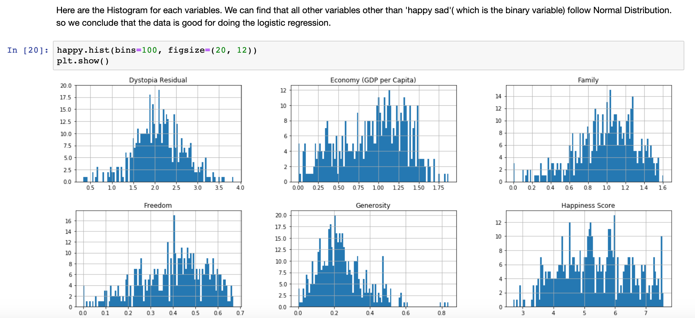
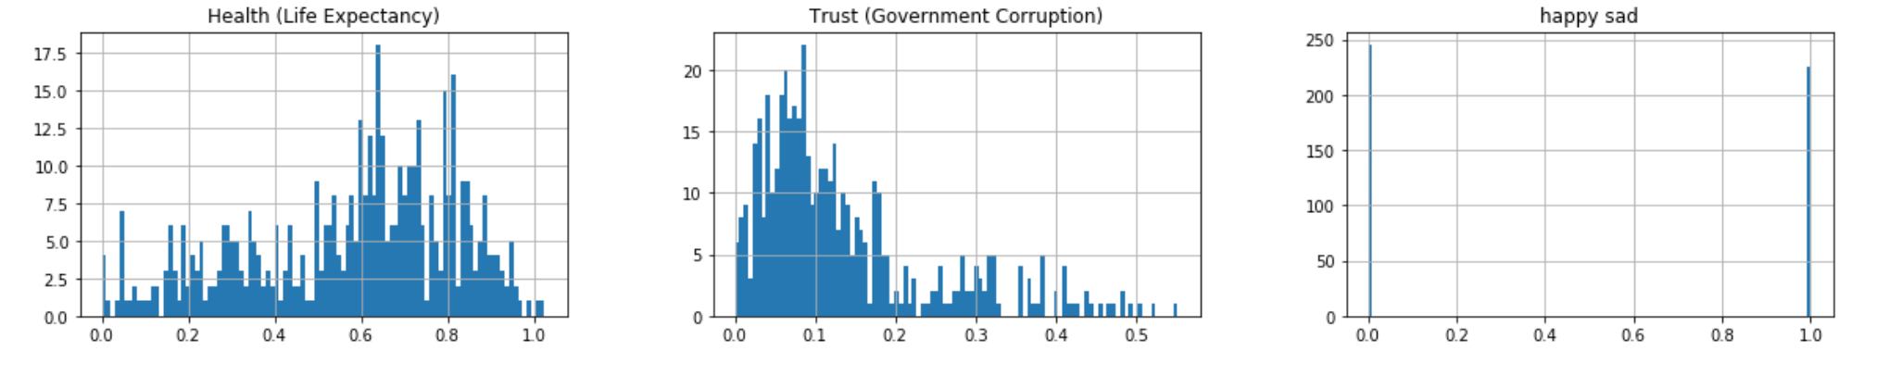
Main visualization

Slide 8
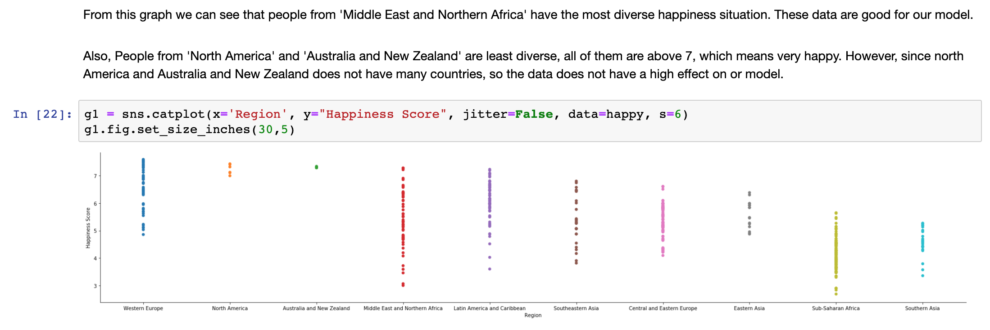
Main visualization

Slide 9
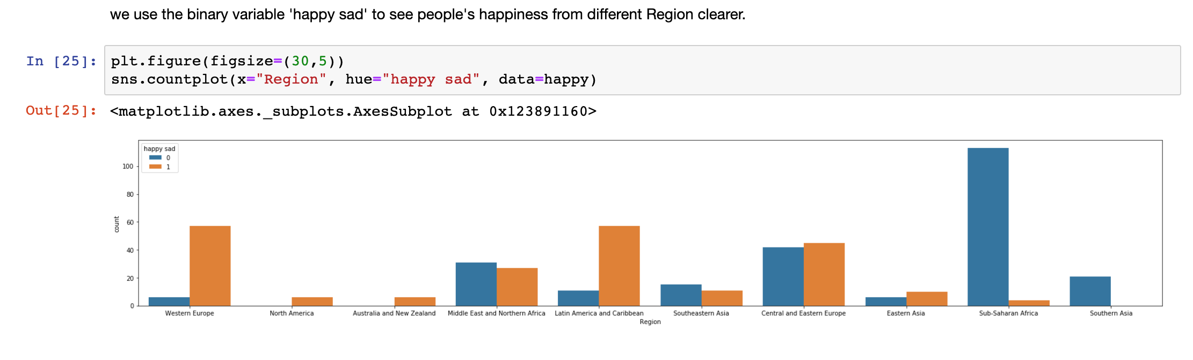
Main visualization

Slide 10
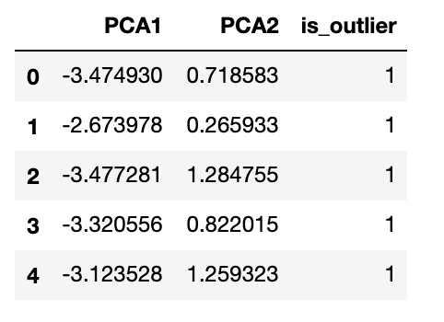
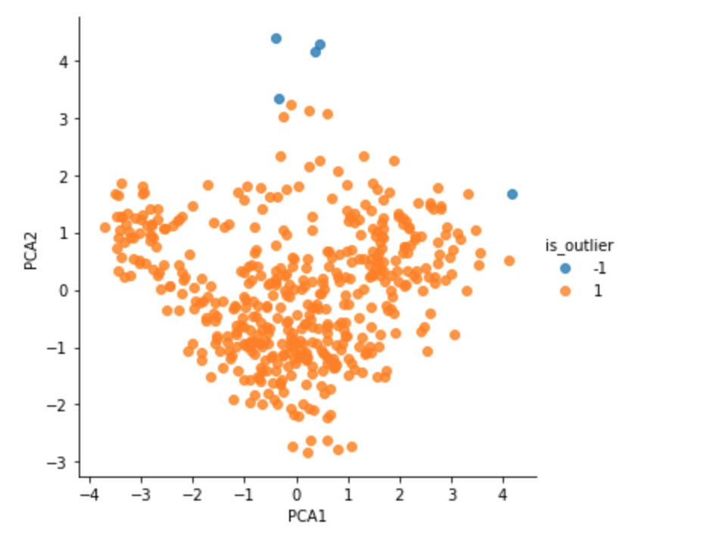
Outlier Detection
We don't remove any outlier
Reason:
This dataset is not an experimental dataset but a research question dataset based on each country, not a single person.

Slide 11
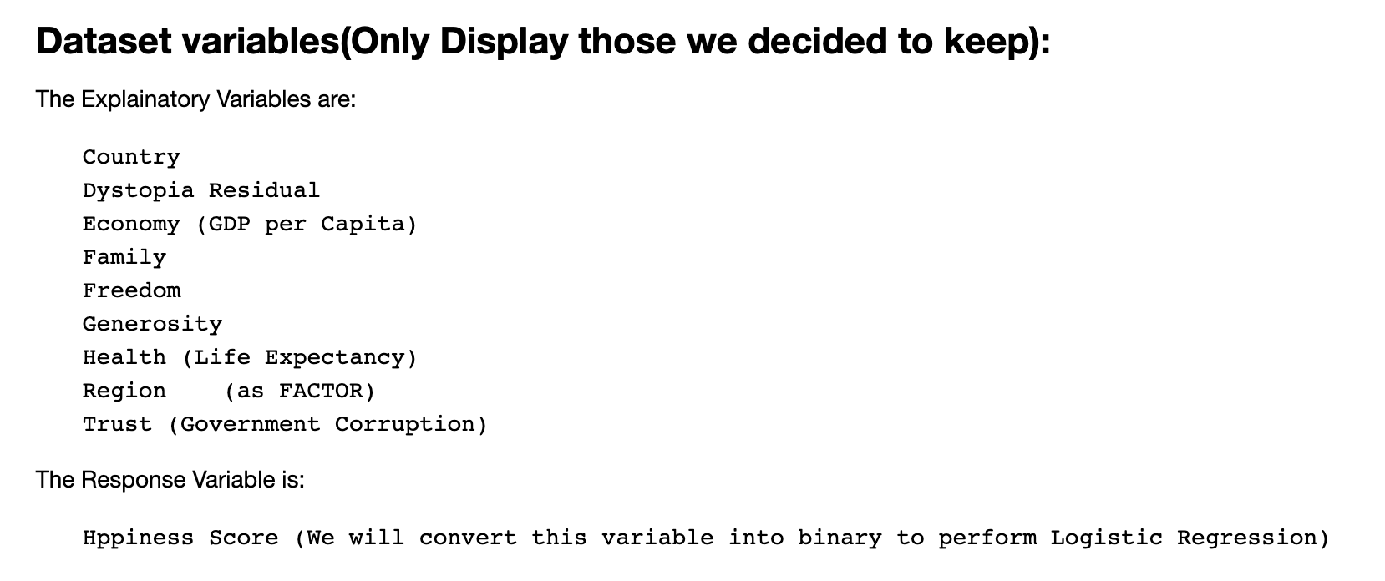
Modeling
Motivates: Because ”happy sad” column is binary so it is better to use logistic regression.

Slide 12
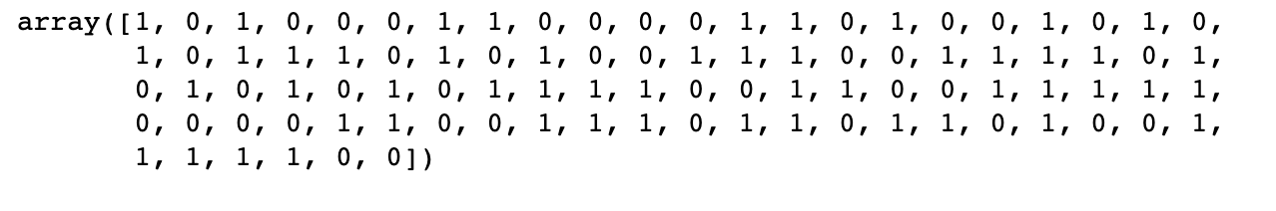
Modeling
We split the dataFrame into X as independent variables and y as dependent variable.
We do the train-test split with 0.2, 0.8 ratio.
We use logistic regression cross validation with 5-folds to train the data and predict the y_values using test data of X.

Slide 13
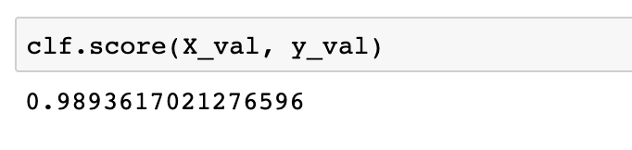
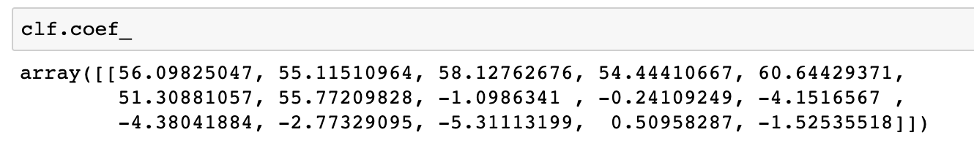
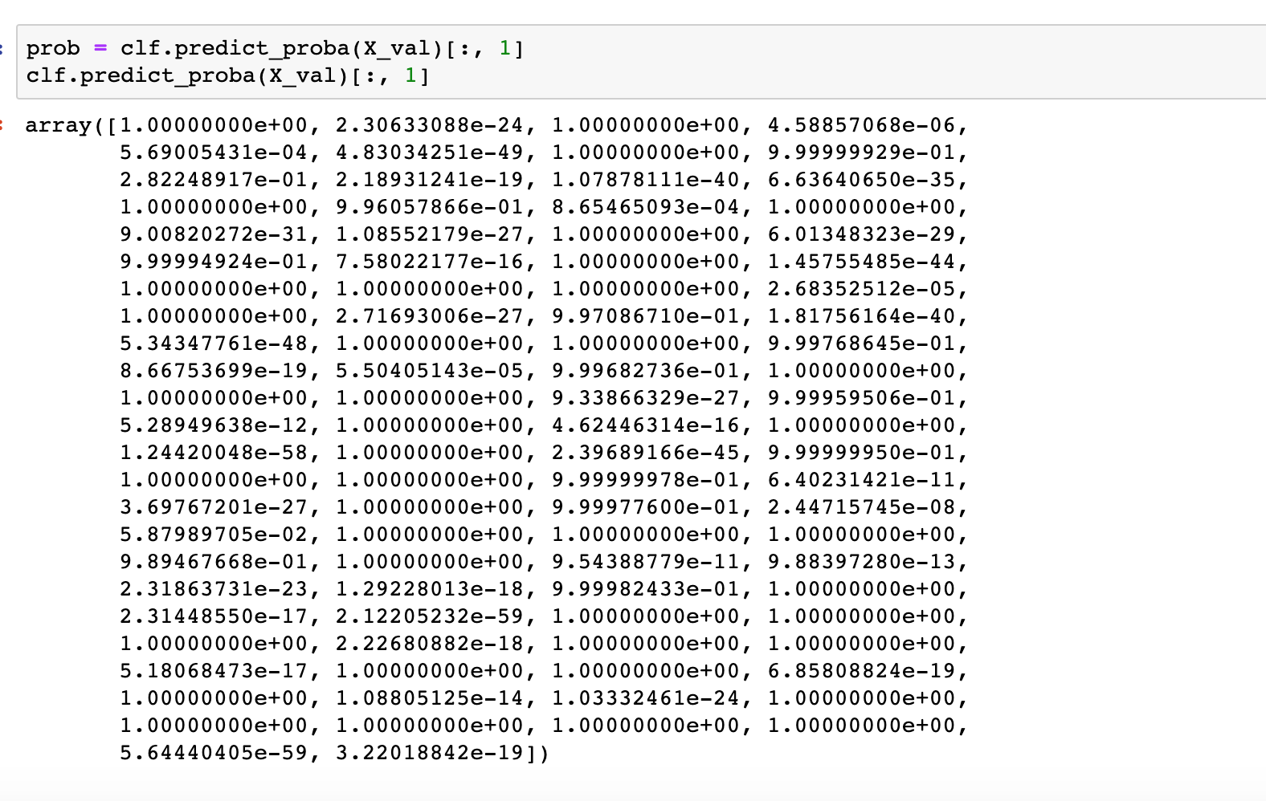
Modeling

Slide 14
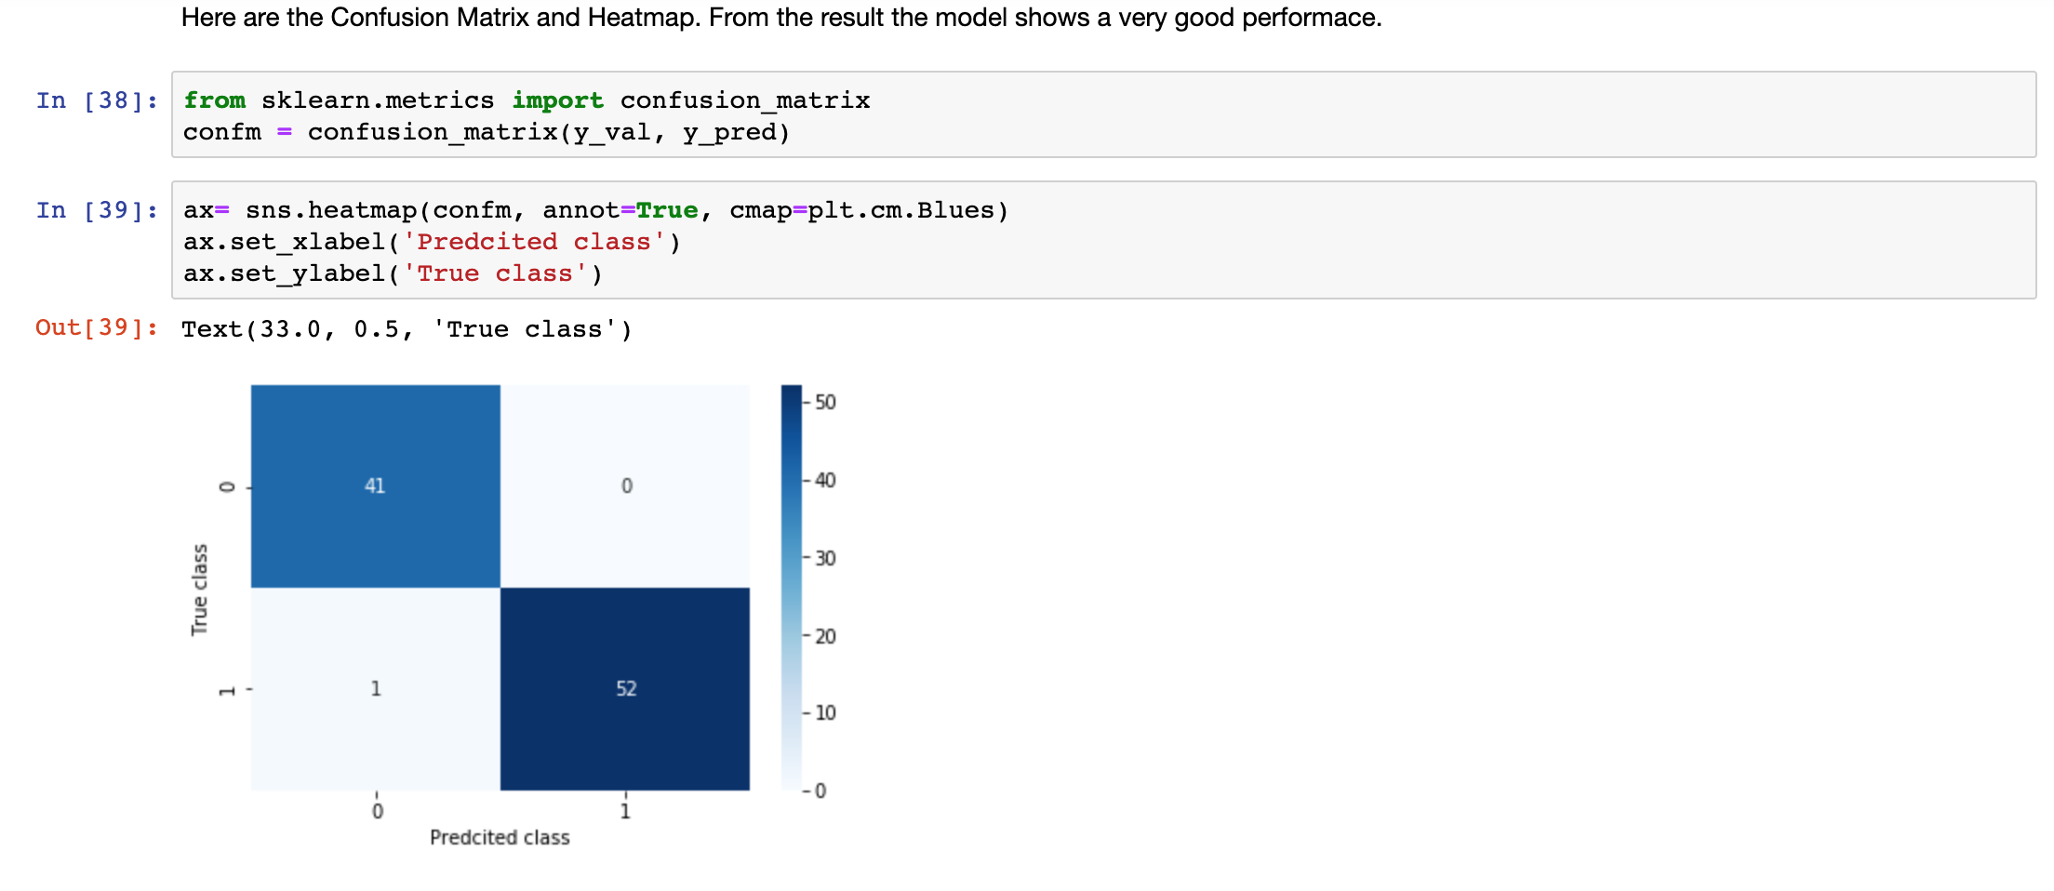
Modeling

Slide 15
Conclusion
From the coefficients of the final model, we can see that all other variables are not that different in affecting one's 'happiness'. They all have the similar coefficient values around 55 to 60, which means they are all at the similar importance deciding whether people from a country are happy or not. 'Generosity' is slightly more important.
This analysis also shows that people from 'Sub-Saharan Africa' and 'Southern Asian' are the Regions with the most people unhappy. Based on our research, maybe they can be more generous to be happy.
The model we got is 'clf', it is a relatively good model which is tested can precisely predict a country's 'happy or not'.

