Slide 1
Guided Capstone Project Report
Big Mountain Resort Pricing Strategy Recommendation
Qian Wang

Slide 2
CONTENTS
Contents
01
02
03
04
Problem
Identification
Recommendation
And
Key findings
Modeling Results
And
analysis
Summary
And
Conclusion

Slide 3
Problem Identification
Problem Statement
How can the Big Mountain Resort select a better ticket price to capitalize on the facilities as much as it can?
What changes can they make to make more profit?
Context
Criteria for Success
A pricing strategy that brings more revenue.
Big Mountain Resort is a ski resort located in Montana. Every year about 350,000 people ski or snowboard at Big Mountain. Recently, Big Mountain Resort has installed an additional chair lift, which increases their operating costs by $1,540,000 this season. The resort’s pricing has been to charge a premium above the average price in its market segment. Now they are considering a more data-driven pricing strategy.
Scope of Solution Space
PART.01
Consider a series of changes that will either cut costs without undermining the ticket price or will support an even higher ticket price.

Slide 4
Problem Identification
Problem Statement
How can the Big Mountain Resort select a better ticket price to capitalize on the facilities as much as it can?
What changes can they make to make more profit?
Constraints
Stakeholders
1. The project does not have a very clear guidance on the success criteria.
2. We may need additional data to go deeper.
Jimmy Blackburn Director of Operations
Alesha Eisen Database Manager
Data Sources
PART.01
A CSV file associated with 330 resorts in the US. Initially there are 27 features for each resorts.
Population and area data for each state from Wikipedia.

Slide 5
Recommendations and Key Findings
Recommendations
Key Findings
Increase the vertical drop by adding a run to a point 150 feet lower down, at the same time install an additional chair lift without extra snow making coverage.
Four Features having dominant influence on the ticket price:
fastQuads
Runs
Snow Making_ac
Vertical_drop

Slide 6
Model Result
$95.87
The modelled price for Big Mountain Resort.
The mean absolute error is $10.39
$81.00
The current ticket price per adult.

Slide 7
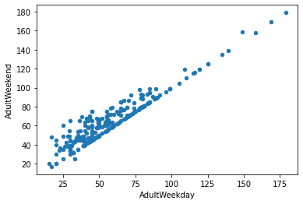
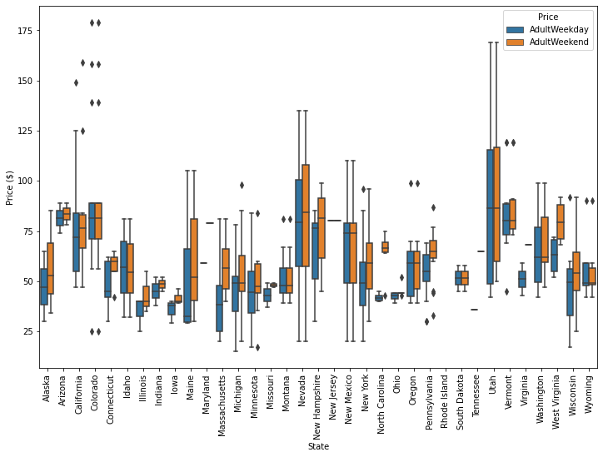
Analysis
Data Wrangling
Boxplot Ticket price by State
Weekday vs weekend
There is no clear grouping pattern.
There is a clear line where the values are equal, which shows they are highly correlated.
There are more missing values in weekdays, so we are only modelling weekend price.

Slide 8
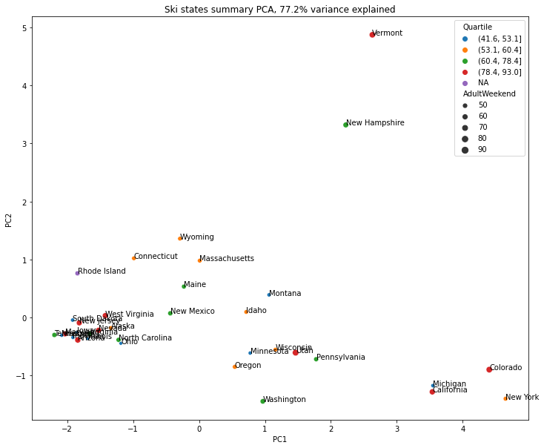
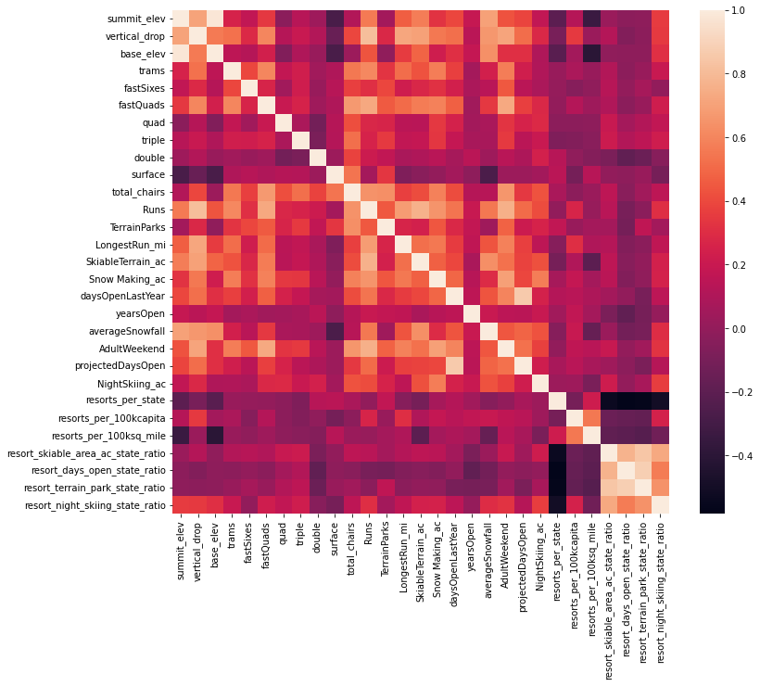
Analysis
Data Exploration
PCA for price vs state data
Ski data correlation heatmap
First 2 components explain 77.2% variance.
There are several features are related to each other.
Some features have more influence on ticket price

Slide 9
Analysis
Preprocessing and Training
70% Training
30% Test
 | Linear Regression | Random Forest
MAE Average | 10.5 | 1.62
MAE STD | 9.6 | 1.35
Test MAE | 11.79 | 9.54
Linear Regression Model
Random Forest Model

Slide 10
Model Result
$95.87
The modelled price for Big Mountain Resort.
The mean absolute error is $10.39
$81.00
The current ticket price per adult.

Slide 11
Summary and Conclusion
The model is based on treating all the stats equally.
2. We use this model to predict the price associated with a few changes in the feature of the resort and the revenue increasing it brings, supposing there are 350000 visitors in this season.
3. Even though we have the recommendation of changes, the model is still open to test other scenarios.
More data might be needed to make more accurate prediction
Visitors of each resorts in the US
Current operating cost on the chair lift
Current operating cost on the snow making machine

Slide 12
THANKS
报人：皖艺旗舰店

