Slide 1


Production DB
DeleteConnectionString
Production DB
CopyConnectionString (Setting1)
LogShipping DB
CopyConnectionString (Setting2)
Archive DB
ArcConnectionString

Slide 2
Parameter list:
/Mail : Test Mail function
/P : Only prepare data, do not delete
/M : Only move data, do not prepare
/FK: Get all FK table list and insert data to ArchiveAllFKConstraint
/? : Show all parameter usage
/PM: P +M

Slide 3

Setting 1 : Copy Src=LogShipping DB
1.Prepare Archive Data ID List
(Product,Delivery,PCB....)
LogShipping DB
After 15 mins
Production DB
2. Log Shipping
(copy Archive Data ID List)
4. Delete Data
3. Copy Data from LogShipping DB
to Archive DB
Archive DB

Slide 4
Setting 2 : Copy Src=Production DB
1.Prepare Archive Data ID List
(Product,Delivery,PCB....)
Production DB
2. Copy Data Archive DB
Archive DB
3. Delete Data

Slide 5
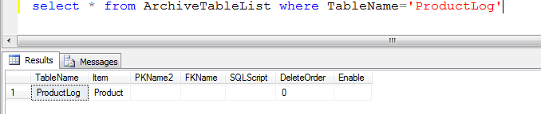
case 1 : Product & ProductLog
sample SQL :
select * from ProductLog
where ProductID in
(
Select PK_ID from ArchiveIDList where Item='Product'
)

Slide 6
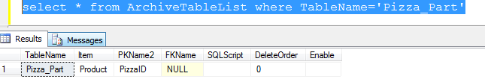
case 2 : Product & Pizza
sample SQL :
select * from Pizza_Part
where PizzaID in
(
Select PizzaID from Product where ProductID in
(Select PK_ID from ArchiveIDList where Item='Product')
)

Slide 7
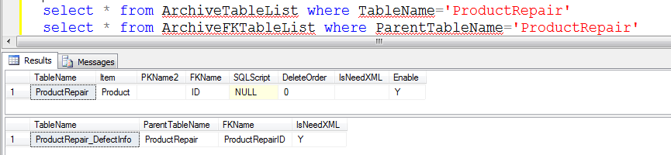
case 3 : Product & ProductRepair & ProductRepair_DefectInfo
sample SQL :
select * from ProductRepair
where ProductID in
( Select ProductID from Product where ProductID in
(Select PK_ID from ArchiveIDList where Item='Product'))
select * from ProductRepair_DefectInfo where ProductRepairID in
( select ID from ProductRepair
where ProductID in
( Select ProductID from Product where ProductID in
(Select PK_ID from ArchiveIDList where Item='Product')))

Slide 8
注：以下重要表格不可随意动
select * from ArchiveFKTableList
select * from ArchiveTableList
select * From ArchiveMainTable

