Slide 1
Factory Diag Process
Jim MacDonald 15 October 2012

Slide 2
Typical RCTO Factory Process Overview
PT Area
Assemble
unit per order
Diagnostics
download / extraction
Pretest
Stations
RI Area
Diagnostic Runin
Customer Image download
SDV
Post processing
SDV
X%
Functional Audit (EOL)
Notes:
Vision execution model doesn’t require this flow. There are different factory models that we support. L10 may use data blaster or network download.

Slide 3
Factory Download Process Flow Using Magellan
Enter PO and Serial Number
Download Files into the UUT
Prism Diag Server
Prism Searches S/N, PO and Product Info
\\forwksdiv2\DiagRel\Diags\
MyHome\R\BPOSXA001
My Home\D\BPRXA001
My Home\D\BPRXA001
My Home\D\BPCXA001
My Home\D\BPPPD001
Find base Cell AV# in Hardware PO
Find Diag
Components in Prism Diag
Server
Magellan Database
AV#LOC | Download Seq | Package | Path
MyAV#ABA | 1 | OS | MyHome\R\BPOSXA001
MyAV#ABA | 2 | Driver | My Home\D\BPRXA001
MyAV#ABA | 3 | Diagnostics | My Home\D\BPRXA001
MyAV#ABA | 4 | Configuration | My Home\D\BPCXA001
MyAV#ABA | 5 | Product | My Home\D\BPPPD001
Hardware PO (ctohw.txt)
MyAV#ABA,1
C1234AV,1

Slide 4
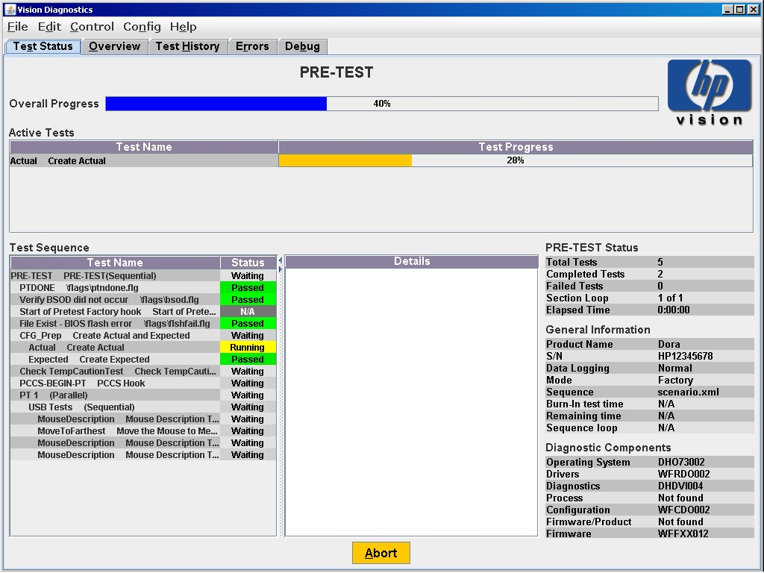
Standard execution - continued
Factory view
Pre-test
in progress
Run full screen
Number of times
PRE-TEST will
be executed
Current test
sequence executed
Abort execution of current tests when pressed,
Abort window is displayed for confirmation

Slide 5
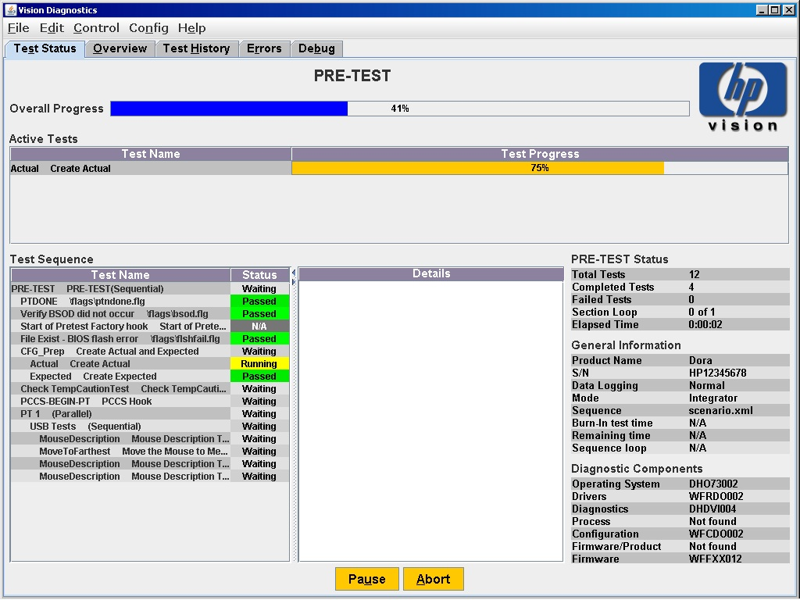
Standard execution - continued
display the overall percentage completion
for a particular stage
Integrator view
Pre-test
In progress
Integrator mode:
Pause button/
control feature
No security
Other features
defined later in
the presentation
Time since the
test execution
started.
Elapsed time is
not affected when
Paused button is
pressed
Operation mode:
Integrator or
Factory

Slide 6
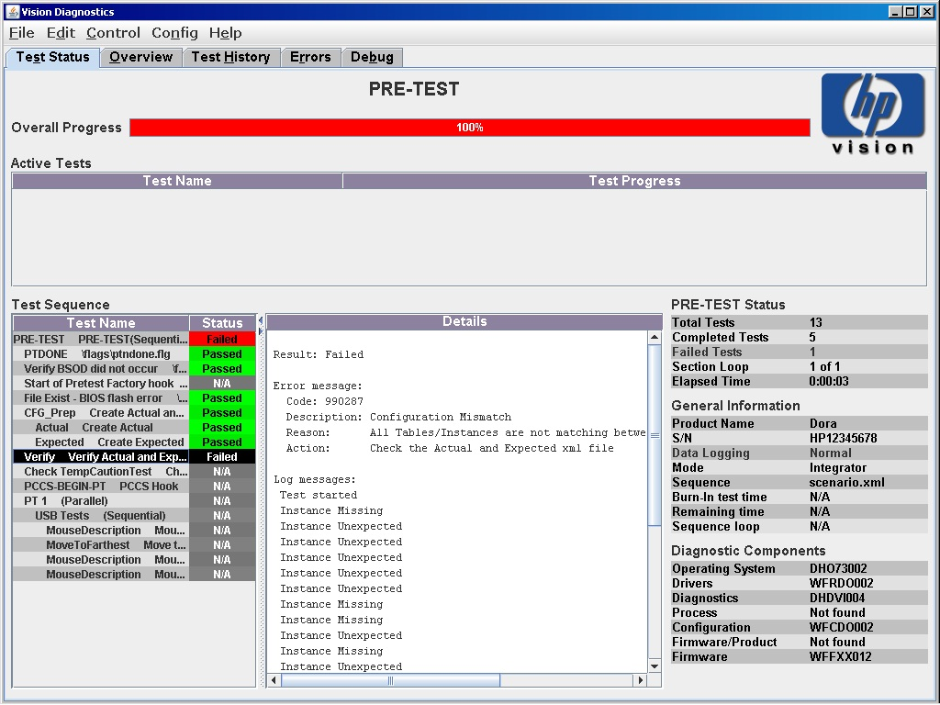
Pass/Fail screens - continued
After pressing OK on Fail screen, the status window of vision will look as on the left side.
More detailed failure information may be found when clicking on the failed test in the Test Sequence frame
Each status has a specific color:
Running – yellow
Waiting – white
Bypassed - grey
Passed – green
Failed – red.
Clicked on Verify test then detailed results
of the test are displayed.

Slide 7
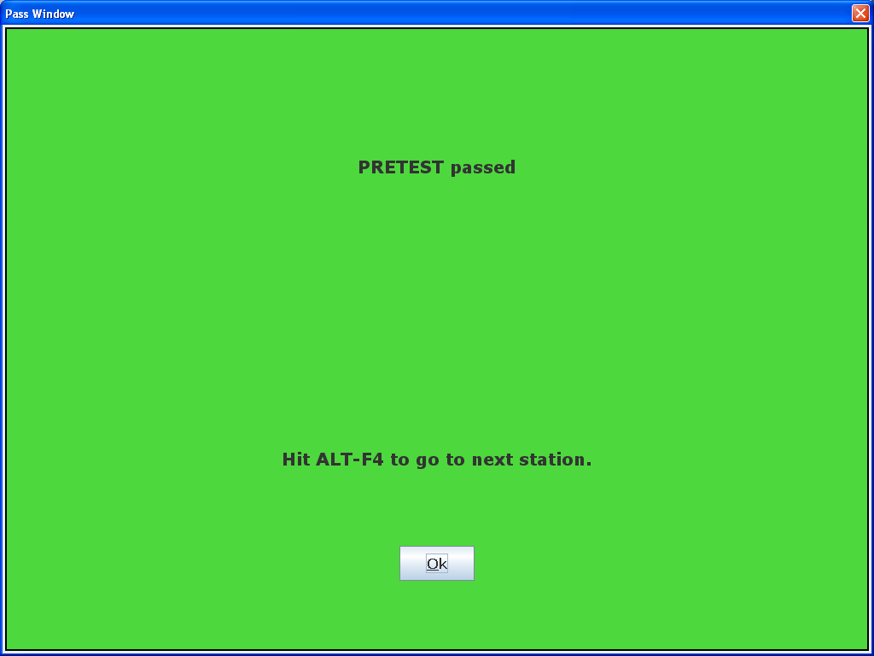
Pass/Fail screens
Messages are customizable using Vision.msg (Framework messages file)
Colors and texts size are customizable using
Configuration.xml

Slide 8
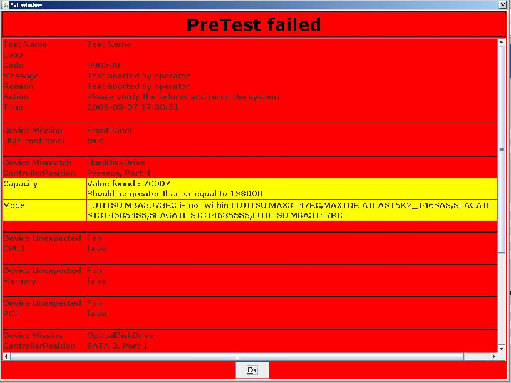
Pass/Fail screens - continued
Message, error code, Reason and action defined in DefectCode.xml (multiple languages can be used, one file for all diagnostics except CDM vendor specific diagnostics)
Colors and top text size are customizable using Configuration.xml
All issues will be reported using this screen
Multiple issues can be reported depending on the configuration settings (do not stop at first error for example)

Slide 9
Test Equipment List
 |  |  |  | Quantity |  |  |  |  |  | 2009/2010 AiO
Item | Part No. | Price | Description | PT | RI | Supplier/Manufacturer | lead-time | flexible | Application/Comments | Niagrara Omni 100 (Full Postponement) | Rhine 200 (Full Postponement) | Jesse 300 (Full Postponement) | Shasta 310 (full postponement) | M5 600 (light postponement) | M5 600 (Full Postponement) | Brahma (HP Dreamscreen All-in-One PC) | Yangtze (Compaq Presario CQ1 PC) | 9100 Da Vinci HP Touchsmart | 6000 - TongaE AiO | Touchsmart 610 - M6 AiO | Smart Omni 105 | Mini Cooper Omni 305 | lamar-Hudson Omni100 PC
Workstation products only: For End of Line Audit test equipment, please refer to the equipment list document (PSG CPU End-of-Line Audit) on the site: http://standards.corp.hp.com/qualdocs/nadf/ --- This document does maintain those items.
Monitors
1 | DVI Monitor | $275.00 | DVI-D and VGA capable monitor | 1 | 1 |  |  | Some | DVI-D required for DP (primary connector) cards for pretest.
 |  | $214.00 | HP L1745 17-inch LCD Monitor |  |  | HP | Yes | No | http://h10010.www1.hp.com/wwpc/us/en/sm/WF05a/382087-382087-64283-72270-444767-3375462.html
 |  | $199.00 | HP L1750 17-inch LCD Monitor- models |  |  |  |  |  | http://h10010.www1.hp.com/wwpc/us/en/sm/WF25a/382087-382087-64283-72270-444767-3463248.html
2 | VGA Monitor | $200.00 | monitor (1024X768 minimum resolution and support a refresh range of 60Hz to 85Hz max) |  |  |  | Yes | Yes | VGA is ONLY allowed in run-in DVI is preferred
Removable Media
3 | 293835-002 | $0.52 | Revolution Test Media (ver2.0) | 1 |  | Wetmore or JVC | 2 weeks | No | for units shipping with CD or DVD |  |  |  |  |  |  | x
CD | Any CDRW Media |  | Verbatim CDRW media | 1 |  |  |  | limited | for units shipping with CDRW; Verbatim Part no's 154428-201 (CDRW) , 230575-LAO (CDRW), 224202-LAO (CDR) or DVD-RW drives |  |  |  |  |  |  | x
 |  |  | Philips CDRW media |  |  |  |  |  | alternate CDRW media; Philips part no's 154428-HO2 (CDRW) , 224202-HAO (CDR)
 | ACDWM4X100 | $2.00 | CDRW media, Mr. Write |  |  |  |  |  | alternate CDRW media
 |  | $1.50 | CD-RW media, Imation 8x CD-R |  |  |  |  |  | alternate CDRW media
DVD |  |  | DVD+RW or DVD+R | 1 |  | Reference ODD Media Vendor information Tab in this worksheet |  | No | Recommended X16 DVD media “HP Branded” Media or Media purchased from an approved HP vendor. HP internal media information provided | x | x | x | x |  | x | x | x |  | x | x | x | x | x
DVD |  |  | DVD-RW 8cm DISC - (ALTERNATIVE) |  |  | Reference ODD Media Vendor information Tab in this worksheet |  |  | ALTERNATIVE to standard DVD-RW media. CAUTION: May not be applicable to all platforms. ONLY SONY 8cm DVD-RW has been validated, and ONLY on workstation products.
Notes:
The above slide shows a small portion of the test equipment list. Test equipment is used by the tests to test the component or system.

Slide 10
Factory Support Process
Factory Test Engineering team plays important role
Diag or product issue occurs on the production line.
Perform troubleshooting to rule out operator induced error.
Factory Test Engineer collects the following data and reports issue to help desk.
The “support.zip” file. (Diags generates a file which contains the debug information for Vision team.)
Failure rate and number of impacted units.
Type of order: Normal or Specials.
Quantifies issue to which components are contributing to the issue.
If a changed component contributed to the issue.
Helps to quantify if product or diags issue.

Slide 11
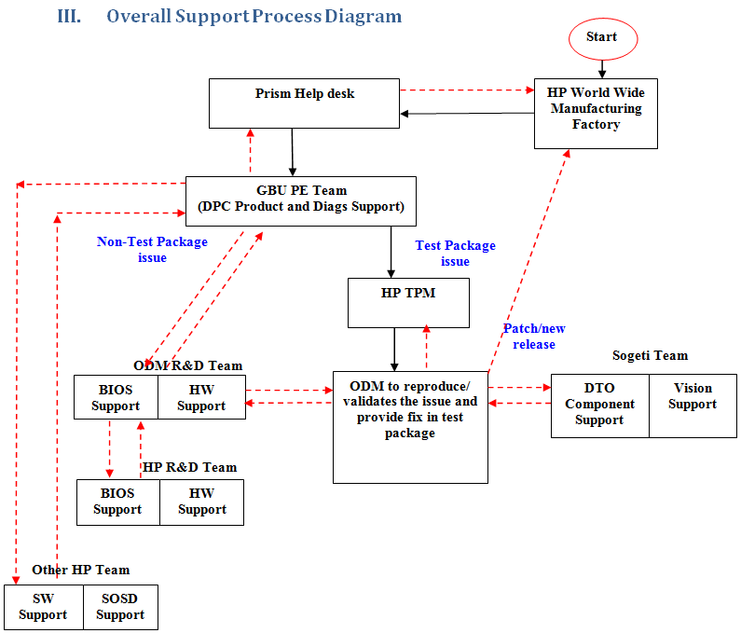

Slide 12
Factory Issue - Service Level Agreement (SLA)
Escalation/issue Investigation
priority | acknowledge, with action plan | corrective action delivery
 |  | no fix required | work-around | permanent fix
critical | <= 4 business hours | notify requester | <= 1 business day | release plan per agreement with HP
high | <= 1 business day | notify requester | <= 5 business days | release plan per agreement with HP
medium | <= 5 business days | notify requester | Na | release plan per agreement with HP
Notes:
The SLA is defined for resolving issues that you encounter in your factory as well as issues encountered in the RCTO L10 factories.

