Slide 1

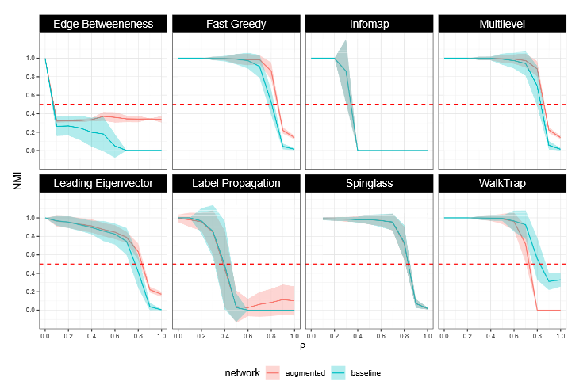
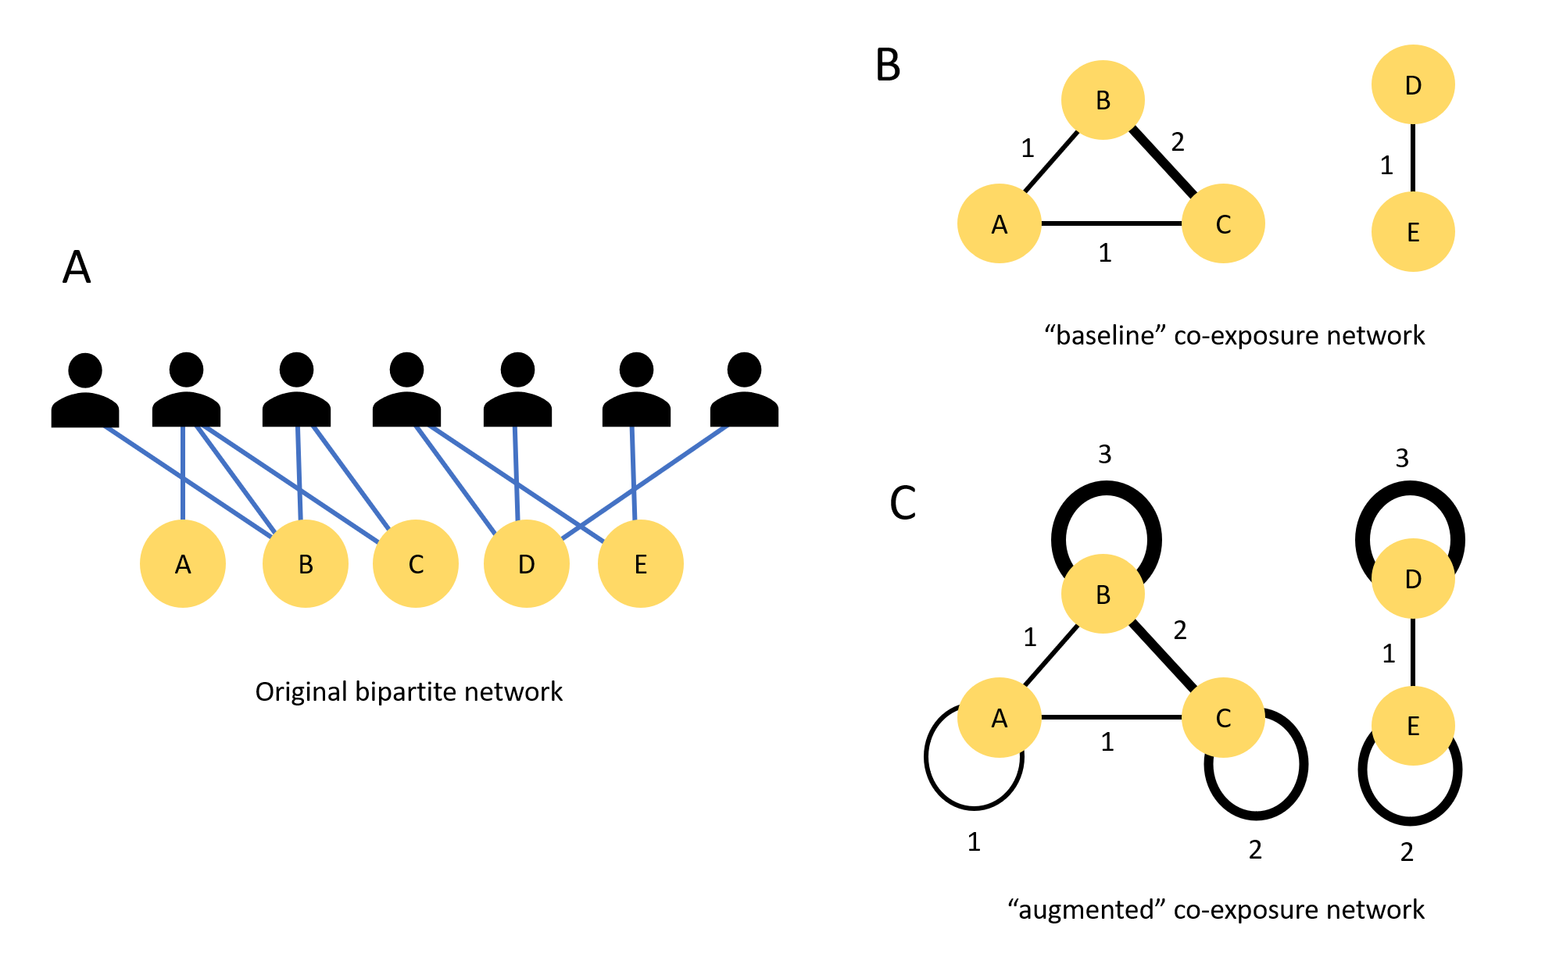
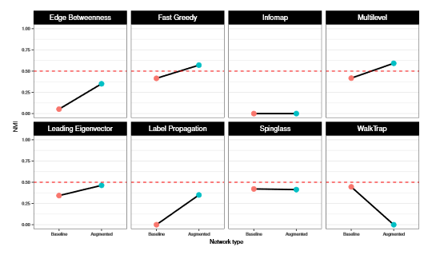
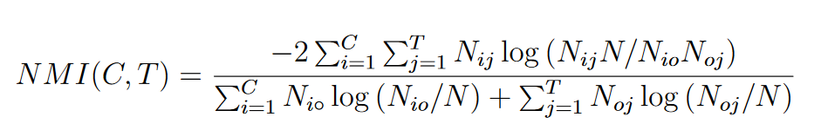
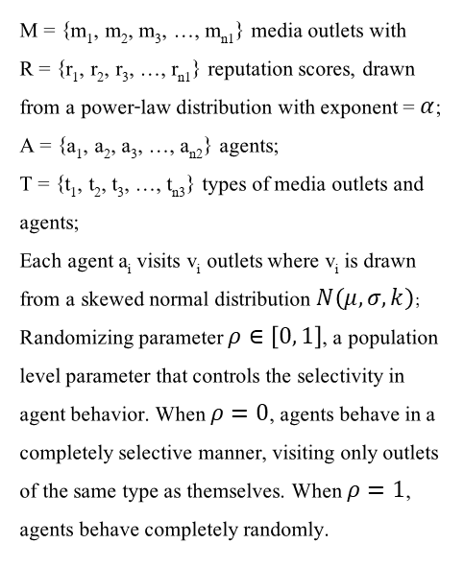
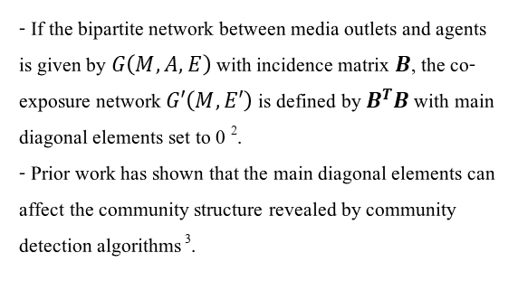
A Network Model of Selective Exposure Using Community Detection
Subhayan Mukerjee, Ph.D. – National University of Singapore – email: mukerjee@nus.edu.sg – twitter: @wrahool
Motivation
Network Construction: Baseline vs Augmented
Results on Simulated Networks
Conclusion
Many studies use community detection techniques on audience co-exposure networks¹ to study selective exposure. However, their analytical choices are often arbitrary, rarely guided by systematic comparison of how different algorithms perform on audience co-exposure networks or grounded in network theory.
100 simulations for each value of $ρ.$
- If the bipartite network between media outlets and agents is given by $G\left(M, A, E\right)$ with incidence matrix $B$, the co-exposure network $G′\left(M, E′\right)$is defined by $B^{T}B$ with main diagonal elements set to 0 ².
- Prior work has shown that the main diagonal elements can affect the community structure revealed by community detection algorithms ³.
- Fast Greedy and Multilevel perform best.
- Their performances are further enhanced when the network is augmented
- Performances are replicated on an empirical network tracking a nationwide online population for nearly 4 years.
Model specification
- So I define “baseline” vs “augmented” networks depending on whether the main diagonal elements are set to 0 or not.
M = {m₁, m₂, m₃, …, m_{n1}} media outlets with
R = {r₁, r₂, r₃, …, r_{n1}} reputation scores, drawn from a power-law distribution with exponent = $α$;
A = {a₁, a₂, a₃, …, a_{n2}} agents;
T = {t₁, t₂, t₃, …, t_{n3}} types of media outlets and agents;
Each agent a_{i} visits v_{i} outlets where v_{i} is drawn from a skewed normal distribution $N\left(μ,σ, k\right)$;
Randomizing parameter $ρ∈\left[0, 1\right]$, a population level parameter that controls the selectivity in agent behavior. When $ρ=0$, agents behave in a completely selective manner, visiting only outlets of the same type as themselves. When $ρ=1$, agents behave completely randomly.
References
Fig 2: algorithm performance on simulated networks
1. Nir Grinberg, Kenneth Joseph, Lisa Friedland, Briony Swire-Thompson, Nir Grinberg, and David Lazer. Fake news on twitter during the 2016 U.S. presidential election.Science,363(6425):374–378, 2019.
2. M. E. J. Newman. Networks. Oxford University Press, Second Edition
3. Alex Arenas, Alberto Fernandez, and Sergio Gomez. Analysis of the structure of complex networks at different resolution levels. New Journal of Physics, 10(5), 2008
Results on Empirical Network
Fig 1: the logic of network construction
- Performance of algorithm is measured using the Normalized Mutual Information (NMI) score:
Fig 3: algorithm performance on empirical network

