Slide 1

b
B
D
1
2
1
A
C
E
a
1
“baseline” co-exposure network
3
3
c
A
B
C
D
E
B
D
1
2
1
Original bipartite network
A
C
E
1
1
2
2
“augmented” co-exposure network

Slide 2
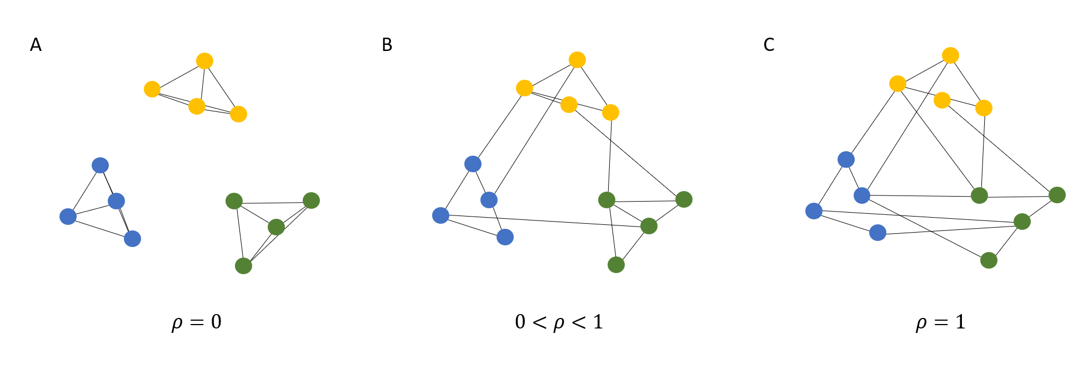
a.
b.
c.

