Slide 1

akka.net
Einführung in das Actor Model mit .net

Slide 2


Über mich
Software Engineer, Principal @ Progress Software
ralph.waldenmaier@progress.com
@eigeneachse
Sprecher auf Konferenzen und User Groups
Freier Autor für donetpro
Ralph Waldenmaier
Notes:
Welchen hintergrund haben die Leute? Web; Backend; Ui?

Slide 3
Ziel
Entwicklung von Anwendungen
Skalierbar
Fehlertolerant
Selbst heilend
Verteilt
Was ist das Actor Model
Was ist akka.net

Slide 4
Actor Model – Die Theorie
1973
Carl Hewitt, Peter Bishop und Richard Steiger
Implementierungen
Erlang
Scala
C#
Wikipedia (https://de.wikipedia.org/wiki/Actor_Model):
„Das Actor Model (deutsch Aktorenmodell) ist in der Informatik ein Modell für nebenläufige Rechnungen bzw. Programme. Diese werden in nebenläufige Einheiten, sog. Aktoren, unterteilt, die ausschließlich über Nachrichtenaustausch kommunizieren.“
Quelle: https://de.wikipedia.org/wiki/Actor_Model
Notes:
Erlang:
Netzwerk;
Fail fast

Slide 5
Actor Model – Die Theorie #2
Drei Grundsätze
Send: Nachrichten an sich selbst oder andere Aktoren verschicken
Create: Neue Aktoren erzeugen
Behavior: Das eigene Verhalten ändern
“An island of sanity in a sea of concurrency”
“Shared nothing”
“Location transparent”
“Distributable by design”
Quelle: https://de.wikipedia.org/wiki/Actor_Model
Notes:
Getrennte Speicherbereiche;
Eigener Thread vs. Multihreaded Concurrency
Distributable by Design
Location transparent
OOP vs. Actor model
Behavior
Stateful
Synchronous vs Asynchronous

Slide 6
Wer nutzt das?
WhatsApp (Erlang)
RabbitMQ (Erlang)
CouchDB (Erlang)
LinkedIn.com (JVM Akka)
Walmart.com (JVM Akka)
Bank of America Merrill Lynch (Akka.net)
Halo ( Project Orleans )

Slide 7
Wofür verwende ich das?
Alternative zu Threading
Message routing
State machines
CQRS / Event Driven Design
IoT
Singleton

Slide 8
.net Entwicklung heute
Service
BLL
DAO
Telerik Data Access
DB
DAO2
WebApi
RestHandler

Slide 9
Skalierung
Server 1
Server 2
Service
BLL
DAO
Telerik Data Access
DB
DAO2
WebApi
RestHandler
Service
BLL
DAO
Telerik Data Access
DB
DAO2
WebApi
RestHandler
MSMQ
Elastic?
CPU 2
Parallel LINQ
TPL – async/await
Threads
WCF
WebAPI
MSMQ / RabbitMQ / Azure Queues

Slide 10
Skalierung mit akka.net
Server 1
Server 2
ActorX
ActorY
ActorZ
ActorX
ActorY
ActorZ
Elastic!
CPU 2
Akka.Actor
Akka.Remote
Akka.Cluster

Slide 11
Akka.net
akka.net
Initial Entwickelt von Roger Johansson und Aaron Stannard
OpenSource ( Apache 2 License )
Orientiert sich an den Features der JVM Akka Implementierung
~ 5 core Entwickler
~ 70 github contributor
Akka.net Version 1.0 – Q1/2015
Aktuell 1.04
C# und F# API
.net und Mono
~ 50 mio msg/sec auf einer Maschine
~ 2,5 millionen actor / GB RAM
Reactive Manifesto ( Responsive, Resilient, Elastic, Message Driven )
Notes:
Resilient = Wiederstandsfähig

Slide 12
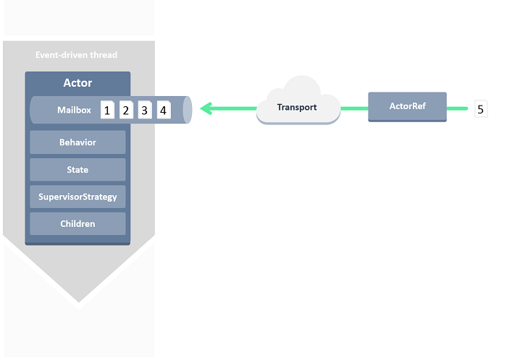
Wie funktioniert ein Actor?
Quelle: http://getakka.net/docs/concepts/actors
Notes:
Explain
MailBox vs. Public API
Behavior
State
Supervision
Children
ActorRef
Transport:
It doesn’t matter where the Actor lives. We just need the Actor ref

Slide 13
Actor Lifecycle
Terminated
Actor is dead
PostStop()
Starting
Receiving
Stopping
Actor initializes
Actor is up and now able to process messages
Actor cleans up
PreStart()
Restarting
Actor is going to restart
PreRestart()
PostStop()
PostRestart()

Slide 14
Dispatcher
Actor1
Actor1
Actor2
Actor3
Actor4
Actor1
Thread Pool
Actor2
Actor3
Actor1
Actor2
Actor2
Actor4
Actor4
Actor3
Time
ThreadPoolDispatcher ( default, max concurrency )
TaskDispatcher ( TPL )
CurrentSynchronizationContextDispatcher ( UI sync )
…
Notes:
The first free thread will be used by the actor
Using a thread per actor would be too expensive
Memory consumption wise
64bit system = 1 Thread = 4mb -> 1000 Threads = 4Gb
32bit system = 1mb / thread
Actor consumes only CPU when it is processing

Slide 15
Demo Akka.Actor
Server 1
Hello World
Actor System
ReceiveActor
ActorRef
ActorX
ActorY
ActorZ
Notes:
Demo
- Create HelloWorld from scratch

Slide 16
Demo Akka.Remote
Demo 1
Chat app
ActorSelection
RemoteActorRefProvider
ActorX
ActorY
ActorZ
ActorX
ActorY
ActorZ
Akka.Remote
Demo 2
Remote deployment
Remote daemon
ActorX
ActorY
ActorZ
ActorX
ActorY
ActorZ
ActorA*
Akka.Remote
Notes:
Demo 1
Chat example
Client 2 Client also possible since P2P (With ActorRef)
Demo 2
Node 1 und Node 2
RemoteDeployment:
Example: Gather performance counter information on a remote system

Slide 17
Router
Leitet Nachrichten an „routee“ Actors weiter
Group vs. Pool Router
BroadcastRouter
ConsistentHashingRouter
SmallestMailboxRouter
Elastische pools
RoundRobinRouter
ScatterGatherFirstCompletedRouter
Notes:
Group: Eigen definierte Routee
Pool: System erstellte Routee
Erkläre abgesetzte Router

Slide 18
RoundRobinRouter
Eingang
Ausgang
4
1
Routee1
4
3
2
1
Router
2
Routee2
3
Routee3
Notes:
RemoteRoundRobin
ScaleUp and Out at the same time

Slide 19
ScatterGatherFirstCompleted
Eingang
Ausgang
1
Routee1
1
Sender
Router
1
Routee2
!
1
Routee3

Slide 20
Router konfiguration
akka.actor.deployment {
/myActor {
router = round-robin-pool
nr-of-instances = 5
}
}
// Hocon config
var router = system.ActorOf(Props.Create<Worker>()
.WithRouter(FromConfig.Instance),
„myActor");
// Code config
var router = system.ActorOf(Props.Create<Worker>()
.WithRouter(new RoundRobinPool(5))
, „myActor");
Notes:
HOCON = Human-Optimized Config Object Notation

Slide 21
Elastische pools
akka.actor.deployment
{
/my-router
{
router = round-robin-pool
resizer
{
enabled = on
lower-bound = 1
upper-bound = 10
messages-per-resize = 10
ramp-up-rate = 0.2
pressure-threshold = 1
backoff-threshold = 0.3
…
}
}
}
Notes:
pressure-threshold = 1 // all have at least 1 msg
backoff-threshold = 0.3 // less than 30% are busy
messages-per-resize - The # of messages to route before checking if resize is needed

Slide 22
Demo Akka.Routing
RoundRobin
Deployment configuration
Notes:
Demo
Node 1 und Node2
Node 1 different config -> regions

Slide 23
Supervision
Jeder Actor wird durch einen anderen Actor überwacht, welcher entscheidet, wie im Fehlerfall zu reagieren ist.
Restart
Terminate
Ignore and Resume
Escalate an eigenen Supervisor
Selbstheilung

Slide 24
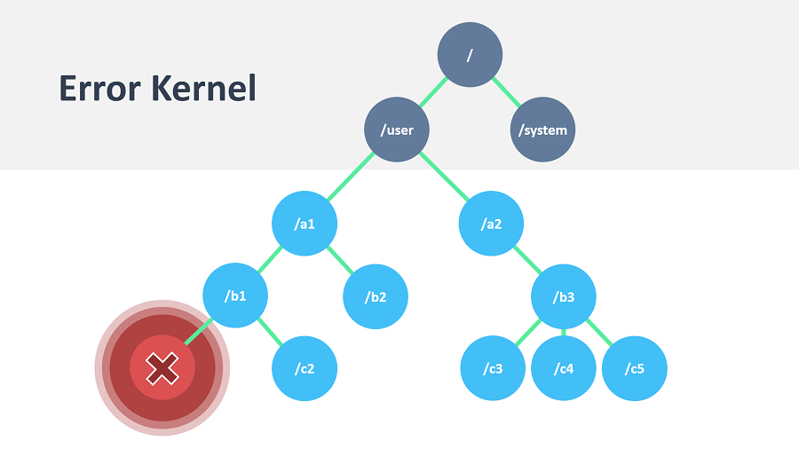
ErrorHandling – OneForOne
Quelle: http://getakka.net/docs/concepts/supervision
Notes:
Explain Guardian
User guardian
Created by user
System guardian
Inside akka.net

Slide 25
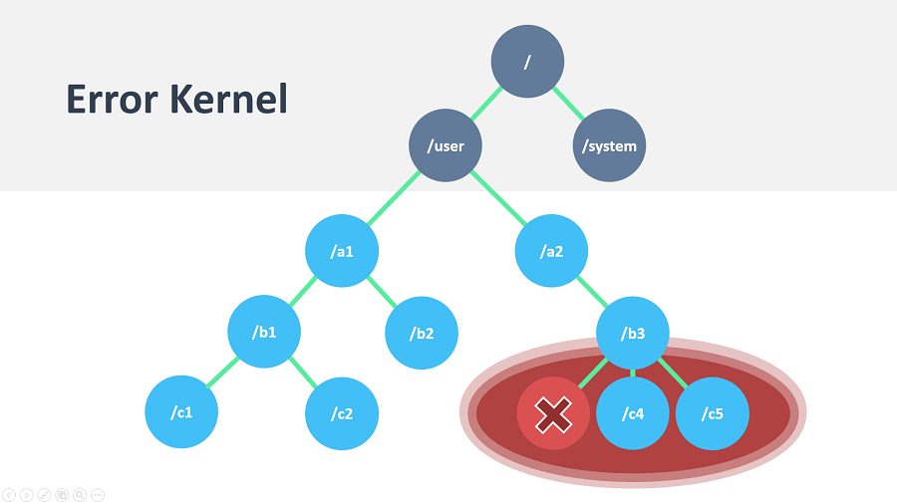
ErrorHandling – AllForOne
Quelle: http://getakka.net/docs/concepts/supervision

Slide 26
Error handling
protected override SupervisorStrategy SupervisorStrategy()
{
return new OneForOneStrategy( // oder AllForOneStrategy
maxNumberOfRetries: 10,
duration: TimeSpan.FromSeconds(30),
decider: x =>
{
if (x is ArithmeticException) return Directive.Resume;
else if (x is NotSupportedException) return Directive.Stop;
else if (x is ArgumentOutOfRangeException) return Directive.Escalate;
else return Directive.Restart;
});
}
Notes:
MaxNumberOfRetries: how often can those errors occur
Duration: In which timeframe can they occur
Stops the child actor if exceeded

Slide 27
Switchable Behavior
private void Lebendig(){
…//other code
if (this.lebenspunkte <= 0)
this.Become(Tot);
…
}
private void Tot(){
Receive<Wiederbeleben>(() => {
this.lebenspunkte = this.maxLebenspunkte;
this.Become(Lebendig);
});
}
Notes:
Actor can decide how to handle next incoming message
Super for state machines

Slide 28
Weitere Features
Cluster
Cluster Sharding
Dependency Injection – Autofac
Persistence
Finite State Machines
F# API
Notes:
Persistence
Journal -> in database for instance

Slide 29

Wie gehts weiter?
http://getakka.net/
https://github.com/akkadotnet/akka.net/tree/dev/src/examples
https://gitter.im/akkadotnet/akka.net
https://petabridge.com/bootcamp/ (kostenlos)
https://petabridge.com/

Slide 30
Zusammenfassung
Was ist das Actor Model
Was ist akka.net
Entwicklung von Anwendungen
Verteilt
Akka.Actor
Skalierbar
Akka.Remote
Akka.Cluster
Widerstandsfähig
Error Kernel
Fehlertolerant
Notes:
Just summarize what we have done

Slide 31
Q & A
Ralph Waldenmaier
@eigeneachse
ralph.Waldenmaier@progress.com

