Slide 1



^{MACHINE LEARNING I:}
^{Evaluating the ML models.}
^{DÉBORA CORRÊA and} ^{AYHAM ZAITOUNY}
^{23 OCT 2018}

Slide 2
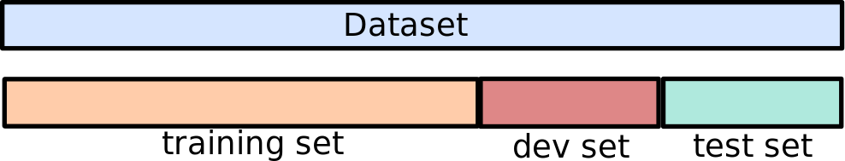
^{HOW TO SET UP YOUR DATA?}
Training set: The subset of the data used to fit the model.
Development set: (also known as hold-out cross-validation set): The subset of the data that is not used in training, but it will be used to guide choices in the learning process, e.g., fine-tune of hyperparameters.
Test set: The subset of the data that is not involved in the training process - unbiased estimation of the generalization error.
Common choices used for many years: 80%-20%-20%, 70%-30%.
With the area of big-data: 90%-10%-10%, or even 98%-1%-1%.

Slide 3
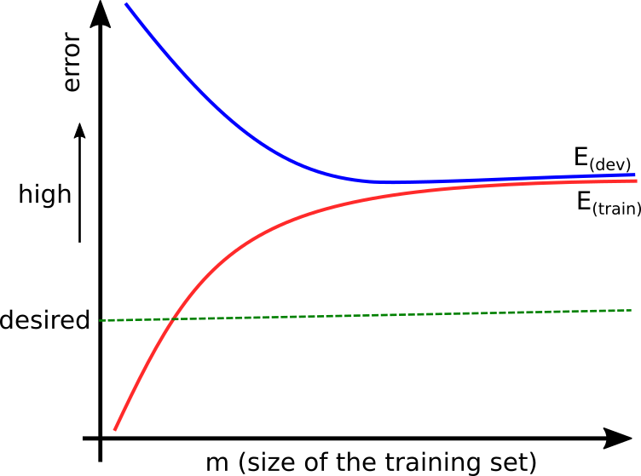
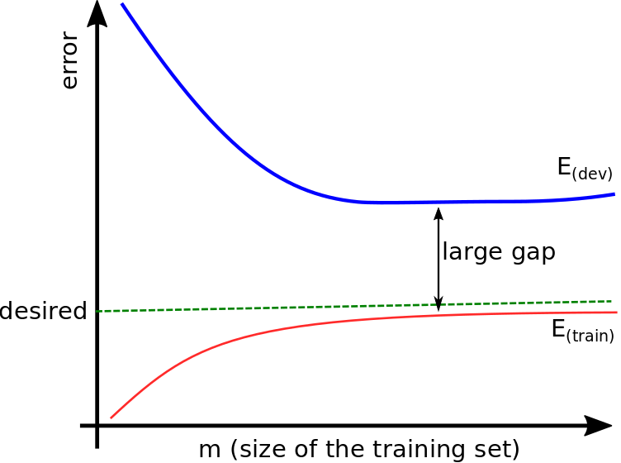
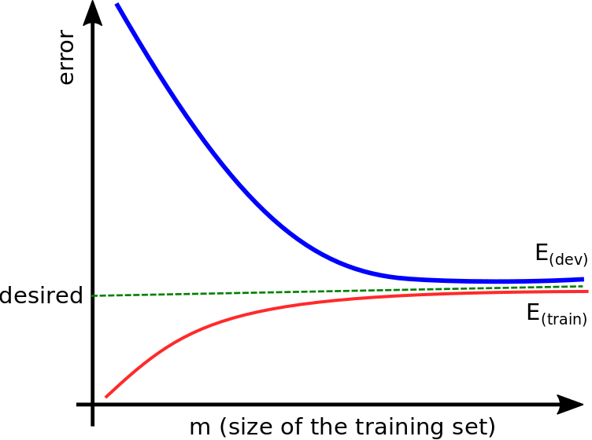
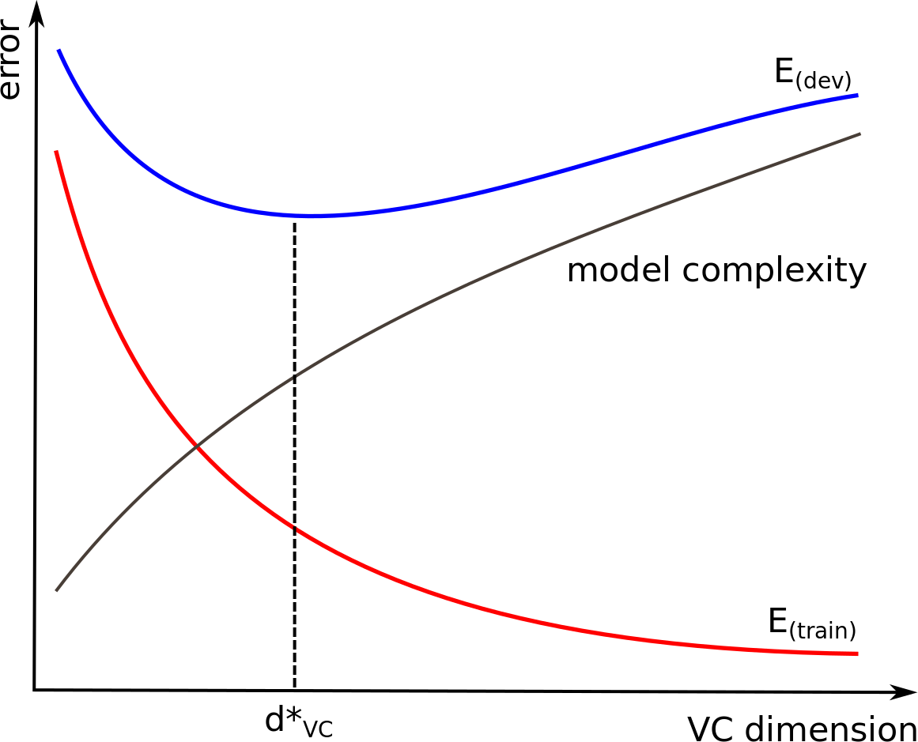
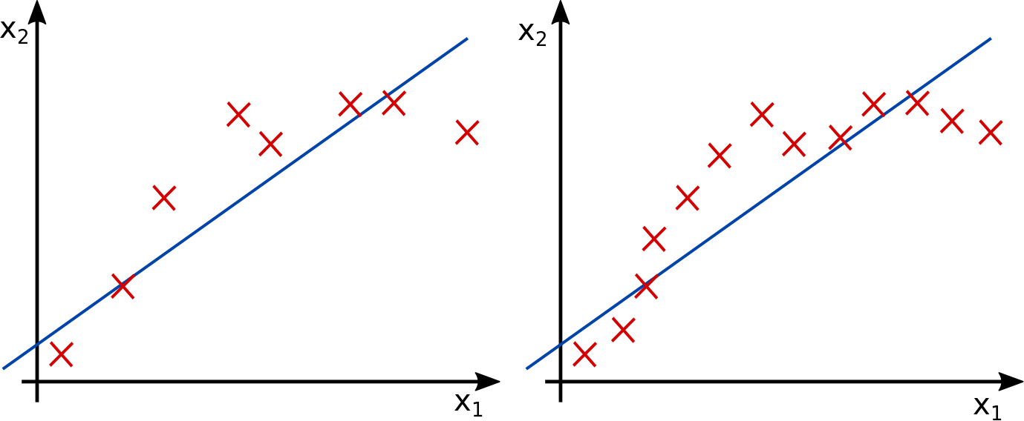
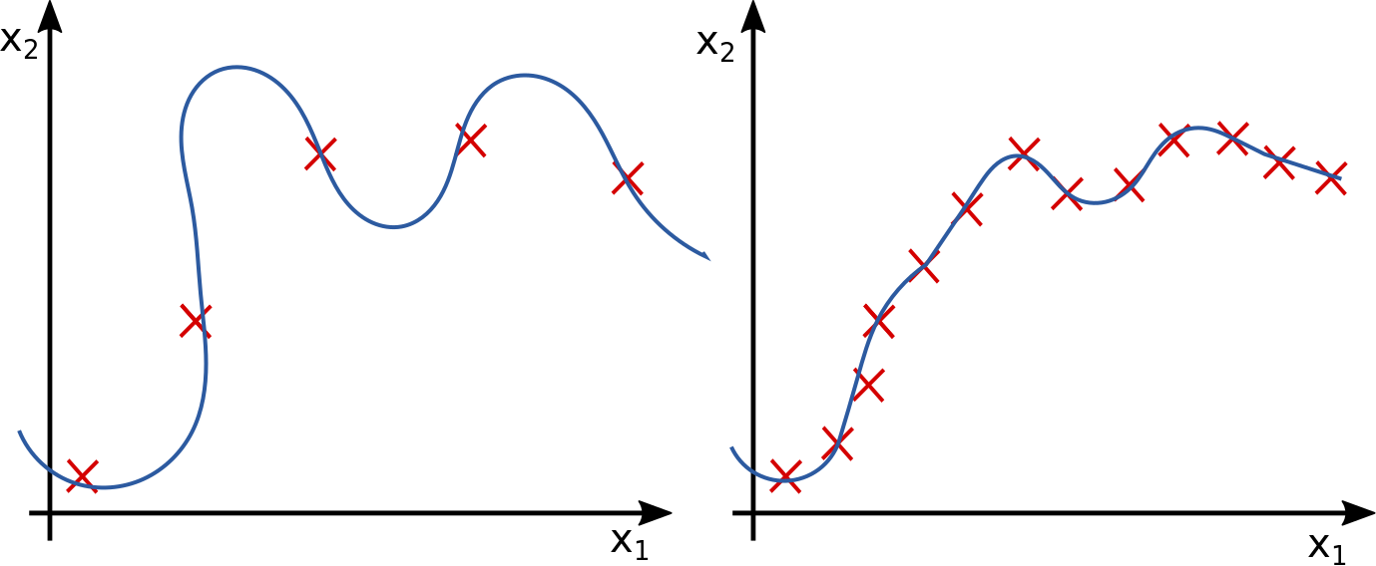
^{THE LEARNING CURVE}
More training samples won't help.
More training samples might help.

Slide 4
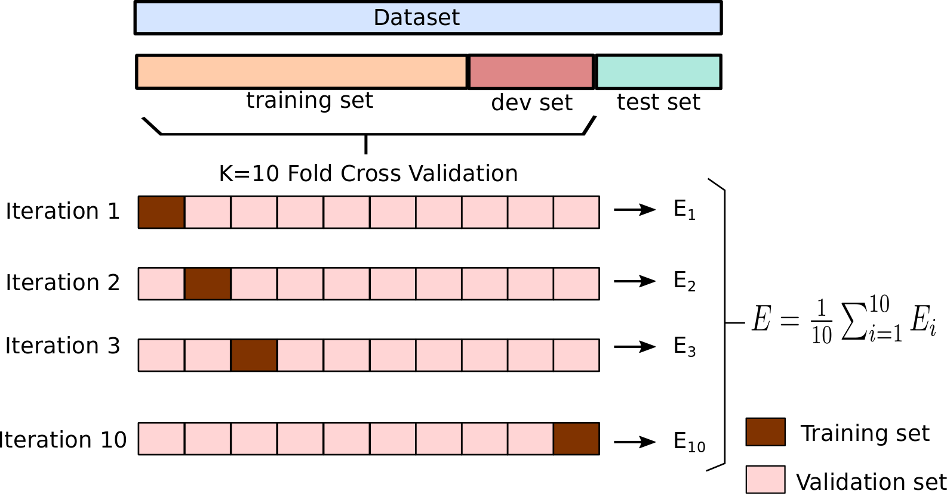
^{K FOLD CROSS-VALIDATION}
Split the training set into K complementary subsets. Each model is trained and validated using a different combination of such subsets.
Stratified K-Fold Cross Validation for imbalanced datasets: each fold contains
approximately the same proportion of each class.

Slide 5
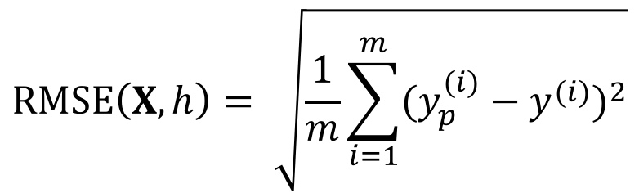

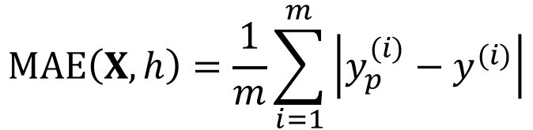
^{PERFORMANCE MEASURES}
Regression
$$y_{p}^{(i)}= h\left(x^{\left(i\right)}\right)$$
Root Mean Square Error (RMSE)
$$RMSE\left(X,h\right)= \sqrt{\frac{1}{m}\sum_{i=1}^{m}{{(y_{p}^{(i)}−y^{(i)})}^{2}}}$$
Mean Absolute Error (MAE) – sometimes used when there are many
outliers.
$$MAE\left(X,h\right)=\frac{1}{m}\sum_{i=1}^{m}{\left|y_{p}^{(i)}−y^{(i)}\right|}$$

Slide 6
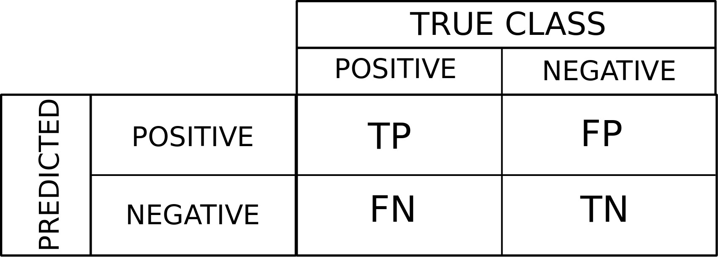
^{PERFORMANCE MEASURES (Cont.)}
Classification
Accuracy (trickier for unbalanced datasets)
Confusion matrix
Example:
4344
1307
1077
53272
Accuracy over 95% !

Slide 7
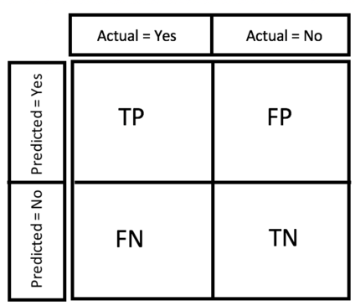


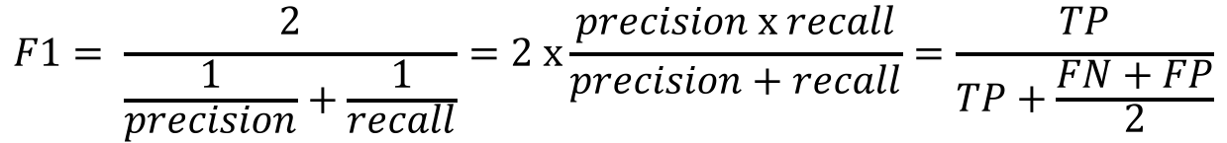
^{PERFORMANCE MEASURES (Cont.)}
Precision:
Accuracy of positive predictions
$$precision= \frac{TP}{TP+FP}$$
77%
Recall:
Ratio of correct positive predictions
Example:
$$recall= \frac{TP}{TP+FN}$$
79%
4344
1307
F1-score:
Harmonic mean of prediction and recall
High F1 score if both prediction and recall are high.
53272
1077
$$F1= \frac{2}{\frac{1}{precision}+\frac{1}{recall}}=2 x\frac{precision x recall}{precision+recall}=\frac{TP}{TP+\frac{FN+FP}{2}}$$
78%

Slide 8
^{PERFORMANCE MEASURES (Cont.)}
Precision/Recall tradeoff

Slide 9
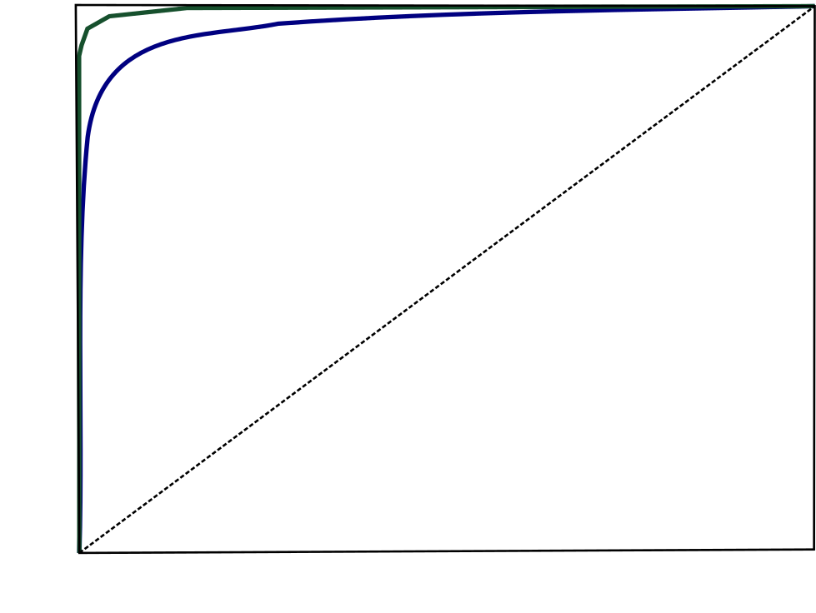
^{PERFORMANCE MEASURES (Cont.)}
The receiver operating characteristic (ROC) curve
Common tool used to compare classifiers.
It plots the true positive rate x false positive rate
Area under the curve (AUC)
1.0
AUC classifier 1 = 0.96
AUC classifier 2 = 0.99
AUC Random Classifier = 0.5
true positive rate
classifier 1
classifier 2
0.0
0.0
false positive rate
1.0
1.0

Slide 10

^{TITLE}
bullets
Notes:
CORE Skills first program is the Data Science pilot
Rapid delivery – entrepreneurial business delivery model - Developed by entrepreneurs in collaboration with subject matter experts
top priority given the urgency of this growing gap in the pipeline - skills shortage must not become a crisis
develop the critical skills needed in the context of disruption and opportunity from new digital technologies
We’ve created a vision for a unique social learning environment that is extremely collaborative
We will have real and challenging data-related projects “train hard, fight easy”

Slide 11

^{TITLE}
Bullets
Notes:
.. therefore we are (1) intensive skills pilot programs to bring new opportunities to market supporting individuals and organisations – and (2) a community of practice
Proactive stance – have impact or be impacted
Industry is supporting us – share knowledge, data, case studies – they recognise the imperative
Can’t predict the future but can be prepared
Profound advances - disrupting old ways of working and enabling step changes in productivity. Jobs, including knowledge work, are being replaced by automation at scale, and those remaining require increased human–machine interaction.
Data generation continues to grow exponentially, as every piece of equipment connects. This explosion of data—combined with analytics and machine learning—creates opportunities
means great improvements in workforce productivity. E.g. advanced analytics -sift through 1000s of capital projects - isolate a few simple measures that improved engineering productivity >20%.

