Slide 1



Welcome to week 6!
^{MACHINE LEARNING I:}
^{Fundamental concepts and}
^{supervised techniques.}
^{DÉBORA CORRÊA and} ^{AYHAM ZAITOUNY}
^{23 OCT 2018}

Slide 2

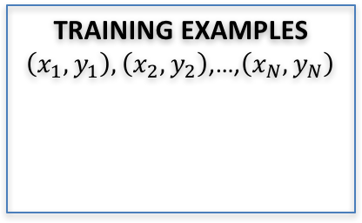
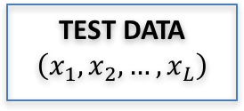

Overview of what is coming
UNKOWN TARGET FUNCTION
$$f:χ →y$$
(e.g. ideal formula to predict when to replace a component)
TEST DATA
$$\left(x_{1},x_{2},…,x_{L}\right)$$
STUDY THE
PROBLEM
TRAINING EXAMPLES $\left(x_{1},y_{1}\right),\left(x_{2},y_{2}\right)$,…,$\left(x_{N},y_{N}\right)$
LEARNING
ALGORITHM
EVALUATE
APPLY
SOLUTION
$$\hat{f}≈f$$
(e.g. learned maintenance prediction formula)
(e.g. historical records of maintenance)
ANALYZE
ERRORS
Week 7: Neural networks and deep learning.
Week 8: Sandbox! ☺
Picture adapted from: Hands on Machine Learning with Scikit-Learn and TensorFlow, Cap 1.

Slide 3
PLAN OF THE DAY:
The machine learning (ML) landscape and types of ML.
Discussion in groups on different scenarios for ML.
Bias x variance tradeoff.
Supervised technique: K-NN.
Morning
Supervised techniques: Random Forest.
Supervised techniques: SVM.
Work on python notebook.
Late morning
After lunch
Evaluating the ML models.
Work on python notebook.
More about ML.
Toolboxes and further reading.
Apply models to your own problem/data! ☺
Takeaways and close.
Late afternoon

Slide 4
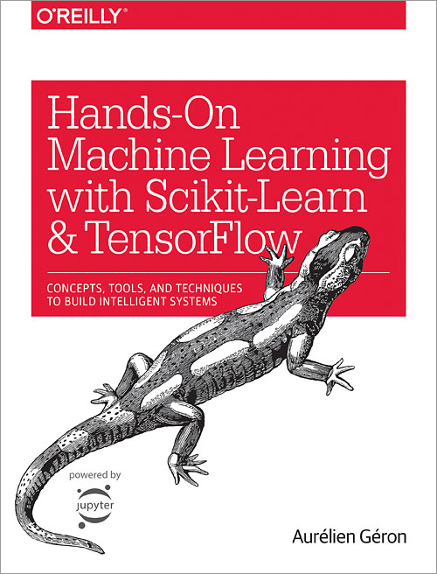

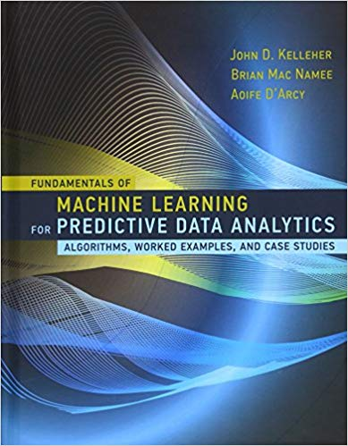
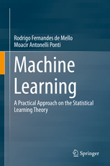
Principal references
Scikit-learn: http://scikit-learn.org
Get prepared:
https://github.com/core-skills/06-machine-learning

Slide 5
DATA FUSION AND MACHINE LEARNING I:
^{The MACHINE LEARNING LANDSCAPE}
DÉBORA CORRÊA AND AYHAM ZAITOUNY
^{23 OCT 2018}

Slide 6


WHAT IS MACHINE LEARNING?
Arthur Samuel (1959) addressed the Machine Learning as a field of study that gives computers the ability to learn without being explicitly programmed.
Machine learning is the science (art) of programming computers so they can learn from data. Data or examples that the system is using to learn are called “training set”, each training example is called “training instance or sample”.
Learn from experience
Learn from data

Slide 7
WHY IS MACHINE LEARNING GREAT?
Traditional approaches are based on writing rules while ML is based on training from examples and data.

Slide 8
WHY IS MACHINE LEARNING GREAT?
Traditional approaches are based on writing rules while ML is based on training from examples and data.
ML algorithms reduce the complexity of a problem and they are easier to maintain and most likely more accurate: e.g. problems for which existing solutions require a long list of rules, ML can simplify code and perform better than traditional approaches.

Slide 9
WHY IS MACHINE LEARNING GREAT?
Traditional approaches are based on writing rules while ML is based on training from examples and data.
ML algorithms reduce the complexity of a problem and they are easier to maintain and most likely more accurate: e.g. problems for which existing solutions require a long list of rules, ML can simplify code and perform better than traditional approaches.
ML algorithms shine and can find solutions for problems that either are too complex for traditional approaches or have no known solution.

Slide 10
WHY IS MACHINE LEARNING GREAT?
Traditional approaches are based on writing rules while ML is based on training from examples and data.
ML algorithms reduce the complexity of a problem and they are easier to maintain and most likely more accurate: e.g. problems for which existing solutions require a long list of rules, ML can simplify code and perform better than traditional approaches.
ML algorithms shine and can find solutions for problems that either are too complex for traditional approaches or have no known solution.
They can automatically learn and adopt to change and new data.

Slide 11
WHY IS MACHINE LEARNING GREAT?
Traditional approaches are based on writing rules while ML is based on training from examples and data.
ML algorithms reduce the complexity of a problem and they are easier to maintain and most likely more accurate: e.g. problems for which existing solutions require a long list of rules, ML can simplify code and perform better than traditional approaches.
ML algorithms shine and can find solutions for problems that either are too complex for traditional approaches or have no known solution.
They can automatically learn and adopt to change and new data.
ML can help humans learn and get insights about complex problems and large amounts of data as they can be inspected to see what they have learned.

Slide 12
Artificial Intelligence vs Machine Learning vs Data Mining:
DM: applying techniques to dig into large amounts of data to discover patterns that were not immediately apparent.
DM

Slide 13
Artificial Intelligence vs Machine Learning vs Data Mining:
DM: applying techniques to dig into large amounts of data to discover patterns that were not immediately apparent.
DM
ML
ML: goes beyond DM and provides the system the ability to build a trained model that can predict and compare new data or situations based on the training set.

Slide 14
Artificial Intelligence vs Machine Learning vs Data Mining:
DM: applying techniques to dig into large amounts of data to discover patterns that were not immediately apparent.
AI
DM
ML
ML: goes beyond DM and provides the system the ability to build a trained model that can predict and compare new data or situations based on the training set.
AI: goes beyond ML and provides the system the ability to take decisions so the model can create associations among events and situations without ever having seen such patterns or data before.

Slide 15
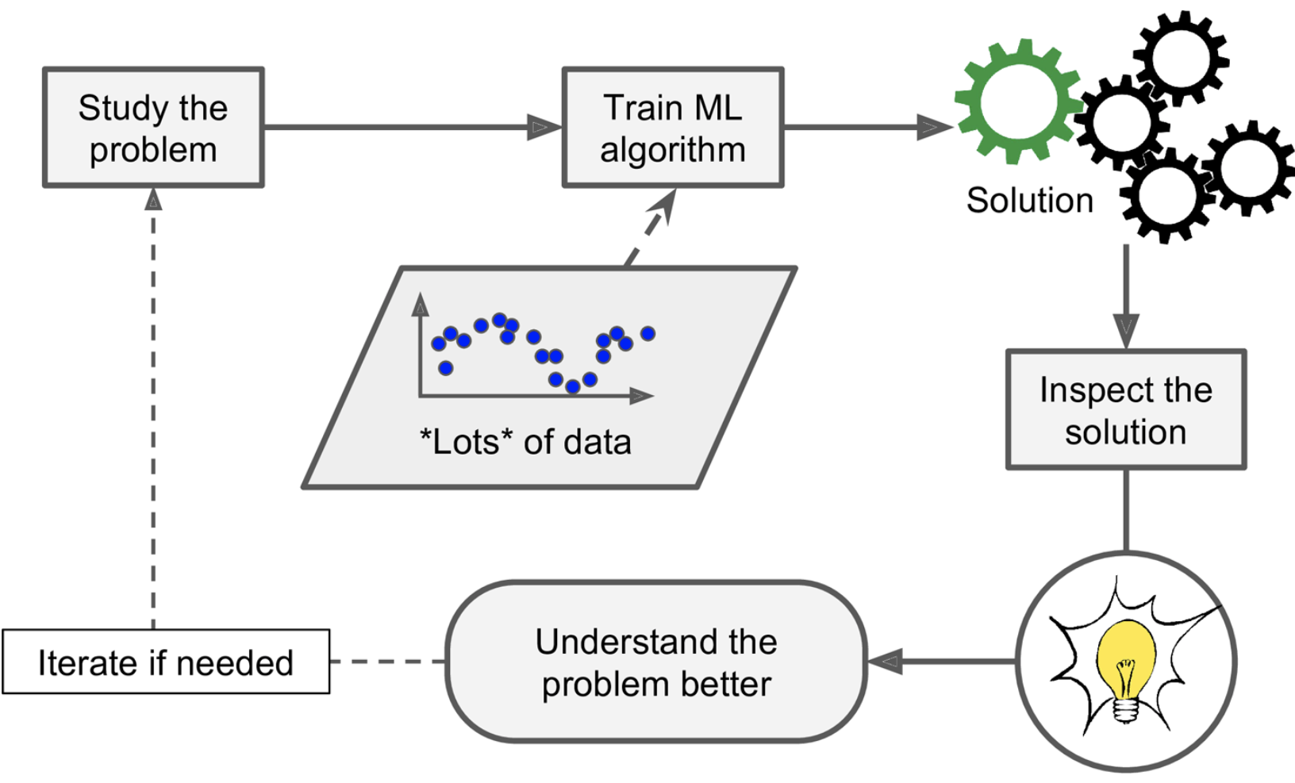
WORK FLOW OF A TYPICAL ML PROJECT:

Slide 16
TYPES OF ML AND WAYS TO CATEGORISE THEM:
Whether they work by simply comparing new data points to known data points, or instead detect patterns in the training data and build a prediction model:
Instance-based learning
Model-based learning

Slide 17
TYPES OF ML AND WAYS TO CATEGORISE THEM:
Whether they work by simply comparing new data points to known data points, or instead detect patterns in the training data and build a prediction model:
Instance-based learning
Model-based learning
Whether or not they can learn incrementally from a stream of incoming data:
Online learning
Batch learning

Slide 18
TYPES OF ML AND WAYS TO CATEGORISE THEM:
Whether they work by simply comparing new data points to known data points, or instead detect patterns in the training data and build a prediction model:
Instance-based learning
Model-based learning
Whether or not they can learn incrementally from a stream of incoming data:
Online learning
Batch learning
Whether or not they are trained with human supervision:
Supervised learning
Unsupervised learning
Reinforcement learning

Slide 19
TYPES OF ML AND WAYS TO CATEGORISE THEM:
Whether they work by simply comparing new data points to known data points, or instead detect patterns in the training data and build a prediction model:
Instance-based learning
Model-based learning
Whether or not they can learn incrementally from a stream of incoming data:
Online learning
Batch learning
Whether or not they are trained with human supervision:
Supervised learning
Unsupervised learning
Reinforcement learning
These criteria are not exclusive, you can combine them in any way you like

Slide 20
SUPERVISED vs UNSUPERVISED LEARNING:
Supervised learning: the training data we feed to the algorithm includes the desired solutions (called labels). Typical supervised tasks:
Most important algorithms:
K-Nearest Neighbours (K-NN)
Linear regression
Logistic regression
Support Vector Machines (SVMs)
Decision trees and Random forests
Neural networks
Classification
Regression

Slide 21
SUPERVISED vs UNSUPERVISED LEARNING:
Supervised learning: the training data we feed to the algorithm includes the desired solutions (called labels). Typical supervised tasks:
Most important algorithms:
K-Nearest Neighbours (K-NN)
Linear regression
Logistic regression
Support Vector Machines (SVMs)
Decision trees and Random forests
Neural networks
Unsupervised learning: the training data is unlabeled (doesn’t include a desired solution), the system tries to learn without a teacher.
Typical unsupervised tasks:
Most important algorithms:
K-means clustering
Hierarchical cluster analysis (HCA)
Expectation Maximization
Principle Component Analysis (PCA)
Kernel PCA
Locally linear embedding
Classification
Regression
Dimensionality reduction
Anomaly detection
Clustering

Slide 22
TWO MAIN CHALLENGES YOU MAY FACE IN ML PROJECT:
BAD DATA:
Insufficient quantity of training data: ML requires sufficient amount of data for efficient training and better generalising.
Nonrepresentative training data: it is crucial that the training data be representative of new cases you want to generalise. Some large data are nonrepresentative the sampling method is flawed (sampling bias).
Poor quality data: full of errors, outliers or noise, such data need to be cleaned before use.
Irrelevant features (data type): ML requires a good set of relevant features to train on, you could use the most useful feature or combine existing features to produce a more useful one.

Slide 23
TWO MAIN CHALLENGES YOU MAY FACE IN ML PROJECT:
BAD DATA:
Insufficient quantity of training data: ML requires sufficient amount of data for efficient training and better generalising.
Nonrepresentative training data: it is crucial that the training data be representative of new cases you want to generalise. Some large data are nonrepresentative the sampling method is flawed (sampling bias).
Poor quality data: full of errors, outliers or noise, such data need to be cleaned before use.
Irrelevant features (data type): ML requires a good set of relevant features to train on, you could use the most useful feature or combine existing features to produce a more useful one.
BAD ALGORITHM:
Over-fitting the training data: the model performs well in the training data but does not generalise well.
Under-fitting the training data: the model is too simple to learn the underlying structure of the data.

Slide 24
HOW TO EVALUATE AND FINE-TUNE A ML SYSTEM:
Best way is to split your data into two sets: “training-set” and “test-set”

Slide 25
HOW TO EVALUATE AND FINE-TUNE A ML SYSTEM:
Best way is to split your data into two sets: “training-set” and “test-set”
Use the “test-set” to estimate the error rate on new cases “generalisation error”

Slide 26
HOW TO EVALUATE AND FINE-TUNE A ML SYSTEM:
Best way is to split your data into two sets: “training-set” and “test-set”
Use the “test-set” to estimate the error rate on new cases “generalisation error”
Very useful to choose the better model if you are hesitating between two models by comparing their generalisation errors on a test-set.

Slide 27
HOW TO EVALUATE AND FINE-TUNE A ML SYSTEM:
Best way is to split your data into two sets: “training-set” and “test-set”
Use the “test-set” to estimate the error rate on new cases “generalisation error”
Very useful to choose the better model if you are hesitating between two models by comparing their generalisation errors on a test-set.
Distinguish between a model’s parameters and ML algorithm’s hyperparameters.

Slide 28
HOW TO EVALUATE AND FINE-TUNE A ML SYSTEM:
Best way is to split your data into two sets: “training-set” and “test-set”
Use the “test-set” to estimate the error rate on new cases “generalisation error”
Very useful to choose the better model if you are hesitating between two models by comparing their generalisation errors on a test-set.
Distinguish between a model’s parameters and ML algorithm’s hyperparameters.
Use a validation-set (subset of the training-set) to compare models and tune the hyperparameters then the generalisation error is estimated based on the test-set.

Slide 29
HOW TO EVALUATE AND FINE-TUNE A ML SYSTEM:
Best way is to split your data into two sets: “training-set” and “test-set”
Use the “test-set” to estimate the error rate on new cases “generalisation error”
Very useful to choose the better model if you are hesitating between two models by comparing their generalisation errors on a test-set.
Distinguish between a model’s parameters and ML algorithm’s hyperparameters.
Use a validation-set (subset of the training-set) to compare models and tune the hyperparameters then the generalisation error is estimated based on the test-set.
If you use the test-set to tune hyperparameters then you risk overfitting the test-set and the generlisation error will be optimistic.

Slide 30
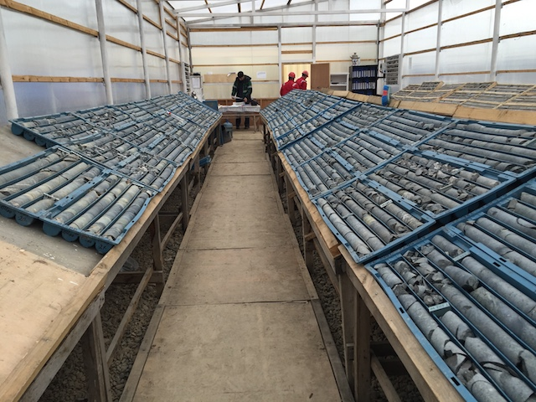
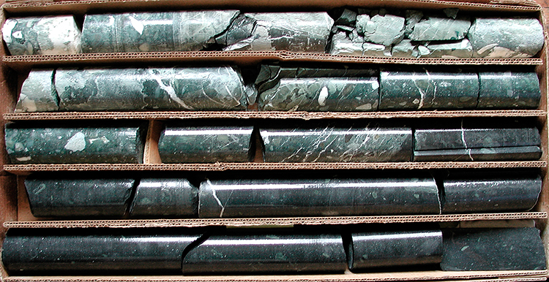
EXERCISES:
Scenario 1 (rock type problems):
Part 1: Your company has just taken over a new operating mine and you don't trust the old operator's classifications or rock models. You have a bunch of photographs of core and a pile of core trays. The asset manager has asked you to take a look at the photographs and determine roughly how many different types of rock you've got.
Questions: what sort of problem is this? What features could you extract from the data?

Slide 31
EXERCISES:
Scenario 1 (rock type problems):
Part 1: Your company has just taken over a new operating mine and you don't trust the old operator's classifications or rock models. You have a bunch of photographs of core and a pile of core trays. The asset manager has asked you to take a look at the photographs and determine roughly how many different types of rock you've got.
Questions: what sort of problem is this? What features could you extract from the data?
Part 2: You've taken a subset of exemplar rock types from your clusters and validated these with your geoscience function at head office who have given you some labels for each of the rock types. What approaches could you take to leverage this information to predict rock types across all the photographed core?

Slide 32
EXERCISES:
Scenario 1 (rock type problems):
Part 1: Your company has just taken over a new operating mine and you don't trust the old operator's classifications or rock models. You have a bunch of photographs of core and a pile of core trays. The asset manager has asked you to take a look at the photographs and determine roughly how many different types of rock you've got.
Questions: what sort of problem is this? What features could you extract from the data?
Part 2: You've taken a subset of exemplar rock types from your clusters and validated these with your geoscience function at head office who have given you some labels for each of the rock types. What approaches could you take to leverage this information to predict rock types across all the photographed core?
Part 3: You've been able to send some rocks off for assay - how would you predict the composition of the remaining rocks that you didn't assay?

Slide 33
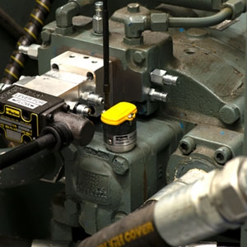
EXERCISES:
Scenario 2 (predictive maintenance problems):
You are working in the production section of an asset, and your boss has been lured into investing in a whizz-bang new vibration sensor for predictive maintenance. Your job is to work out whether you'll get any useful information out of the data.
Part 1: What sorts of features could you extract from a vibration sensor? How could you use these features for maintenance purposes? What kind of approaches or algorithms would you use?
http://blog.parker.com/vibration-monitoring-is-key-to-predictive-maintenance-of-rotating-machinery

Slide 34
EXERCISES:
Scenario 2 (predictive maintenance problems):
You are working in the production section of an asset, and your boss has been lured into investing in a whizz-bang new vibration sensor for predictive maintenance. Your job is to work out whether you'll get any useful information out of the data.
Part 1: What sorts of features could you extract from a vibration sensor? How could you use these features for maintenance purposes? What kind of approaches or algorithms would you use?
Part 2: You have vibration data from failing machinery and machinery that is operating normally. What sort of problem is this? How would you approach it?
http://blog.parker.com/vibration-monitoring-is-key-to-predictive-maintenance-of-rotating-machinery

Slide 35
EXERCISES:
Scenario 2 (predictive maintenance problems):
You are working in the production section of an asset, and your boss has been lured into investing in a whizz-bang new vibration sensor for predictive maintenance. Your job is to work out whether you'll get any useful information out of the data.
Part 1: What sorts of features could you extract from a vibration sensor? How could you use these features for maintenance purposes? What kind of approaches or algorithms would you use?
Part 2: You have vibration data from failing machinery and machinery that is operating normally. What sort of problem is this? How would you approach it?
Part 3: Your maintenance manager wants to be able to plan the replacement and maintenance work based on likely time to failure. What data could you collect to measure this? What sort of prediction problem is it? Could you design an experiment to determine how accurate your predictions are?
http://blog.parker.com/vibration-monitoring-is-key-to-predictive-maintenance-of-rotating-machinery

