Slide 1



DATA FUSION AND MACHINE LEARNING I:
^{More about ML}
^{Toolboxes and further readings}
^{DÉBORA CORRÊA and} ^{AYHAM ZAITOUNY}
^{23 OCT 2018}

Slide 2
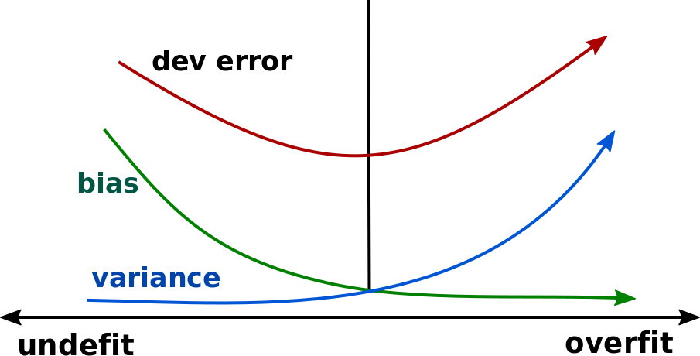
DIRECTIONS FOR OVERFIT/UNDERFIT
High bias: performance on the training set.
Try a larger (or new!) set of features.
Try high variance ML models (K-NN, SVM, RF, NN).
High variance: performance on the dev set.
Get more training data.
Try smaller set of features.
Try to decrease the complexity of the model.
K-fold cross validation.
Try regularization.

Slide 3
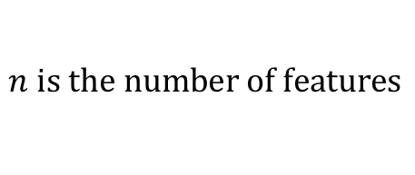
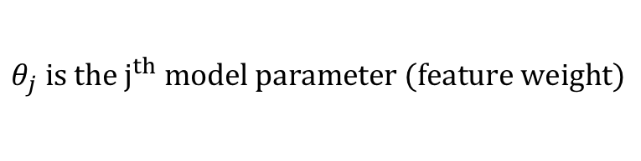
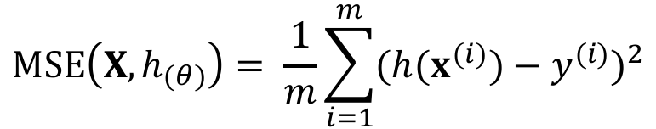
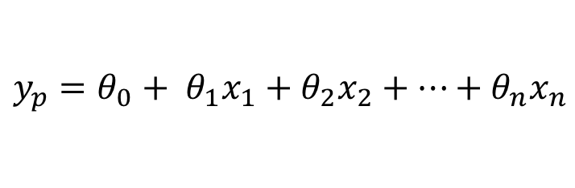

^{REGULARIZATION}
Penalize the parameters of the model (degrees of freedom) in order to produce a simpler model.
Tradeoff between increasing the bias and decreasing the variance.
Linear regression model prediction
$$y_{p}=θ_{0}+ θ_{1}x_{1}+θ_{2}x_{2}+…+θ_{n}x_{n}$$
$y_{p}=h_{θ}\left(x\right)=θ^{T}.$ $x$
$$n is the number of features$$
$$θ_{j} is the j^{th} model parameter (feature weight)$$
MSE cost function for a Linear regression model
$$MSE\left(X,h_{\left(θ\right)}\right)= \frac{1}{m}\sum_{i=1}^{m}{{(h(x^{\left(i\right)})−y^{(i)})}^{2}}$$
Source: Hands on Machine Learning with Scikit-Learn and TensorFlow, Cap. 3.

Slide 4
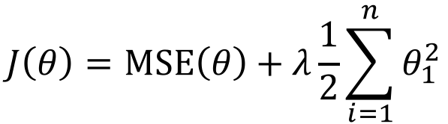
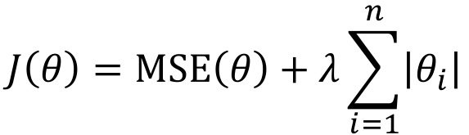
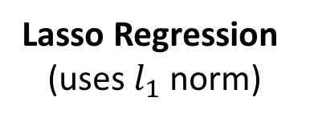

^{REGULARIZATION (Cont.)}
Penalize the parameters of the model (degrees of freedom) in order to produce a simpler model.
Tradeoff between increasing the bias and decreasing the variance.
Regularized linear models
Ridge Regression
(Tikhonov regularization)
$$J\left(θ\right)=MSE\left(θ\right)+λ\frac{1}{2}\sum_{i=1}^{n}{θ_{1}^{2}}$$
Fit the model keeping the model weights as small as possible.
Lasso Regression
(uses $l_{1}$ norm)
$$J\left(θ\right)=MSE\left(θ\right)+λ\sum_{i=1}^{n}{\left|θ_{i}\right|}$$
Tends to eliminate the weights of the less important features.
Sparse models.
Feature selection.
$λ$ is the regularization parameter.

Slide 5
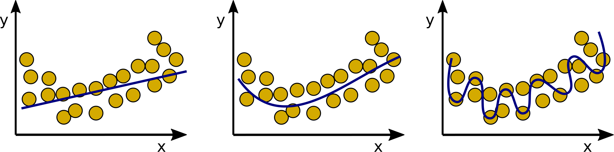
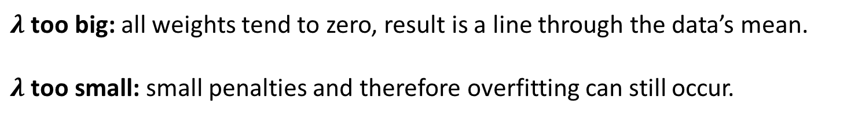
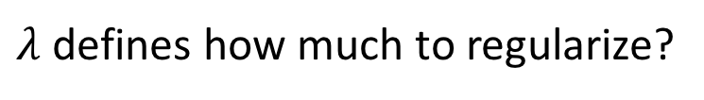
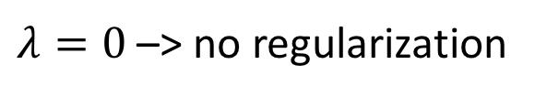
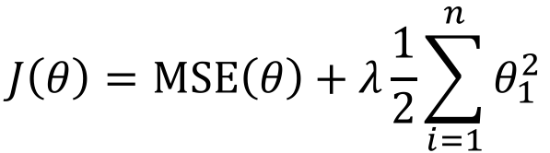
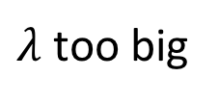
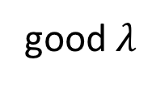
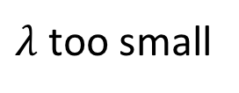
^{REGULARIZATION (Cont.)}
$λ$ defines how much to regularize?
$$J\left(θ\right)=MSE\left(θ\right)+λ\frac{1}{2}\sum_{i=1}^{n}{θ_{1}^{2}}$$
$λ=0$ –> no regularization
$λ$ too big
good $λ$
$λ$ too small
$λ$ too big: all weights tend to zero, result is a line through the data’s mean.
$λ$ too small: small penalties and therefore overfitting can still occur.

Slide 6
^{TOOLBOXES AND OPEN LIBRARIES}
Scikit-learn: machine learning in python.
StatsModels: Python for statistical models.
Imbalanced-learn: ML for imbalanced datasets in python.
Shogun: machine learning library that supports many languages.
Spark MLlib: for scalable machine learning applications.
H2O: For fraud and tend predictions.
GoLearn: To build machine learning in Go language.
DeepLearn.js: Hardware accelerate machine intelligence for javaScript.
Notes:
CORE Skills first program is the Data Science pilot
Rapid delivery – entrepreneurial business delivery model - Developed by entrepreneurs in collaboration with subject matter experts
top priority given the urgency of this growing gap in the pipeline - skills shortage must not become a crisis
develop the critical skills needed in the context of disruption and opportunity from new digital technologies
We’ve created a vision for a unique social learning environment that is extremely collaborative
We will have real and challenging data-related projects “train hard, fight easy”

Slide 7

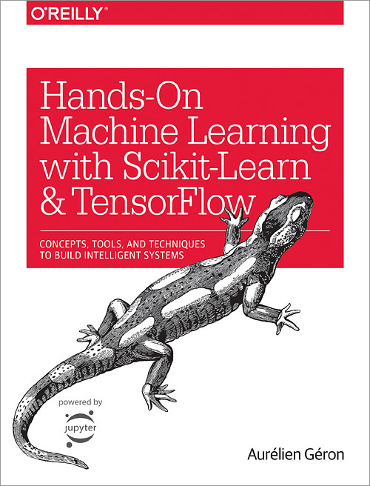

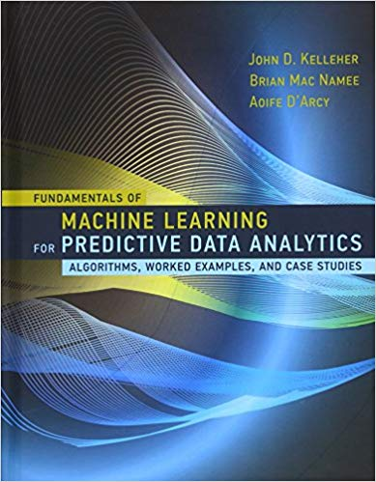

^{FURTHER READING}
Medium website (nice tutorials for practical ML).
https://medium.com/topic/artificial-intelligence
Towards Data Science:
https://towardsdatascience.com
Oracle + Data Science:
https://www.datascience.com/blog
KDNuggets:
https://www.kdnuggets.com
Kaggle:
http://blog.kaggle.com
Stack Exchange:
https://stats.stackexchange.com
Notes:
.. therefore we are (1) intensive skills pilot programs to bring new opportunities to market supporting individuals and organisations – and (2) a community of practice
Proactive stance – have impact or be impacted
Industry is supporting us – share knowledge, data, case studies – they recognise the imperative
Can’t predict the future but can be prepared
Profound advances - disrupting old ways of working and enabling step changes in productivity. Jobs, including knowledge work, are being replaced by automation at scale, and those remaining require increased human–machine interaction.
Data generation continues to grow exponentially, as every piece of equipment connects. This explosion of data—combined with analytics and machine learning—creates opportunities
means great improvements in workforce productivity. E.g. advanced analytics -sift through 1000s of capital projects - isolate a few simple measures that improved engineering productivity >20%.

Slide 8
^{TAKEAWAYS}
Understanding the problem is the most crucial step.
Training set should be representative of new cases to be generalized.
And should contain relevant features.
Devote a time to explore the structure of the data.
Data matters more than algorithms for complex problems¹.
Noise in your data can affect learning process, enhancing the probability of overfitting.
Simple models can give plausible results and should be tested first.
If the "test set" contributed to any aspect during the learning process, it is not a "test set", and assessment of future outcomes might be compromised.
If you data set is biased, your learning algorithm will produce a biased outcome as well (sampling bias problem).
1 - Halevy, A., Norvig, P., & Pereira, F. (2009). The unreasonable effectiveness of data. IEEE Intelligent Systems, 24(2), 8-12.
Notes:
.. therefore we are (1) intensive skills pilot programs to bring new opportunities to market supporting individuals and organisations – and (2) a community of practice
Proactive stance – have impact or be impacted
Industry is supporting us – share knowledge, data, case studies – they recognise the imperative
Can’t predict the future but can be prepared
Profound advances - disrupting old ways of working and enabling step changes in productivity. Jobs, including knowledge work, are being replaced by automation at scale, and those remaining require increased human–machine interaction.
Data generation continues to grow exponentially, as every piece of equipment connects. This explosion of data—combined with analytics and machine learning—creates opportunities
means great improvements in workforce productivity. E.g. advanced analytics -sift through 1000s of capital projects - isolate a few simple measures that improved engineering productivity >20%.

Slide 9
^{TAKEAWAYS (Cont.)}
What are your takeaways?
Homework:
Story and video class from HBR on Nokia’s company-wide ML approach.
Next week:
Artificial Neural Networks
Deep Learning
Working with images.
https://hbr.org/2018/10/the-chairman-of-nokia-on-ensuring-every-employee-has-a-basic-understanding-of-machine-learning-including-him
Notes:
CORE Skills first program is the Data Science pilot
Rapid delivery – entrepreneurial business delivery model - Developed by entrepreneurs in collaboration with subject matter experts
top priority given the urgency of this growing gap in the pipeline - skills shortage must not become a crisis
develop the critical skills needed in the context of disruption and opportunity from new digital technologies
We’ve created a vision for a unique social learning environment that is extremely collaborative
We will have real and challenging data-related projects “train hard, fight easy”

