Slide 1
College Football Stats Data Exploration
Wyatt Rasmussen
DSC 530

Slide 2

Variables Used
Win
Loss
FirstDownPerGame
OppFirstDownPerGame
PenaltyYardsPerGame
TurnoversGain
TurnoversLost

Slide 3
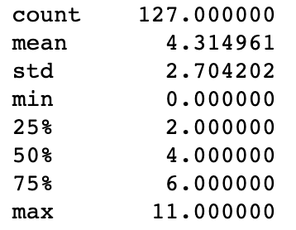
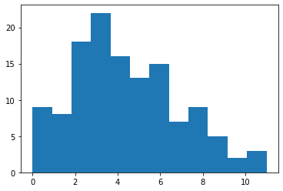
Win
Win is the amount of wins that a team has in one year
As shown in the summary statistics the max wins in a season was 11

Slide 4
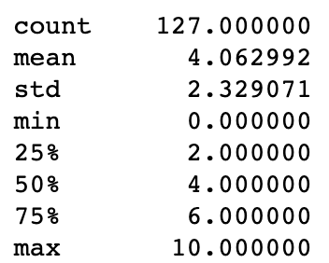
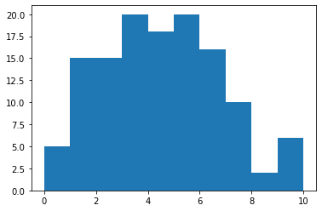
Loss
Loss is the amount of losses that a team has in one year

Slide 5
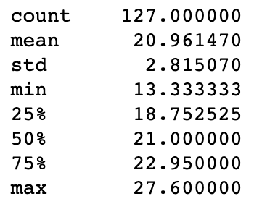
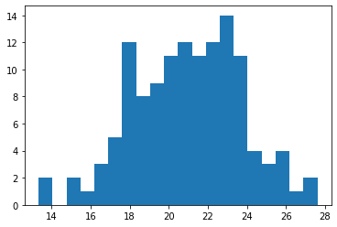
FirstDownPerGame
FirstDownPerGame is the amount of first downs that a team gets in a per game basis, offense related stat

Slide 6
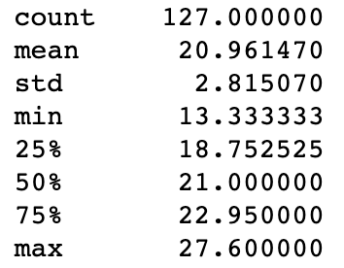
OppFirstDownPerGame
OppFirstDownPerGame is the amount of first downs that a team lets up in a per game basis, defense related stat

Slide 7
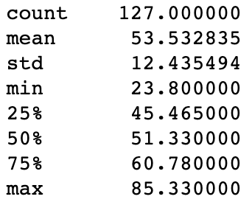
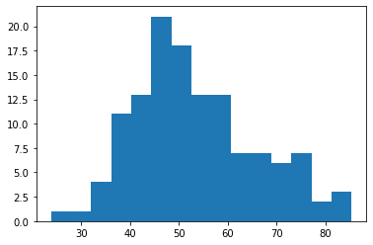
PenaltyYardsPerGame
PenaltyYardsPerGame is the amount of yards from accepted penalties that a team has enforced on them

Slide 8
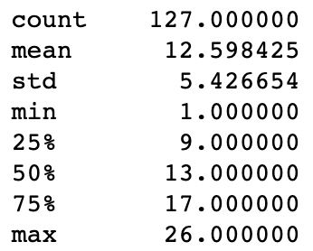
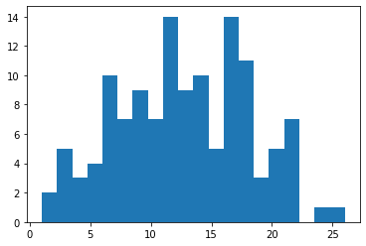
TurnoversGain
TurnoversGain is the sum of the amount of fumbles recovered and interceptions caught by one team

Slide 9
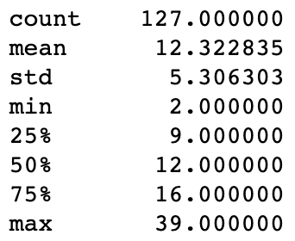
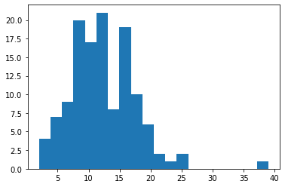
TurnoversLost
TurnoversLost is the sum of the amount of fumbles lost and interceptions thrown by one team
One big outlier in this group that is 5 Standard Deviations from the mean

Slide 10
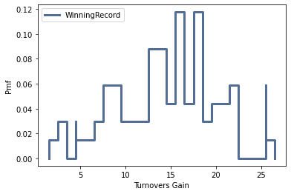
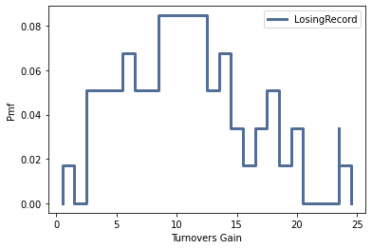
Comparing PMFS of Winning Record Turnovers Gained vs Losing Record Turnovers Gained

Slide 11
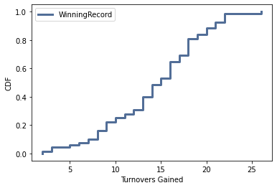
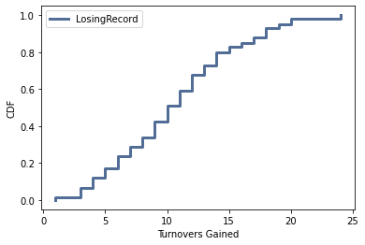
Comparing CDFS of Winning Record Turnovers Gained vs Losing Record Turnovers Gained
Comparing the CDFs for Winning Record and Losing Record allows us to see the probability of teams with winning records having a certain amount of turnovers or less compared to a winning teams. We can see that the Winning Record is slower to climb than the Losing Record teams. This means that the mean for winning teams is higher.

Slide 12
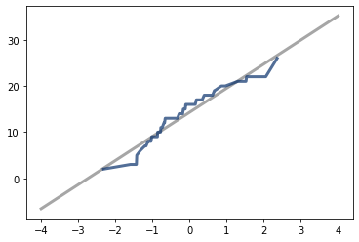
LogNormal Distribution of Winning Teams Turnovers Gained
This shows the lognormal relationship of winning teams and Turnovers. I used the lognormal here because the normal Distribution didn’t follow the best fit line and had some tails. The log Scale gives us a good fit and further backs up that we don’t typically see winning teams with few turnovers gained.

Slide 13
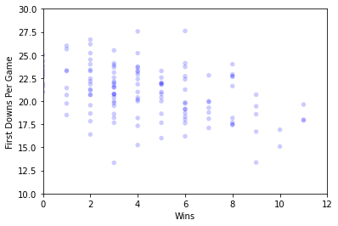
Scatter Plot 1 – Wins vs First Downs Per gAme
I created this scatter plot to help see the relationship between wins in a season and the amount of first downs per game. This data is seems to have a downward/negative relationship
Correlation =
-0.414590692381488
Covariance =
-3.1312290486774335
This backs up that there is negative relationship with this data, which is rather interesting.

Slide 14
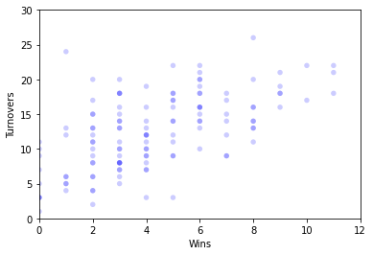
Scatter Plot 1 – Wins vs Turnovers Gained
I created this scatter plot to help see the relationship between wins in a season and the amount of Turnovers in a season. This data seems to follow a positive pattern.
Correlation =
0.5938618266000544
Covariance =
8.646165292330585
This backs up that there is a positive relationship between these two variables.

Slide 15
Hypothesis Testing
For my Hypothesis testing I wanted to test whether winning teams and Losing Teams commit a different amount of penalties in a game.
Based on our P-Value calculation between winning teams and losing teams penalty yards per game of 0.07, we fail to reject the hypothesis that losing teams tend to lose because of penalties they commit during a game. A p-value of greater than 0.05 suggests that our null hypothesis is correct.

Slide 16
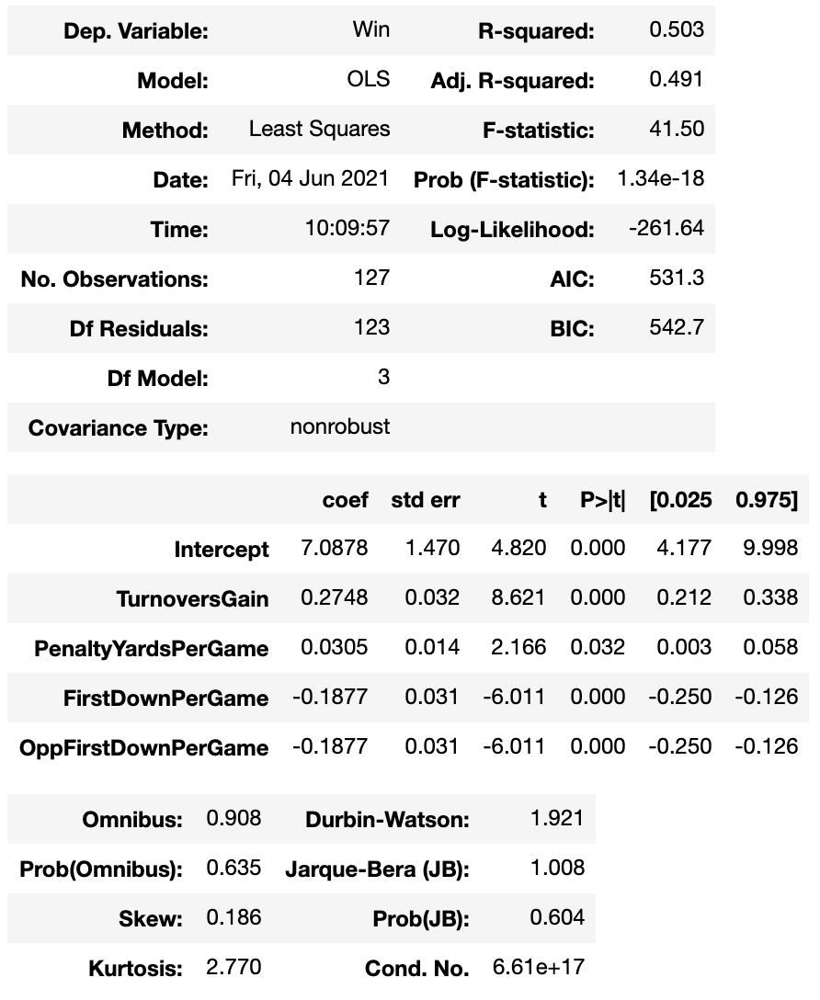
Multiple Regression Analysis
In this multiple regression I compared Wins to explanatory variables: TurnoversGain, PenaltyYardsPerGame, FirstDownPerGame, and OppFirstDownPerGame

Slide 17
Conclusion
I found a lot of interesting findings in this Exploratory Data Analysis. I think what I found most interesting was the negative correlation with the first downs per game and winning.
How can teams use this data?
It seems TurnoversGain leads to winning football games
Less FirstDownPerGame leads to winning football games, likely because big plays score, so creating big plays
Minimizing TurnoversLost because that seems to have a correlation with losing

